Slide 1
K-Means Clustering
A Parallel Implementation using C++ and OpenMPI

Slide 2

Outline
K-Means
Initialization and termination
Serial algorithm
Complexity, parallelism, and theoretical analysis
Parallel algorithm
Schema, and theoretical analysis
Implementation
Language, OOP, Dataset
Experimental results
Different clusters composition

Slide 3
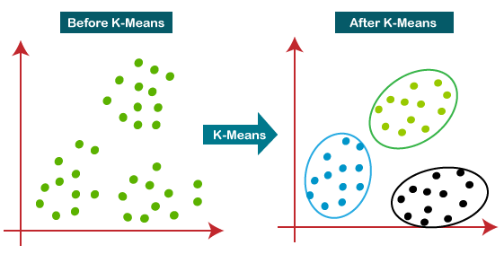
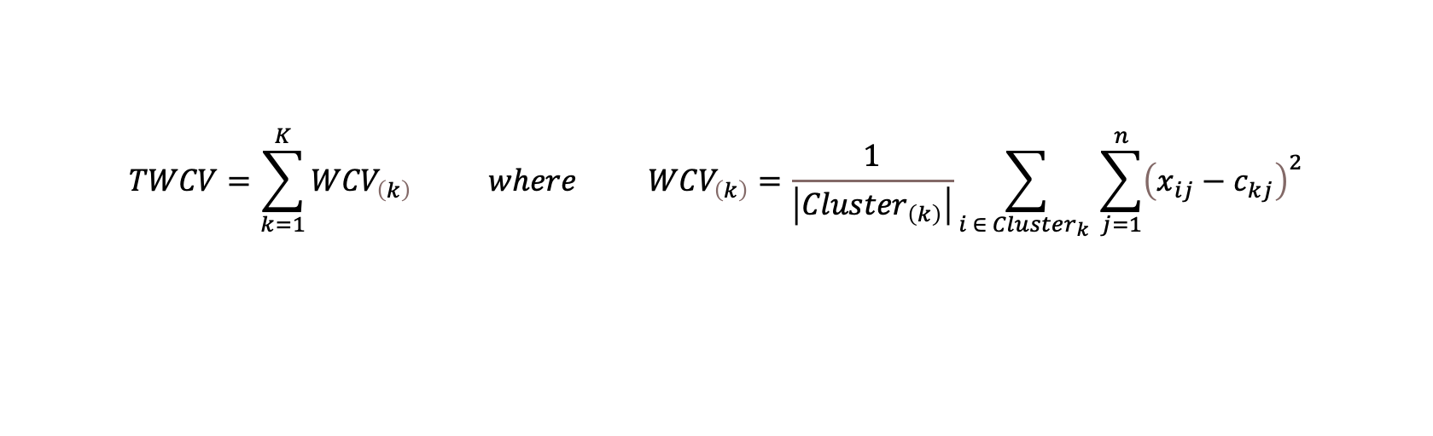
K-Means
Cost function
$$TWCV=\sum_{k=1}^{K}{{WCV}_{\left(k\right)}} where {WCV}_{\left(k\right)}=\frac{1}{\left|{Cluster}_{\left(k\right)}\right|}\sum_{i ∈ {Cluster}_{k} }{\sum_{j=1}^{n}{{\left(x_{ij}−c_{kj}\right)}^{2}}}$$

Slide 4

K-Means
Initialization
$$K = \sqrt{m/2}$$
$$Centroids selected at random$$
Termination
$$REPEAT until$$
$${TMSE}^{\left(j iteration\right)}<{TMSE}^{\left(j−1 iteration\right)} and N_Iterations < MaxIterations$$

Slide 5
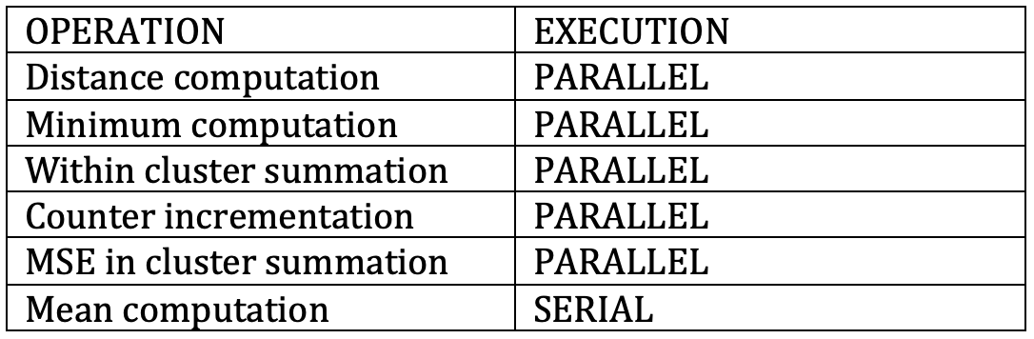
Serial Algorithm
Computational complexity
Parallelizable blocks
Intra and Infra block available parallelism

Slide 6
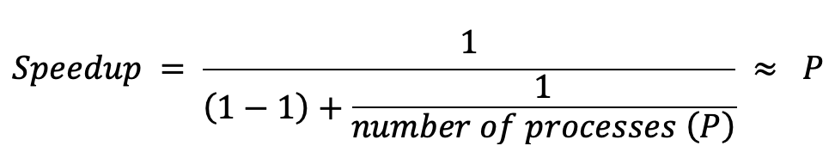
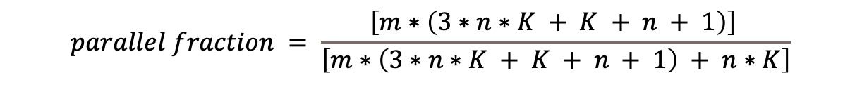
Serial Algorithm
Theoretical speedup
$$parallel fraction = \frac{\left[m∗\left(3∗n∗K + K + n + 1\right)\right] }{\left[m∗\left(3∗n∗K + K + n + 1\right) + n∗K\right]}$$

Slide 7
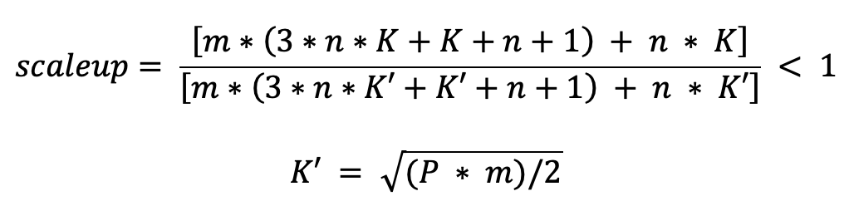
Serial Algorithm
Theoretical scaleup
Multidimensional problem – different cases
- Case K dependent on m

Slide 8
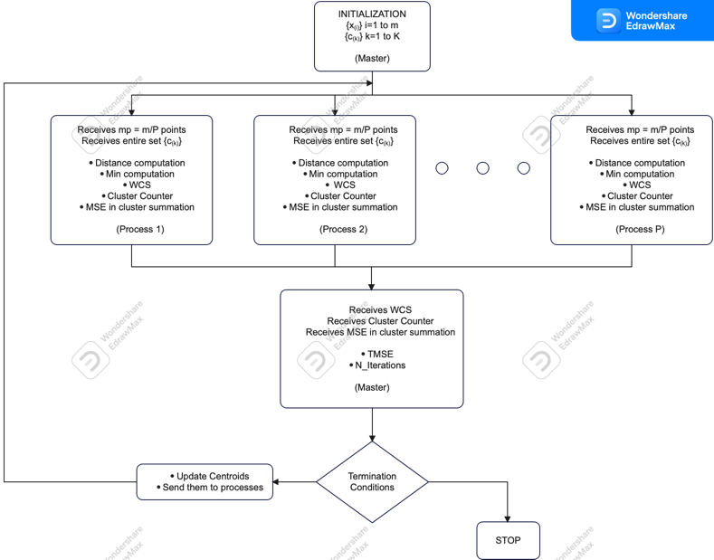
Parallel Algorithm
Intuitive schema

Slide 9
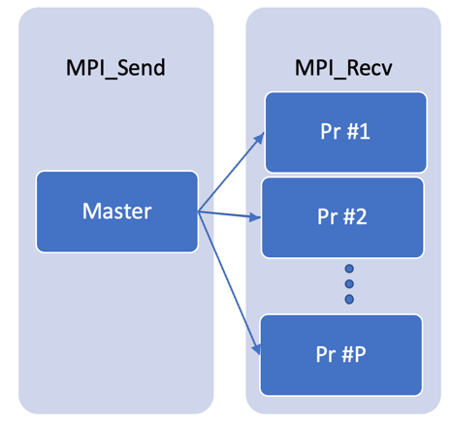
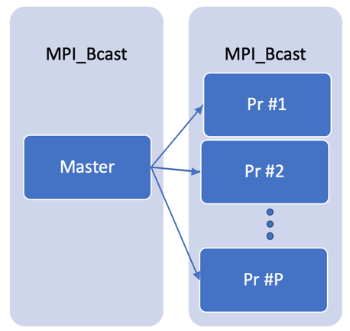
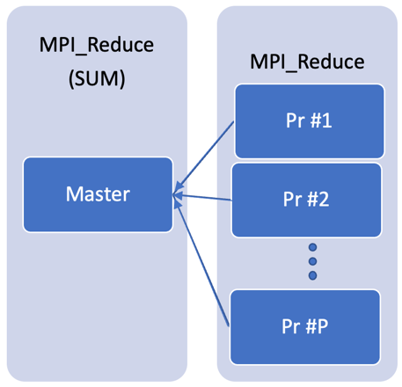
Parallel Algorithm
Communication Strategy
Sending clusters information
Sending updated centroids
Sending finish condition
Sending sum and number of points in each cluster
Sending the Sum_distance
Sending points

Slide 10
Parallel Algorithm
Deeper analysis speedup and scaleup
$$speedup= \frac{m ∗ \left(3∗n∗K + K + n + 1\right) + n∗K}{\frac{m}{P} ∗ \left(3∗n∗K + K + n + 1\right) + K ∗ \left(2∗P + n\right)} ≈ P if m big enough$$
$$scaleup = \frac{\left[m∗\left(3∗n∗K+K+n+1\right) + K ∗ \left(2 + n\right)\right]}{\left[m∗\left(3∗n∗K′+K′+n+1\right) + K′ ∗ \left(2∗P + n\right)\right]} < 1$$
$$where K′ = \sqrt{(P ∗ m)/2}$$

Slide 11
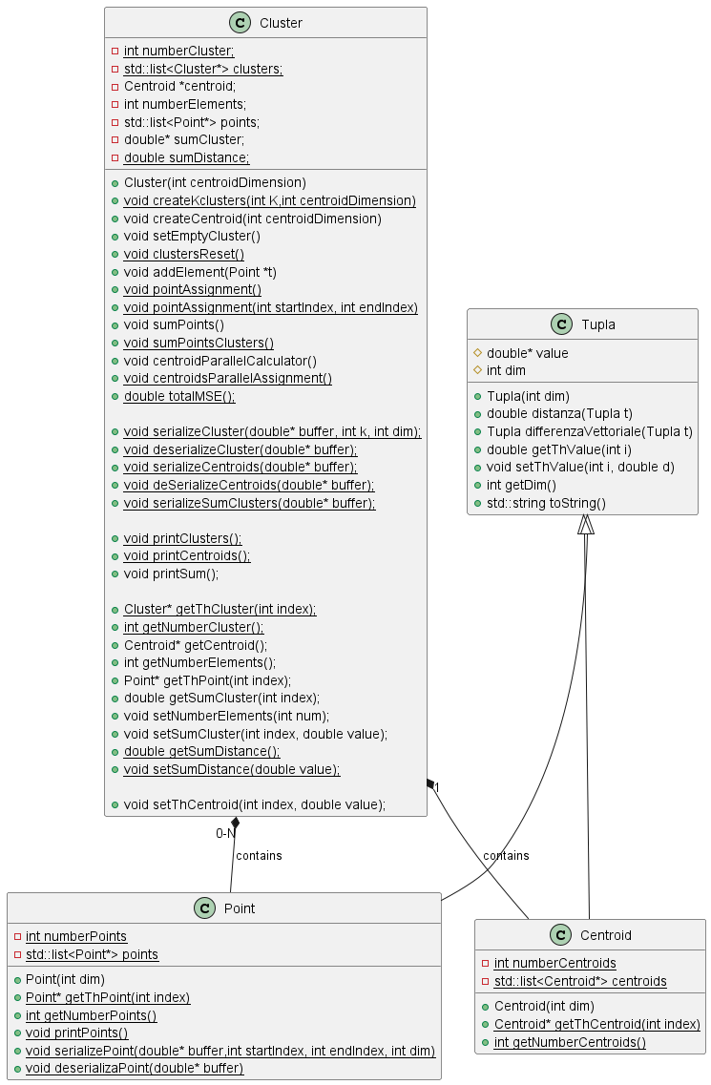
Implementation and Testing
Language: C++
Object Oriented Programming
Data structure communicated with Serialization
Figure 12 - Class Diagram

Slide 12
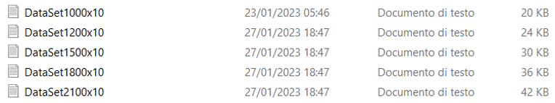


Implementation and Testing
Test performed using different dataset

Slide 13
Experimental results
Different clusters:
Fat Cluster – Infra Regional: 2 machines, 16 cores, 64Gb RAM each one;
Fat Cluster – Intra Regional: 3 machines, 8 cores, 32 Gb RAM each one;
Light Cluster – Infra Regional: 16 machines, 2 cores, 4 Gb RAM each one
Light Cluster – Intra Regional: 12 machines, 2 cores, 4 Gb RAM each one;
Asked for more IP

Slide 14
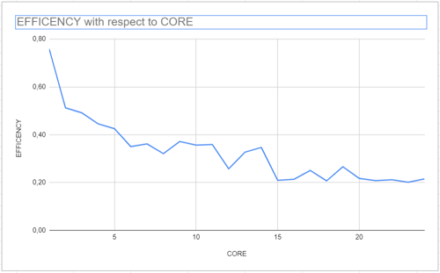
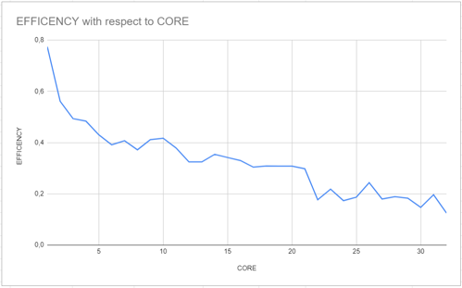
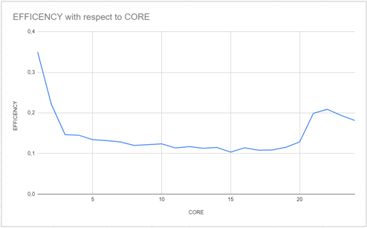
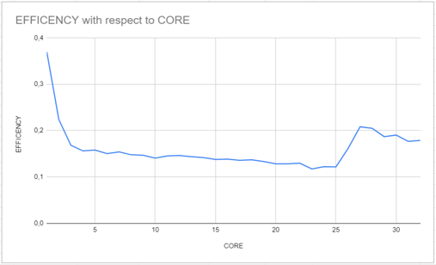
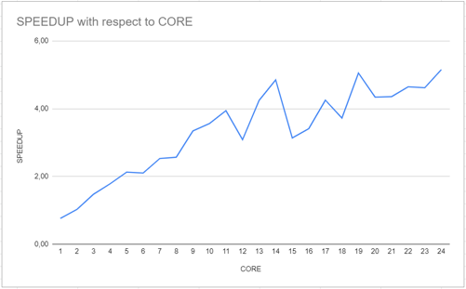
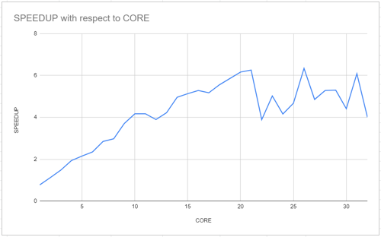
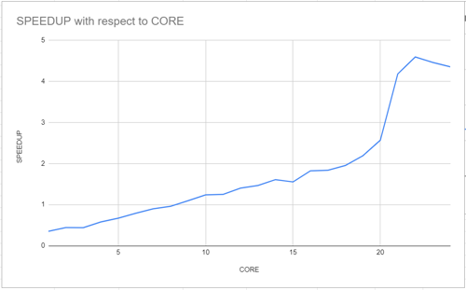
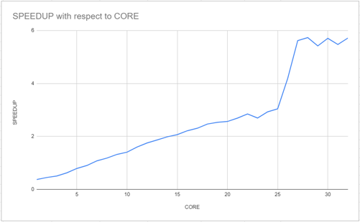
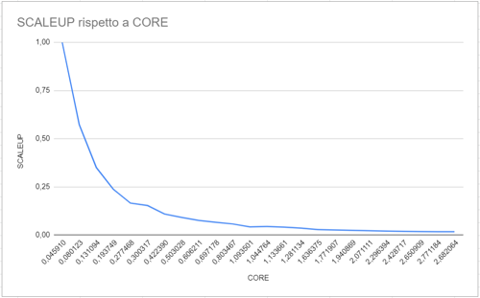
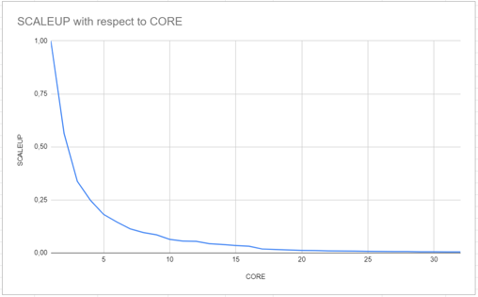
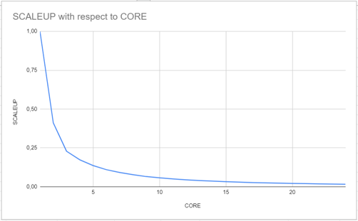
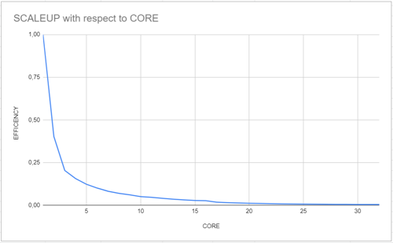
Experimental results
Fat, Intra, Efficiency
Fat, Infra, Efficiency
Light, Intra, Efficiency
Light, Infra, Efficiency
Fat, Intra, Speedup
Fat, Infra, Speedup
Light, Intra, Speedup
Light, Infra, Speedup
Fat, Intra, Scaleup
Fat, Infra, Scaleup
Light, Intra, Scaleup
Light, Infra, Scaleup

