Slide 1
Software Engineering Project
Final Examination - Group AM42: Altomare, Colombi, Corbetta
Politecnico di Milano

Slide 2
General functionalities
Specific functionalities
Santorini game rules
Socket
CLI
GUI
Persistence
Undo
CLI (Standard version)
CLI (Command Prompt-Compatible)
Resizable GUI with in-game Chat
Losing player becomes a spectator

Slide 3
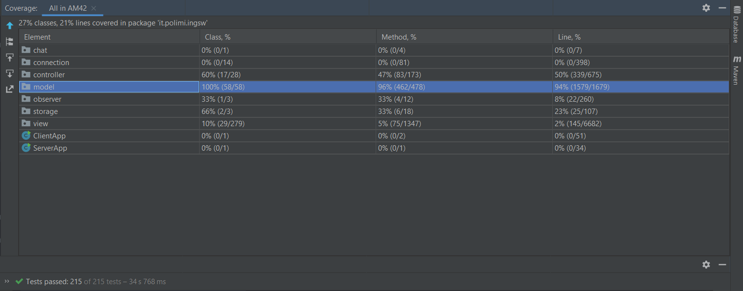
Test coverage

Slide 4
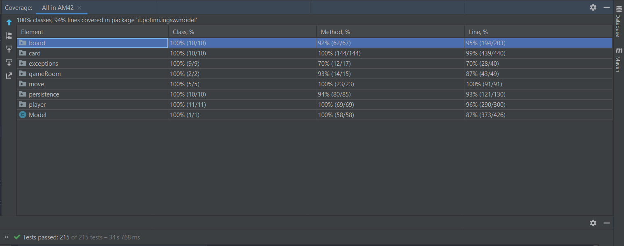
Test coverage - Detail

Slide 5
Design patterns
Model-View-Controller (Distributed MVC)
Singleton
Observer
State
Facade
Memento
Template method

