Slide 1
BIG
Breast Inpainter Generator
Andrea Baldi, id 1966232
Neural Networks
01/04/2026
A.Y. 2025/2026

Slide 2
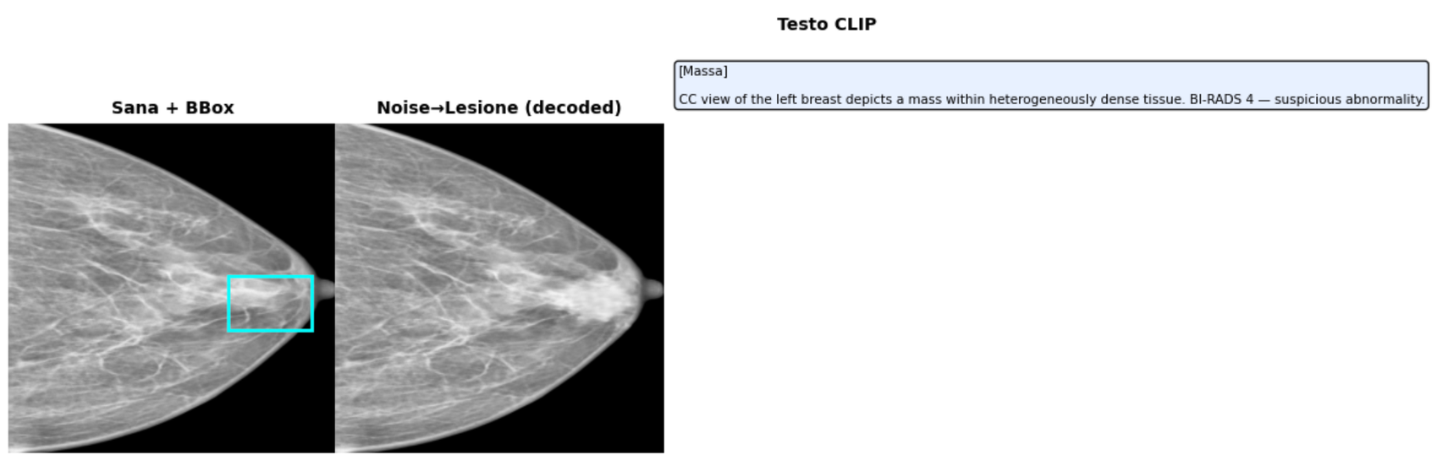
Project’s Aim:
Generating new radiological images, especially showing illnesses, plays a crucial role in medical field. Recent deep learning models provide a sensible hand to Doctors and Medical Triage in screening and treatment decisions.
The aim of this project is to provide a model able to generate clinical-consistent and high-resolution Mammograms that can overcome data bottle-necks.
BIG is capable of generating new lesions or transferring existing ones with the possibility of conditioning them.
The backbone relies on a Latent Diffusion Model (LDM) composed of a Variational AutoEncoder (VAE) and a Denoiser leveraging CLIP for textual conditioning.

Slide 3
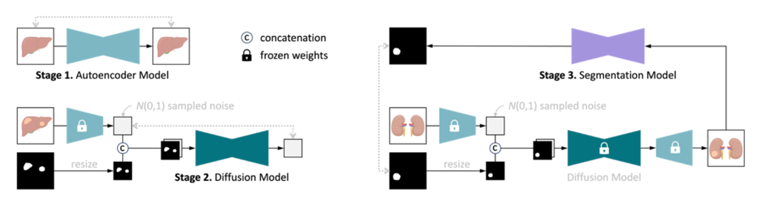
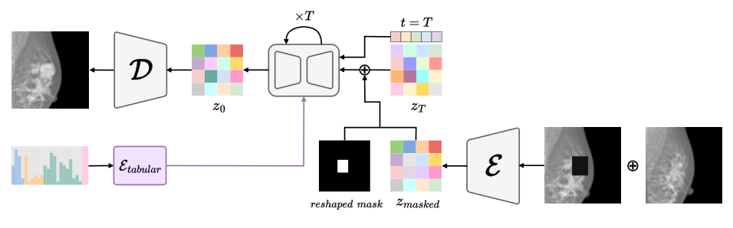
Related Work:
DiffTumor (Chen et al., 2024):
Key Point: some lesions are local constrained features.
The framework uses a 3D VQGAN autoencoder for CT compression and trains a Latent Diffusion Model conditioned on tumor masks and healthy tissue context.
RadiomicsFill-Mammo (Na et al., 2024):
Key Point: using existing models with good performances and finetune them.
Extends diffusion-based synthesis to 2D breast imaging by replacing text conditioning with radiomics-driven control. Instead of CLIP embeddings, it employs a Tabular Encoder. Built on Stable Diffusion 2, it leverages contralateral breast symmetry as additional conditioning.

Slide 4
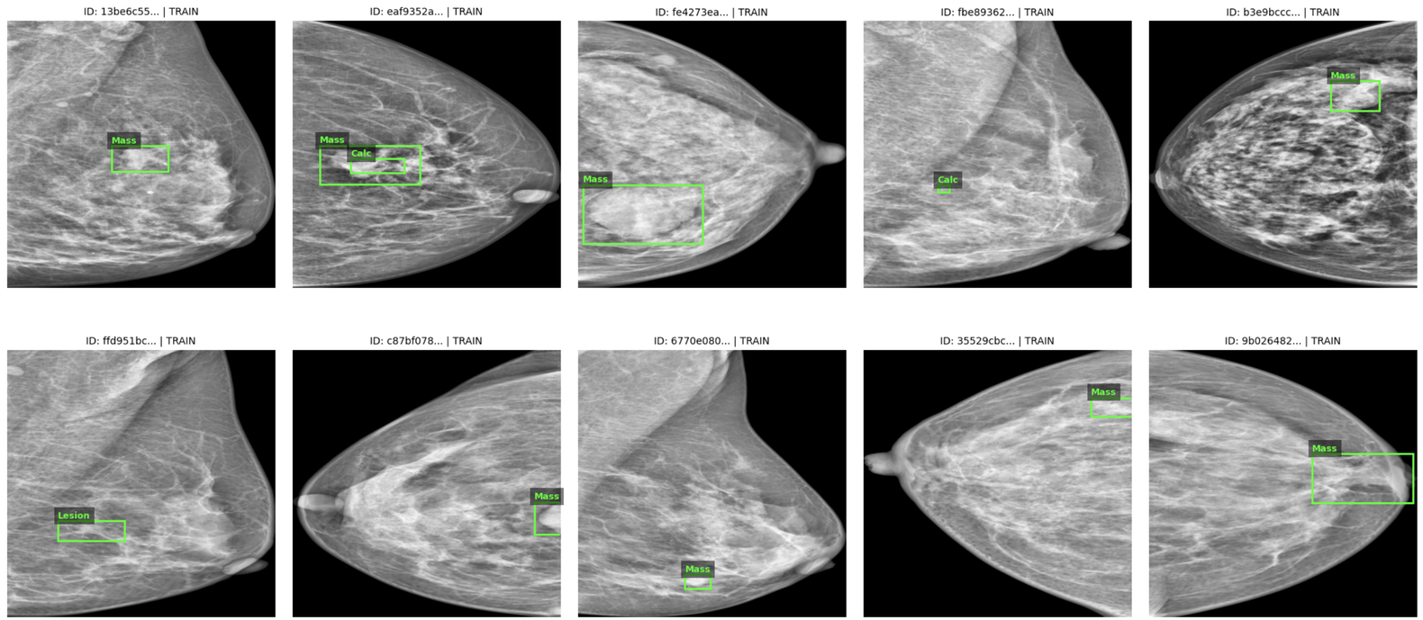
Dataset and Preprocessing
VinDr-Mammo: 5000 mammograms, 4 images per patient: (CC/MLO views, Left/Right breast) with boxes and annotations on lesions.
Preprocessing:
Resize to 512×512, grayscale, bounding boxes extracted
Keep lesion type (mass/calcification), BI-RADS score, breast density
Intensity clipping to reduce artifacts; reject 68 corrupted images
Train/val/test split without patient overlap (prevent leakage)

Slide 5
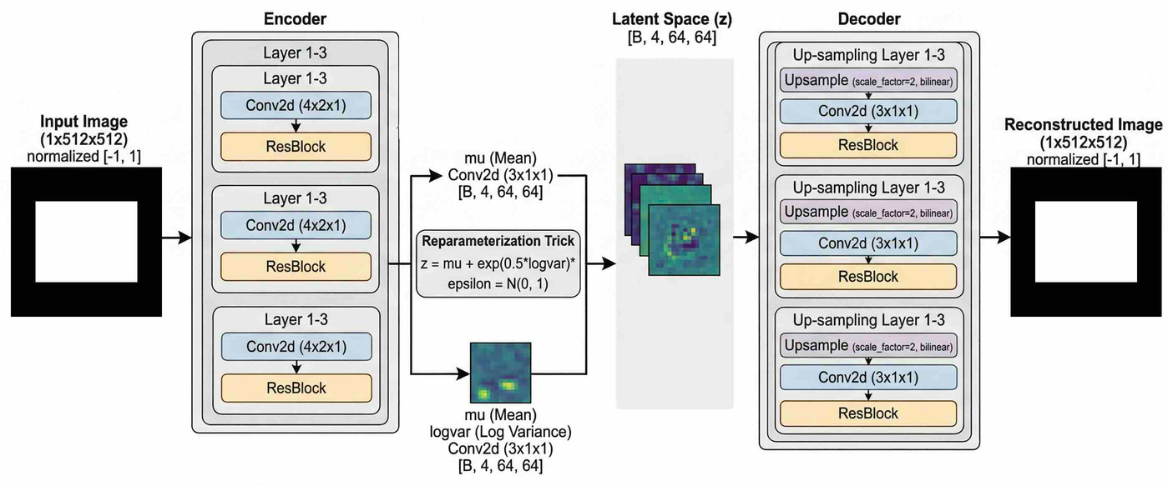
VAE Architecture and Training:
Architecture:
3 downsampling blocks (Conv2d + ResBlock) compress 512×512 → latent [B, 4, 64, 64]. Reparameterization trick: z = μ + σ × ε.
Loss:
L1 reconstruction + KL divergence + perceptual loss + adversarial (2D slice + 3D volume discriminators)
Training: 300 epochs, Adam (lr=1e-4, batch=32), cosine annealing. Best checkpoint selected on validation L1.
Latent Scaling: Post-training, compute σ_latent across training set. Apply scaling factor 1/σ_latent to normalize latent codes for diffusion model.

Slide 6
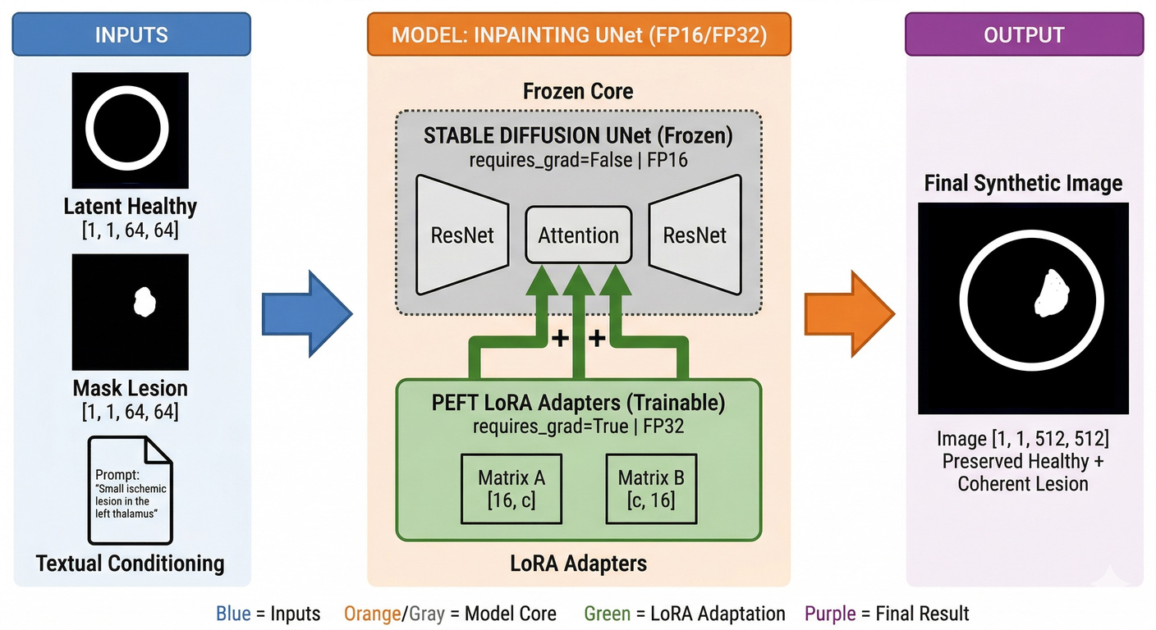
Denoiser (LoRA Fine-tuning)
Architecture: Stable Diffusion 2 U-Net + LoRA (rank-16) in attention layers (frozen base weights, trainable LoRA only).
Input: [noisy latent z_t | mask | masked_z | text embedding]. Mask derived from bbox coordinates.
Training: 200 epochs, batch=32, Adam (lr=2e-4). Random timesteps from 1000-step noise schedule.
Loss: MSE(noise_pred, noise_true).
Inference: DDIM (50 steps), CFG guidance (scale=7.5), ~4 seconds per sample.
Here’s the entire pipeline of BIG:
VAE ENCODER DENOISER VAE DECODER
ENCODER
DENOISER

Slide 7
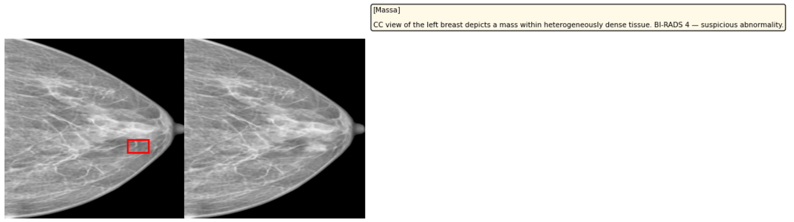
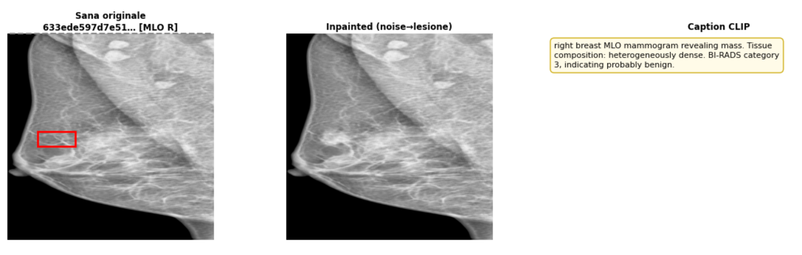
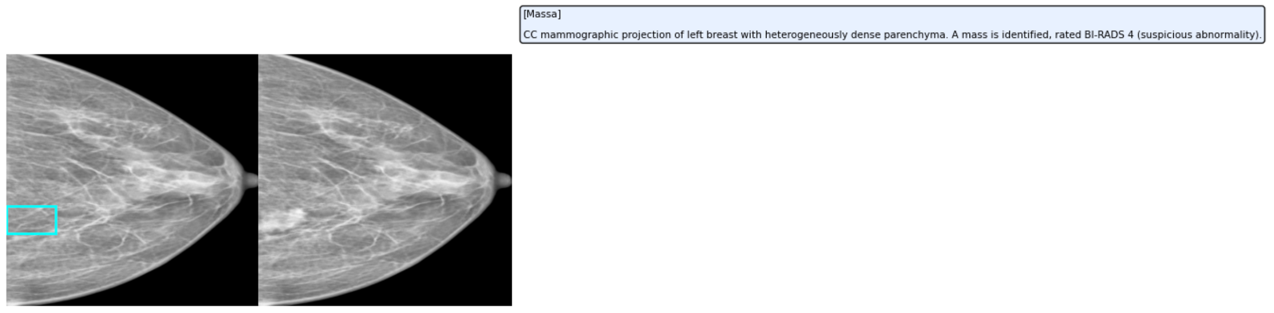
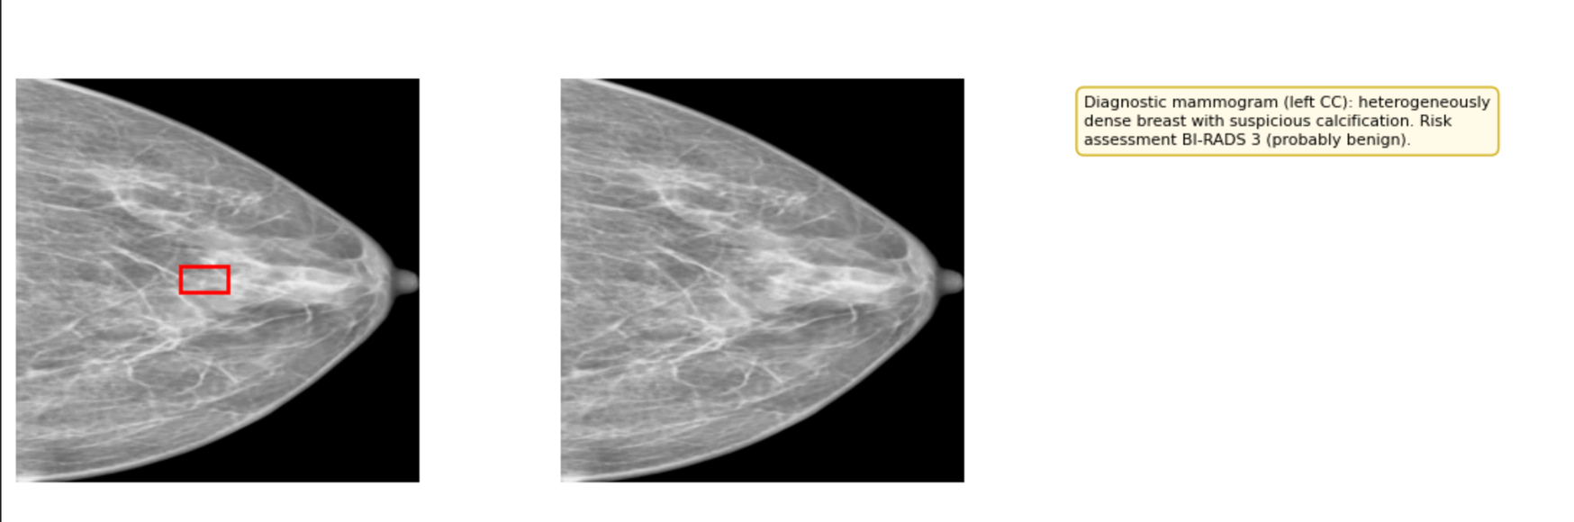
Results, Conclusion and Limitations

