Slide 1
Algorithmic bias: a framework to address multiple sensitive attributes

Slide 2
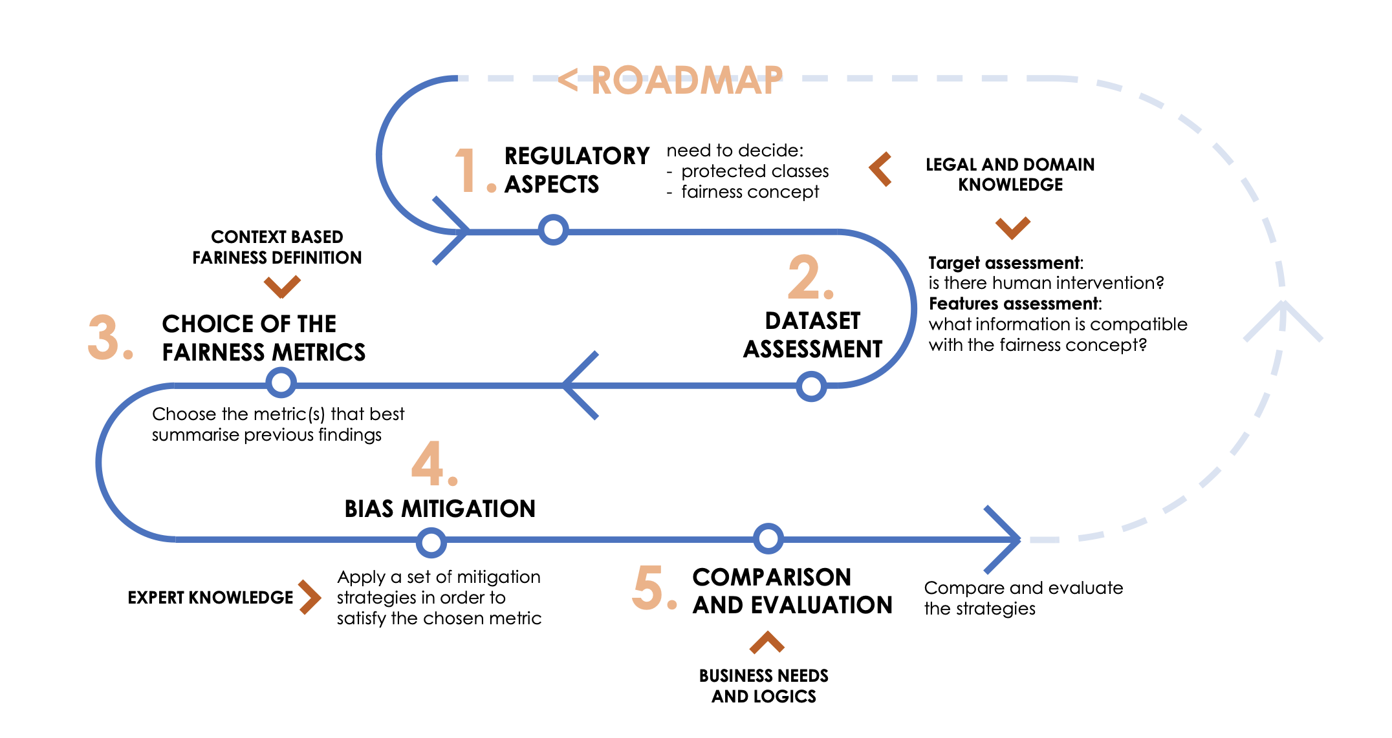
Introduction
0
Test of metrics and mitigation technique
1
Research on regulation requirements
2
Detection metrics review
3
Research and test of mitigation of multiple attributes models

Slide 3

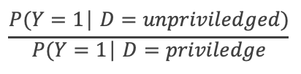
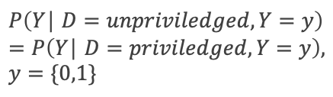
Detection: metrics
Disparate Impact Ratio
It compares the proportion of individuals that receive a positive output for two groups: an unprivileged group and a privileged group.
The aim is to have the metric close to one but as an industry standard a result above 80% is acceptable.
Statistical/Demographic parity
Evaluate the proportion of each segment of a protected class (eg. gender). The probability of having a positive outcome should be equal.
With regard to the confusion matrix, we require the Positive Rate (PR) to be the same for each segment of the protected class.
Equal opportunity
States that each group should get the positive outcome at equal rates, assuming that people in this group qualify for it. It requires the positive outcome to be independent of the protected class A, conditional on Y being an actual positive.
Based on the confusion matrix, we require the True Positive Rate (TPR) to be the same for each segment of the protected class.
$$\frac{P(Y=1\text{│ }D=unpriviledged)}{P(Y=1\text{│ }D=priviledge}$$
$$P\left(Y\text{│ }D=unpriviledged\right)=P(Y\text{│ }D=priviledged)$$
$$P\left(Y\text{│ }D=unpriviledged,Y=y\right)=P\left(Y\text{│ }D=priviledged,Y=y\right), y=\{0,1\}$$
M. Feldman, S. A. Friedler, J. Moeller, C. Scheidegger, and S. Venkatasubramanian, “Certifying and removing disparate impact,” in proceedings of the 21th ACM SIGKDD international conference on knowledge discovery and data mining, 2015, pp. 259–268

Slide 4
Mitigation
Pre-processing -> Pre-processing approaches recognize that often an issue is the data itself, and the distributions of specific sensitive or protected variables are biased, discriminatory, and/or imbalanced.
In-processing -> In-processing approaches recognize that modelling techniques often become biased by dominant features, other distributional effects, or try to find a balance between multiple model objectives, for example having a model which is both accurate and fair.
Post-processing -> Post-processing approaches recognize that the actual output of an ML model may be unfair to one or more protected variables and/or subgroup(s) within the protected variable. Thus, post-processing approaches tend to apply transformations to model output to improve prediction fairness
Notes:
What we can see for the test which has been discussed by academic is that while try to mitigate the discrimination against a protected group another may be negatively affected

Slide 5
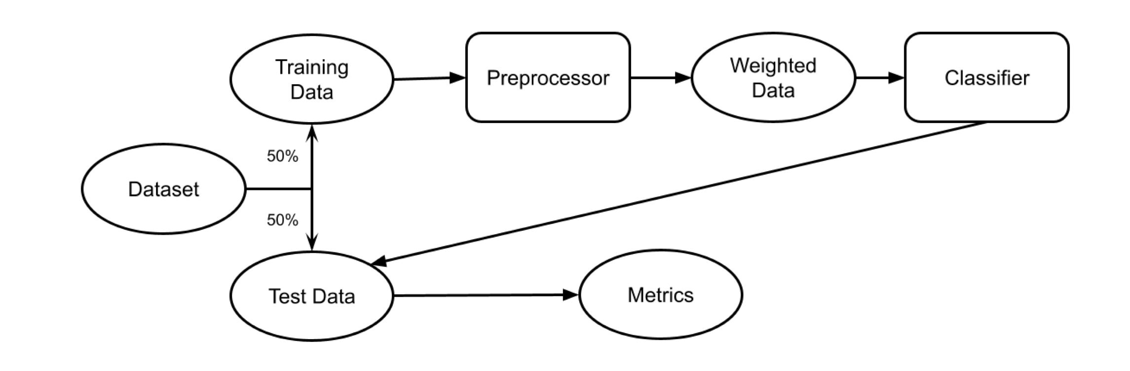
Per-processing model implementation

Slide 6
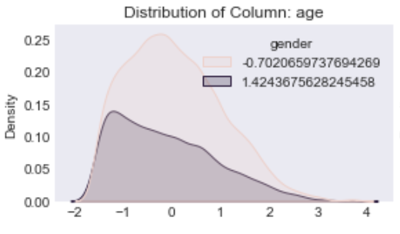
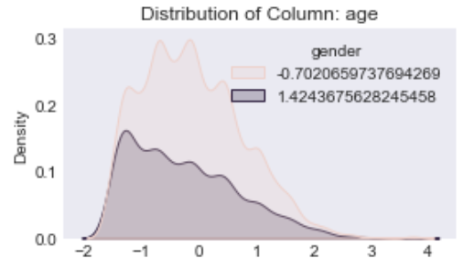
Mitigation: Disparate impact remove
Disparate Impact Remover is a pre-processing technique that edits values, which will be used as features, to increase fairness between the groups.
Notes:
What we can see for the test which has been discussed by academic is that while try to mitigate the discrimination against a protected group another may be negatively affected

Slide 7
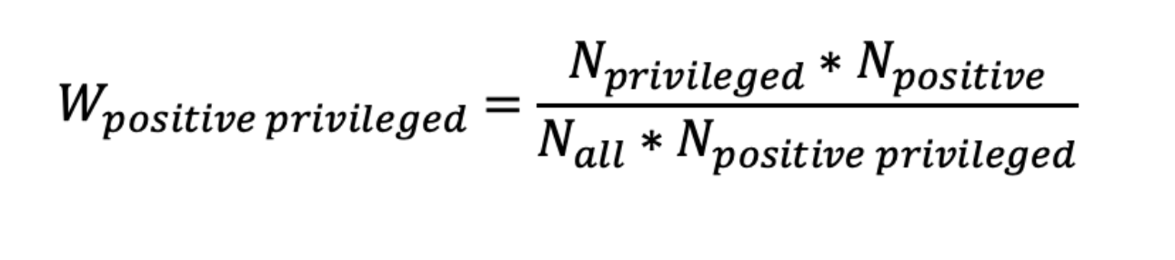
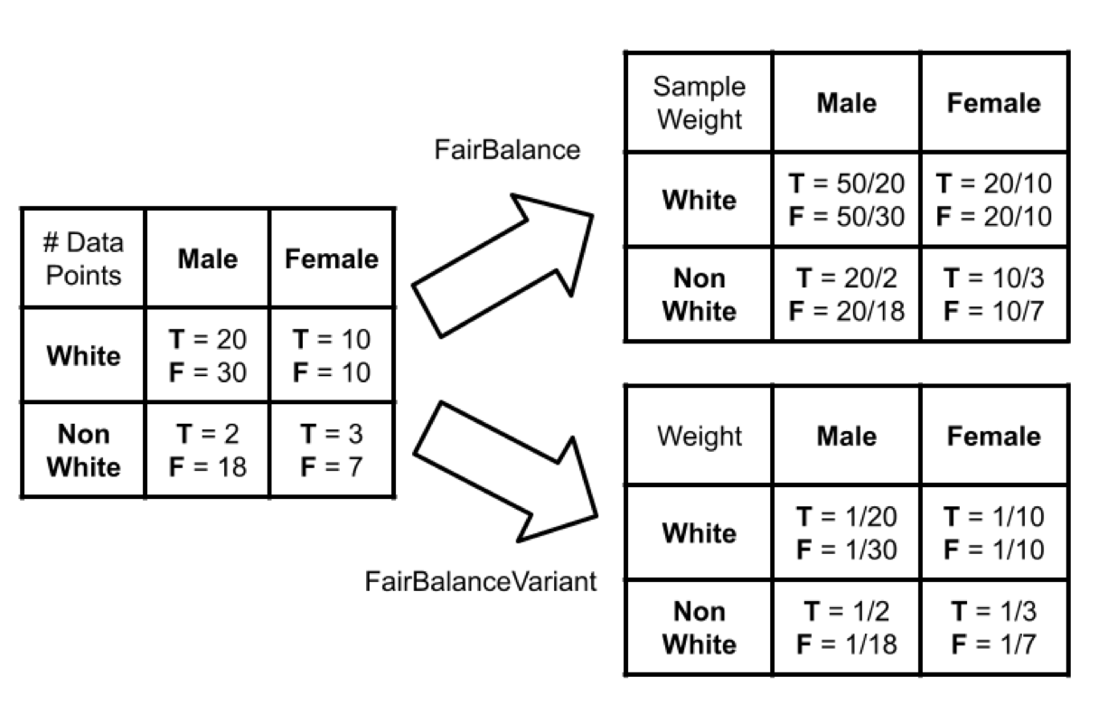
Mitigation: Reweighing and FairBalance
Assigns different weights to the examples based upon their categories of protected attribute and outcome such that bias is removed from the training dataset. The weights are based on frequency counts. However as this technique is designed to work only with classifiers that can handle row-level weights, this may limit your modelling options.
https://towardsdatascience.com/reweighing-the-adult-dataset-to-make-it-discrimination-free-44668c9379e8
https://arxiv.org/pdf/2107.08310.pdf
Notes:
What we can see for the test which has been discussed by academic is that while try to mitigate the discrimination against a protected group another may be negatively affected

Slide 8
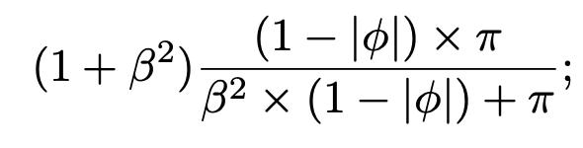
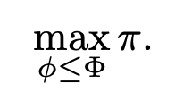
Comparison Mitigation models
Trade-off fairness-performance. -> This indicator is inspired by Fβ -score used in ML, whose value for β = 1 results in the harmonic mean of precision and recall:
where π and φ are the preferred performance and fairness metrics, respectively and β is the weight associated with the performance metric.
Constrained performance -> Once chosen an upper bound Φ for a desired fairness metric φ, this indicator corresponds to the highest possible performance given that fairness constraint.
The optimal choice is then given by the model maximizing the selected indicator
For the performance metric π we have considered accuracy, precision, recall and F1. For the fairness metric φ we have included Demographic Parity, Equal Opportunity, Predictive Parity and Equality of Odds.
https://arxiv.org/pdf/2102.02137.pdf
Notes:
What we can see for the test which has been discussed by academic is that while try to mitigate the discrimination against a protected group another may be negatively affected

Slide 9
Comparison Mitigation models
In addition, a nonparametric null- hypothesis significance testing (Mann–Whitney U test [44]) and a nonparametric effect size testing (Cliff’s delta [45]) are applied to check if one treatment performs significantly better than another in terms of a specific metric.
A set of observations is considered to be significantly different from another set if and only if the null-hypothesis is rejected in the Mann–Whitney U test and the effect size in Cliff’s delta is medium or large.
https://arxiv.org/pdf/2102.02137.pdf
Notes:
What we can see for the test which has been discussed by academic is that while try to mitigate the discrimination against a protected group another may be negatively affected

Slide 10
Next steps
1
Research on regulation EU and UK
2
Research metrics
3
Test FairBalance for multiple attributes and against existing methods Test other mitigation technique
4
Test FairBalance for compliance on the UK and EU regulation
5
Compare the shapely value for OLS and RF and see how they behave
6
Use a graph to compare the different mitigation technique in relation to the accuracy

