Slide 1
A (very) brief introduction to PBS
Andrea Borghesi

Slide 2
PBS terminology
Vnode: abstract object representing a set of resources which form a usable part of a machine
This could be an entire host, or a nodeboard or a blade; single host can be made up of multiple vnodes
A vnode has some attributes and a state - the state defines if a vnode can accept and run jobs
Host: a physical machine/node (i.e. the nodes from 1 to 64 which compose Eurora are hosts)
Chunk: a set of resources allocated as a unit to a job
Chunks cannot be split across hosts
Exec_vnode: List of chunks for the job
Example - For a job which requested two chunks satisfied by resources from three vnodes, exec_vnode=(vnodeA:ncpus=N:mem=X)+(nodeB:ncpus=P:mem=Y+nodeC:mem=Z)
MoM: a daemon that runs on each execution host and manages the jobs on that execution host

Slide 3
PBS Queues
When a job is submitted to PBS and accepted, it is placed in a queue
Routing queues, used to move jobs to other queues
jobs cannot run from a routing queue
Whenever a job enters a routing queue, PBS immediately attempts to route the job to a destination queue
You can use resources to direct jobs to the desired queues
Example: you can set up queues for specific kinds of jobs (jobs requesting very little memory, many cpus, or a particular application), then you can route jobs to the appropriate queues
Execution queues , used as home for waiting or running jobs
Advanced or standing reservation, dedicated time, (non)primetime, express, etc.

Slide 4
PBS resources
PBS resources represent things such as CPUs, memory, application licenses, switches, scratch space, and time.
They can also represent whether or not something is true (ex. a machine dedicated to a project,..)
Jobs can request resources then the scheduler matches requested resources with available resources.
2 main type of resources:
Chunk/host level (cpus, memory, etc.)
Job-wide/server/queue level (scratch space. walltime, etc.)
Custom resources - new resources created by users, jobs may request them and PBS can schedule on them

Slide 5
PBS Scheduling
PBS will always places jobs where it finds the resources requested by the job.
PBS will not place a job where that job would use more resources than it thinks are available
The scheduler (pbs_sched) implements scheduling policy.
The scheduler communicates with the MoMs to query the state of host-level resources and with the Server to learn about the availability of jobs to execute and the state of server-level resources.
Job prioritization
Any technique used to come up with a ranking of each job’s relative importance
Execution priority and preemption priority
Queue based mechanisms
Using queues order to affect order of consideration, special queues (express, reservations, etc.)

Slide 6
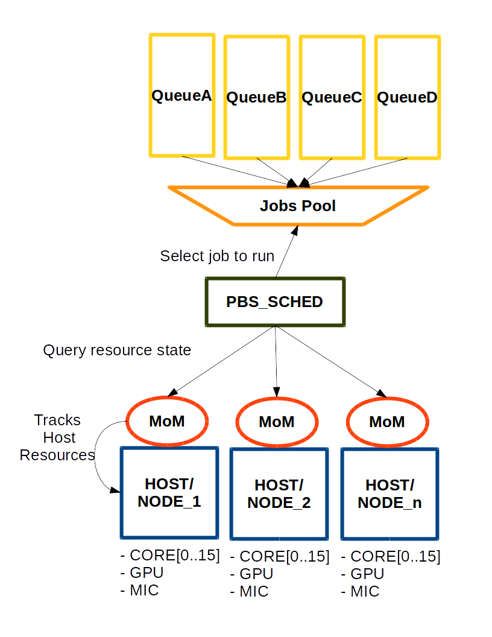
Scheduler Overview

Slide 7
Scheduling tools / 1
When the scheduler examines jobs, either at the whole complex or within a queue, it gives each job an execution priority, and then uses this job execution priority to select which job(s) to run
Job might also be grouped by class, i.e. non-special jobs, reservation, express, starving jobs, etc.
Fairshare
Method for ordering the start times of jobs based on two things: how a site's resources are apportioned, and the resource usage history of site members
Ensures that jobs are run in the order of how deserving they are
The scheduler performs the fairshare calculations each scheduling cycle
Can be enabled/disabled; if enabled, all jobs have fairshare applied to them and there is no exemption from fairshare

Slide 8
Scheduling tools / 2
Associating vnodes with queues
When a vnode is associated with a queue, that means it accepts jobs from that queue only
Backfilling
fitting smaller jobs around the higher-priority jobs that the scheduler is going to run next in such a way that the higher-priority jobs are not delayed
Examine jobs queue by queue
When the scheduler examines waiting jobs, it can either consider all of the jobs in the complex as a whole, or it can consider jobs queue by queue; when considering jobs queue by queue, the scheduler runs all the jobs it can from the first queue before examining the jobs in the next queue, and so on
Organizing job chunks
Specify how job chunks should be organized onto hosts or vnodes

Slide 9
Scheduling tools / 3
Custom resources
Use custom resources as tags that you attach to jobs in order to help schedule the jobs
Assign custom resources to jobs through routing them to special queues which set default values or hooks
Use custom resources to represent arbitrary elements like projects
Use custom resources as coefficients in the job sorting formula
Job sorting formula
When the scheduler sorts jobs according to the formula, it computes a priority for each job - sort jobs at the finest-granularity level
Only one formula is used to prioritize all jobs
At each scheduling cycle, the formula is applied to all jobs, regardless of when they were submitted
All variables and coefficients in the formula must be resources

Slide 10
Scheduling tools / 4
Queue priority
Each queue can have a different priority
Queue priority can be used as a term in the job sorting formula
Specify order in which queues are examined when scheduling jobs
Routing jobs
Routing jobs can involve collecting jobs so they don’t stray into the wrong queues, moving those jobs to the correct queues, and filtering which jobs are allowed into queues
Routing queues and hooks are the main mechanisms to route jobs
Filtering methods to control which jobs are allowed into destination queues, such as resource limits or access control limits
Combination of moving a job and “tagging” it (including a special custom resource in the job’s resource request), to route the job
Sorting queues

Slide 11
Hooks / 1
A hook is a block of Python code that PBS executes at certain events, for example, when a job is queued
Hooks that run before a job is received by an execution host
Queuing/modifying/moving a job
Hooks that run after a job is received by an execution host
When a job is received by an execution host, just before/after executing/killing a job
Hooks that are not directly related to a specific job
Submitting a PBS reservation, provisioning a vnode
Each hook can
Accept (allow) or reject (prevent) the action that triggers it.
Modify the input parameters given for the action
Make calls to functions external to PBS

Slide 12
Hooks / 2
To create a hook under UNIX/Linux, you must be logged into the primary or secondary server host as root
Hooks usage examples:
Route jobs into specific queues or between queues
Reject job submissions that do not specify a valid queue
Reject improperly specified jobs
Modify job resource requests
Reject jobs that could cause problems, based on the user and type of job that have caused previous problems
Check whether an entity has enough resources allocated to accept the job
Modify job attributes and requested resources

