Slide 1
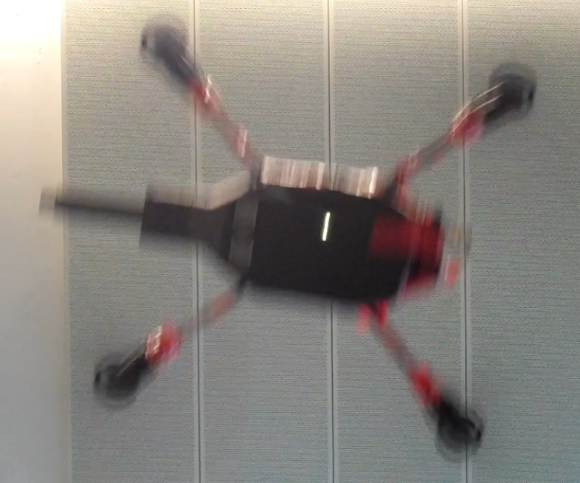

Low-latency localization by Active LED Markers tracking using a Dynamic Vision Sensor
Andrea Censi*, Jonas Strubel⁺, Christian Brandliº,
Tobi Delbruckº, Davide Scaramuzza⁺
* California Institute of Technology
º Institute of Neuroinformatics - UZH/ETH ⁺ University of Zurich
The agility of MAVs is limited by the latency
of their sensing and processing pipeline.
A DVS ("silicon retina") represents visual information using a sequence of brightness change events with microsecond resolution.
We present a method for pose tracking using
a DVS observing Active LED Markers.
We evaluate the method for localization
of a quadrotor during aggressive maneuvers.
a) Blurry CMOS camera frame
b) DVS events capture
the rotors rotation

