Slide 1
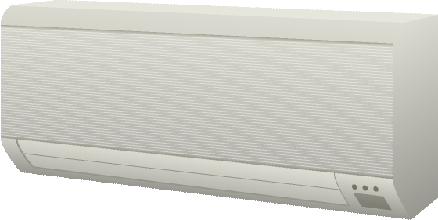

3.2.1 Device controllers
Electronic
Appliance
Remote
Controller
Trusted Environment
Server role
Client role

Slide 2

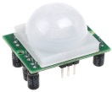
3.2.2 Thing-to-Thing
Electronic
Appliance
Controller with sensor
Trusted Environment
Server role
Server and Client role

Slide 3
3.2.3 Remote access
Remote
Controller
Electronic
Appliance
Remote
Controller
Trusted Environment
Server role
Client role

Slide 4
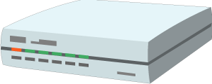
3.2.4 Gateways
Remote
Controller
Gateway/Proxy
Electronic
Appliance
Trusted Environment
Server role
Server and Client role
Client role

Slide 5
3.2.5 Cloud-ready devices
Proxy
Electronic
Appliance
Remote
Controller
Trusted Environment
Server role
Server and Client role
Client role

Slide 6
3.2.6 Cloud proxies
Proxy
Proxy/Gateway
Electronic
appliance
Remote
controller
Trusted Environment
Server role
Server and Client role
Server and Client role
Client role

Slide 7
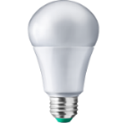
3.2.7 Legacy devices
Proxy
Gateway
Existing
Device
Remote
controller
Trusted Environment
Server role
Server and Client role
Client role

Slide 8
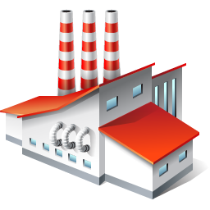
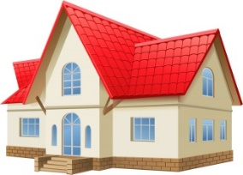
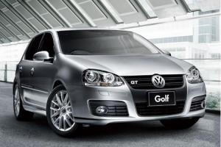


3.2.8 Multiple Subsystems
Proxy
Remote controller
Gateway/
Proxy
Gateway/
Proxy
Gateway/
Proxy
Electronic appliance
Factory facilities
Car sensors and facilities

Slide 9


3.3 Summary
Cloud
Gateway
client
client
Connected Car
server
Proxy/ gateway
proxy
Remote access and Synchronization
Integration and Orchestration
Device
client
Web Browser
Existing Device
Device
client
server
server
server
Direct Thing-to-Thing
Interaction
Complement Existing Devices
Web Integration

Slide 10
6.5 Inter connection of application and device
Client
Client
ConsumedThing
ConsumedThing
Server
ExposedThing
ExposedThing
Servient
ConsumedThing
Server
ExposedThing

Slide 11
8.5 Devices in a Local Network Controlled from a Cloud
Client 1
Client 2
ConsumedThing
ConsumedThing
E
ExposedThing
C
ConsumedThing
ExposedThing
Remote
Servient
Internet
ConsumedThing
ExposedThing
Local
Servient
C
C
C
Server A
Server B
Server C
ExposedThing
ExposedThing
ExposedThing

Slide 12
8.6 service-to-service connections across multiple domains Cloud service with directory
Thing Directory
Client
ConsumedThing
ExposedThing
Remote
Servient
Internet
ConsumedThing
ExposedThing
Local
Servient
ConsumedThing
Server
ExposedThing

Slide 13
8.6 service-to-service connections across multiple domains multiple cloud connect through directory synchronization
Thing Directory
Thing Directory
Client A
Client B
synchronize
ConsumedThing
ConsumedThing
ExposedThing
ExposedThing
Remote
Servient B
Remote
Servient A
Internet
ConsumedThing
ConsumedThing
ExposedThing
ExposedThing
Local
Servient B
Local
Servient A
ConsumedThing
ConsumedThing
Server A
Server B
ExposedThing
ExposedThing
Network A
Network B

Slide 14
8.6 service-to-service connections across multiple domains multiple cloud connect through servient synchronization
Thing Directory
Thing Directory
Client A
Client B
ConsumedThing
ConsumedThing
synchronize
ExposedThing
ExposedThing
Remote
Servient B
Remote
Servient A
Internet
ConsumedThing
ConsumedThing
ExposedThing
ExposedThing
Local
Servient B
Local
Servient A
ConsumedThing
ConsumedThing
Server A
Server B
ExposedThing
ExposedThing
Network A
Network B

