Slide 1
Process
WoT Thing
Description
Describe
Consumer
Thing
Interact

Slide 2
TD
B
Links
TD
A
Other
resources
Other
Resources
TD
C
Thing B
Consumer
Thing A
Related
Thing C
Interact

Slide 3
TD
A
Thing A
TD
C
Consumer
Intermediary
Interact
Thing B
TD
B

Slide 4
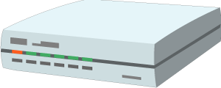



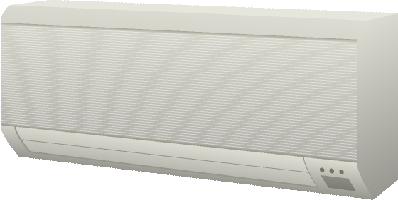
Cloud
Gateway
Servient
Proxy Thing
Control Agent
Servient
Proxy Thing
Virtual Thing
WoT Scripting API
Control Agent
Interaction Model
Proxy Thing
WoT Binding Templates
WoT Scripting API
Remote Access and Synchronization
Interaction Model
WoT Binding Templates
Web Browser
Integration and Orchestration
App Script
WoT Scripting API
Interaction Model
WoT Binding Templates
Thing
Servient
Existing Device
Seamless
Web Integration
Classic Firmware
App Script
+
WoT Scripting API
Interaction Model
Interaction Model
⇒
Thing
Protocol
Direct Thing-to-Thing
Interaction
WoT Binding Templates
Complement Existing Devices
Notes:
architecture-abstract.png

Slide 5
Cloud
Edge
Intermediary / Thing
Behavior
Interaction Affordances
Intermediary / Thing
Data Schema
Behavior
Security Configuration
Interaction Affordances
Protocol Bindings
Remote Access and Synchronization
Data Schema
Security Configuration
Protocol Bindings
Consumer
Thing-to-cloud
Integration and Orchestration
Behavior
Thing-to-gateway
Security Configuration
Protocol Bindings
Seamless
Web Integration
Thing
Thing + Consumer
Existing Device
Behavior
Behavior
+
Interaction Affordances
Interaction Affordances
⇒
Data Schema
Direct Thing-to-Thing
Interaction
Data Schema
Complement Existing Devices
Thing
Security Configuration
Security Configuration
Protocol Binding
Protocol Bindings
Protocol
Local Network
Notes:
architecture-abstract.png

Slide 6
Thing
Behavior
Interaction Affordances
Data Schema
WoT Thing Description
Security Configuration
Protocol Binding(s)

Slide 7
WoT Thing Description
Thing
General Metadata
Behavior Implementation
Interaction Affordances
Private Security Configuration
Data Schema
Public Security Configuration
Protocol Stack(s)
Protocol Binding(s)
Binding Templates
Notes:
architecture-concept.png

Slide 8
WoT Thing Description
Thing
General Metadata
Behavior Implementation
Interaction Affordances
WoT Scripting API
Data Schema
Public Security Configuration
Private Security Configuration
Protocol Binding(s)
Protocol Stack Implementation
Binding Templates
Notes:
architecture-concept.png

Slide 9
Servient
Exposed
WoT Thing Description
Application Script
Behavior Implementation
General Metadata
Consumed
Interaction Affordances
Scripting WoT Runtime
WoT Thing Description
Data Schema
Public Security Configuration
WoT Scripting API
Protocol Binding(s)
Exposed Thing
Consumed Thing
Consumed Thing
…
WoT Thing Description
Binding Templates
Private Security Configuration
Protocol Stack Implementation
Notes:
architecture-concept.png

Slide 10
Servient
Exposed
WoT Thing Description
Behavior Implementation in preferred language
General Metadata
Consumed
Interaction Affordances
Native WoT Runtime
WoT Thing Description
Data Schema
Public Security Configuration
Native API
Protocol Binding(s)
Exposed Thing
Consumed Thing
Consumed Thing
…
WoT Thing Description
Binding Templates
Private Security Configuration
Protocol Stack Implementation
Notes:
architecture-concept.png

Slide 11
Manual Creation or Tool
Existing Device or Service
Describe
Black Box
Behavior Implementation
WoT Thing Description
General Metadata
Private Security Configuration
Interaction Affordances
Data Schema
Protocol Stack Implementation
Public Security Configuration
Protocol Binding(s)
Interact
Binding Templates
Consumer
Process
Notes:
architecture-concept.png

Slide 12
Exposed Thing Description
Thing: WoT Servient
WoT Thing Description
WoT Runtime
General Metadata
Scripting Runtime
Interaction Affordances
Application Script
Public Security Configuration
Behavior Implementation
Communications Metadata
ExposedThing
ConsumedThing
ConsumedThing
…
ConsumedThing
Binding Templates
WoT Scripting API
Private Security Configuration
Consumed Thing Description(s)
Protocol Bindings
WoT TDs
Notes:
architecture-concept.png

Slide 13
Exposed Thing Description
Thing: WoT Servient
WoT Thing Description
WoT Runtime
General Metadata
Alternative Language Runtime
Interaction Affordances
Behavior Implementation
Public Security Configuration
ExposedThing
Communications Metadata
ConsumedThing
ConsumedThing
…
ConsumedThing
Alternative WoT API
Binding Templates
Private Security Configuration
Protocol Bindings
Consumed Thing Description(s)
WoT TDs
Notes:
architecture-concept.png

Slide 14
Thing: Existing Device or Service
TD Definition
Native Runtime
Native Behavior Implementation
Native API
WoT Thing Description
Private Security Configuration
General Metadata
…
Interaction Affordances
Native Protocol
Public Security Configuration
Communications Metadata
WoT Client
Binding Templates
Notes:
architecture-concept.png

Slide 15
Web
with JSON
over HTTP
using “nosec”
OCF
with CBOR
over CoAP
using DTLS
oneM2M
with JSON
over MQTT
using TLS
LWM2M
with SenML
over CoAP
using DTLS
Web with CBOR over CoAP u/ COSE+CWT
…
Binding Templates
WoT Thing Description
“IoT Platform” × “Media Type” × “Transfer Protocol” × “Subprotocol” × “Security”
Protocol Bindings
Implementation
Protocol Stacks
JSON
CBOR
HTTP
CoAP
MQTT
TLS
DTLS
OAuth
Notes:
binding-templates.png

