Slide 1
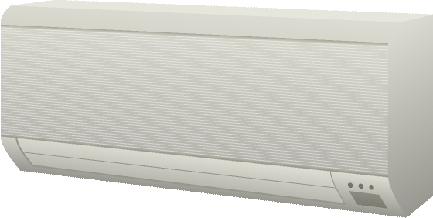

Electronic
Appliance
Remote
Controller
Trusted Environment

Slide 2

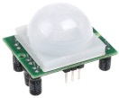
Electronic
Appliance
Control Agent
Trusted Environment

Slide 3
Remote
Controller
Electronic
Appliance
Remote
Controller
Trusted Environment

Slide 4
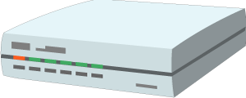
Remote
Controller
Gateway
Electronic
Appliance
Trusted Environment

Slide 5
Remote
Controller
Edge Device
Electronic
Appliances
Trusted Environment

Slide 6
Proxy
Electronic
Appliance
Remote
Controller
Trusted Environment

Slide 7
Appliance Twin
Electronic
Appliance
Remote
Controller
Trusted Environment

Slide 8
Appliance Twin
Gateway
Electronic
appliance
Remote
controller
Trusted Environment

Slide 9
Appliance Twin
Gateway
Electronic
appliance
Remote
controller
Trusted Environment

Slide 10
Digital Twin
Device Client
Connected devices
Trusted Environment

Slide 11
Digital Twin
Gateway
Device
Client
Connected devices
Trusted Environment

Slide 12
Connected devices
Digital Twin
Connected devices
Device Client
Connected devices

Slide 13


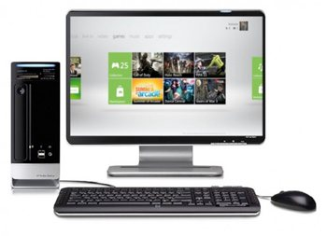


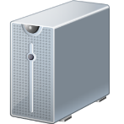
Services
Monitor
RS-485
EtherCAT

Slide 14
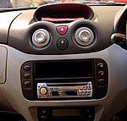
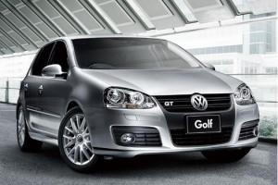

Services
DCU
Gateway
CAN
CAN
ECU
ECU
ECU

Slide 15



Cloud
Gateway
client
client
Connected Car
server
Proxy/ gateway
proxy
Remote access and Synchronization
Integration and Orchestration
Device
client
Web Browser
Existing Device
Device
client
server
server
server
Direct Thing-to-Thing
Interaction
Complement Existing Devices
Web Integration

Slide 16








BACnet
Services
Direct
collaboration
Services
Gateway
RS-485
Electronic
appliance
EtherCAT

Slide 17
BACnet
Services
C
Indirect
collaboration
Collaboration
platform
Services
Gateway
RS-485
Electronic
appliance
EtherCAT

Slide 18

Services
Services
Cross-domain
Collaboration
Digital Twins
Edge Device
Gateway
Control Agent
Electronic
Appliance
Remote
Controller
Connected devices
Trusted Environment

