Slide 1
Use full width of each slide.
Text Font: Calibri Regular/Bold
Font size: 20pt
Place white background rectangle

Slide 2



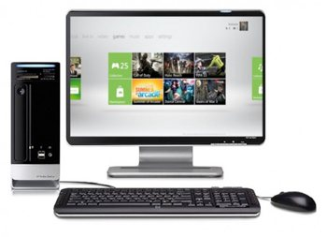
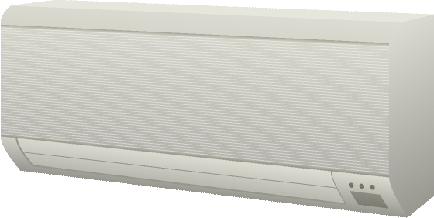
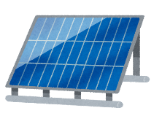
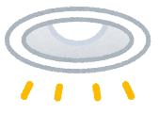


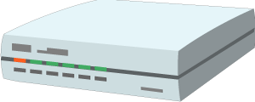

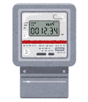
Services
Remote Access
Remote Monitoring
KNX /ECHONET
ZigBee /DECT ULE
/Wi-SUN
Notes:
Figure 1 Smart Home
images/wot-use-cases/smart-home.png

Slide 3



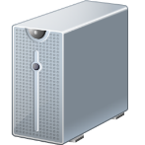


Monitoring, Prediction
Services
Notes:
Figure 2 Smart Factory
https://w3c.github.io/wot-architecture/images/wot-use-cases/smart_factory_new.png

Slide 4
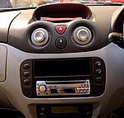
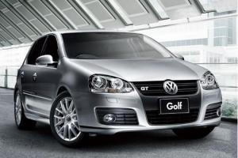

Services
DCU
Gateway
CAN
CAN
ECU
ECU
ECU
Notes:
Figure 3 Connected Car
https://w3c.github.io/wot-architecture/images/wot-use-cases/connected-car.png

Slide 5
Electronic
Appliance
Remote
Controller
Trusted Environment
Notes:
Figure 4 Device Control
https://w3c.github.io/wot-architecture/images/wot-use-cases/smart-home-device.png

Slide 6

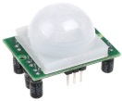
Electronic
Appliance
Control Agent
Trusted Environment
Notes:
Figure 5 Control Agent
https://w3c.github.io/wot-architecture/images/wot-use-cases/smart-home-t2t.png

Slide 7
Remote
Controller
Electronic
Appliance
Remote
Controller
Trusted Environment
Notes:
Figure 6 Multiple Network Interfaces https://w3c.github.io/wot-architecture/images/wot-use-cases/smart-home-multi.png

Slide 8
Remote
Controller
Gateway
Electronic
Appliance
Trusted Environment
Notes:
Figure 7 Smart Home Gateway https://w3c.github.io/wot-architecture/images/wot-use-cases/smart-home-gateway.png

Slide 9
Remote
Controller
Edge Device
Electronic
Appliances
Trusted Environment
Notes:
Figure 8 Edge device
https://w3c.github.io/wot-architecture/images/wot-use-cases/edge-device.png

Slide 10
Digital Twin
Device Client
Connected devices
Trusted Environment
Notes:
Figure 9 Digital Twin
https://w3c.github.io/wot-architecture/images/wot-use-cases/digital-twin.png

Slide 11
Connected devices
Digital Twin
Connected devices
Device Client
Connected devices
Notes:
Figure 10 Digital Twin for Multiple Devices
https://w3c.github.io/wot-architecture/images/wot-use-cases/digital-twin-multiple-devices.png

Slide 12
Appliance Twin
Electronic
Appliance
Remote
Controller
Trusted Environment
Notes:
Figure 11 Appliance twin for a Cloud-ready Devices
https://w3c.github.io/wot-architecture/images/wot-use-cases/smart-home-cloud1a.png

Slide 13
Appliance Twin
Gateway
Electronic
appliance
Remote
controller
Trusted Environment
Notes:
Figure 12 A Digital Twin for a Legacy Device https://w3c.github.io/wot-architecture/images/wot-use-cases/smart-home-cloud2.png

Slide 14



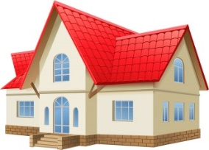




Services
Direct
collaboration
Gateway
Services
Electronic
appliance
Notes:
Figure 13 Cross-domain collaboration (direct) https://w3c.github.io/wot-architecture/images/cross-domain-direct.png

Slide 15
Services
C
Indirect
collaboration
Collaboration
platform
Gateway
Services
Electronic
appliance
Notes:
Figure 13 Cross-domain collaboration (indirect)
https://w3c.github.io/wot-architecture/images/cross-domain-indirect.png

Slide 16


Services
Services
Cross-domain
Collaboration
Digital Twins
Edge Device
Gateway
Control Agent
Electronic
Appliance
Remote
Controller
Connected devices
Trusted Environment
Notes:
Figure 14 Use Case Overview https://w3c.github.io/wot-architecture/images/wot-use-cases/use-case-summary.png

