Slide 1
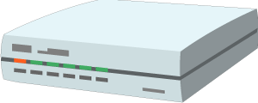



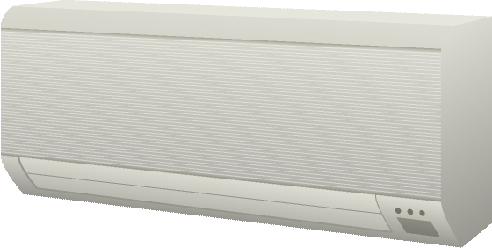
Cloud
Gateway
Servient
Proxy Thing
Control Agent
Servient
Proxy Thing
Virtual Thing
WoT Scripting API
Control Agent
Interaction Model
Proxy Thing
WoT Binding Templates
WoT Scripting API
Remote Access and Synchronization
Interaction Model
WoT Binding Templates
Web Browser
Integration and Orchestration
App Script
WoT Scripting API
Interaction Model
WoT Binding Templates
Thing
Servient
Existing Device
Seamless
Web Integration
Classic Firmware
App Script
+
WoT Scripting API
Interaction Model
Interaction Model
⇒
Thing
Protocol
Direct Thing-to-Thing
Interaction
WoT Binding Templates
Complement Existing Devices
Notes:
architecture-abstract.png

Slide 2
Cloud
Gateway
Thing
Behavior
Interactions
Thing
Security Configuration
Behavior
Protocol Bindings
Interactions
Remote Access and Synchronization
Security Configuration
Protocol Bindings
Thing
Behavior
Integration and Orchestration
Interactions
Security Configuration
Protocol Bindings
Seamless
Web Integration
Thing
Thing
Existing Device
Behavior
Behavior
+
Interactions
Interactions
⇒
Thing
Security Configuration
Direct Thing-to-Thing
Interaction
Security Configuration
Complement Existing Devices
Protocol Bindings
Protocol Bindings
Notes:
architecture-abstract.png

Slide 3
Cloud
Edge
Intermediary / Thing
Behavior
Interaction Affordances
Intermediary / Thing
Security Configuration
Behavior
Protocol Bindings
Interaction Affordances
Remote Access and Synchronization
Security Configuration
Protocol Bindings
Consumer
Thing-to-cloud
Behavior
Thing-to-gateway
Integration and Orchestration
Security Configuration
Protocol Bindings
Seamless
Web Integration
Thing
Thing + Consumer
Existing Device
Behavior
Behavior
+
Interaction Affordances
Interaction Affordances
⇒
Thing
Security Configuration
Direct Thing-to-Thing
Interaction
Security Configuration
Complement Existing Devices
Protocol Binding
Protocol Bindings
Protocol
Local Network
Notes:
architecture-abstract.png

Slide 4
Thing
Behavior
WoT Thing Description
Interaction Affordances
Security Configuration
Protocol Binding(s)

Slide 5
Thing
Behavior
Interactions
Security Configuration
Protocol Bindings
Protocol 1
Protocol 2
Protocol 3
Protocol 4
Notes:
architecture-concept.png

Slide 6
WoT Thing Description
Thing
General Metadata
Behavior
Interaction Affordances
Interaction Implementation
Public Security Configuration
Communications Metadata
Private Security Configuration
Protocol Bindings
Binding Templates
Protocol 1
Protocol 2
Protocol 3
Protocol 4
Notes:
architecture-concept.png

Slide 7
WoT Thing Description
Thing
General Metadata
Behavior Implementation
Interaction Affordances
Public Security Configuration
Interaction Implementation
Communications Metadata
WoT Scripting API
Private Security Configuration
Binding Templates
Protocol Bindings
Protocol 1
Protocol 2
Protocol 3
Protocol 4
Notes:
architecture-concept.png

Slide 8
Exposed Thing Description
Thing: WoT Servient
WoT Thing Description
WoT Runtime
General Metadata
Private Security Configuration
Interaction Affordances
Application Script
Public Security Configuration
Behavior Implementation
Communications Metadata
Interaction Implementation
ExposedThing
ConsumedThing
ConsumedThing
…
ConsumedThing
Binding Templates
WoT Scripting API
Protocol Bindings
Consumed Thing Description(s)
Protocol1
Protocol2
...
ProtocolN
WoT TDs
Thing1
Thing2
…
ThingN
Notes:
architecture-concept.png

Slide 9
Exposed Thing Description
Thing: WoT Servient
WoT Thing Description
WoT Runtime
General Metadata
Private Security Configuration
Interaction Affordances
Scripting Runtime
Public Security Configuration
Application Script
Communications Metadata
Behavior Implementation
Interaction Implementation
ExposedThing
Binding Templates
ConsumedThing
ConsumedThing
…
ConsumedThing
WoT Scripting API
Consumed Thing Description(s)
Protocol Bindings
WoT TDs
Protocol1
Protocol2
...
ProtocolN
Thing1
Thing2
…
ThingN
Notes:
architecture-concept.png

Slide 10
Exposed Thing Description
Thing: WoT Servient
WoT Thing Description
WoT Runtime
General Metadata
Private Security Configuration
Interaction Affordances
Behavior Implementation
Public Security Configuration
Interaction Implementation
Communications Metadata
ExposedThing
ConsumedThing
ConsumedThing
…
ConsumedThing
Binding Templates
Alternative WoT API
Protocol Bindings
Consumed Thing Description(s)
Protocol1
Protocol2
...
ProtocolN
WoT TDs
Thing1
Thing2
…
ThingN
Notes:
architecture-concept.png

Slide 11
Thing: Existing Device or Service
TD Definition
Native Runtime
Private Security Configuration
Native Behavior Implementation
WoT Thing Description
Native Interaction Implementation
General Metadata
Native API
…
Interaction Affordances
Public Security Configuration
Native Protocol
Communications Metadata
WoT Client
Binding Templates
Notes:
architecture-concept.png

Slide 12
Thing
Application Script
General Metadata
WoT Scripting API
WoT Thing Description
Interaction Affordances
Security Configuration
Communications Metadata
WoT Binding Templates
Web
OCF
oneM2M
…
Web Client
OCF Device
oneM2M
Thing
Notes:
architecture-concept.png

Slide 13
Thing
Custom Application Software
General Metadata
WoT Thing Description
Interaction Affordances
Security Configuration
Communications Metadata
WoT Binding Templates
Web
OCF
oneM2M
…
Web Client
OCF Device
oneM2M
Thing
Notes:
architecture-concept.png

Slide 14
Servient
Application Script
Security Metadata
WoT Scripting API
Thing Description
WoT Runtime
Protocol Bindings
System API
HTTP(S)
CoAP(S)
Local Hardware
Proprietary Communi- cation
Binding Templates
…
MQTT
Web Client
Thing
Legacy Device
Servient
Notes:
architecture-implementation.png

Slide 15
Web Browser Servient
Application Script
WoT Scripting API
Thing Description
Browser Runtime + WoT Library
Protocol Bindings
Browser APIs
HTTP(S)
(S)RTP
Geolocation
Web Storage
WebSockets
FTP
Vibration
…
Web Server
WebRTC Device
*-over-WSs Device
Notes:
architecture-browser.png

Slide 16
Web
with JSON
over HTTP
using “nosec”
OCF
with CBOR
over CoAP
using DTLS
oneM2M
with JSON
over MQTT
using TLS
LWM2M
with SenML
over CoAP
using DTLS
Web with CBOR over CoAP u/ COSE+CWT
…
Binding Templates
Thing Descriptions
“IoT Platform” × “Transfer Protocol” × “Media Type” × “Security”
Binding
Instances
Protocol Bindings
Binding
Implemen- tations
Web
OCF
HTTP
CoAP
JSON
CBOR
OAuth
(D)TLS
Notes:
binding-templates.png

Slide 17
WoT Client (Browser)
Servient
Application Script
Application Script
Security Metadata
WoT Scripting API
WoT Scripting API
Browser + Library
Thing Description
WoT Runtime
Protocol Bindings
Protocol Bindings
System API
HTTP(S)
(S)RTP
HTTP(S)
CoAP(S)
Local Hardware
Proprietary Communi- cation
…
FTP
…
MQTT

Slide 18
Servient
Application Script
Security Metadata
WoT Scripting API
WoT Runtime
Protocol Bindings
Thing (Existing Device)
Thing Description
HTTP(S)
CoAP(S)
…
MQTT
Notes:
wot-existing.png

Slide 19
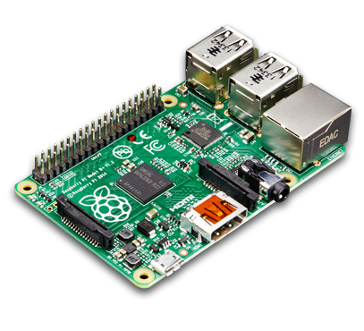
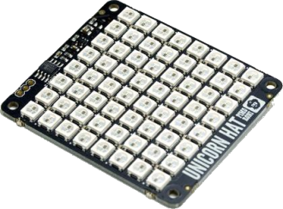
WoT Client (Browser)
Servient (Device)
Application Script
Application Script
Security Metadata
WoT Scripting API
WoT Scripting API
Browser + Library
Thing Description
WoT Runtime
Protocol Bindings
Protocol Bindings
System API
HTTP(S)
(S)RTP
HTTP(S)
CoAP(S)
Local Hardware
…
FTP
…
MQTT
Notes:
wot-on-device.png

Slide 20
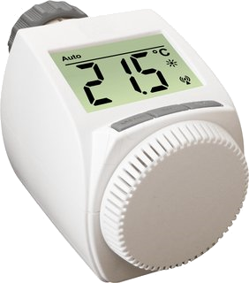
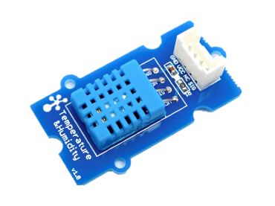
WoT Client (Browser)
Minimal Servient (Device)
Firmware
Application Script
WoT Scripting API
Browser + Library
Thing Description
Protocol Bindings
Protocol Binding
Driver API
HTTP(S)
(S)RTP
CoAP(S)
Local Hardware
…
FTP
Notes:
wot-on-device-minimal.png

Slide 21


WoT Client (Browser)
Servient (Smartphone)
Application Script
Gateway Script
Security Metadata
WoT Scripting API
WoT Scripting API
Browser + Library
Thing Description
WoT Runtime
Protocol Bindings
Protocol Bindings
System API
HTTP(S)
(S)RTP
HTTP(S)
CoAP(S)
Proprietary Communi- cation
…
FTP
…
MQTT
Legacy Device
Notes:
wot-on-smartphone.png

Slide 22

WoT Client (Browser)
Servient (Gateway)
Application Script
Integration Script
Security Metadata
WoT Scripting API
WoT Scripting API
Browser + Library
Thing Description
WoT Runtime
Protocol Bindings
Protocol Bindings
System API
HTTP(S)
(S)RTP
HTTP(S)
CoAP(S)
Local Hardware
Proprietary Communi- cation
…
FTP
…
MQTT
Thing
Legacy Device
Servient
Notes:
wot-on-gateway.png

Slide 23
WoT Client (Browser)
Servient (Cloud)
Servient (Gateway)
Application Script
Mirror Script
Integration Script
Security Metadata
Security Metadata
WoT Scripting API
WoT Scripting API
WoT Scripting API
Browser + Library
TD
WoT Runtime
TD
WoT Runtime
Protocol Bindings
Protocol Bindings
Protocol Bindings
System API
HTTP(S)
(S)RTP
HTTP(S)
CoAP(S)
HTTP(S)
CoAP(S)
Local Hardware
Proprietary Communi- cation
…
FTP
…
MQTT
…
MQTT
Thing
Legacy Device
Servient
Notes:
wot-on-cloud.png

Slide 24
WoT Client (Browser)
Servient (Cloud)
Application Script
Integration Script
Security Metadata
WoT Scripting API
WoT Scripting API
Browser + Library
TD
WoT Runtime
Protocol Bindings
Protocol Bindings
System API
HTTP(S)
(S)RTP
HTTP(S)
CoAP(S)
Proprietary Communi- cation
Legacy Gateway
…
FTP
…
MQTT
Legacy Device
Legacy Device
Notes:
wot-on-cloud-legacy.png

Slide 25
WoT Servient
Application Script
Security Metadata
Semantic Metadata
Runtime System
Protocol Bindings
System API
HTTP
MQTT
Proprietary Communi- cation
Local Hardware
CoAP
…
WoT Servient
Web Server
Legacy Device
Web Client
WoT Servient

Slide 26
WoT Servient
App Script A
App Script B
Security Metadata
Security Metadata
Discovery API
Client API
Server API
WoT Scripting API
Thing Description
User Thing A
User Thing B1
Echonet Proxy
Local Sensor
User Thing B2
Binding Templates
System API
Web
oneM2M
Proprietary Communi- cation
Local Hardware
OCF
…
WoT Servient
Web Server
Legacy Device
Web Client
WoT Servient

Slide 27
Runtime Environment
Application Script A
Application Script B
Application Script C
Security Metadata
Security Metadata
Security Metadata
Discovery API
Client API
Server API
WoT Scripting API
Thing Description
ExposedThing A
ExposedThing B1
ExposedThing B2
ConsumedThing C
Protocol Bindings
“Standard Body” × “Media Type” × “Transfer Protocol” × “Security”
oneM2M
with JSON
over HTTP
using TLS
oneM2M
with JSON
over MQTT
using TLS
OCF
with CBOR
over CoAP
using DTLS
LWM2M
with SenML
over CoAP
using DTLS
Web
with JSON
over HTTP
u/ JOSE+JWT
…

