Slide 1
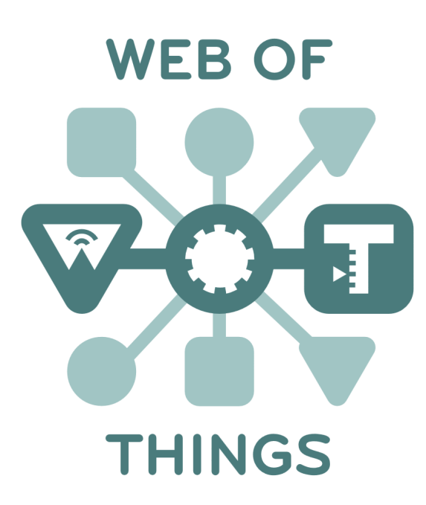
Two-Phase Discovery Framework
Virtual F2F 16 March 2020
Michael McCool: Intel Principal Engineer / W3C WoT WG Co-chair

Slide 2
Discovery Requirements
Capabilities
Support both local and global/remote discovery (unconstrained by network domain)
Support “localizable” discovery (constrainable by location)
Support some form of “semantic query”
Support both
Directory services for searching large repositories of Things
Peer-to-peer (self-identifying) discovery
Privacy-Preserving Architecture
Respect device and information Lifecycle
Distribute TDs only to authenticated and authorized users
Don’t leak private data to unauth. users
Don’t leak information that can be used to INFER private information to unauth. users
Alignment with existing standards
E.g. IETF CoRE Resource Directories, CoRE Link Format, DID, …
Align with WoT Scripting API

Slide 3
Proposal: Two-Phase Discovery
Introduction
“First Contact” Protocol
Answers the question: how to start?
Open
Can be accessed with no or limited access controls
Lightweight
Does not use significant resources on responder
resistant to Denial of Service attacks
Provides intentionally limited information
Avoid leaking any metadata that can be used to infer private data
This includes types of devices, device ids, owners, timestamps, etc.
Exploration
Authentication and authorization required
Supports more complex search capabilities
Provides rich metadata
Access controls can limit data returned

Slide 4
Introduction
“First Contact” protocol
Output: Address of directory service
Need not be broadcast; could use well-known network services (eg DNS, DHCP, etc)
Address should not leak any other metadata, eg type of devices
Can have multiple mechanisms for introduction
Local: QR code, mDNS, DNS-SD, DHCP, Bluetooth beacons (Eddystone), etc.
Global: Search engine, well-known global repositories, company repositories, cities, etc.
Self: Well-known addresses, eg “.well-known/td”
Existing mechanisms that have lists of typed links can also be used here:
CoRE RD, DID Documents, DNS, etc.
Use these to find directories rather than to distribute metadata directly
May in some cases point directly at a Thing Description
Degenerate case: like a “directory” has only one TD
Still requires authentication in principle to access content

Slide 5
Exploration
Authentication required, and then…
Queryable Directory service
Lightweight: specific query parameters, eg. location, keywords
Full: (sub-)SPARQL semantic query AND/OR GraphQL AND/OR by-example
Gateway: registration sub-API, timeouts, etc.
Self: same query API, but no public registration API
Mutable IDs → need way to notify registered users of changes

Slide 6
Privacy Issue
Privacy
Two-phase approach not sufficient to preserve privacy in all contexts
Privacy preservation also depends on the design of API
API needs to hide data that can be used to infer private information, such as location of device doing the discovery
Third-party code context (eg browser):
If discovery API follows two-phase structure, where Introduction returns list of directories, then even without authenticating the list of directories visible can possibly be used to infer location
This is especially true if the discovery mechanism can be constrained to particular Introduction mechanisms.
May also be a problem in proposed non-browser contexts, eg. “Edge Workers”

Slide 7
Current Scripting API – Discussion Points
Allows discovery mechanism to be specified
Returns discovered TDs
Assumes authentication/authorization is handled out-of-band
Discussion Points:
Not incompatible with two-phase approach
Authentication/authorization needs to be set up outside script
Query format needs to be better standardized
What query forms are supported? What are the parameters?
How can I search for Things in a particular physical location (that I am not necessarily at?)
Options to select mechanisms may be a privacy risk
If I can discover a thing via Bluetooth, I know it is within a few meters
Perhaps the mechanisms and desired location should also be specified out of band
Alternatives:
“Discovery sub-API” could be factored out and run during setup, like security config
Things to be consumed by a script perhaps managed declaratively using dependences

