Slide 1

EdgeX/Conexxus Retail PoC
18 March 2020

Slide 2
Outline
Goals: Retail Modernization
EdgeX Foundry
Intel’s Open Retail Initiative (ORI)
WoT/EdgeX/ORI/Conexxus PoC

Slide 3
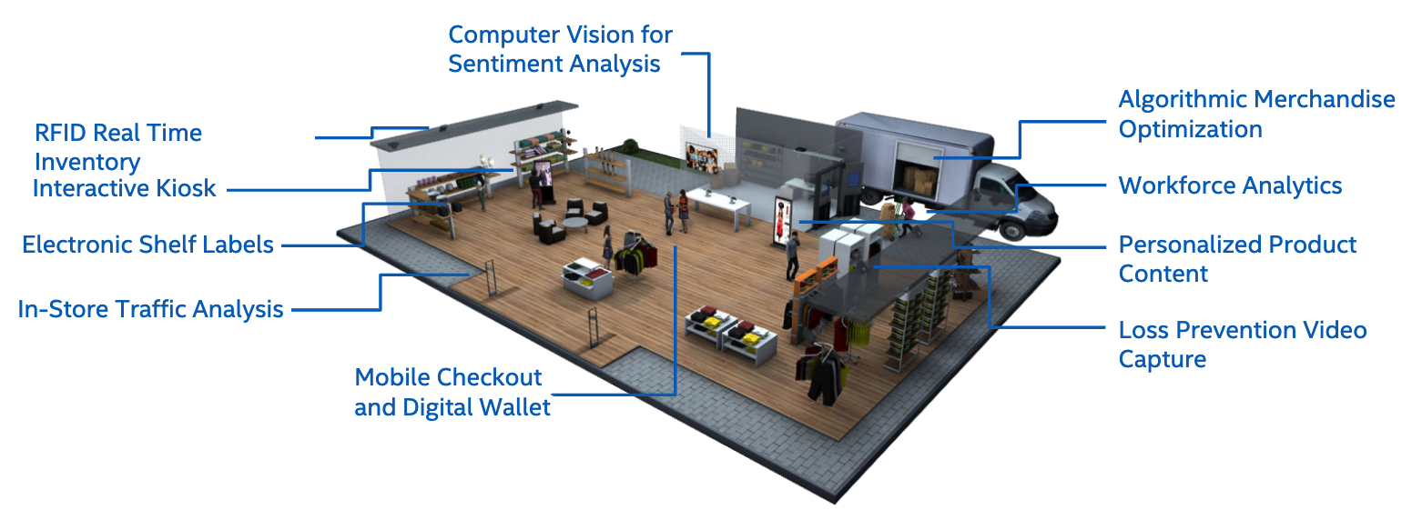
Retail Modernization via AI/IoT

Slide 4

What is EdgeX Foundry?
An open source, vendor neutral project (and ecosystem)
A micro service, loosely coupled software framework for IoT edge computing
Hardware and OS agnostic
Linux Foundation, Apache 2 project
Started April 2017

Slide 5
EdgeX Primer
A collection of a dozen+ micro services
Written in multiple languages (Go, C, Java, … we are polyglot believers!!)
EdgeX data flow:
Sensor data is collected by a Device Service from a thing
Data is passed to the Core Services for local persistence
Data is then passed to Application Services for transformation, formatting, filtering and can then be sent “north” to enterprise/cloud systems
Data is then available for edge analysis and can trigger device actuation through Command service
Many others services provide the supporting capability that drives this flow
REST communications between the service
Some services exchange data via message bus (core data to export services and rules engine)
Micro services are deployed via Docker and Docker Compose

Slide 6
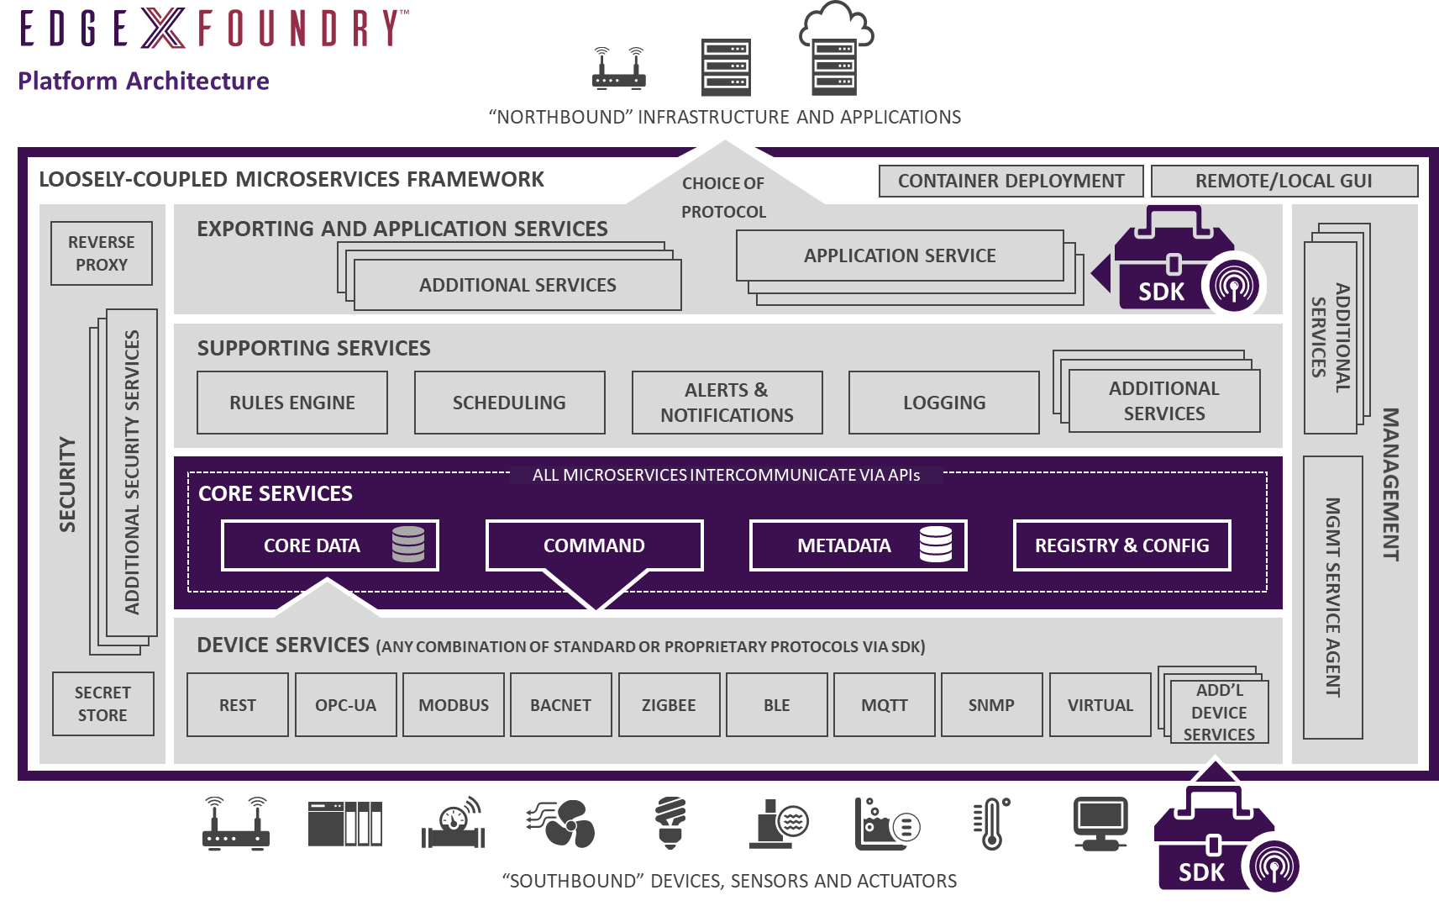
Cloud, Enterprise, On-Prem…
Local Analytics
It’s 102^{◦F}
Stop the machine

Slide 7

Dual Transformation Engine
The layers (and services) of EdgeX constitute a dual transformation engine
1x - Translating information coming from sensors and devices via hundreds of protocols and thousands of formats into EdgeX
2x - Delivering data to applications, enterprises and cloud systems over TCP/IP based protocols in formats and structures of customer choice
APPLICATION SERVICES
“North side”
SUPPORTING SERVICES
CORE SERVICES
DEVICE SERVICES
“South side”

Slide 8
Open Retail Initiative
A marketing initiative to
Promote open source collaboration at the edge
Encourage participation in the EdgeX Vertical Solutions WG “Commerce Project”
Supports retail applications
Sponsors a number of recipes and reference frameworks
For retail edge computing applications built around EdgeX
Sponsored by Intel

Slide 9
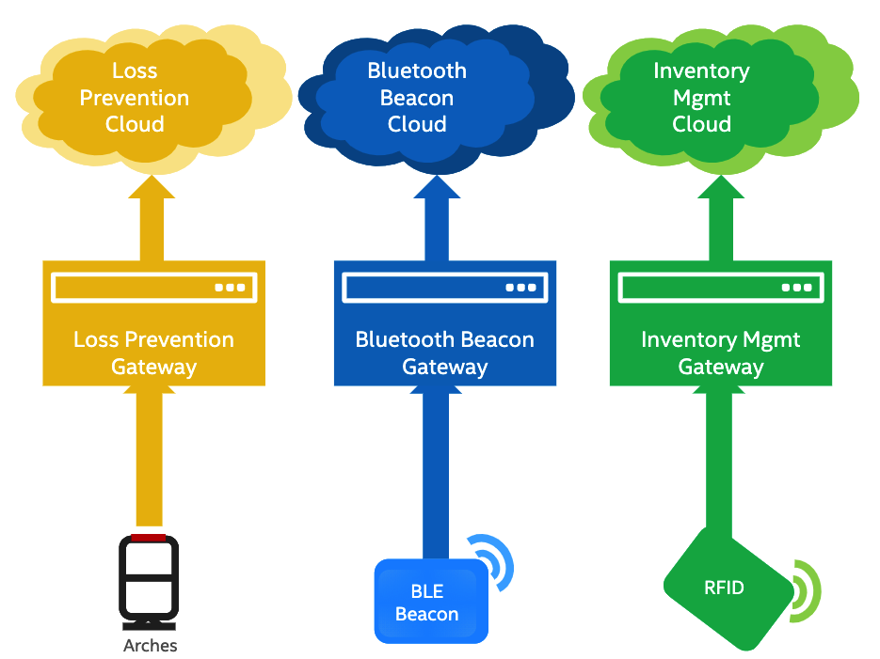
Current Situation: Multiple Silos

Slide 10
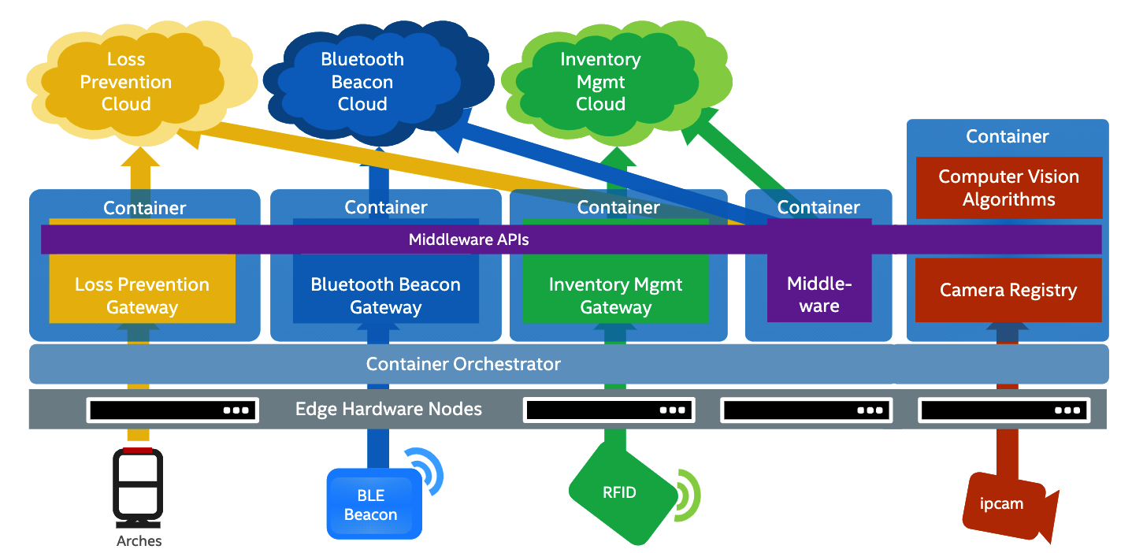
ORI Goals: Consolidation and Integration

Slide 11
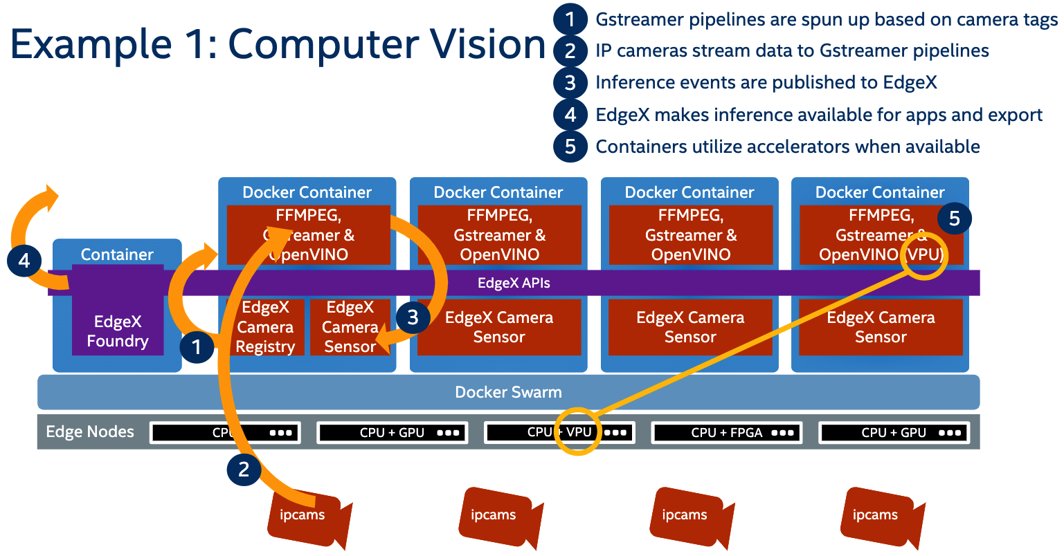
ORI: Computer Vision Example

Slide 12
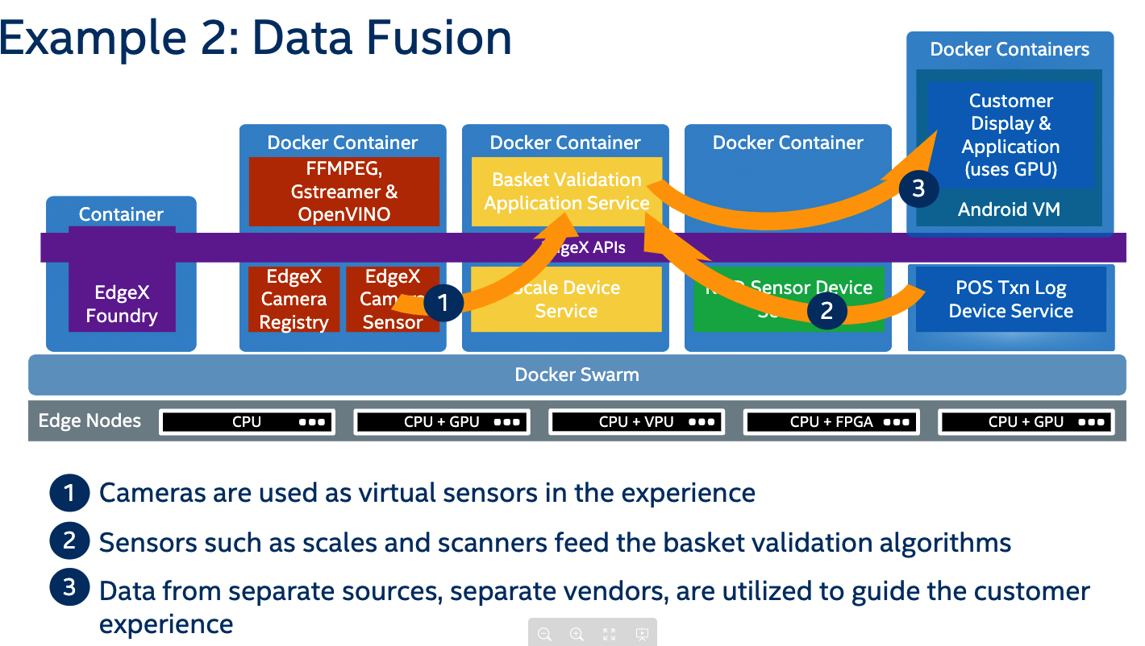
ORI: Data Fusion Example

Slide 13
EdgeX APIs and Metadata
EdgeX includes a “metadata service”
APIs for device access translate protocols into a common protocol
Based on HTTP
Payloads use JSON or CBOR
Events use ZeroMQ
Service APIs have OpenAPI descriptions
Notes:
RED - check

Slide 14
Proposed WoT/EdgeX Integration
Generate WoT Thing Description metadata for all Device services
Including semantic tagging using ODM
Generate WoT Thing Description metadata for select Analytics services
Computer vision services
Prototype a Thing Directory service supporting semantic search
To run in parallel with existing EdgeX metadata service
Existing EdgeX discovery process would act as “Introduction” layer
Generate a template for a “Orchestration Service”
Using WoT Scripting API and node-wot
Stand up retail use case examples that integrates IoT and Analytics, ex:
Loss detection video analytics triggered by an IoT door sensor
Digital shelf signage/RFID and weight-based inventory control/item identification
Customized marketing content based on video analytics

Slide 15
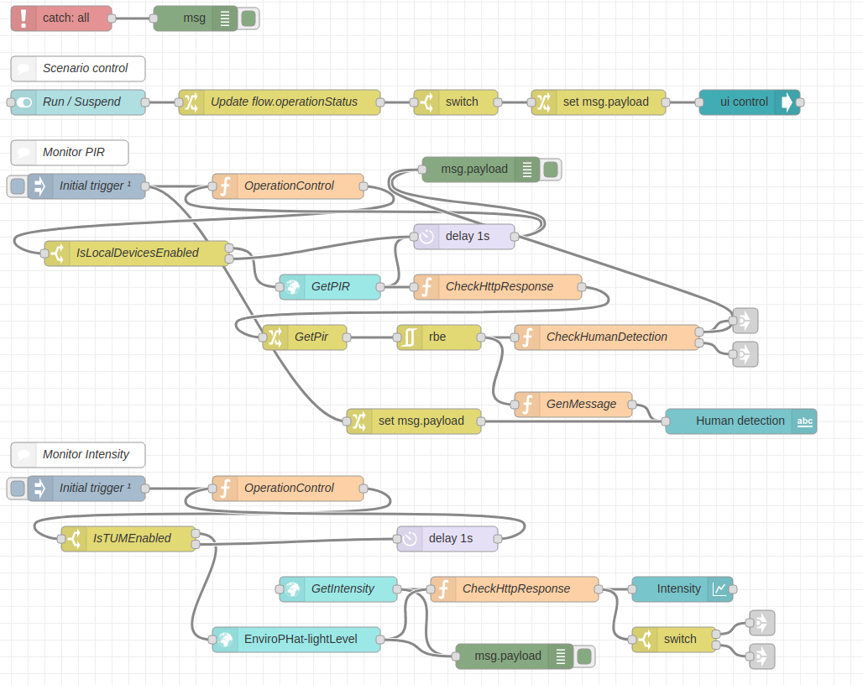
PoC Definition
Want to showcase WoT, not really a specific application
Have a set of devices from different manufacturers
Show how easy they are to orchestrate with WoT support
Audience is “store owners”, so should be as easy as possible…
Suggest using Node-RED
Using nodes autogenerated from TDs
Do want some “pre-baking”…
Show attendees how to write rules for specific scenarios
Script in advance, but point is fast development of orchestration rules

Slide 16
WoT/EdgeX/ORI/Conexxus PoC Timeline
March: Definition and planning
May: Development
April: First prototype
June: Refinement
July: Release candidate
August: Testing and integration
September: Demo Finalization
October: Show
NACS 2020 show (in Conexxus booth): 11-14 October, Las Vegas
TPAC 2020 meeting (+ Edge Workers…): 26-30 October, Vancouver

Slide 17
References
EdgeX Foundry:
https://www.edgexfoundry.org/
https://wiki.edgexfoundry.org/
https://wiki.edgexfoundry.org/display/FA/Commerce+Project
Intel Open Retail Initiative
https://www.intel.com/content/www/us/en/retail/open-retail-initiative.html
Conexxus
https://www.conexxus.org/

Slide 18
Additional EdgeX Foundry Project Links
Access the code:
https://github.com/edgexfoundry
Access the technical documentation:
https://docs.edgexfoundry.org/
Access technical video tutorials:
https://wiki.edgexfoundry.org/display/FA/EdgeX+Tech+Talks
EdgeX Blog:
https://www.edgexfoundry.org/news/blog/
Join an email distribution:
https://lists.edgexfoundry.org/mailman/listinfo
Join the Slack Channels:
https://slack.edgexfoundry.org/
Become a project member:
https://www.edgexfoundry.org/about/members/join/
LinkedIn:
https://www.linkedin.com/company/edgexfoundry/
Twitter:
https://twitter.com/EdgeXFoundry
Youtube:
https://www.youtube.com/edgexfoundry

