Slide 1
WoT for Beginners

Slide 2

This is Luisa, a software engineer, loves IoT
IoT is so cool!
Notes:
Source: https://pixabay.com/de/photos/frau-sch%C3%B6ne-m%C3%A4dchen-liegen-bl%C3%A4tter-2003647/

Slide 3


Luisa bought IoT lamp and wants to integrate and control it in here existing smart home application
System X
System Y
Notes:
https://dribbble.com/shots/1447073-Super-Tablet-Dashboard-Ui

Slide 4
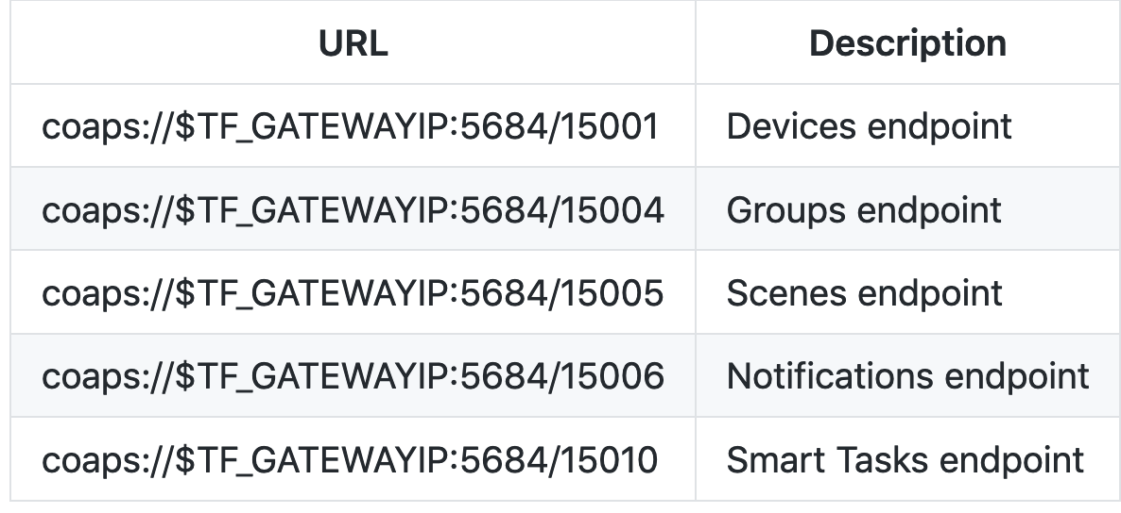
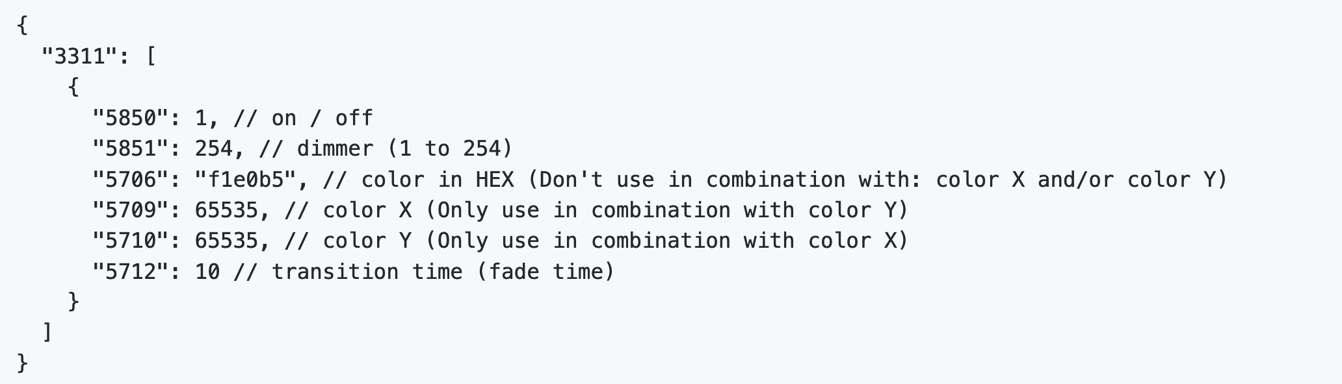
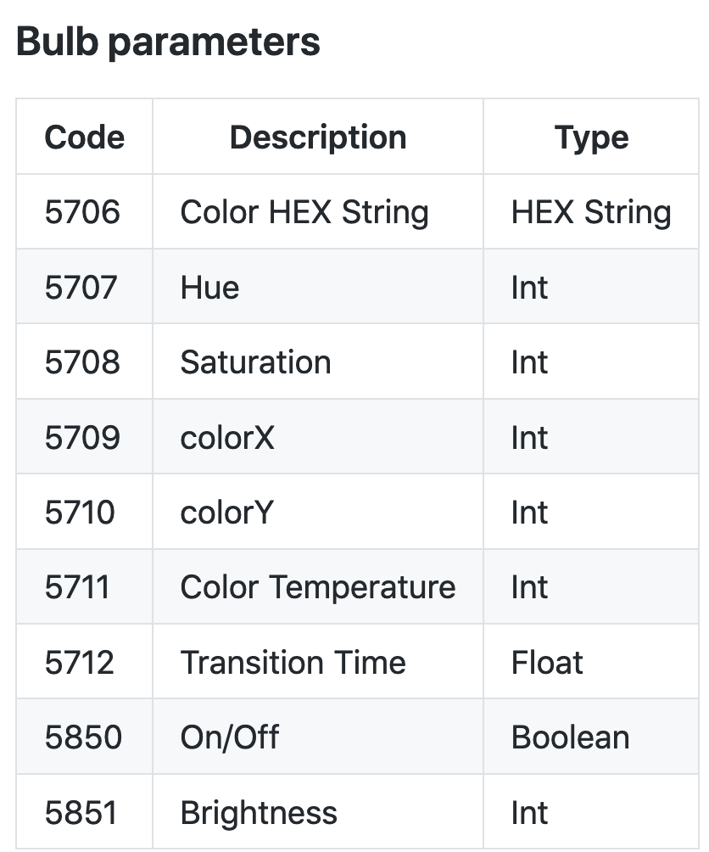

After googling, she finds some non-well documented APIs, code snippet, or cryptic protocol usage to control the lamp

Slide 5


Luisa was thinking about giving up, however, during her search she also stumbled upon an interesting file that was called as WoT Thing Description (TD)
Notes:
https://github.com/w3c/wot/tree/master/testing/tests/2019-05/inputs/SmartThings

Slide 6


She found out that WoT is a new W3C standard designed to simplify the integration of IoT devices and simplify the development of IoT applications.

Slide 7
The found Thing Description is comparable to a index.html for Things, a standardized common language to describe Thing’s capabilities like the served data and operations as well as the required protocol & security setup to interact with the Thing.

Slide 8
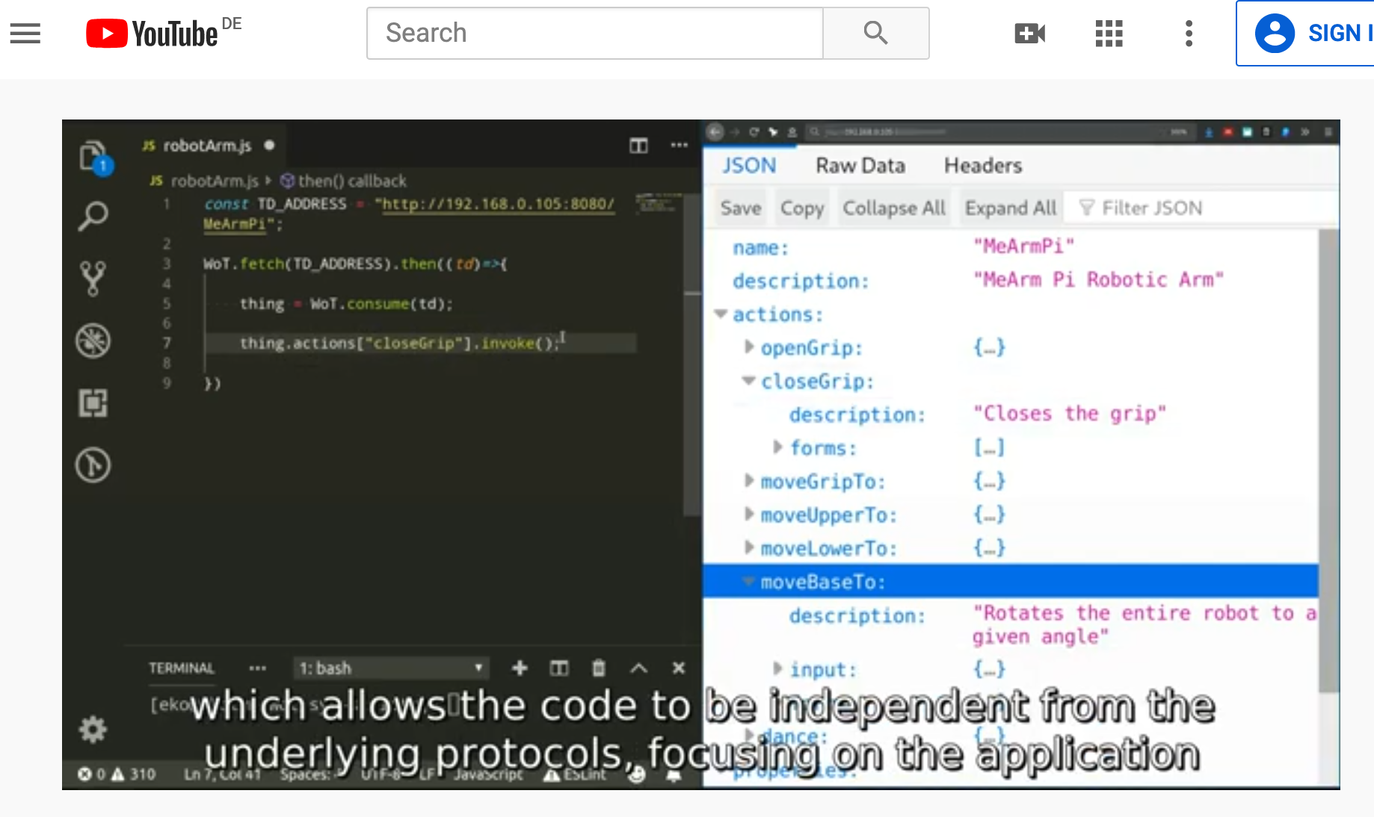
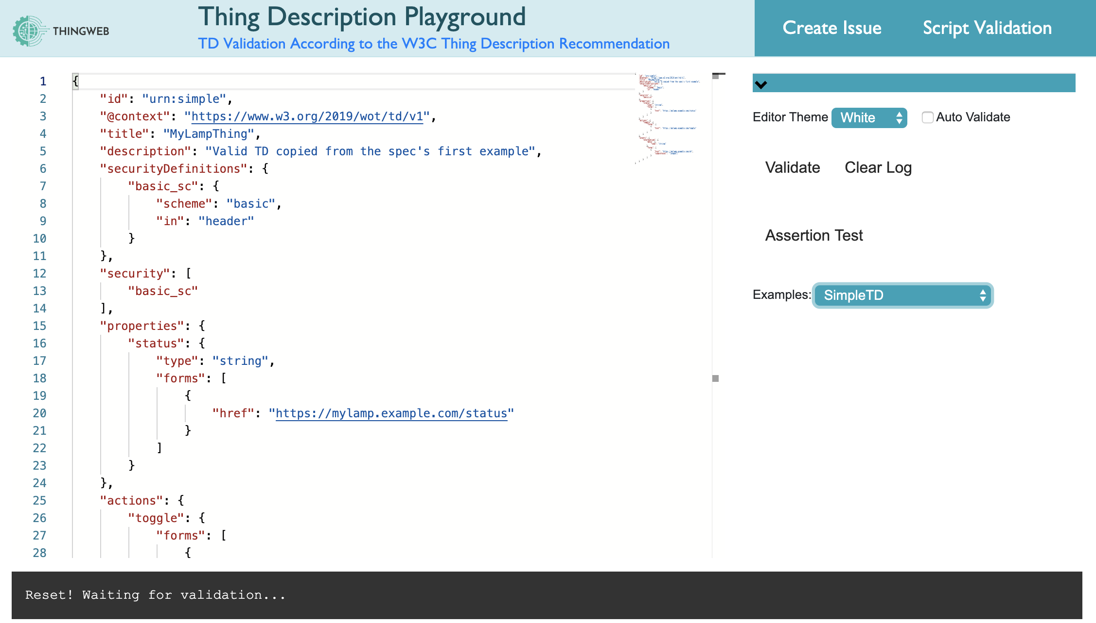


Luisa is happy that there are already some (video) tutorials, tools, and implementations which she can simple use to realize here IoT application similar writing a Web page
https://www.youtube.com/watch?v=lt_P2BU8e3I
http://plugfest.thingweb.io/playground/
https://github.com/eclipse/thingweb.node-wot/
http://www.thingweb.io/hands-on-intro-raspberry.html
Notes:
https://www.youtube.com/watch?v=lt_P2BU8e3I

Slide 9







Finally, Luisa has also found out that WoT is not only applicable for the smart home domain, but can also be used in industry, in smart cities, cloud scenarios, etc.. She immediately needs to share the new WoT standard with her friends who work as engineers in different domains.
…
Img sources: https://www.svgrepo.com/svg
Notes:
https://www.svgrepo.com/svg/73814/industrial-robot

Slide 10
Luisa is happy ☺
WoT is so cool!
Notes:
Source: https://pixabay.com/de/photos/frau-sch%C3%B6ne-m%C3%A4dchen-liegen-bl%C3%A4tter-2003647/

