Slide 1


PlugFest outcome: Farm Status Syncronization
Cristiano Aguzzi
@relu91
@relucri

Slide 2
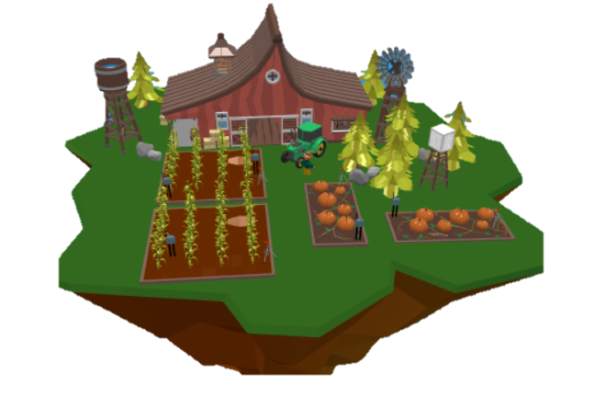
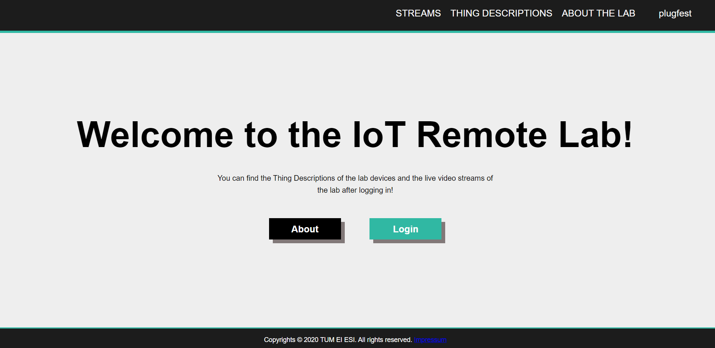
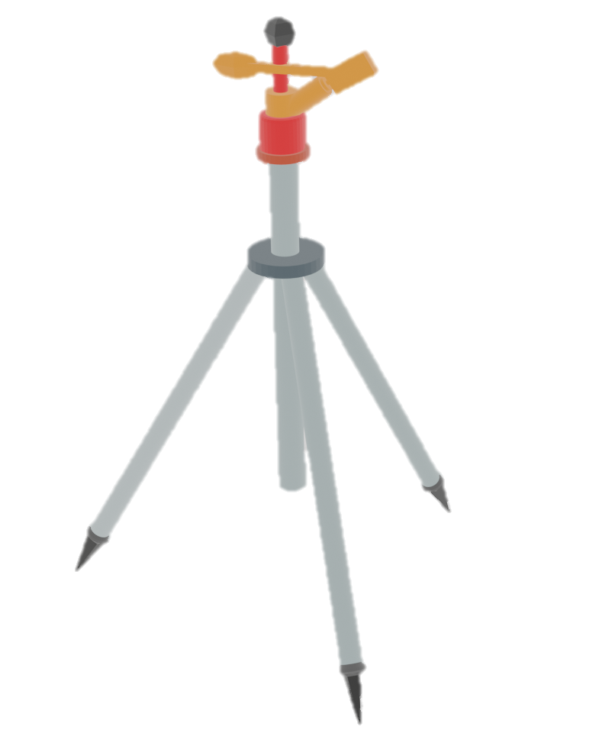
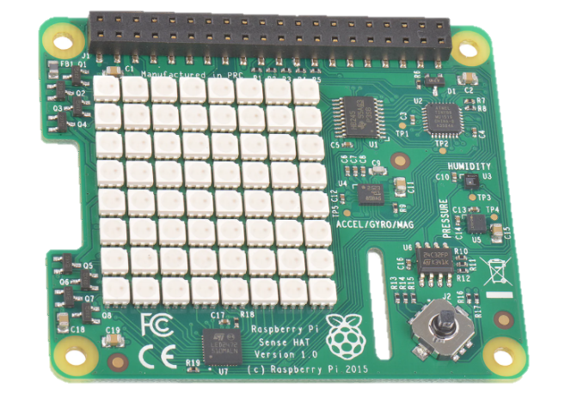
Scenario
WoT Farm
TUM IoT remote lab

Slide 3
Mashup

Slide 4
Mashup
Active!

