Slide 1
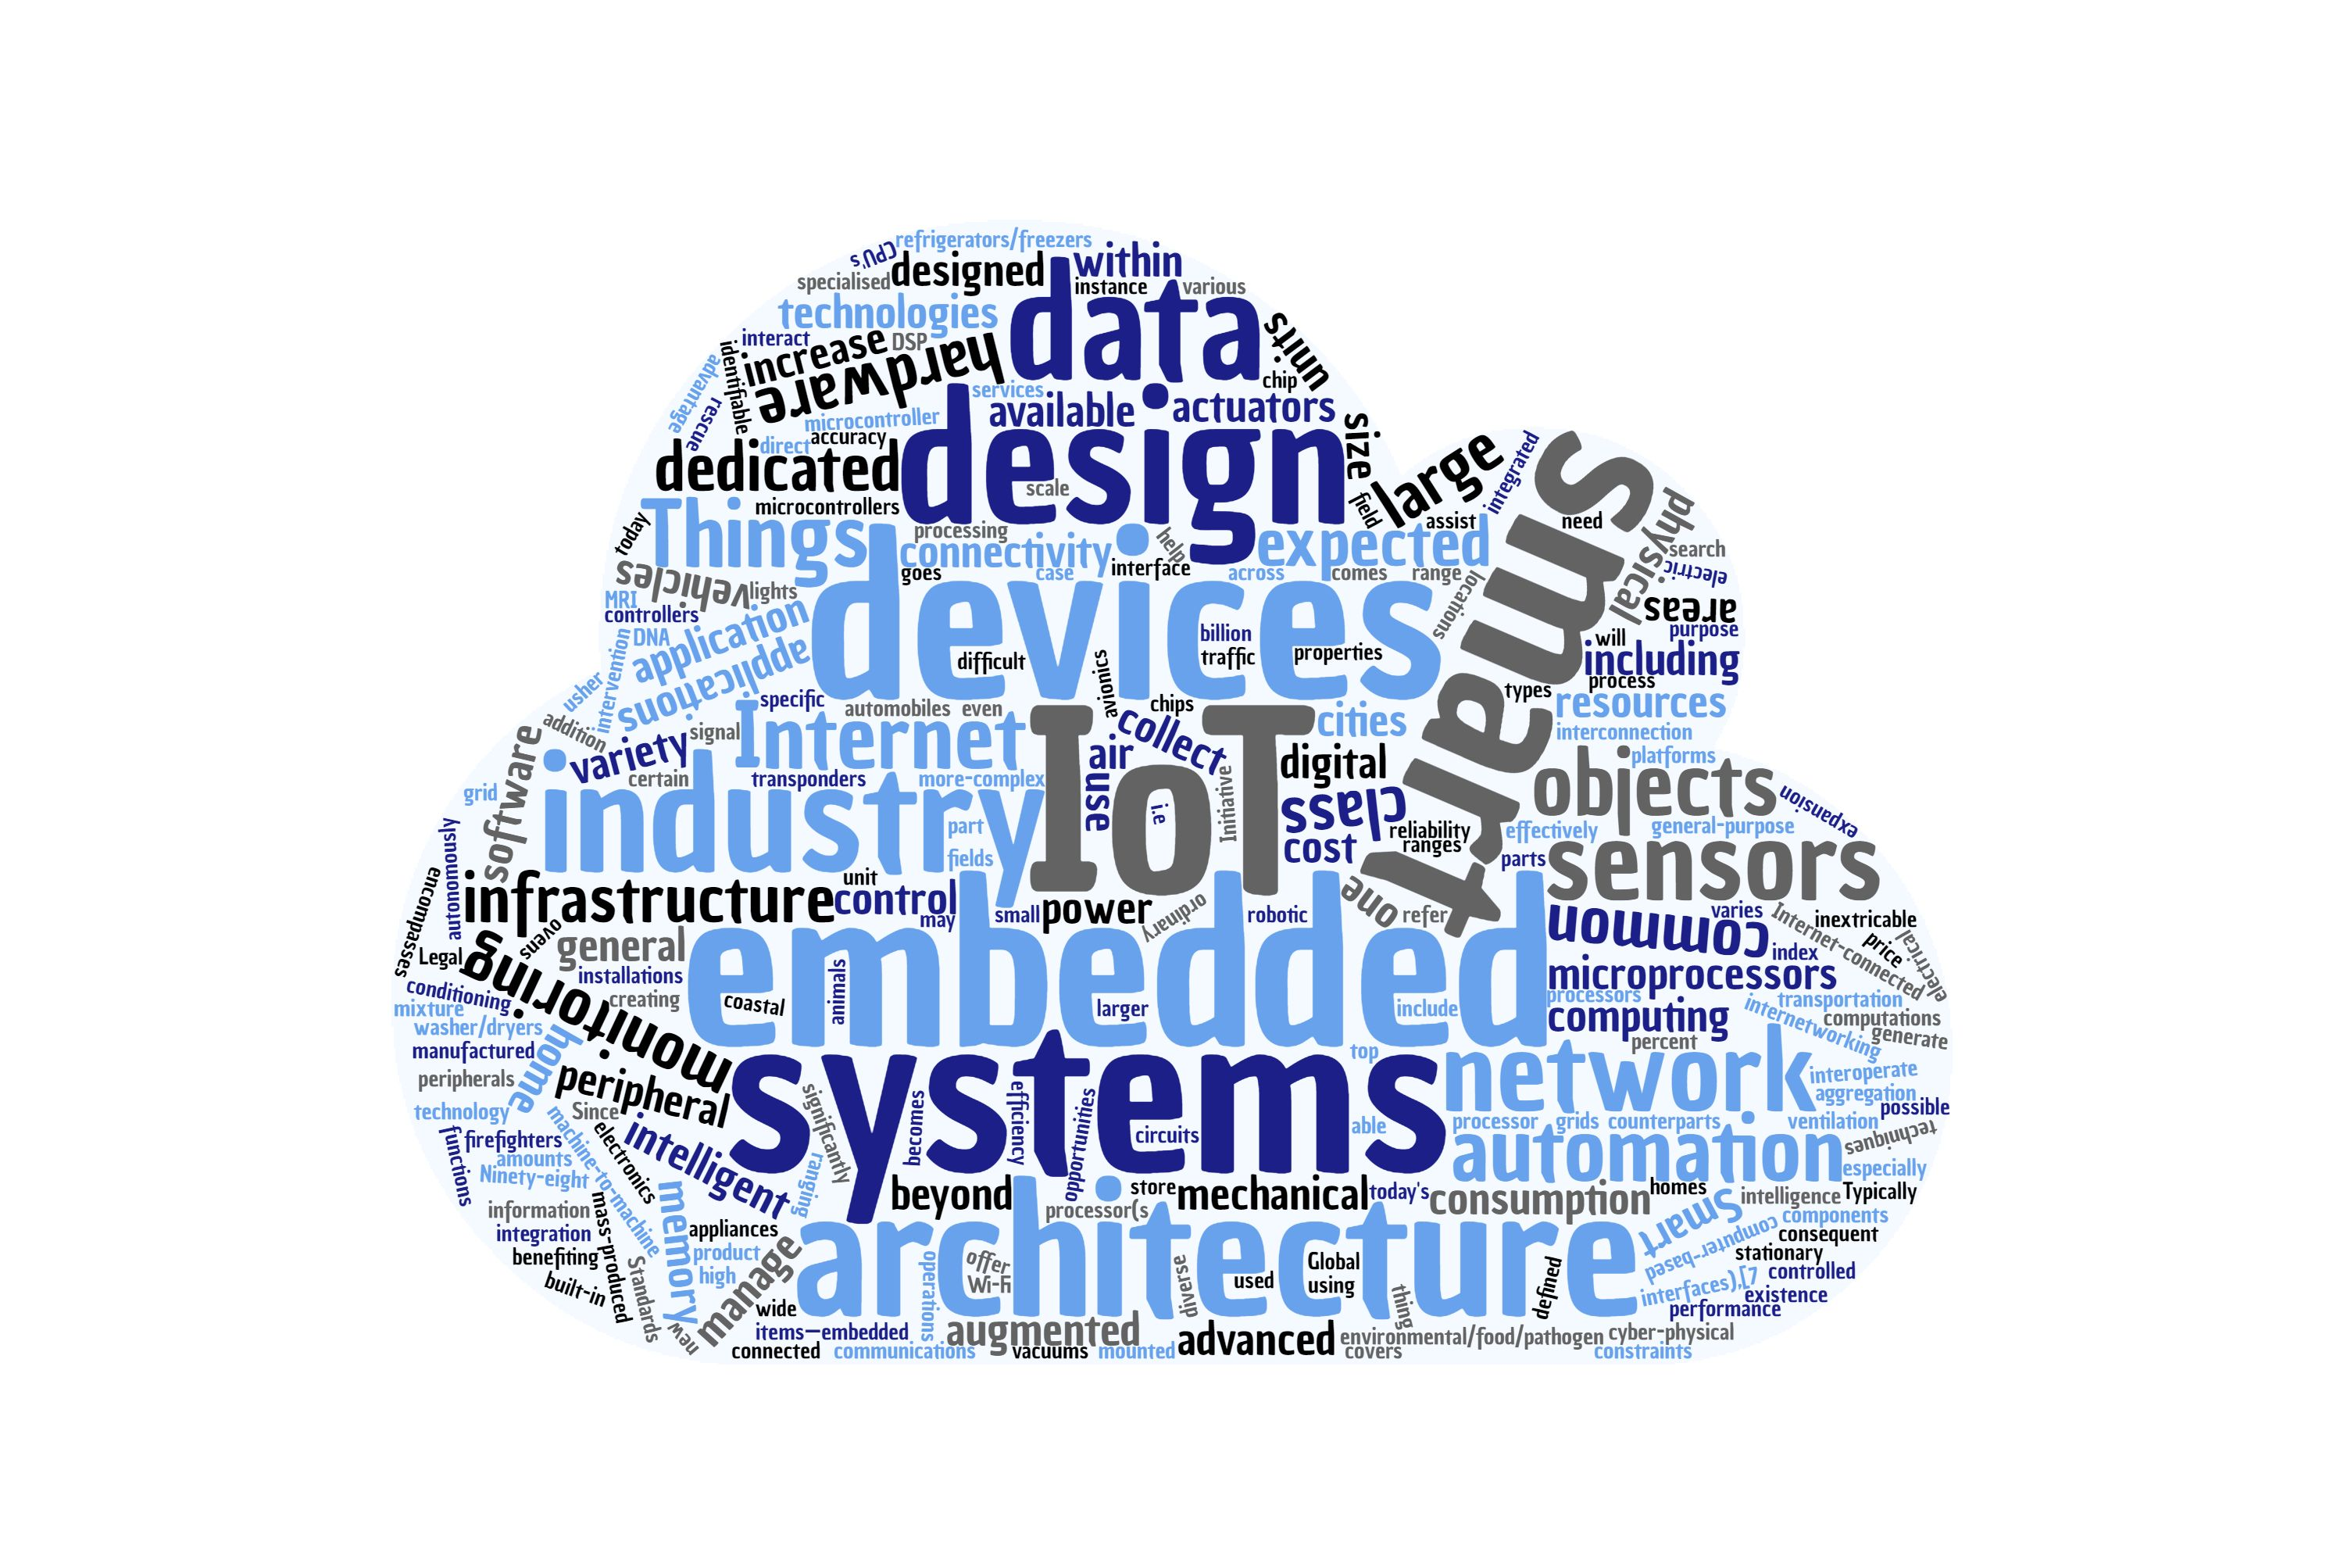
W-ADE and A-MaGe Fady Salama, Ege Korkan fady.salama@tum.de, ege.korkan@tum.de Embedded Systems and Internet of Things Department of Electrical and Computer Engineering

Slide 2
W-ADE
Development Environment:
Modify TDs
Invoke Interactions
Test performance
Spin up a Virtual Thing based on TD

Slide 3
W-ADE
DEMO using Plugfest TDs

Slide 4
A-MaGe
Atomic Mashup Generator:
Choose, which Things participate
Define Rules and Constraints for Generation
View generated Mashups
Generate System Description
Generate Code!

Slide 5
A-MaGe
DEMO using Plugfest TDs

Slide 6
Findings
Tested WADE and A-MaGe using:
Coap light (Philip Blum)
Coffee Machine (Siemens)
Industrial Plant (Oracle)
Led (Oracle)
Camera (Intel)
Wot Farm
Findings:
Fetching TDs using coap works now.
Fetching status is now visible in the status bar
Coap light not specifying readOnly or type of property -> W-ADE does not know how to handle write property!
W-ADE has no way to set URI variables
A-MaGe works with all TDs, but the title of a TD must contain only letters! (renaming them is the only solution now)
A-MaGe uses only the first form that is provided in a TD, still cannot specify which form to choose (remove the forms that are not need)
Having annotation do help a lot when constraining interaction and therefore, we encourage using meaningful annotation that can also be resolved (We fetch them to show their descriptions to the user!)

