Slide 1

W3C Web of Things Test Planning
25 October 2018

Slide 2
Agenda
Timeline
Test Categories
Test Coverage
Tooling
To Do

Slide 3
Timeline
6-Month Extension has been requested
Director still needs to be approved, but is expected
Existing charter deadline is 31 December 2018
Six-month extension goes to 30 June 2019
But we need to get to REC by then
W3C REC Milestone Calculator gives worst-case deadlines of
REC: 27 June 2019
PR: 28 May 2019
CR: 16 April 2019 (planned: 22 Jan 2019)
Requirements
CR Start: Test plan and tooling in place. Partial test coverage (may be) acceptable.
CR Exit/PR Start: Completed all testing.

Slide 4
Test Categories
See: https://github.com/w3c/wot/blob/master/testing/plan.md
Functional Testing:
Thing Description Validation
Thing Network Interface Testing
Does a Thing satisfy the contract given by a specific TD
Including functional security testing
Scripting API Testing
Non-Functional Testing
Fuzz Testing (robustness testing)
Adversarial Security Testing (required by charter…)
Adequate Representation of Appropriate Target Ecosystem Standards

Slide 5
Test Coverage
Technically, we need "evidence of implementation experience"
In practice we want to…
Have a test case for each normative assertion
Have at least one example that passes the test and one that fails it
Evidence that our set of normative assertions sufficiently constrains implementations so they can interoperate
Some normative assertions in our spec need many tests to cover them adequately, and/or specific tooling (eg conformance with JSON-LD specification, tests for set of all security schemas).

Slide 6
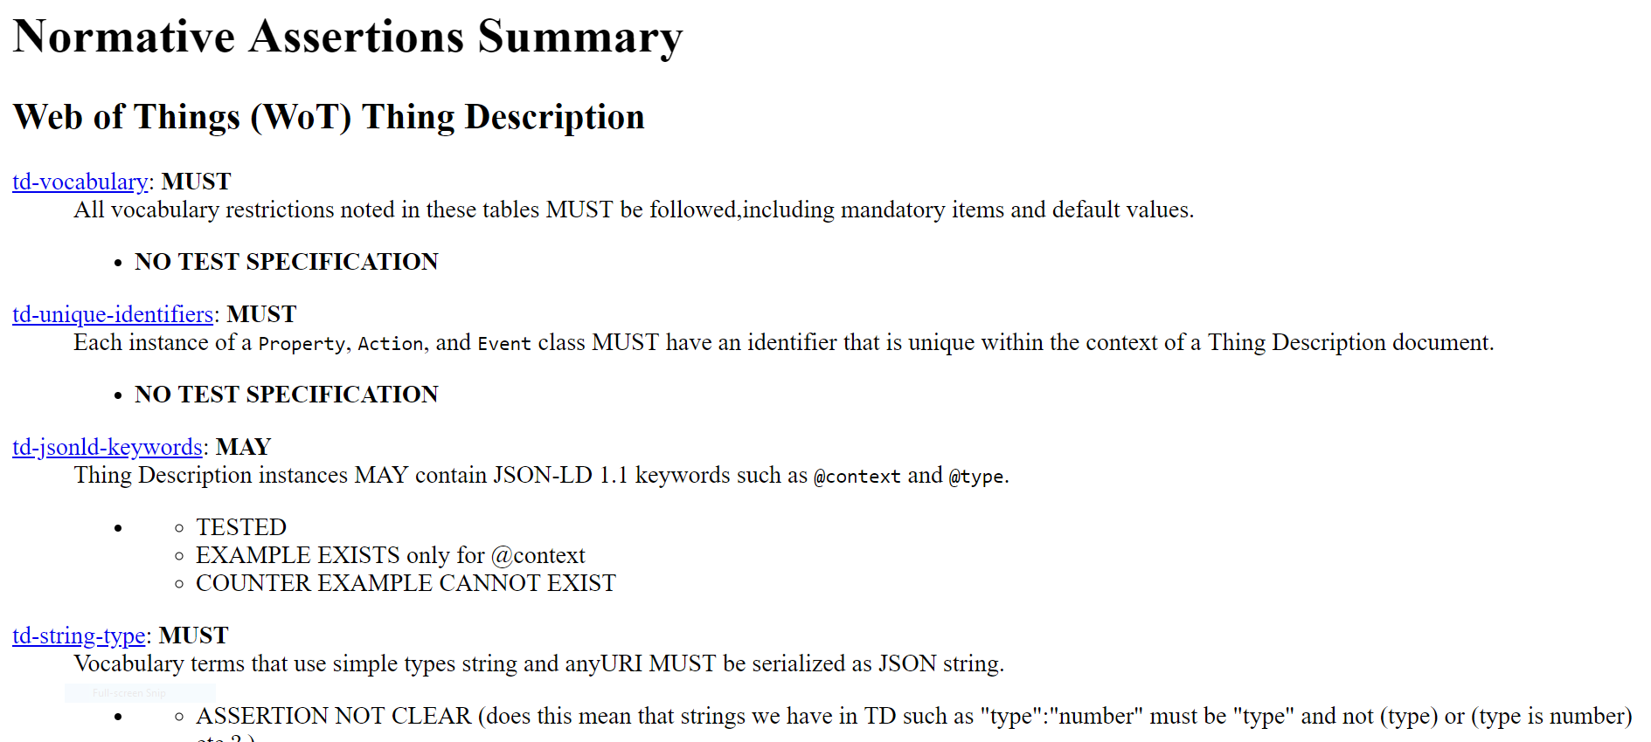
Assertion Collector

Slide 7
What We (Probably) Want
Assertion | Test Case | Example | Counterexample | Implementations
td-vocabulary | T1 | E1-1, E1-2 | CE1-1 | I1, I2
 | T2 | E2-1 | CE2-1 | I2, I3
td-json-keywords | T3 | E3-1, E3-2 | CE3-1 | I1/I4, I2/I4
 | T4 | E4-1 | CE4-1, CE4-2 | I1, I2
td-unique-identifiers | T5 | E5-1 | CE5-1 | I2, I3
 | T6 | E6-1, E6-2 | CE6-1 | I3, I4, I5
At least two tests that work on two different implementations for each assertion. For interop tests, need two pairs.

Slide 8
Tooling
JSON Schema Validator
JSON-LD(1.1) Validator
SHACL
SHEX - Also able to test sub-schemas for included vocabularies
Special Case Tests
Postman (Elena)
Burp Suite (Elena)
CoAP testing scripts (Elena)
Thing Network Tester (Ege Korkan)
Playground (TD Validation)
Arena Interop (Dave Raggett)

Slide 9
Gaps and Issues
No convenient tools for CoAP adversarial security testing
No convenient tools for MQTT adversarial security testing
We can, however, do fuzz testing of these
"Mass" Assertions
There are several assertions that are very broad and depend on information in tables, etc.
Will require many tests and/or tools (e.g. Schema validators)
How to test "expressiveness"?
"Works with existing ecosystems" - not necessarily all features, but the "important" ones, and ones used in practice, and of business value.
Eg REST APIs. What are good (aka "convincing") test targets or examples?

Slide 10
To Do
Complete test plan: for CR Start
Assertion inventory
Hard to add assertions post-CR, so we need to ensure assertions are "complete"
Tooling needed to test each assertion
Partial tests in each category (to test tooling)
Complete test coverages: for CR Exit/PR Start
Tests for each assertion
May be multiple tests for complex assertions
Examples and counter-examples for each test
Multiple implementations for point features
Multiple pairs for interoperation tests

