Slide 1














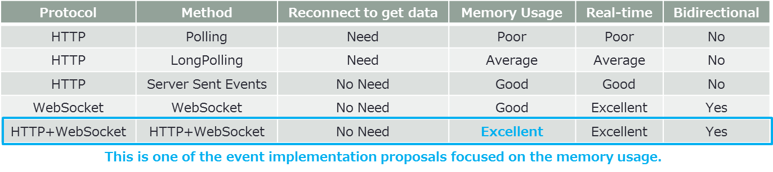
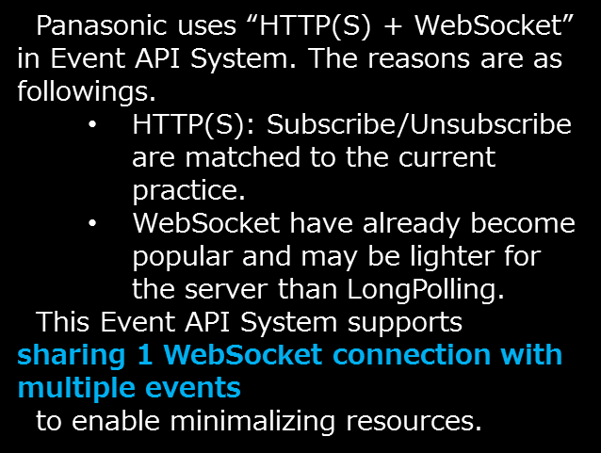
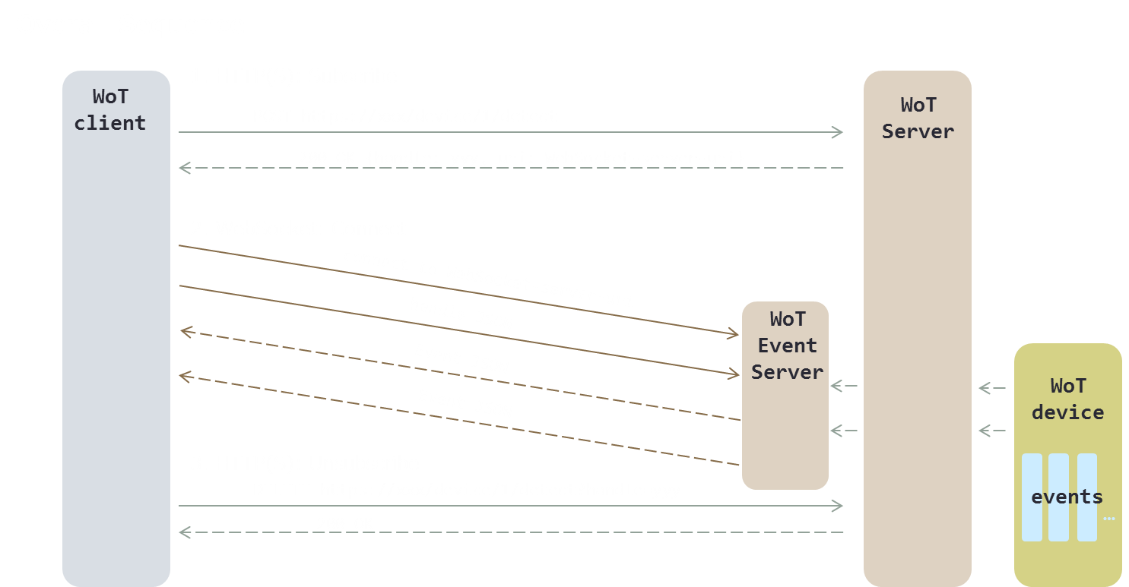
Interoperability with other companies' servients is realized by set up WoT servient on cloud that absorb the difference of various protocols of home appliances
Proposed to WoT WG the method to notify Event suitable for WoT configuration
…
Scripting API
inside
…
Application
Servient
Application
Servient
(Fujitsu)
Application
Servient
(Siemens)
San Francisco
WoT
API
Cloud
Deivce
Servient
Deivce
Servient
Deivce
Servient
Deivce
Servient
Deivce
Servient
Deivce
Servient
Remote
Proxy
(Fujitsu)
Remote
Proxy
(xxxxxxx)
Proprietary
Proprietary
Proprietary
Proprietary
Proprietary
Proprietary
Local
Proxy
(xxxxxxx)
Local
Proxy
(xxxxxxx)
Legacy Devices
Home
Gateway
Device
Servient
(xxxxxxx)
Device
Servient
(xxxxxxx)
LED
Display
IRKit
Sensor
Air conditioner
Robotics
Cleaner
Philips
Hue
Camera
Amazon
Echo
Osaka
San Francisco
Event Implementation Proposal

