Slide 1
Servients and protocols for Prague plugfest
Servients | Fujitsu (example) |  | Company1 | Company2 | company3
Application | Scripting app. | NodeRED
protocol | http | http(s)
Remote proxy | FJ-Server
protocol | WebSocket | HTTP/STUN
Local proxy | FJ-GW | FJ-GW
protocol | http | http
Device | Rotating light | Air conditioner, LED light, Blind

Slide 2
Previous plugfest

Slide 3
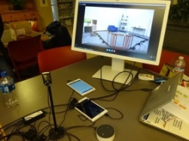
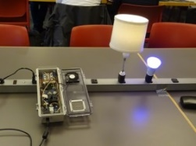
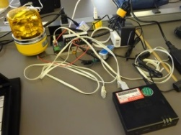
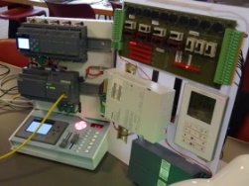
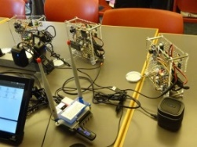
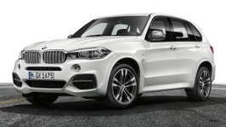
Burlingame plugfest
Internet Research Institute
Samsung SmartThings
Panasonic
Siemens
Lemonbeat
Intel
Eurecom
Fujitsu
Application Servient
Node-RED
(Panasonic)
Application Servient
Scripting
(Panasonic)
Application Servient
(Siemens)
Application Servient
(IRI)
Application Servient
(Intel)
Application Servient
Node-RED
(SmartThings)
Application Servient
Scripting
(Fujitsu)
Application Servient
Node-RED
(Fujitsu)
Remote Proxy Servient
(Siemens)
Thing Directory (Siemens)
Remote Proxy Servient
(Intel)
Remote Proxy Servient
(smartthings)
Remote Proxy Servient
(Fujitsu)
Thing Directory (Fujitsu)
Internet
Implemented inside Remote proxy
Device Servient
(Intel)
Device Servient
(SmartThings)
(Client Requests)
NAT / Firewall
WebUI WoT Client (Siemens)
Application Servient
Node-RED
(SmartThings)
Local Proxy Servient
(Siemens)
Local Proxy Servient
(lemonbeat)
Local Proxy Servient
(Intel)
Local Proxy Servient
(SmartThings)
Local Proxy Servient
(Fujitsu)
Local Proxy Servient
(Fujitsu)
Device Servient
(Panasonic)
Device Servient
(Panasonic)
Device Servient
(Panasonic)
Device Servient
(Panasonic)
Device Servient
(Lemonbeat)
Device Servient
LED Light
(Fujitsu)
Device Servient
(Panasonic)
Device Servient
(Panasonic)
Device Servient
BACnet
(Siemens)
Device Servient
Modbus/TCP
(Siemens)
Device Servient
(Lemonbeat)
Device Servient
(Intel)
Device Servient
(SmartThings)
Device Servient
(EURECOM)
Device Servient
Rotating light
(Fujitsu)
Device Servient
Air Conditioner
(Fujitsu)
Device Servient
(Panasonic)
Device Servient Festo Plant
(Siemens)
Osaka, Japan
Munich, Germany
Local network
San Francisco
Kanazawa, Japan

Slide 4
Servients and protocols (1 of 2)
Servients | Fujitsu |  | Panasonic |  | Internet Research Institute (IRI) | Siemens |  | Lemonbeat
Application | Scripting app. | NodeRED | Scripting/ NodeRED |  | NodeRED | Scripting app. | WebUI
protocol | http | http(s) |  |  | http(s) | HTTP, CoAP, BACnet, Modbus | HTTP, CoAP
Remote proxy | FJ-Server |  |  |  |  | WoS Messaging Service
protocol | http(s) |  |  |  |  | (Tunnel)
Local proxy | FJ-GW | FJ-GW |  |  |  | WoS Messaging Service, TD Registration Agent
protocol | http | http | https | https+wss |  | HTTP |  | http
Device | LED | Air conditioner, LED light, Blind | LED light, Air conditioner, Robot Cleaner | Human Detection Sensor, Amazon Echo, Google Home |  | Remote Festo Plant (valve,pump,levelmeter) |  | Sensors(Luminance sensor Humidity sensor Temperature sensor) Binary actuator
 |  |  |  |  |  | BACnet Demonstrator
 |  |  |  |  |  | Logo! Demonstrator
 |  |  |  |  |  | RGB LED Light

Slide 5
Servients and protocols (2 of 2)
Servients | Intel |  | SmartThings |  | EURECOM
Application | AVS WoT Skill | AlexNet Recog Service | Node-RED Local application | Node-RED Remote application
protocol | HTTPS |  | HTTP
Remote proxy | Cloud proxy shadow |  | Remote Gateway
protocol | HTTPS/CoAP(s) |  | Multi
Local proxy | Local proxy |  | Local Gateway
protocol | CoAP |  | Multi |  | ???
Device | OCF RGB light OCF Light OCF Buzzer OCF temperture OCF Button OCF Proximity OCF Slider Still camera |  | Dimmable Light(ocf) Motion Sensor(ocf) Dimmable Light(st) Motion Sensor(st) Gas Sensor(IPSO) PM2.5 Sensor(IPSO) Temperature Sensor(IPSO) Humidity Sensor(IPSO) | Loudness Sensor(IPSO) Illuminance Sensor(IPSO) PIR Sensor(IPSO) Barometer Sensor(IPSO) OCF Bridge | Sensors and actuators in BMW X5

