Slide 1
Compute Utilities
Michael McCool
Oct 15, 2020
W3C Joint WoT/Web and Networks Meeting
Notes:
Next steps: update, bring in Doug Sommers, Paul Peterson, Kenneth Torrance, Anssi, Rijubrata ...
To do: look at worklets, perhaps a bit more flexible

Slide 2
Problem: Limited Clients, Sensitive Data
Trends:
Limited client tradeoffs
Performance
Power/thermals/runtime
Compute as a utility
Cloud computing
Edge computing
Browser as an application platform
Progressive web apps (PWAs)
Pain Points:
Privacy and security
Programming model
Performance and power
Thermal management
Scalability and Flexibility
Latency
Mobility
Offline functionality

Slide 3
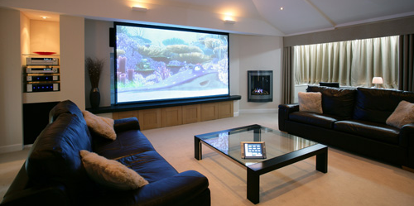
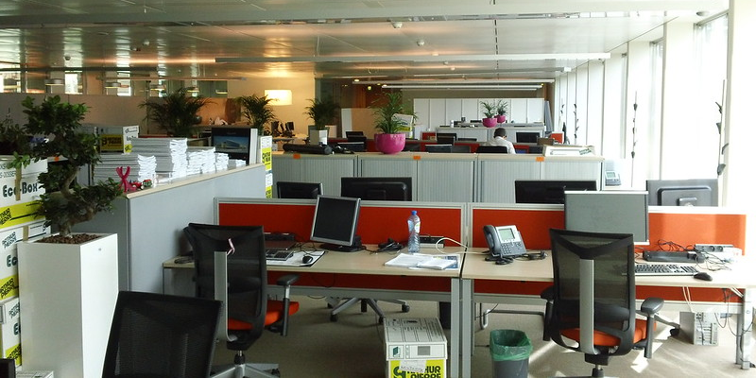
Use Case Domains: Private
Home
Compute offload supporting work from home and home security
User wants to orchestrate local devices and AI services
Owner wants to ensure private data stays on-site
Office
Individual computers can be low-cost and lightweight
Workers can offload work to local edge computers and private cloud
Private business, customer, and employee data stays on-site
Notes:
Need to add citations to images here, they are both cc, now I have to find them again…

Slide 4
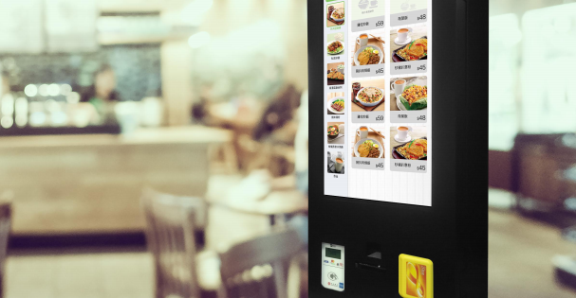

Use Case Domains: Public
Retail
Small business owners wanting to self-manage technology (1)
Large retail franchises deploying applications for use on employees’ own devices (BYOD context)
Manage private payment data
City
Cities want to develop third-party application ecosystem to best provide value to citizens (2,3)
Ambient services supporting citizens
Multivendor, avoid silos
Maintain privacy and transparency
https://www.conexxus.org/
https://www.mckinsey.com/business-functions/digital-mckinsey/our-insights/the-internet-of-things-the-value-of-digitizing-the-physical-world
https://machinaresearch.com/news/smart-cities-could-waste-usd341-billion-by-2025-on-non-standardized-iot-deployments/

Slide 5
Edge Compute/Web Hybrids Discussed in W&N
Edge Worker
Extend web worker to offload work from browser to edge computer (Intel)
Extend service worker to execute computations in the CDN (CloudFlare)
Distributed Browser
Break browser into multiple processes, offload some to another computer
Mobile Worker
Dynamically migrate running web worker to another computer
→ All need "another computer" to offload to: How to find? How to decide to offload?

Slide 6
Edge Worker
Host Computer (Edge, Cloud, etc.)
Proposal (W3C Web and Networks IG)
Purpose:
Run compute-intensive tasks elsewhere on the network, improving performance
Provide persistent (always-on) response
Implementation:
Work moved to a "compute utility" hostable on a variety of platforms
Lifetime tied to installation of persistent web app; event-driven execution
May respond even when web app closed
Compute Utility
Web (Worker) Environment
Edge Worker Task
Client Computer
Browser
Web Environment
Main Task
Notes:
We could mention, or merge with the concept of “mobile worker”, one that can be migrated across nodes, like in
https://dl.acm.org/doi/pdf/10.1145/3357223.3362735

Slide 7
Key Issues for Standardization
Discovery of “compute utility” or compute services
Both local (local area network) and remote (on the internet)
Compute utility network API
To load workload into a compute node and to perform migration
Metadata and metrics
Capabilities, performance, latency, etc.
Packaging of compute workloads
Options include container images, scripts, and WASM
Browser API (edge workers)
Based on web worker API
Notes:
Peng, Ding, Xintian are interested in metadata and metric issues
once you get metadata, how do you aggregate, summarize, and get insight from metadata
- McCool: working on sparql, json-ld, etc.
ZK: IMHO Wot Scripting could be updated from edge workers work, rather than vice versa. Currently WoT Scripting is not chartered to support IoT orchestration, that would be a different API.
The orchestration API is a big topic, let’s not carve that in stone yet.

Slide 8
Packaging/Runtime Choices
Container Images
Non-browser runtime, e.g. Docker, Kubernetes, etc.
Both docker and kata containers allow GPU access
High performance
WASM Modules
Needs browser runtime or WASI runtime
Support for acceleration still in design phase or experimental
Scripts
Send script to remote lightweight execution environment (w/ webGPU)

Slide 9
Relationship to WoT
Discovery of “compute utility” or compute services
Can use WoT Discovery
Compute utility network API
Can describe with WoT Thing Description
Metadata and metrics
Can be provided via JSON in Thing Description
WoT Discovery to support JSONPath/XPath/SPARQL/geo queries
Packaging of compute workloads
Scripts can use WoT Scripting API (orchestration use case)
Notes:
Peng, Ding, Xintian are interested in metadata and metric issues
once you get metadata, how do you aggregate, summarize, and get insight from metadata
- McCool: working on sparql, json-ld, etc.
ZK: IMHO Wot Scripting could be updated from edge workers work, rather than vice versa. Currently WoT Scripting is not chartered to support IoT orchestration, that would be a different API.
The orchestration API is a big topic, let’s not carve that in stone yet.

Slide 10
Metadata
Compute utilities should provide metadata about capabilities, performance, and resources
Metadata about network is also needed to determine QoS (latency, BW, etc).
Workloads need to have metadata about their requirements
The client needs to decide to offload a workload based on this metadata
Issues:
We may not be able to expose the metadata directly to the client application code (privacy issues; want to avoid fingerprinting). Rather the client should support a (configurable, automated) "decision process".
Compute utilities and networks may lie about their capabilities. May need a reputational scoring system to identify untrustworthy compute utilities.
Notes:
A list of metadata for workloads

Slide 11
Metadata
Compute Utility
Memory size
Accelerator technology
Performance/load type/benchmark
Variants (compatible, but with variable performance
Network (LPP)
Latency
Bandwidth
Reliability
Workload
Network QoS
Maximum latency
Minimum bandwidth
Minimum network reliability (opt)
Compute QoS (predictive/adaptive)
Minimum memory size
Performance/load type/benchmarkl
(CPU) + Accelerator technology

Slide 12
Offload Decision Rule
Feasible options exist
Meet minimum QoS requirements
Meet minimum reliability requirements
Satisfies agent settings
Allow remote offload
Extra performance/reliability requirements (e.g. at least 10x speedup/power savings)
Improve some metric by some minimum amounts
Performance
Power reduction

Slide 13
Summary
All proposals for edge computing so far need
A target to offload to with "good" properties relative to client
Need to decide whether offload is beneficial
Decision requires metrics on performance, connectivity, etc.
Compute Utility could be defined that
Is discoverable (via WoT Discovery, for example)
Has standardized network interface (described by WoT TD, for example)
Has standardized workload packaging (using scripts and including WebGPU and WoT Scripting API, for example)
Notes:
API includes both IDL for the script API, and the network API (used only by the browser)

