Slide 1
Atrioventricular nodal reentrant tachycardia
Abbott-UNIPD collaboration
28 May 2024
Francesco Prendin

Slide 2
Outline
Background;
Open issue and aim;
Preliminary data overview;
Open Points;
Next steps;

Slide 3
Outline
Background;
Open issue and aim;
Preliminary data overview;
Open Points;
Next steps;

Slide 4
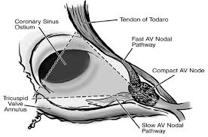
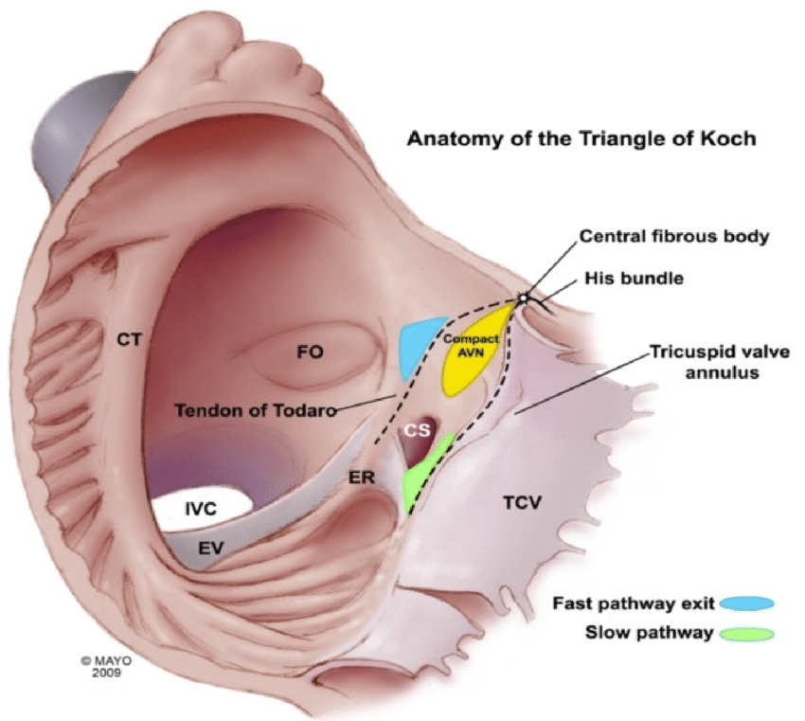
Background [1/4]
The AV node bordered by:
Coronary sinus ostium (posteriorly);
Tendon of Todaro (superiorly, fast pathway: rapid conduction, slow refractory period);
Septal tricuspid valve anulus (anteriorly, slow pathway: rapid refractory period, slow conduction).
The “slow” and "fast” pathway refer to two conduction pathways that determine the speed and the way in which electrical impulses pass through the AV node to reach the ventricles.
The fast pathway: fast conduction speed and a long refractory period. It rapidly conducts the electrical impulse through the AV node to the ventricles, allowing for efficient ventricular contraction. It represents the primary pathway through which impulses pass.
Triangle of Koch
Notes:
More frequent in women, leads to palpitations, anxiety, syncope and circulatory decompensation.
AVF: augmented vector foot (left foot)
Hafeez, Y., & Armstrong, T. J. (2018). Atrioventricular nodal reentry tachycardia.

Slide 5
Background [2/4]
The slow pathway:
acts as a backup route;
If the fast pathway is temporarily ineffective or blocked, the slow pathway allows the passage of atrial impulses to the ventricles (ensuring that the heart continues to beat, albeit at a slower rate).
can modulate the frequency of impulses reaching the ventricles;
During episodes of high atrial rate (such as during physical exercise or stress), the slow pathway helps to filter out excessive impulses (preventing the transmission of excessively high rates to the ventricles).
can provide delayed conduction (ynchronizing ventricular activation).
Triangle of Koch
Notes:
The slow pathway is less prominent compared to the fast pathway.

Slide 6
Background [3/4]
AV-Node reentrant tachycardia: presence of a re-entry circuit within or adjacent to the AV node that lead to tachycardia.
Diagnosis: ECG with heart rate 140-280 bpm and QRS complex fewer than 120 ms.
Slow-Fast AVNRT (90%): pseudo-S wave in leads II, III and AVF; pseudo-R’ wave in V1;
Fast-Slow AVNRT (5-10%): P waves between QRS and T waves
Slow-Slow AVNRT (1-5%): Late P waves after QRS (atrial tachycardia)
Triangle of Koch
Notes:
Sangue arriva da vena cava superiore
More frequent in women, leads to palpitations, anxiety, syncope and circulatory decompensation.
AVF: augmented vector foot (left foot)
Hafeez, Y., & Armstrong, T. J. (2018). Atrioventricular nodal reentry tachycardia.

Slide 7
Background [4/4]
AVNRT is treated by radiofrequency (RF) ablation of the slow pathway.
The aim of the ablation procedure is the non-inducibility of tachycardia after burning:
“successful” if produces a slow rhythm;
“dangerous” if increases the duration of the PR interval, leads to AV block (I, II or total degree).
The identification of the area of interest is driven by:
anatomical landmarks (e.g., catheter position w.r.t. the Koch triangle, Bundle of His, …);
electrophysiological criteria (Jackman and Haissaguerre described the shape of the signals that target the slow pathway, but they can be challenging to identify).
Notes:
Inizialmente il target dell’ablazione era costituito dalla via rapida, ma essendo questa una struttura anteriore e molto vicina al AV ed al fascio di His, l’intervento si complicava in circa il 20% dei casi con un blocco AV completo. Il target quindi si è spostato sulla via lenta che essendo posteriore e più lontana da strutture sensibili mostra una margine di sicurezza maggiore, dato che il blocco AV completo in questo caso è descritto in meno dell’1% dei casi.

Slide 8
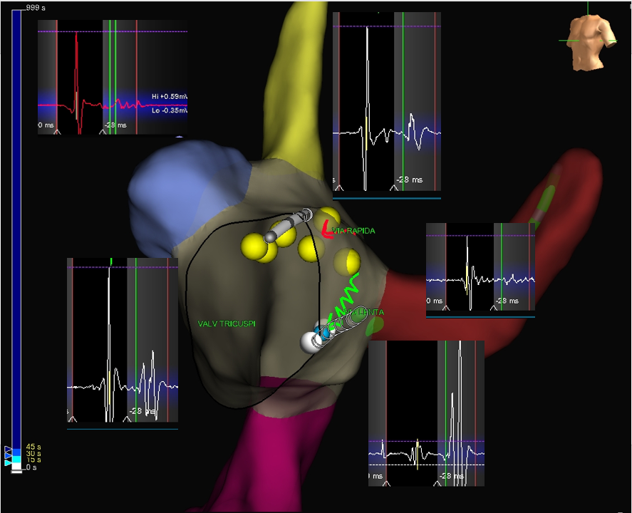
Right Atrium reconstruction during ablation procedure
Dangerous ablation site (MAP_C)
Effective ablation site (MAP_B)
Ineffective site (MAP_A)
Figure 1. EGM signals detected at different anatomical sites.

Slide 9
Outline
Background;
Open issue and aim;
Preliminary data overview;
Open Points;
Next steps;

Slide 10
Open issue and aim
Open issue:
The localization is based on physician expertise that evaluates whether an endocavitary signal (EGM) is “good/effective” or “bad/dangerous” (according to Jackman and Haissaguerre potentials);
Research question:
Is it possible to identify the “target” area from the EGM signals? In other words, is it possible to discriminate between the “effective”, “ineffective” and “dangerous” signals?
Is it possible to provide an index based on the electro-anatomical characteristics? Can we reformulate the concept of “effective” (Jackman-Haissaguerre) potential?
Notes:
Identificazione di sito
Dato un segnale in input l’output atteso è uno score di efficacia/pericolosita/inefficacia di ablare in quel punto.

Slide 11
Background [3/3]
The complexity of the electrograms in the region of Koch's triangle has been well recognized but interpreted differently by various electrophysiologists.
According to Pandozi et al.:
Jackman potential (JP): low-frequency, low-amplitude component followed by a large-amplitude, high-frequency component.
Haissaguerre potential (HP): high-frequency, high-amplitude component followed by a low-frequency, lower-amplitude component.

Slide 12
Outline
Background;
Open issue and aim;
Preliminary data overview;
Open Points;
Next steps;

Slide 13
Data overview and open points
During the ablation procedure the following data are recorded:
MAP_A = “ineffective” points (Atrium dx/Sept Inf)
MAP_B = “effective” points (Slow path)
MAP_C = “dangerous” points (His bundle/fast pathway)
-->> See the .docx file <<--
Notes:
Purtroppo la lunghezza di ciascun file excel è limitata per cui nel caso di molti punti, sono presenti più file per singola tipologia di mappa (es B1, B2, B3, B4) che vanno accorpati in un unica mappa “B”

Slide 14
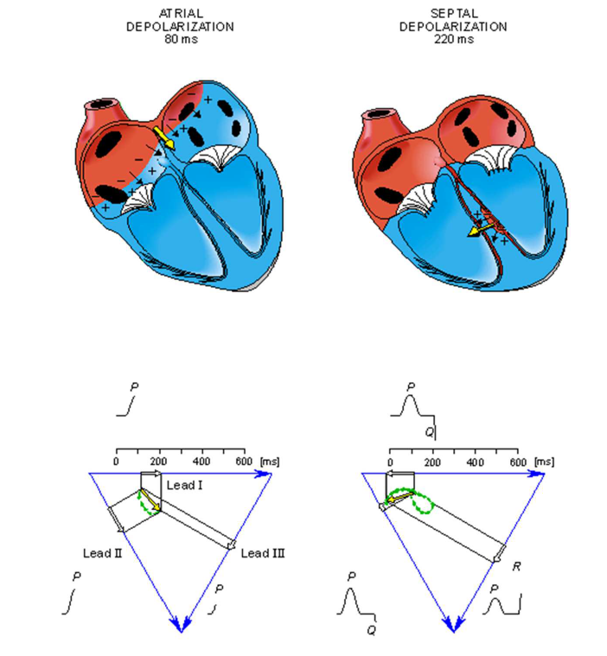
Data overview and open points
The variable «point number» represents the order of collection: should I sort all the columns according to point number?
Roving trace = data generated by roving catheter;
Reference = ECG on lead 1;
S1 = ECG on lead 1;
S2 = ECG on lead 2;
S3 = ECG on lead 3;
End Time of the traces (?)
CFE: Complex Fractionated Electrogram;
Notes:
La lunghezza di ciascun file excel è limitata per cui nel caso di molti punti, sono presenti più file per singola tipologia di mappa (es B1, B2, B3, B4) che vanno accorpati in un unica mappa “B”
In MAP_B, le colonne sono ordinate pt number

Slide 15
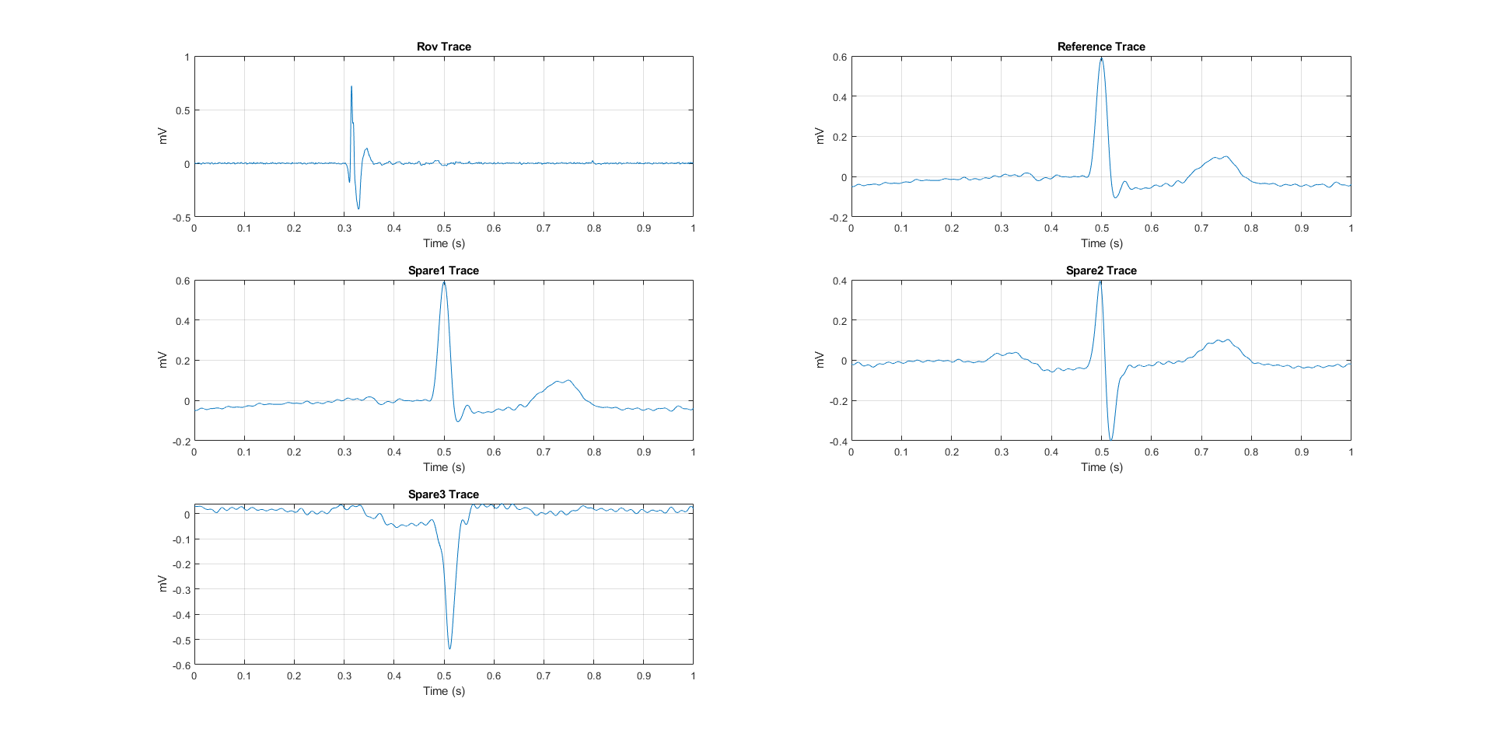
Example-ineffective points (MAP_A)

Slide 16
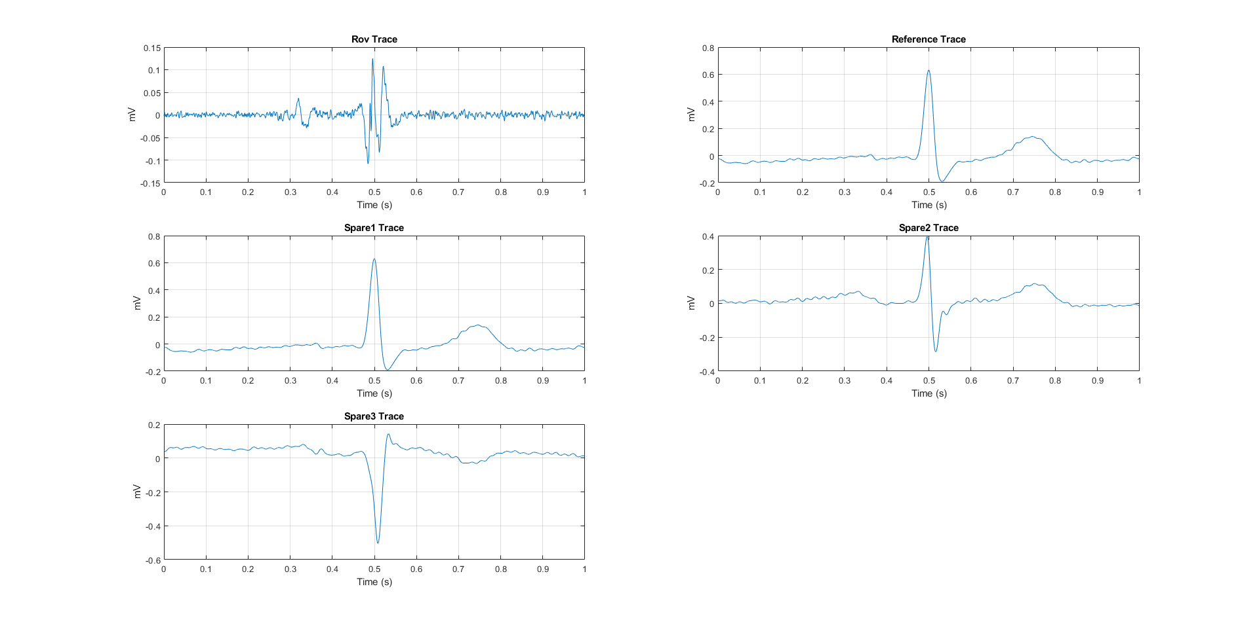
Example-effective points (MAP_B)

Slide 17
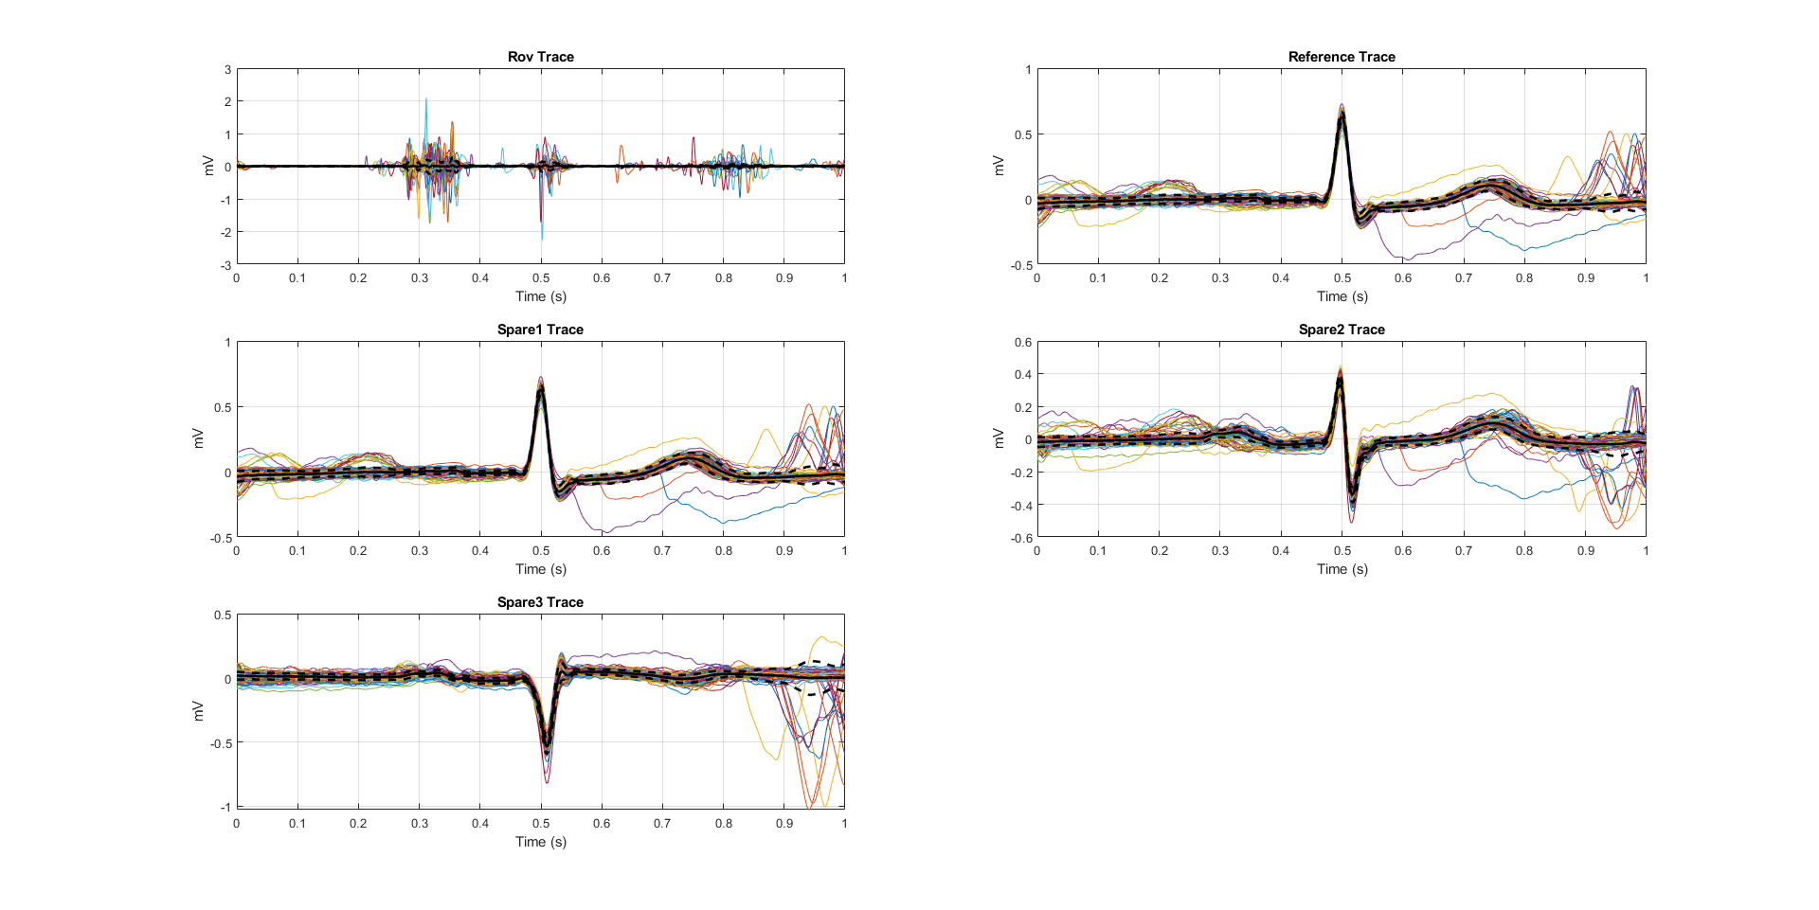
Example-ineffective points (MAP_A)

Slide 18
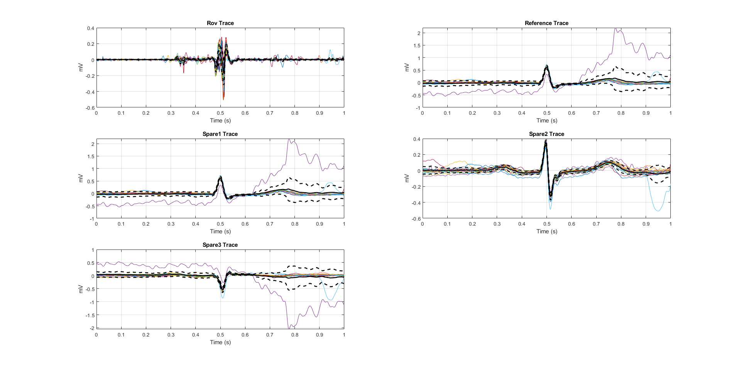
Example-effective points (MAP_B)

Slide 19
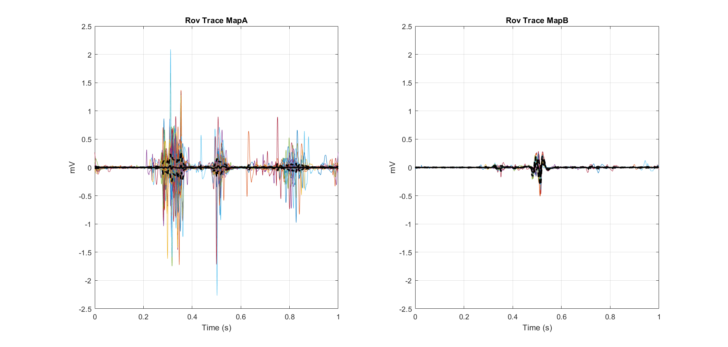
MAP_A vs MAP_B [1/3]

Slide 20
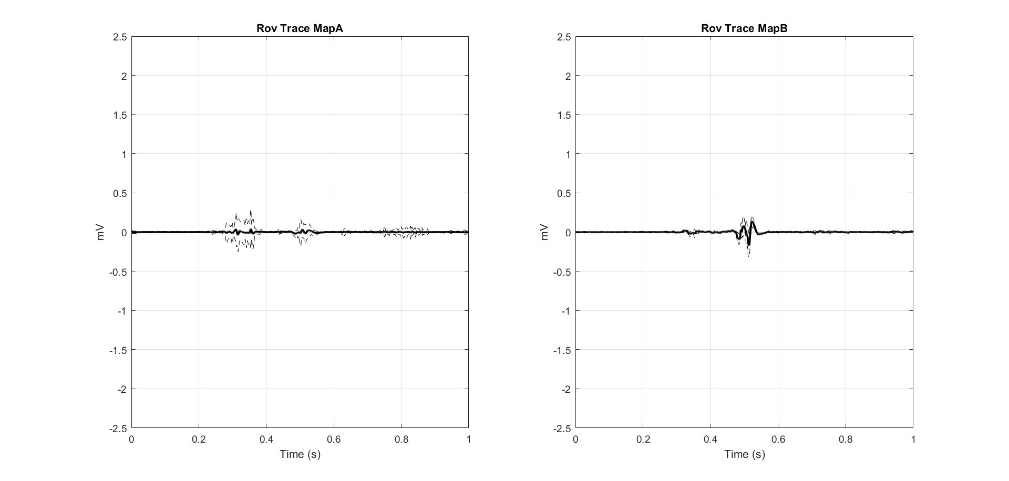
MAP_A vs MAP_B [2/3]

Slide 21
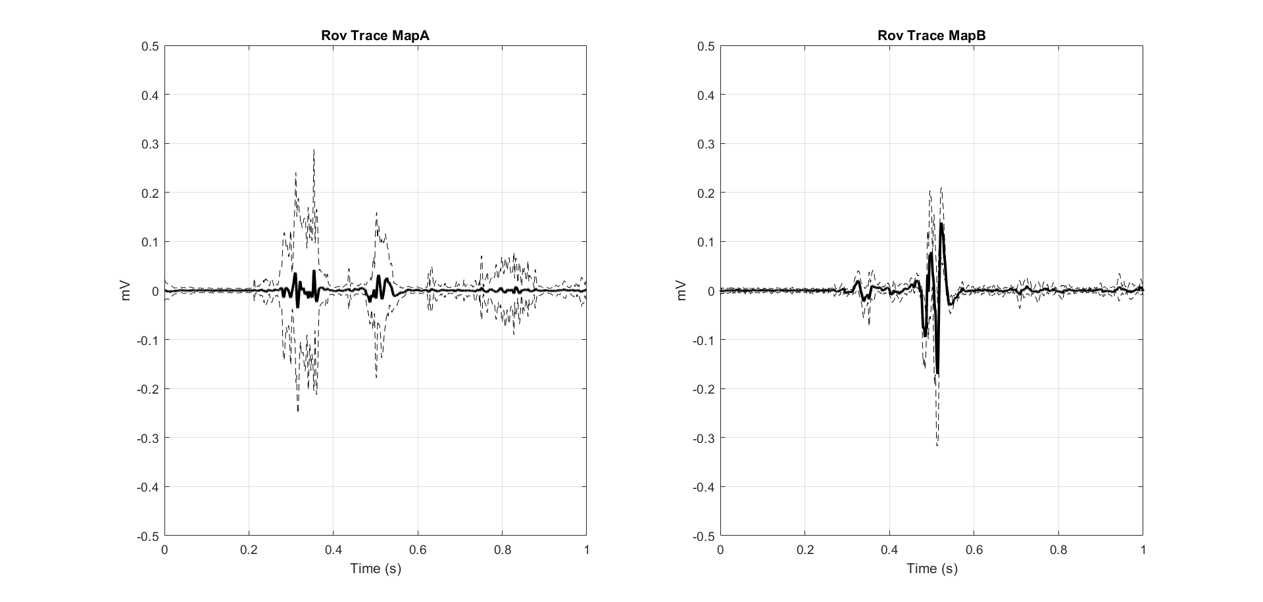
MAP_A vs MAP_B [3/3]

Slide 22
Outline
Background;
Open issue and aim;
Preliminary data overview;
Open Points;
Next steps;

Slide 23
Questions
Q0: Do I miss any important steps from your documentation?
Q1: Are MAP_A, B, C the “ground truth” for a learning algorithm?
Q2: Who decided if a recorded trace belongs MAP_A, MAP_B, MAP_C? In the documentation I found a field “detection algorithm”
Q3: Is MAP_C available?
Q4: Why has MAP_A 193 columns (i.e., 193 traces) and MAP_B 20 columns only?
Q5: Single Subjects o Population?
Q6: MAP_A, MAP_B are the outcome of the ablation procedure?

Slide 24
Outline
Background;
Open issue and aim;
Preliminary data overview;
Open Points;
Next steps;

Slide 25



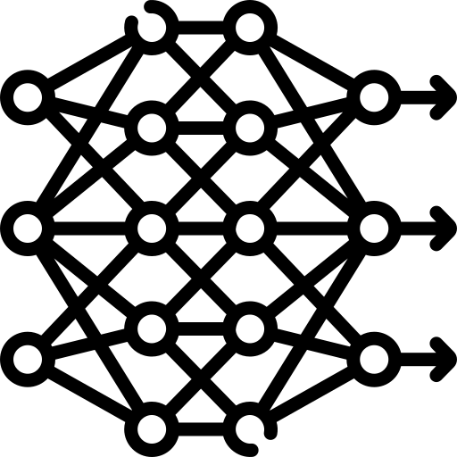
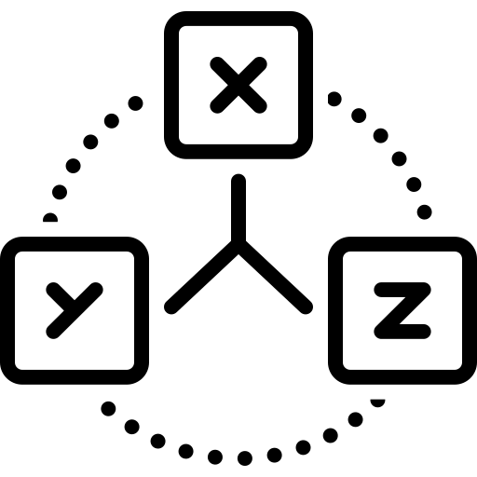
What can we do next?
Dataset analysis, preparation and preprocessing:
Statistical description of the EGM signals;
Handling missing values;
Removing noise and artefacts via filtering;
Split in Train, Validation and Test set;
Development of classification algorithms:
Leveraging EGM signals only;
Combining EGM and ECG signals;
Adding spatial information;
Performance assessment:
Precision, recall, F1-score, accuracy, …
Model interpretation:
Feature ranking;
Shap;
Grad Cam;
Classification algorithm
“ineffective”
“effective”
“dangerous”

Slide 26
What can we do next?
Dataset analysis, preparation and preprocessing:
Statistical description of the EGM signals;
Handling missing values;
Removing noise and artefacts via filtering;
Split in Train, Validation and Test set;
Development of classification algorithms:
Leveraging EGM signals only;
Combining EGM and ECG signals;
Adding spatial information;
Performance assessment:
Precision, recall, F1-score, accuracy, …
Model interpretation:
Feature ranking;
Shap;
Grad Cam;
Classification algorithm
“ineffective”
“effective”
“dangerous”

Slide 27
Classification algorithms based on EGM
Classification algorithm
“ineffective”
“effective”
“dangerous”
Heuristic:
Based on time and amplitude threshold
Template-based approach:
Template matching algorithm
Supervised algorithms:
Based on feature extraction, time and frequence analysis,…
Unsupervised algorithms:
Time series clustering, deep convolutional network

Slide 28
Example: heuristic algorithms
Algorithm:
If t < t* and |A| > A*
return class A
else
return class B

Slide 29
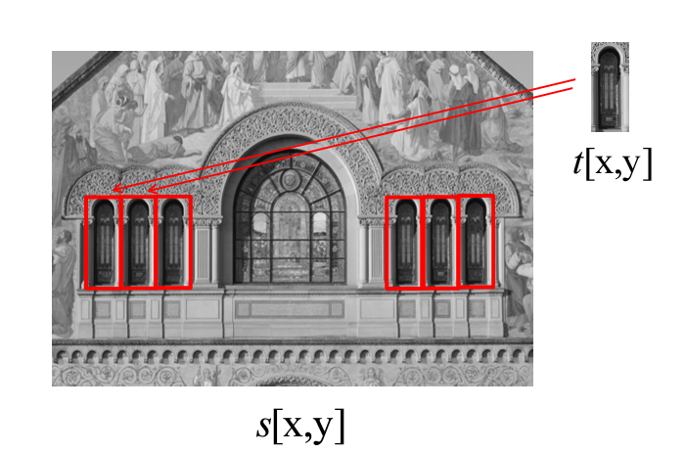
Shape recognition via template matching

Slide 30
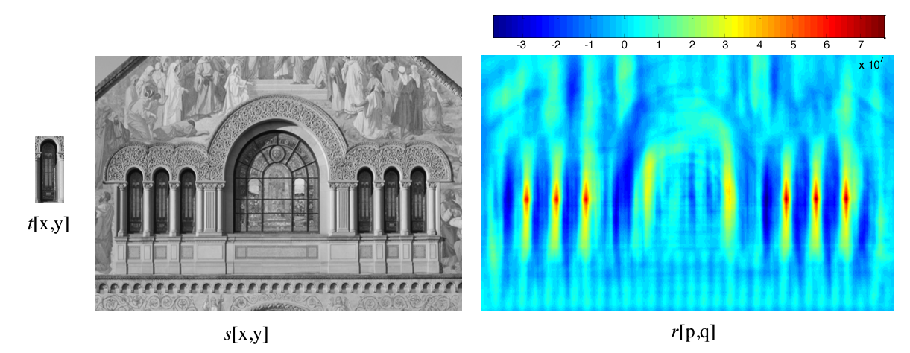
Shape recognition via template matching

Slide 31
Shape recognition via template matching
Well established method, computationally cheap. The template is usually the average of the traces

Slide 32
Supervised approach
Feature extraction time, frequency (FFT, spectrogram), wavelet analysis, morphological, local, global
Models:
Logistic regression, Decision Tree, Random Forest, XGBoost, Support Vector Machine,…
Feature ranking
Interpretability

Slide 33
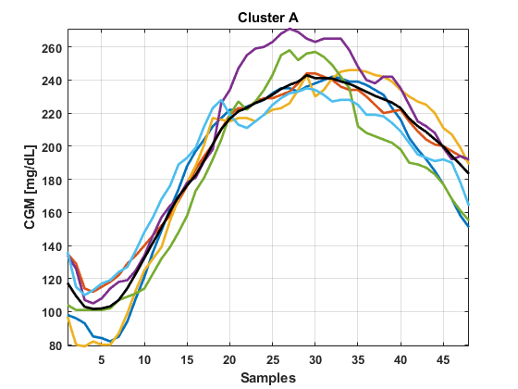
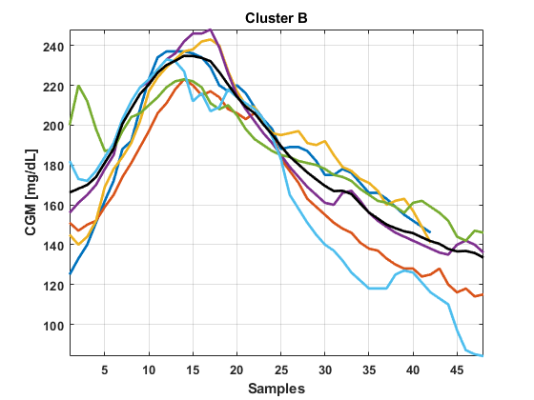
Unsupervised approach [1/2]
Time series clustering aims to group traces with a similar pattern.
It requires a large number of data

Slide 34
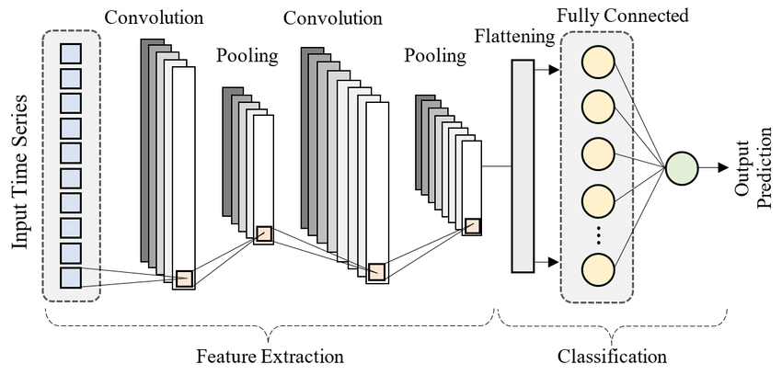
Unsupervised approach [2/2]
Convolutonal Neural Network allows to automatically extract relevant feautures
It requires a large number of data

Slide 35
Conclusion
The preliminary analysis of the dataset provides interesting insight about the difference among the classes;
There are a lot of possibilities in terms of developing classification algorithms, but it depend on the total amount of available data;

