Slide 1
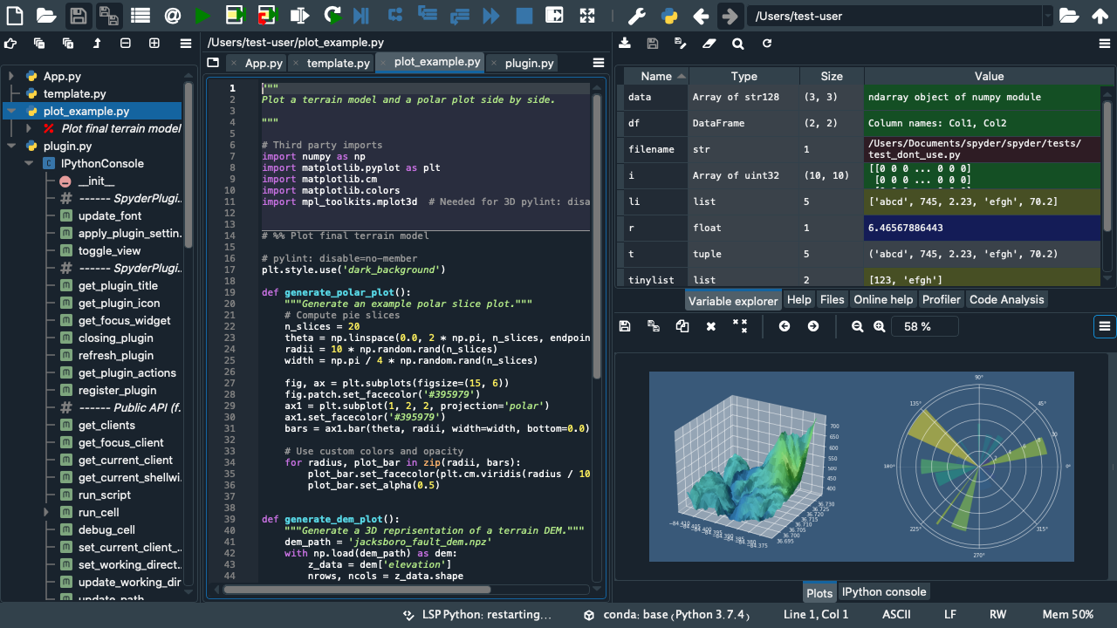
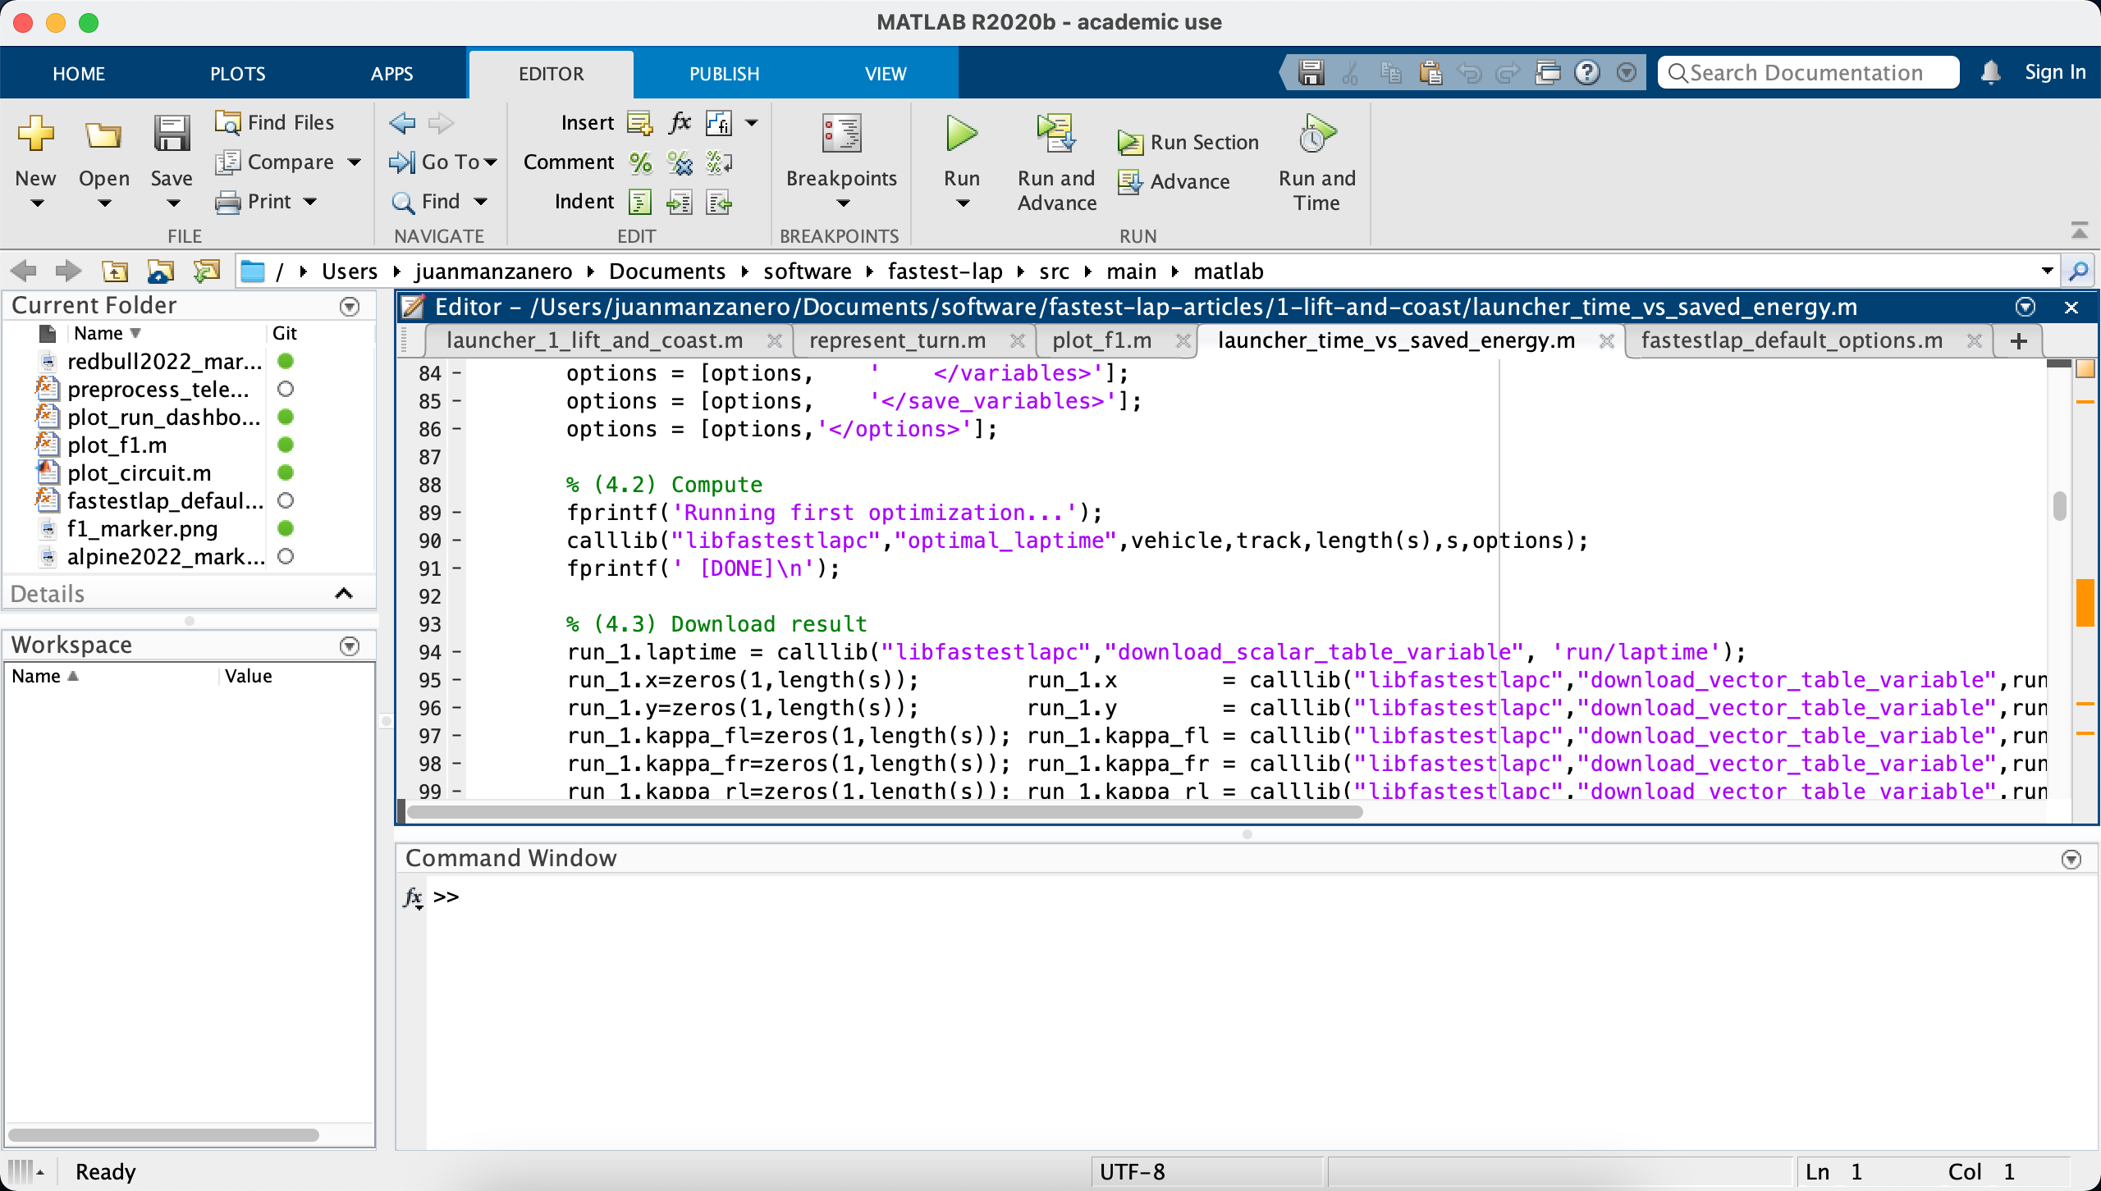
Dynamic library (.dll)
Variables - Internal memory
Vectors
Scalars
Simulation1
Simulation1
chassis.position.x
laptime
chassis.position.y
engine_energy
chassis.velocity.x
chassis.throttle
Simulation2
Simulation2
laptime
chassis.position.x
engine_energy
chassis.position.y
Cars
chassis.velocity.x
chassis.throttle
mercedes-2020-catalunya
Circuits
ferrari-2022-australia
redbull-2022-imola
imola
Access to
internal storage
Python
melbourne
miami
Functions
Factories
Applications
create_vehicle_from_xml()
optimal_laptime()
gg_diagram()
circuit_preprocessor()
create_track_from_xml()
MATLAB
Modifiers
vehicle_set_parameter()
vehicle_declare_new_constant_parameter()
vehicle_change_track()
Getters
download_scalar()
download_vector_size()
download_vector()

