Slide 1
Transducers Internals
Clojure Exchange 2017 - Workshops

Slide 2
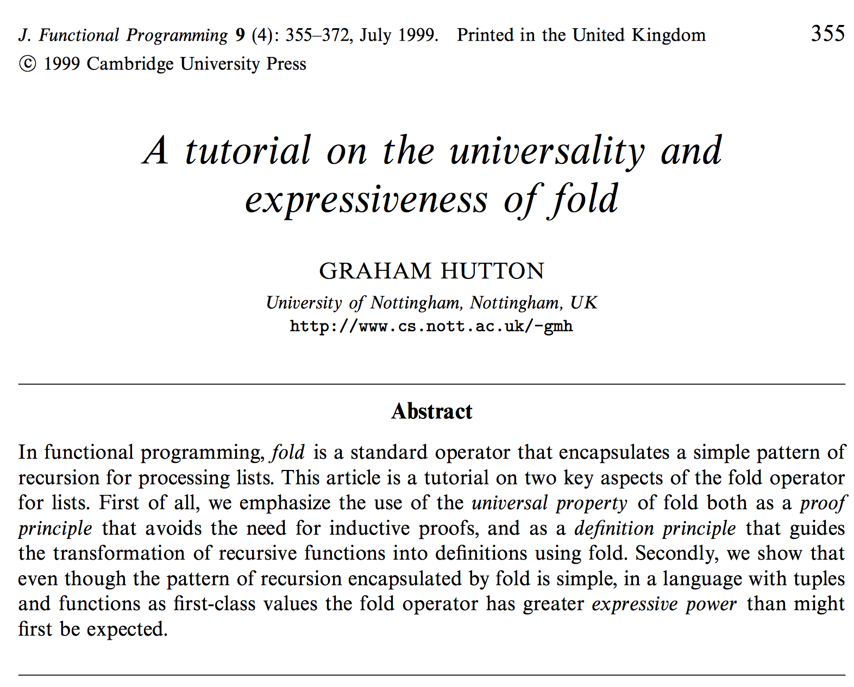
On the universality of fold
reduce as the prototypical recursive iterative process
Redefinition of sequential processing in terms of reduce
Extract transformations and I/O details
Possible? Let’s refactor map and filter to find out

Slide 3
Step 1: express like reduce
(defn map* [f result coll] (if (not= '() coll) (map* f
(f result (first coll))
(rest coll)) result))
; use like (map*
(fn [result el] (conj result (inc el)))
[]
(range 10))
(defn filter* [f result coll] (if (not= '() coll) (filter* f
(f result (first coll))
(rest coll)) result)) (filter*
(fn [result el]
(if (odd? el)
(conj result el)
result))
[]
(range 10))

Slide 4
Step 2: rename it reduce, which is what it is!
(defn reduce* [f result coll] (if (not= '() coll) (reduce* f
(f result (first coll))
(rest coll)) result)) ;; And use like this:
(reduce*
(fn [result el] (conj result (inc el)))
[]
(range 10))
(defn reduce* [f result coll] (if (not= '() coll) (reduce* f
(f reduce
(first coll))
(rest coll)) result)) (reduce*
(fn [result el]
(if (odd? el)
(conj result el)
result))
[]
(range 10))

Slide 5
Step 3: That's just normal reduce!
;; We can throw away our reduce* and just
;; use Clojure's: ;; map
(reduce
(fn [result el]
(conj result (inc el)))
[]
(range 10))
;; filter (reduce
(fn [result el]
(if (odd? el)
(conj result el) result))
[]
(range 10))

Slide 6
Step 4: separate essence into fn
(defn mapping [result el] (conj result (inc el)))
(reduce mapping [] (range 10))
(defn filtering [result el] (if (odd? el) (conj result el) result)) (reduce filtering [] (range 10))

Slide 7
Step 5: introduce "rf", extract "conj" away
(defn mapping [rf] (fn [result el] (rf result (inc el))))
(reduce (mapping conj) [] (range 10))
(defn filtering [rf] (fn [result el] (if (odd? el) (rf result el) result))) (reduce (filtering conj) [] (range 10))

Slide 8
Step 6: introduce param "f" and "pred?"
(defn mapping [f] (fn [rf] (fn [result el] (rf result (f el)))))
(reduce
((mapping inc) conj)
[]
(range 10))
(defn filtering [pred?] (fn [rf] (fn [result el] (if (pred? el) (rf result el) result)))) (reduce
((filtering odd?) conj)
[]
(range 10))

Slide 9
Step 7: finally, extract transduce* fn
(defn mapping [f] (fn [rf] (fn [result el] (rf result (f el)))))
(defn transduce* [xf rf coll] (reduce (xf rf) (rf) coll))
;; Use like
(transduce* (mapping inc) conj (range 10))
(defn filtering [pred] (fn [rf] (fn [result el] (if (pred? el) (rf result el) result))))
(defn transduce* [xf rf coll] (reduce (xf rf) (rf) coll))
(transduce* (filtering odd?) conj (range 10))

Slide 10
Creating your own transducers
Our mapping and filtering are the same in the std lib.
But that's not all you need to know.
A "good transducer" also knows how to behave when other transducers are around.

Slide 11
Some aspects about designing a transducer
Deal with the end of the reduction (1-arg arity).
Providing an initial value (0-arg arity).
Where to initialize state (if needed).
How to terminate early (if needed).
Surrounding transducers awareness (mandatory calls).

Slide 12
Resources
A tutorial on the universality and expressiveness of fold
uSwitch Labs transducers articles

Slide 13
Lab 02
Custom Transducers

Slide 14
Goal of Lab2
Task 1: create a logging transducer to print intermediate results from a transducers chain.
Task 2: create a stateful moving average transducer
Open transducers-workshop.lab02 to start.

