Slide 1
Parallelizing Transducers
Clojure Exchange 2017 - Workshops

Slide 2
Going parallel
Transducers, especially on of large datasets, could run in parallel for additional performances.
Approach 1. Divide and conquer: split the input and work in parallel (only stateless transducers).
Approach 2. Master-workers. Workers fight to take the next item from the dataset.

Slide 3
Parallelization with Reducers
Reducers is a namespace part of Clojure: clojure.core.reducers
They wrap the Java fork-join framework, a divide and conquer parallel strategy with work-stealing.
They assume the input collection can be split into chunks (no laziness).
They also assume combining the chunks back is commutative.
Transducer state is accessed concurrently: no stateful transducers.

Slide 4
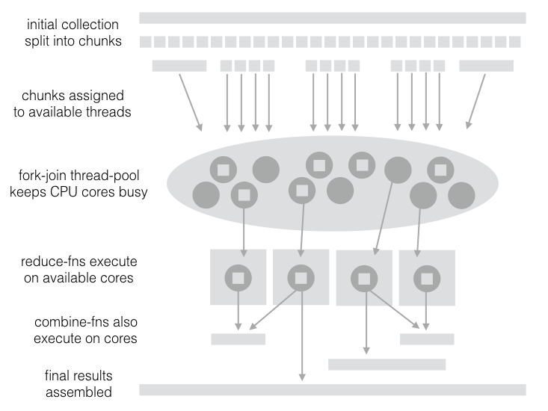

Slide 5
To use Reducers
Require the namespace
r/fold is the main entry point
They need a "reducef" reducing function (at the leaf).
"combinef" function is used to join chunks back together.
Apply the transducer chain (the one with comp) to the reducing function (such as "x" or "conj") to obtain "reducef"

Slide 6
Parallelization with core.async
core.async provides a "pipeline" construct to associate multiple parallel threads to a channel
Pipelines can be further "piped" together and apply a different transducer each
Input data can be streamed or loaded from a collection in one go.

Slide 7
Resources
"A Java fork-join framework" paper by Doug Lea
Clojure Applied book contains chapters dedicated to Transducers with core.async pipes.
Standard Library book, Chapter 32: Reducers and Transducers

Slide 8
Lab 04
Parallelizing Transducers

Slide 9
Goal of Lab4
Task1: parallelise the xform with reducers.
Task2: parallelise the xform with pipelines.
Task3: different pipelines for different transducers.
Open transducers-workshop.lab04 to start.

