Slide 1
Parallelizing Transducers
Transducers in Practice Workshop - CUFP 2017

Slide 2
Going parallel
Transducers, especially big pipeline of transformations on top of large datasets, could run in parallel.
There is no “ptransduce” but we could roll-out our own waiting for a standardized solution.
Approach 1. Divide and conquer: split the input and work in parallel.
Approach 2. Master-workers. Workers fight to take the next item from the dataset.

Slide 3
Parallelization with Reducers
Reducers is a namespace part of Clojure: clojure.core.reducers
They wrap the Java fork-join framework, a divide and conquer parallel strategy with work-stealing.
They assume the input collection can be split into chunks (eagerly).
They also assume combining the chunks back is commutative.

Slide 4
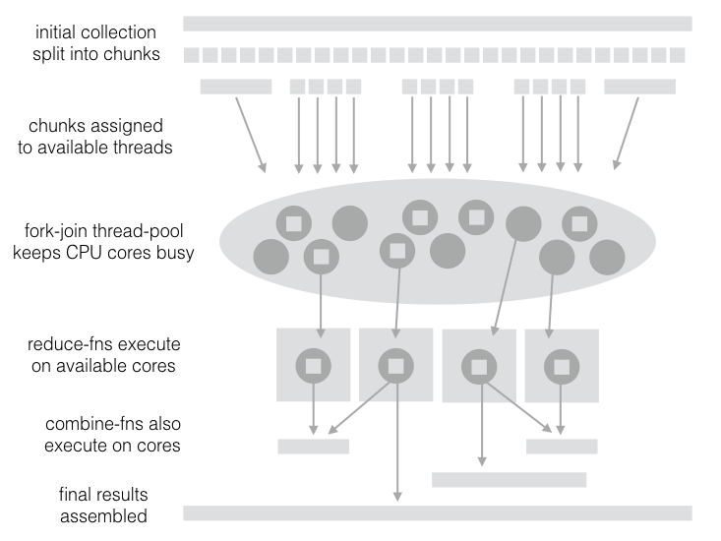

Slide 5
To use Reducers
After requiring the namespace, r/fold is the main entry point
They need a “reducef” reducing function (at the leaf).
A “combinef” to join chunks back together.

Slide 6
Parallelization with core.async
core.async provides a "pipeline" construct to associate multiple parallel threads to a channel
Pipelines can be further "piped" together and apply a different transducer each
Input data can be streamed or loaded from a collection in one go.

Slide 7
Resources
“A Java fork-join framework” paper by Doug Lea
Clojure Applied book contains chapters dedicated to Transducers with core.async pipes.

Slide 8
Lab 04
Parallelizing Transducers

Slide 9
Goal of Lab4
Task1: parallelize the xform with reducers
Task2: parallelize the xform with pipelines.
Task3: different pipelines for different transducers
Open transducers-workshop.lab04 to start.

