Slide 1

Machine Learning Workshop for Beginners
Dr Andrea De Santis
Dr Jujar Singh Panesar
14th December 2019

Slide 2
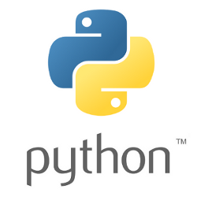

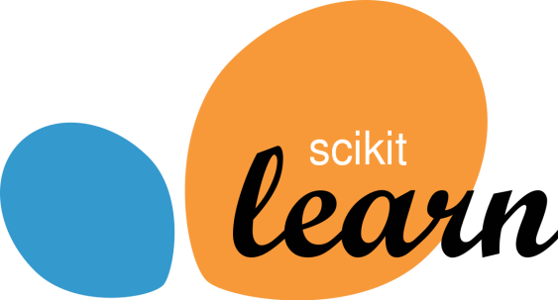
The Workshop in a Nutshell
In this workshop we will use the two Machine Learning algorithms that we introduced before to predict the onset of diabetes in Native American women → Binary Classification
We will perform all the tasks, from importing the data to assess the performance of the different algorithms, in Python and taking advantage of the power of the Jupyter Notebook environment
We will use the implementation of the different algorithms within the well-known Scikit-Learn library for Machine Learning in Python
The Jupyter Notebook and presentations can be found in the GitHub repository:
https://github.com/AndreaDesan/CentDS-Machine-Learning-for-Beginners

Slide 3
Workshop Cheat Sheet
Train-Test Split
Scaling the Features
X is the features array
y is the response array
X_{train} and y_{train} are the portion of the dataset used for training the ML algorithms
X_{test} and y_{test} are the «unseen» data used for testing the trained model
Some ML algorithms perform better on scaled features
We used SKLearn’s StandardScaler to scale the features
X_{train_scaled} and X_{test_scaled} are the resulting scaled training and testing features arrays
The response y does not need scaling
Assessment of the Models (Regression)
Instantiate
Model development workflow
Optimise
(if necessary)
Fit
(Train)
Assess
Predict
(Infer)

