Slide 1




Leeds, Yorkshire 14 December 2019

Slide 2
What Is Machine Learning? A Practical Basic Introduction
Dr Andrea De Santis
CTO, CentDS – Centre for Digital Systems
Dr Jujar Panesar
CEO, CentDS – Centre for Digital Systems

Slide 3



CentDS – About Us
CentDS is an engineering R&D company focusing on delivering Industry 4.0 themes
We deliver cutting edge solutions to real engineering problems
We deliver cutting edge solutions to real engineering problems
CentDS
R&D grants
Training
Engineering simulations with experimental validation
UK grants
International grants
Services
Products
Industrial internet of things (IoT) product
Machine and deep learning

Slide 4
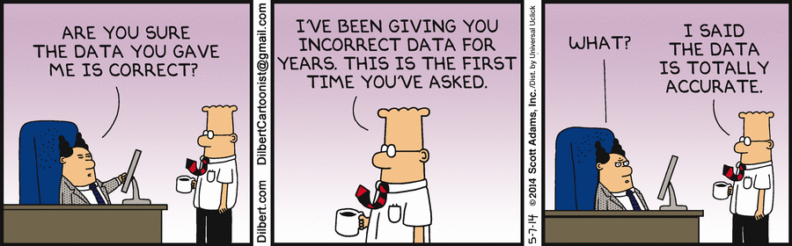
Machine Learning - Background
Arthur L. Samuels (IBM) coined the term “machine learning” (1959)
“Field of study that gives computers the ability to learn without being explicitly programmed”
There is no universally accepted definition
Is regarded as a branch of Computer Science and Artificial Intelligence (AI)
It’s all about the data...
From: http://dilbert.com/strip/2014-05-07

Slide 5
Machine Learning – Basic Workflow
Raw
Data
EDA
Feature Engineering
Engineered Data
Instantiate
Train
Cross-Validation (i.e. testing)
Predictive Model
• Deploy the model
Machine Learning algorithms learn from and make predictions on data
Such algorithms operate by building a model from training data in the training step in order to make data-driven predictions and decisions
Model Optimization
Data-Driven Predictions

Slide 6
Machine Learning – Key Definitions and Concepts/1
Machine Learning
Supervised Models
Fit input variables $x_{i}$ to a known output variable $y$
Supervised Models
Fit input variables 𝑥_𝑖 to a known output variable 𝑦
Unsupervised Models
Take input variables $x_{i}$ and try to understand the relationships between them
Unsupervised Models
Take input variables 𝑥_𝑖 and try to understand the relationships between them
Regression
The output is a continuous numerical value
Classification
The output can be assigned to a discrete set of possibilities
Reinforcement Learning
How an agent takes actions in a given environment to maximise a reward

Slide 7
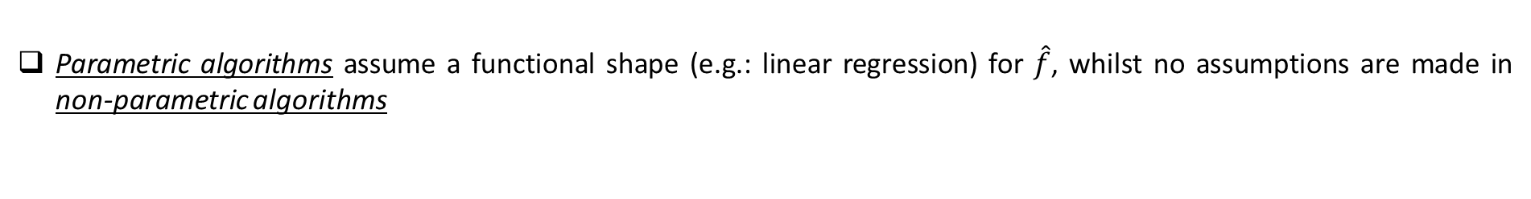

Machine Learning – Key Definitions and Concepts/2
The input variables ${X=(x}_{1},x_{2},…, x_{p})$ are called predictors, features or independent variables whilst the output $y$ is called response or dependent variable
Systematic information that $X$ provides about $y$
$$y=f\left(X\right)+ε$$
Error term (independent of $X$ - due to unmeasured/unmeasurable factors)
The form of $f$ is generally unknown, and supervised ML seeks to find an estimate $\hat{f}$ of the “real” $f$ from a set of available observations (i.e. our training data) which allows for the prediction of $y$, i.e. $\hat{y}=\hat{f}\left(X\right)$
Reducible error: is what we want to minimize!
$$E{\left(y−\hat{y}\right)}^{2}={\left(f\left(X\right)−\hat{f}(X)\right)}^{2}+Var(ε)$$
Irreducible error
Parametric algorithms assume a functional shape (e.g.: linear regression) for $\hat{f}$, whilst no assumptions are made in non-parametric algorithms

Slide 8

Machine Learning – Key Definitions and Concepts/3
Train error is the error associated with the training data
Test error is used to evaluate the model on “unseen” data → Important to assess if the predictive capability of the model can be generalized beyond the training data
How do we estimate the test error? Cross Validation (CV) is the answer
Validation set: split the available data into training data and test data → Use the former to train the model and the latter to evaluate the test error
Other approaches to CV:
Leave-One-Out CV (LOOCV)
k-fold CV

Slide 9
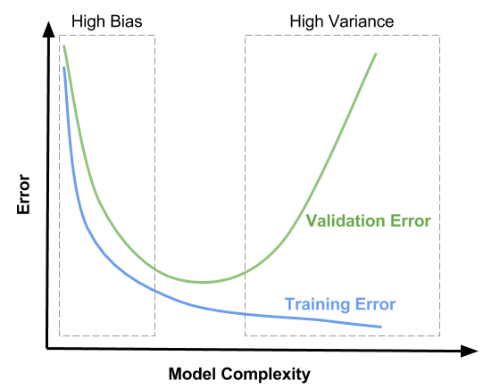
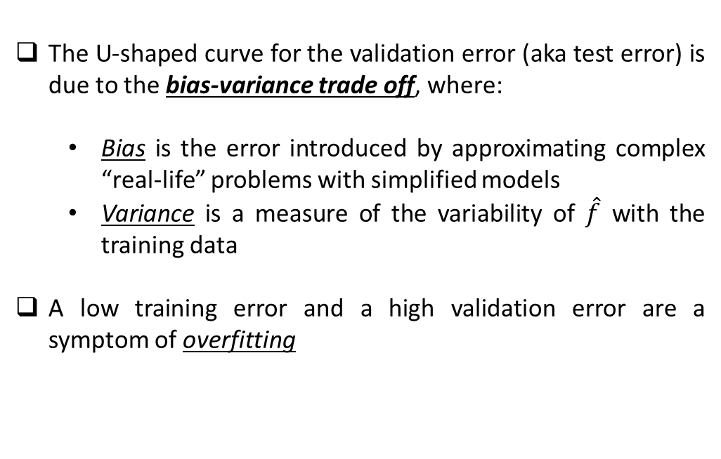
Machine Learning – Key Definitions and Concepts/4
Bias-variance trade-off: a low training error does not automatically imply a low test error. “Flexible” models have low bias but high variance and are more prone to overfitting the training data
The U-shaped curve for the validation error (aka test error) is due to the bias-variance trade off, where:
Bias is the error introduced by approximating complex “real-life” problems with simplified models
Variance is a measure of the variability of $\hat{f}$ with the training data
A low training error and a high validation error are a symptom of overfitting

Slide 10
Machine Learning – Algorithms
We will focus on two algorithms that can be considered at two opposite extremes of the “complexity” spectrum:
Linear/Logistic Regression
Artificial Neural Network (ANN)
... many other ML algorithms exist but …
No Free Lunch Theorem
No single machine learning algorithm is better than all the others on all problems.

Slide 11
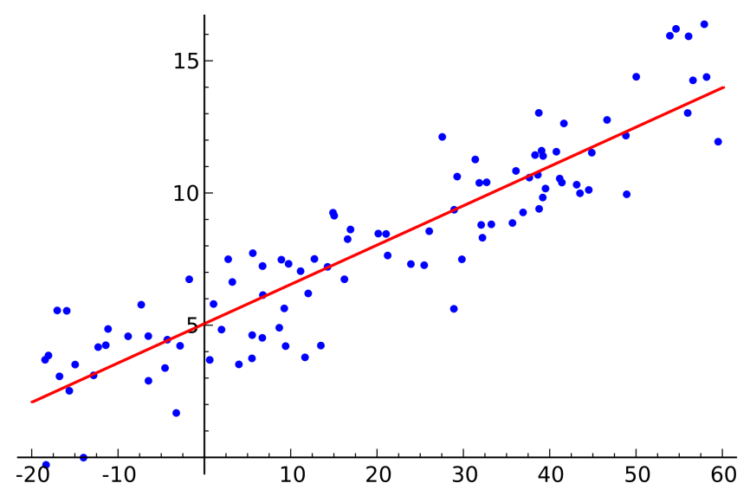
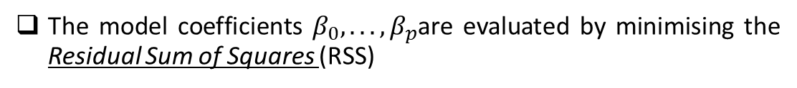

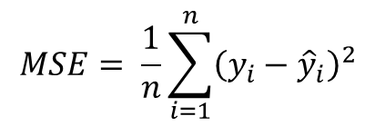
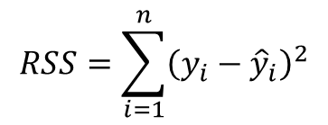
Linear Regression
Linear Regression assumes a linear relationship between the response and the predictors, so that the response is estimated as
$$\hat{y}=β_{0}+β_{1}x_{1}+.. .+β_{p}x_{p}$$
The model coefficients $β_{0}, .. .,β_{p}$are evaluated by minimising the Residual Sum of Squares (RSS)
$$RSS=\sum_{i=1}^{n}{{\left(y_{i}−{\hat{y}}_{i}\right)}^{2}}$$
The Mean Squared Error (MSE) is the most common metric to assess the accuracy of the models in regression problems
$$MSE= \frac{1}{n}\sum_{i=1}^{n}{{\left(y_{i}−{\hat{y}}_{i}\right)}^{2}}$$

Slide 12
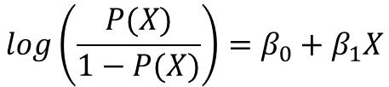



Logistic Regression
In binary classification linear regression predicts the probability of y being equal to 1, i.e. $P(y=1|X)$
Logistic Regression transforms the output of the linear regression via the logistic function, which is always bound between 0 and 1
$$P\left(X\right)=\frac{e^{β_{0}+β_{1}X}}{1+e^{β_{0}+β_{1}X}}$$
$$P\left(X\right)=β_{0}+β_{1}X$$
Odds:
$$\frac{P(X)}{1−P(X)}=e^{β_{0}+β_{1}X}$$
Log-odds or logit
$$log\left(\frac{P(X)}{1−P(X)}\right)=β_{0}+β_{1}X$$
Example from James G., «An introduction to statistical learning», Springer, 2013

Slide 13
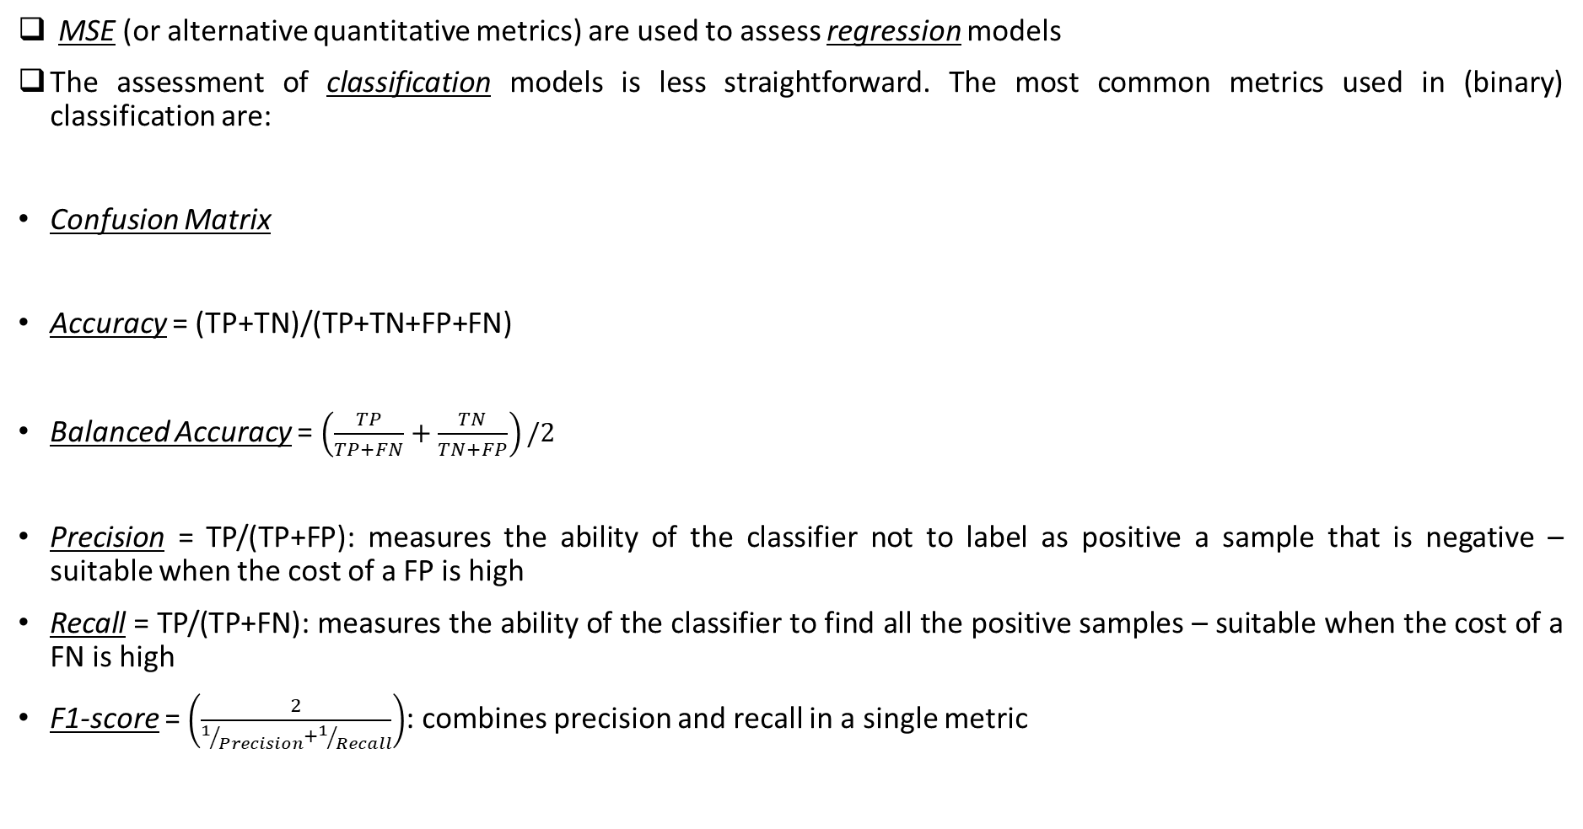
Binary Classification – Model Assessment
MSE (or alternative quantitative metrics) are used to assess regression models
The assessment of classification models is less straightforward. The most common metrics used in (binary) classification are:
Confusion Matrix
Accuracy = (TP+TN)/(TP+TN+FP+FN)
Balanced Accuracy = $\left(\frac{TP}{TP+FN}+\frac{TN}{TN+FP}\right)/2$
Precision = TP/(TP+FP): measures the ability of the classifier not to label as positive a sample that is negative – suitable when the cost of a FP is high
Recall = TP/(TP+FN): measures the ability of the classifier to find all the positive samples – suitable when the cost of a FN is high
F1-score = $\left(\frac{2}{1/{Precision}+1/{Recall}}\right)$: combines precision and recall in a single metric
 | Predicted No | Predicted Yes
Actual No | True Negatives (TN) | False Positives (FP)
Actual Yes | False Negatives (FN) | True Positives (TP)

Slide 14
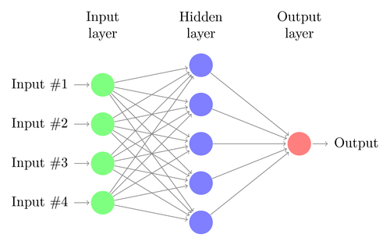
Artificial Neural Network
An ANN is a collection of connected unit nodes called artificial neurons which is inspired by the functioning of the biological brain
An ANN consists of different layers of neurons
The input layer receives the input data from the external world
The output layer produces the prediction
The layers between the input and the output do not interact with the external world and are called hidden layers
A Deep Neural Network (DNN) is a NN with more than one - and possibly a large number - of hidden layers
There are a large variety of possible ANN architectures. One of the simplest one is the feed-forward Multi-Layer Perceptron (MLP)

Slide 15
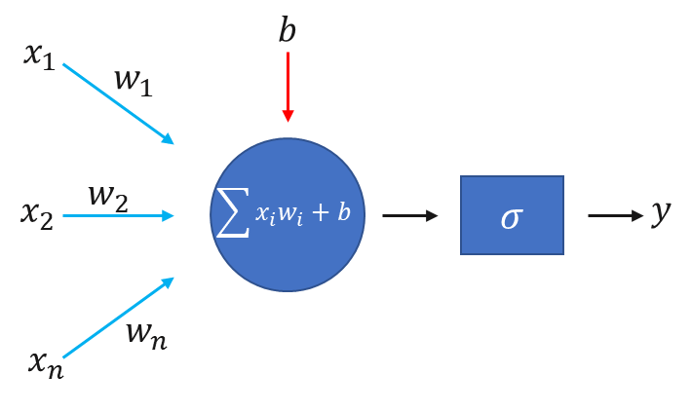
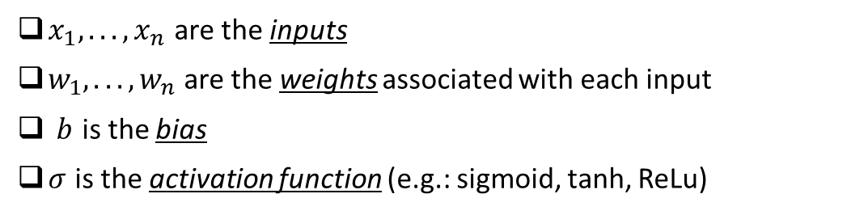
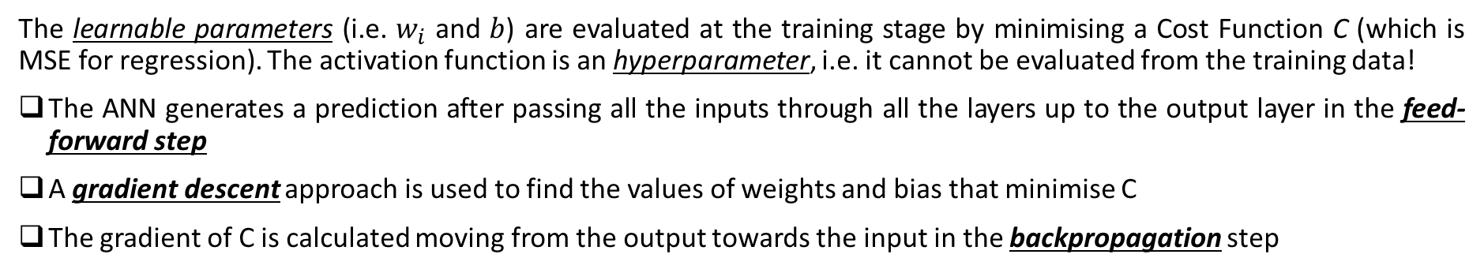
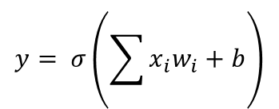
Artificial Neural Network/2
A Perceptron represents a single neuron within the ANN
$x_{1}, .. ., x_{n}$ are the inputs
$w_{1}, .. ., w_{n}$ are the weights associated with each input
$b$ is the bias
$σ$ is the activation function (e.g.: sigmoid, tanh, ReLu)
$$y= σ\left(\sum{x_{i}w_{i}+b}\right)$$
The learnable parameters (i.e. $w_{i}$ and $b$) are evaluated at the training stage by minimising a Cost Function C (which is MSE for regression). The activation function is an hyperparameter, i.e. it cannot be evaluated from the training data!
The ANN generates a prediction after passing all the inputs through all the layers up to the output layer in the feed-forward step
A gradient descent approach is used to find the values of weights and bias that minimise C
The gradient of C is calculated moving from the output towards the input in the backpropagation step

Slide 16
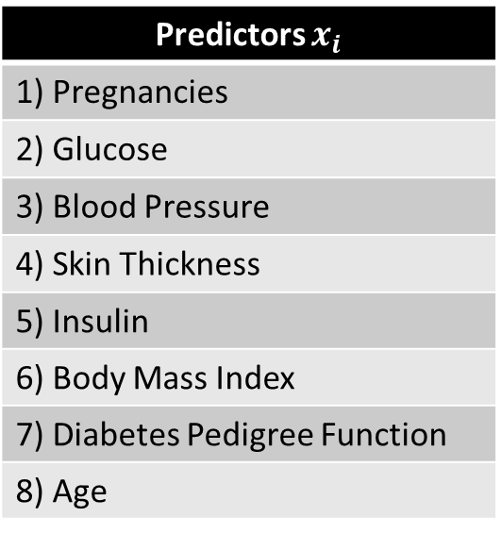
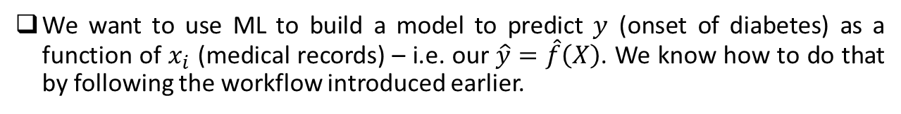
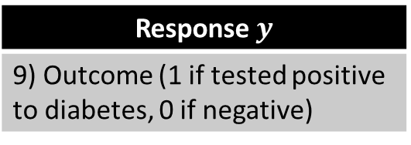
A Practical Example
Use existing medical records to predict the onset of diabetes in Native American Pima women
The dataset is publicly available con Kaggle – contains the medical records of 768 Pima women
Predictors $x_{i}$
1) Pregnancies
2) Glucose
3) Blood Pressure
4) Skin Thickness
5) Insulin
6) Body Mass Index
7) Diabetes Pedigree Function
8) Age
We want to use ML to build a model to predict $y$ (onset of diabetes) as a function of $x_{i}$ (medical records) – i.e. our $\hat{y}=\hat{f}\left(X\right)$. We know how to do that by following the workflow introduced earlier.
…ok…but why???
With a reliable (remember CV) model we can:
Predict the onset of diabetes from the medical records
Infer the relationship between the predictors and the response:
Identify risk factors
Take corrective actions
Response $y$
9) Outcome (1 if tested positive to diabetes, 0 if negative)

Slide 17
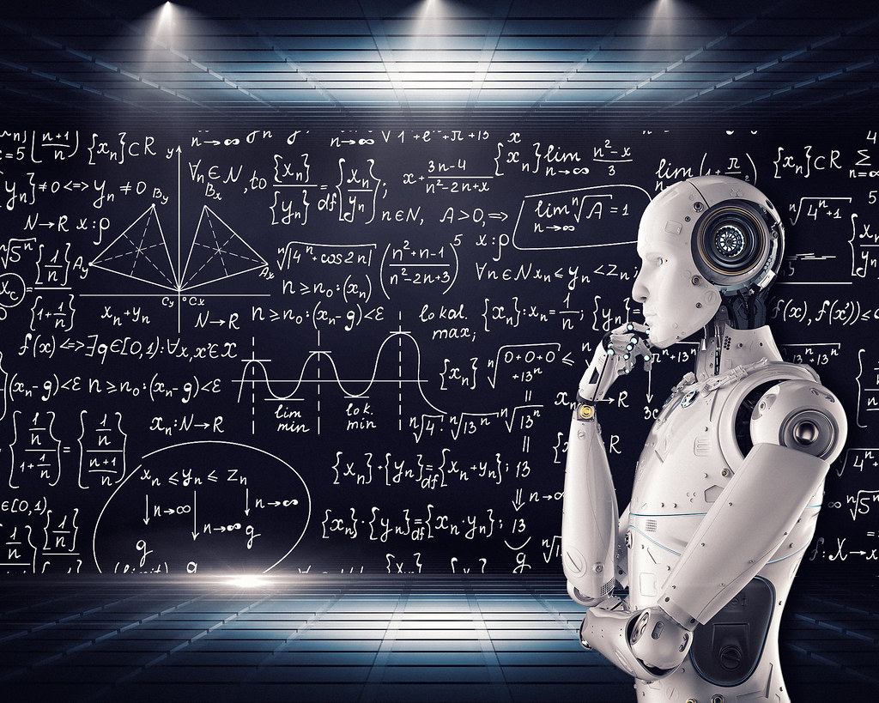
Useful Resources
CentDS
Website: www.CentDS.com
Datasets to Practice With
Kaggle: https://www.kaggle.com/
UCI Machine Learning: https://archive.ics.uci.edu/ml/index.php
Python 3 Documentation https://docs.python.org/3/
Scikit-Learn https://scikit-learn.org/
ANN and Deep Learning Theory
MIT’s book: https://www.deeplearningbook.org/
Statistical Learning Theory
G. James’ book: http://www-bcf.usc.edu/~gareth/ISL/
IBM’s book: https://www.ibm.com/downloads/cas/GB8ZMQZ3
The material from this talk and the ML workshop can be found in the GitHub repository:
https://github.com/AndreaDesan/Global-AI-Bootcamp-Leeds

Slide 18
Any Questions?

