Slide 1
Graph_LTPL.py (GraphLTPL class)
init()
log()
files
initialize the class
log the current time step to a file (to be called after “calc_vel_profile()”)
graph_init()
visual()
veh. dyn.
initialize the graph by calculating performing the offline calculation (nodes and vertices)
visualize the current planning step (to be called after “calc_vel_profile()”)
pose
set_startpos()
velocity
set the start pose of the vehicle within the grid (can be called multiple times, until the driving task started)
success
prev. act.
calc_paths()
object list
calculate an action set of paths for the current time stamp and given environment
paths
zones
pose
calc_vel_profile()
max. vel.
calculate a velocity profile for the calculated paths
trajectories
veh. dyn.
<text>
Mandatory input
<text>
Optional input
<function>()
Mandatory function
<function>()
Optional function

Slide 2
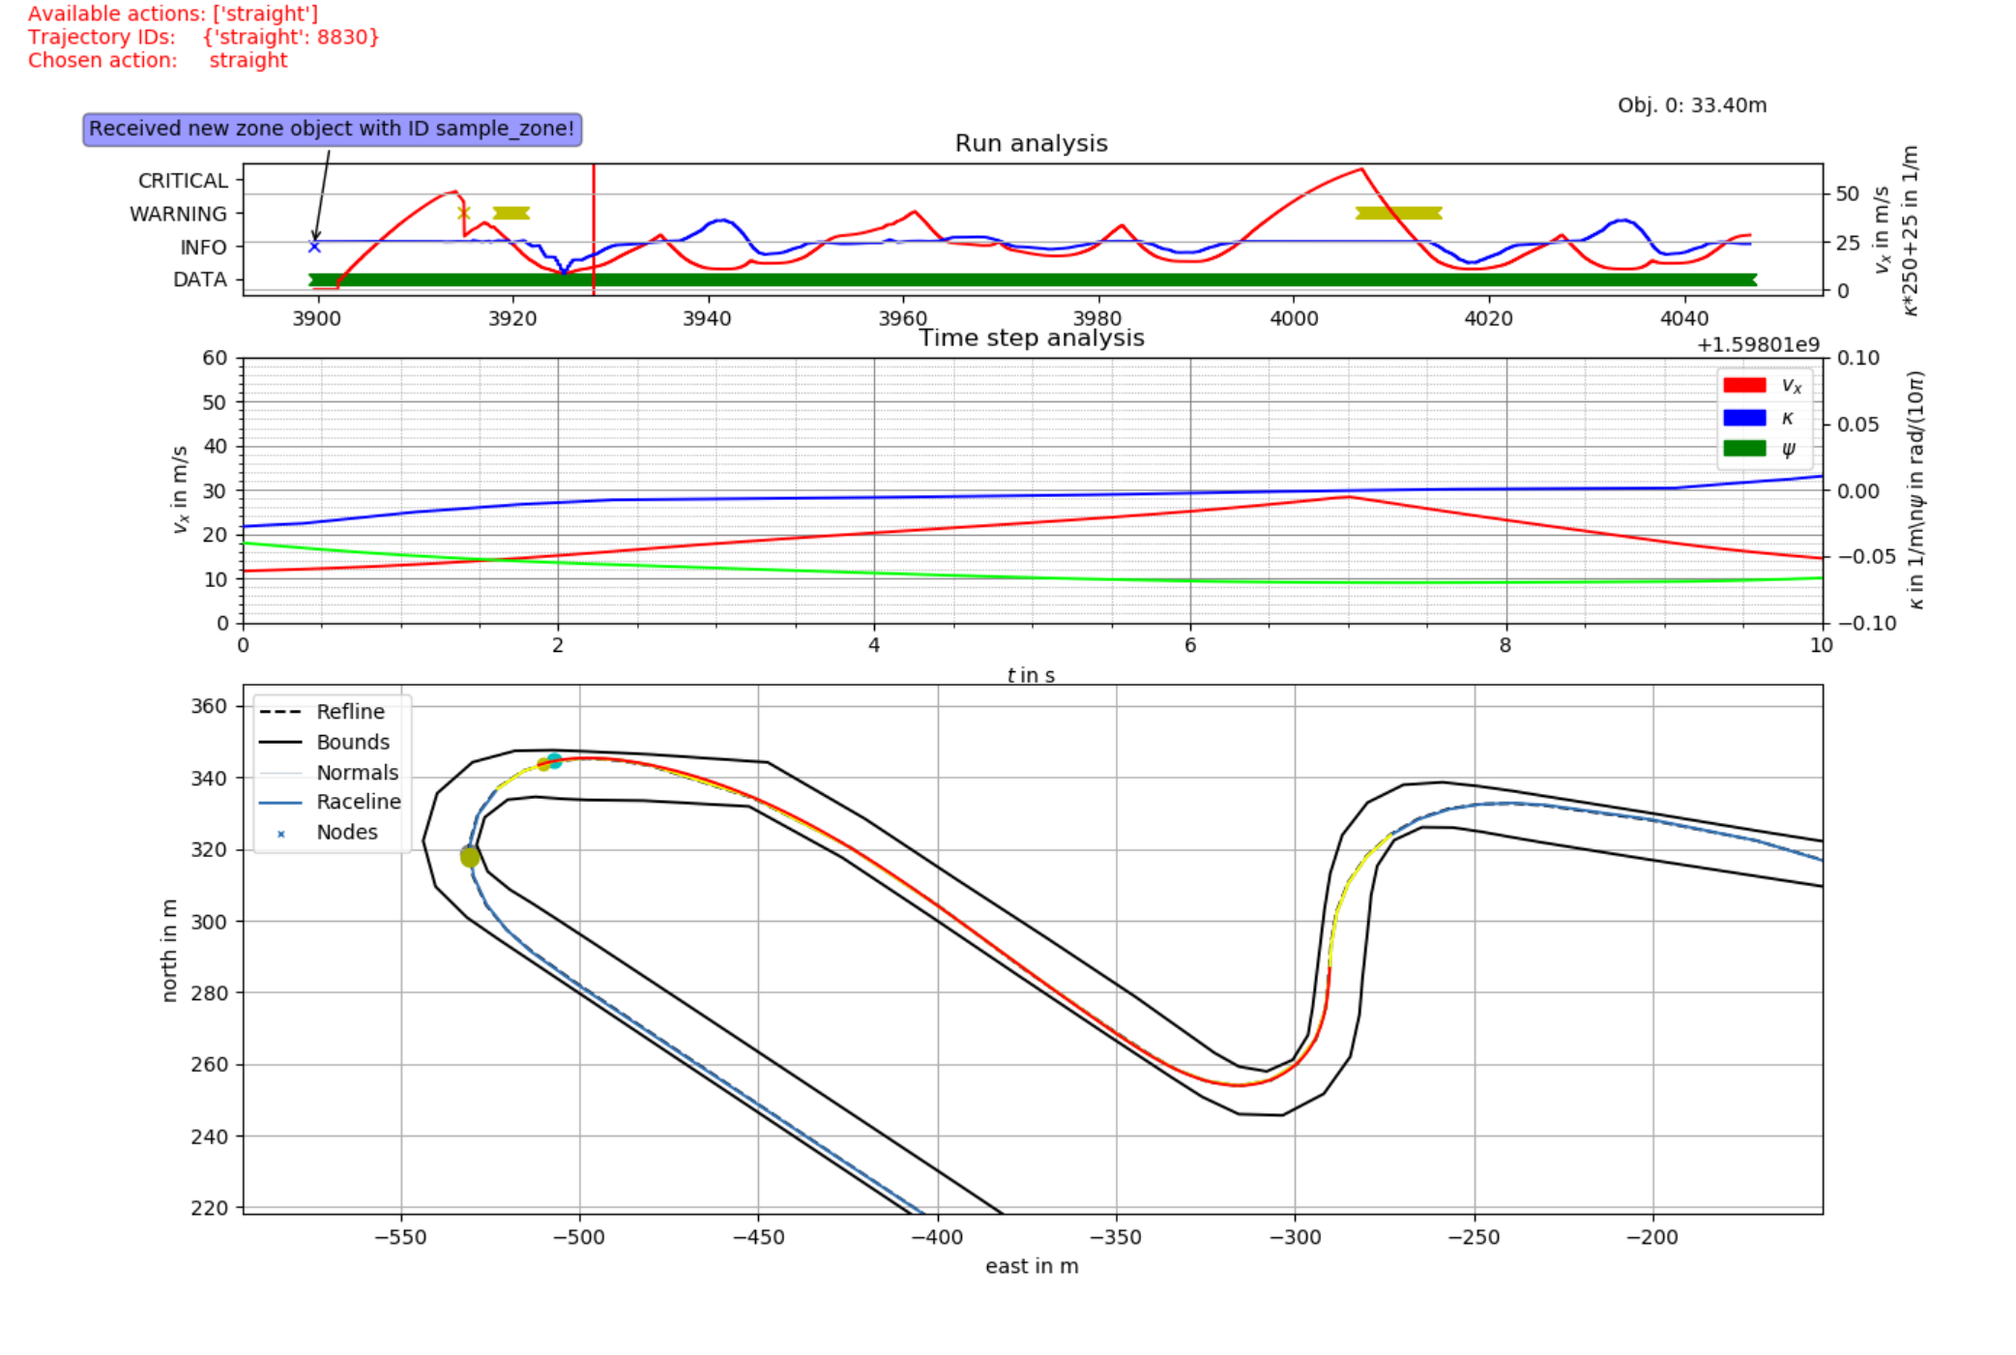
❹
❶
❷
❸

