Slide 1

PARK PLANNER
Andrea, Faithful, Joshua and
Zachariah

Slide 2
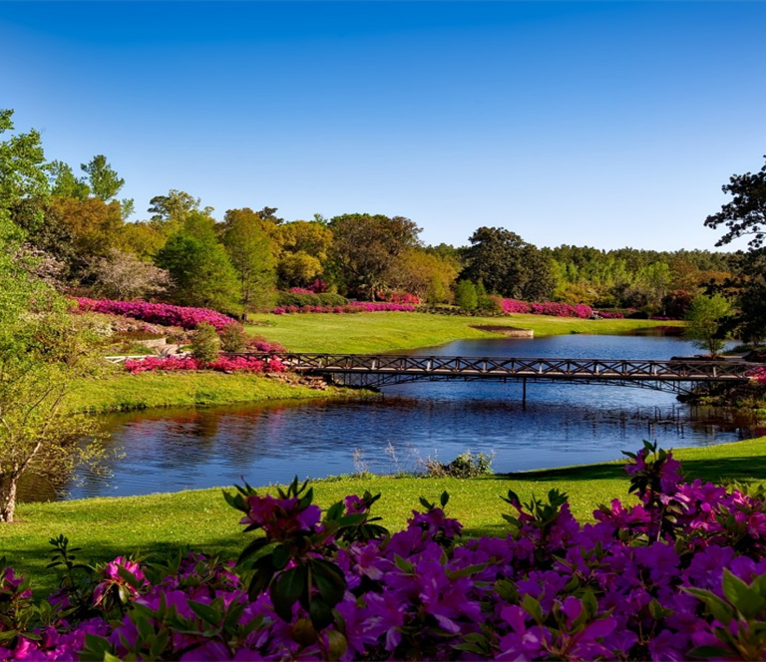
Elevator Pitch
Looking around you at some point during the pandemic (COVID-19), during times you've been stuck indoors wondering where to go,
how to spend time with your family outdoors, a place to clear your head, relieve yourself of stress, anxiety and never really deciding at the end of the day?
We as developers understand that need and have designed a website with well-thought of features that will handle all those needs and will definitely make your life relatively easier. Just visit Park-Planner.com.:)

Slide 3
Concept
Description
Motivation for development
User story
Park Planner is an interactive website which allows Users to conveniently find parks in the State of Georgia. It offers descriptive information about the national parks, captivating pictures - displaying the beauty each park possess, their location, a five-day weather forecast - if favorable or worse, including the humidity. The session will be stored in a database. This will allow the user to actively track the weather anytime using the weather map. In addition to this, the user will have the ability to use their map for directions to their intended park.
As a quarantined resident of Georgia, I want help deciding where to go when I get out of the house, so I can get some fresh air, sunshine, and to feel free again. Also, it would be great to have a pleasant experience of nature.
Thinking about all the families locked in during this quarantine period of COVID-19, people are suffering from depression, anxiety and indoor sickness. it inspired our team to create Park Planner that provides several users access to the National Parks without any hassle. Creating Park Planner, allows several residents to look forward to spending time outdoors, alleviate their moods, to be able to receive sunlight.

Slide 4

Process
Technologies used
Breakdown of tasks and roles
Challenges
Successes
This Photo by Unknown Author is licensed under CC BY-SA

Slide 5
Technologies/Framework used
Materialize Framework https://materializecss.com/
Stack overflow: https://stackoverflow.com/
Treehouse: https://teamtreehouse.com/
w3schools.com: https://www.w3schools.com/
Javascript and jquery
freeCodeCamp: https://www.freecodecamp.org/
MDN web docs moz://a: https://developer.mozilla.org/en-US/
API References
Leaflet: https://leafletjs.com/
OpenWeather API: https://openweathermap.org/
National Parks of Georgia: https://www.nps.gov/index.htm
This Photo by Unknown Author is licensed under CC BY-SA

Slide 6
Breakdown of tasks and roles
Tasks were assigned to each member of the team based on the Project's User story and, on the need of the team as we proceeded deeper into the project. Each member of the team was able to learn something new and the various roles highlighting individual strengths. Also, everyone had a chance to contribute to different aspects of the project despite the allocated roles.
Researcher - Zachariah T.
Front-end developer - Joshua S.
Back-end developer - Andrea B.
Project Manager - Faithful O.
This Photo by Unknown Author is licensed under CC BY-SA

Slide 7

Working together as a team was a ton of fun, but this project introduced us to the joys of forced git merges, when (not) to use branches, and passive-aggressive stylistic revisions. We faced several difficult situation as a team during the project. Fixing the carousel and ensuring the API's are loading up the pictures of each park. Map did not display, got the right component and ensured the site was responsive with a polished user Interface.
This Photo by Unknown Author is licensed under CC BY-SA-NC

Slide 8

Successes
The carousel worked; we were able to ensure the site was responsive across all devices, finally got the map API loading pictures to the site; accumulated knowledge in the process
With a lot of hard-work, perseverance, we as a team can say we did it!
This Photo by Unknown Author is licensed under CC BY-SA
This Photo by Unknown Author is licensed under CC BY-SA

Slide 9
DEMO

Slide 10
Directions for future Development
We as a team plan to improve the site by adding to the parks/locations,
tab a ticket purchasing option, present transportation options like - Uber, Lyft.
Possible layouts may change, but for the most part, we believe that the end user will appreciate the uncluttered design, the preview.

Slide 11
Links
Code repository
hosted on GitHub - https://github.com/AndreaGT91/Park-Planner
Live webpage
hosted on GitHub Pages // link goes here

