Slide 1
Agile Infrastructure for
Service Managers: getting started
V 0.07

Slide 2
Objectives of the training
Learn how to provision, configure and monitor servers in CERN-IT computer centre using the tools and services provided by the Agile Infrastructure

Slide 3
Hands-on training overview
9:00 - 9:15 Agile Infrastructure introduction
9:15 - 10:15 Cloud Infrastructure
10:15 - 10:30 Coffee Break
10:30 - 12:00 Configuration Management
12:00 - 13:00 Lunch Break
13:00 - 15:00 Configuration Management hands-on
15:00 - 15:15 Coffee Break
15:15 - 17:15 Monitoring

Slide 4
Prerequisites reminder
Please confirm that:
You have access to the aiadm administrative nodes:
$ ssh aiadm.cern.ch
You have access to Foreman:
Login to https://judy.cern.ch
Check if you have joined the following e-groups (from https://e-groups.cern.ch)
ai-admins, ai-playground
Please register for Cloud Infrastructure
http://openstack.cern.ch -> Subscribe

Slide 5
Agile Infrastructure (AI)
AI Goal: provide a modern set of tools to manage IT services at CERN
Aims:
  use standard Open Source tools (skills)
  support dynamic ‘cloud’ environment
  improve efficiency of resources and people
Who uses it?
  Anyone who needs to manage IT services at CERN

Slide 6




Agile Infrastructure Overview
Monitoring / GNI
Configuration Management
Cloud Infrastructure

Slide 7




Cloud and Configuration
CERN IT supports nodes with 2 options for configuration:
  None / DIY: use Openstack tools directly
    VM is prebuilt and pre-configured to just start running, run the payload, then dies (e.g. experiment compute boxes)
  Puppet: use the Configuration Management tools
    Most long-lived IT services run using Puppet option, because Puppet maintains the box’s configuration over its lifetime
Cloud Infrastructure tools only (Cloud talk)
Configuration Management tools (Config talk) using
the Cloud Infrastructure underneath

Slide 8
Cloud Infrastructure

Slide 9
Configuration Management System
Goal: provide tools for service managers to configure their servers in CERN’s computer center

Slide 10
What you should expect?
Learn basic Puppet / Foreman concepts
Understand where Puppet “code” lives
To become friends with the Git VCS
Know how to make a Puppet managed VM
Learn how to configure existing modules
Learn how to install packages
Learn how to add config files
Pointers to further documentation

Slide 11
General Concepts

Slide 12
Configuration Management System
The AI Configuration Management System was created based on Agile principles
  Close and daily cooperation between everyone involved in the project (including the end-users)
  Make it easy to test your configuration changes
  Make it easy to release your configuration changes
  Most tools based around “devops” mantra of “configuration is code”
    Treat it like code and use similar tools / processes

Slide 13
Diving straight in
The aim of configuration is:
  to group your nodes into convenient management chunks (hostgroups)
  be able to define in some language what these nodes actually are (what packages, what configuration files, what services)
  Have a system that maintains that configuration over time
    keeps nodes up to date
    be able to make another node quickly if there’s a problem (or if you need to scale out)

Slide 14
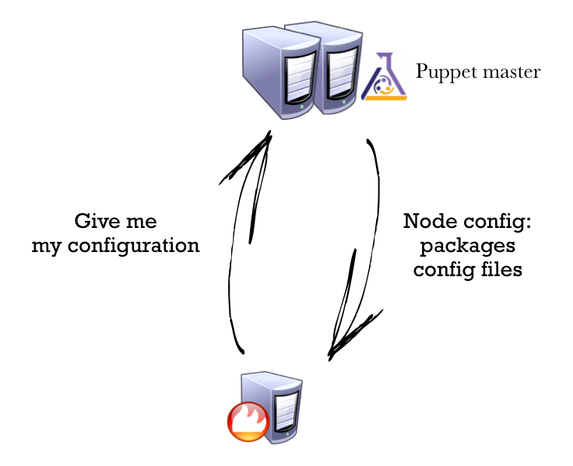

Slide 15
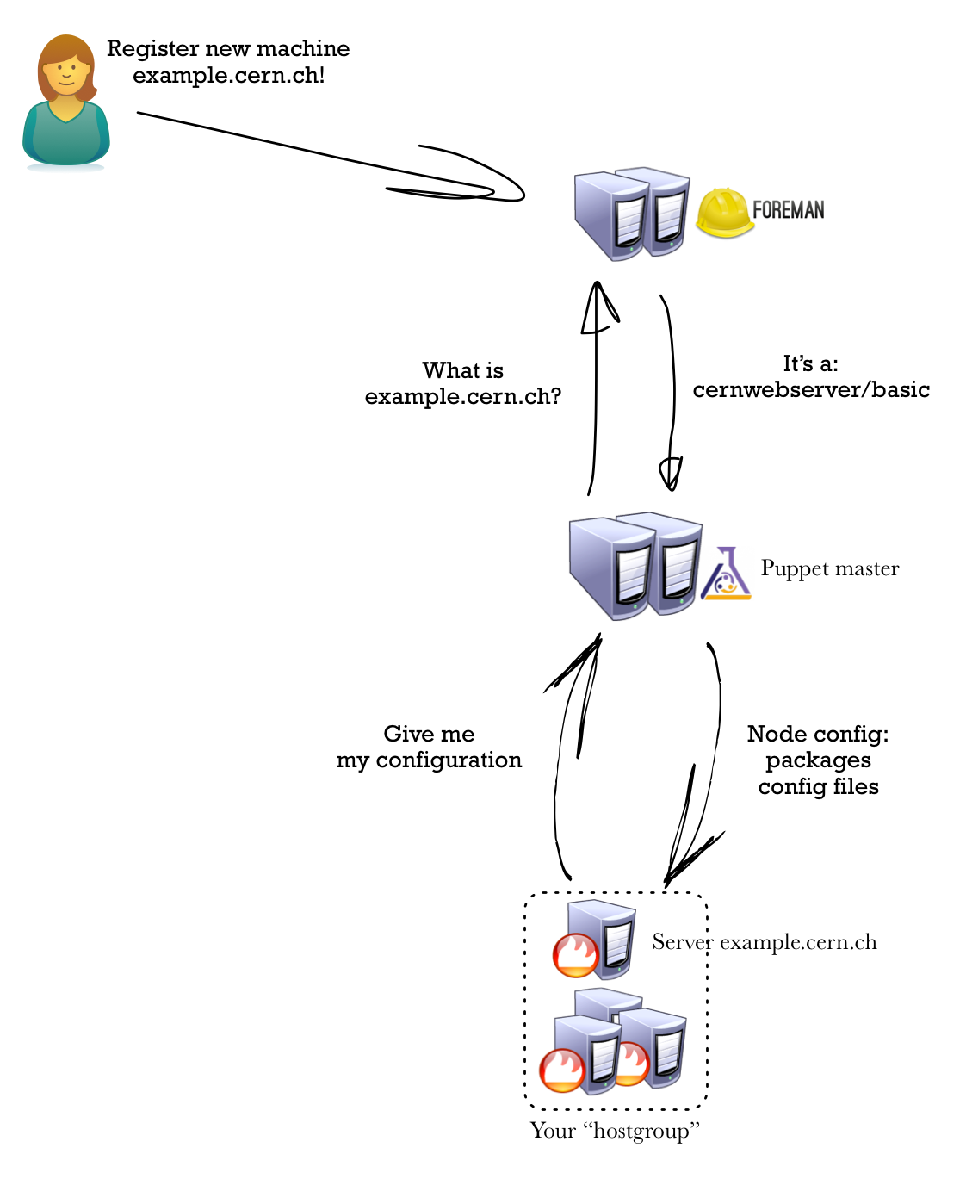

Slide 16
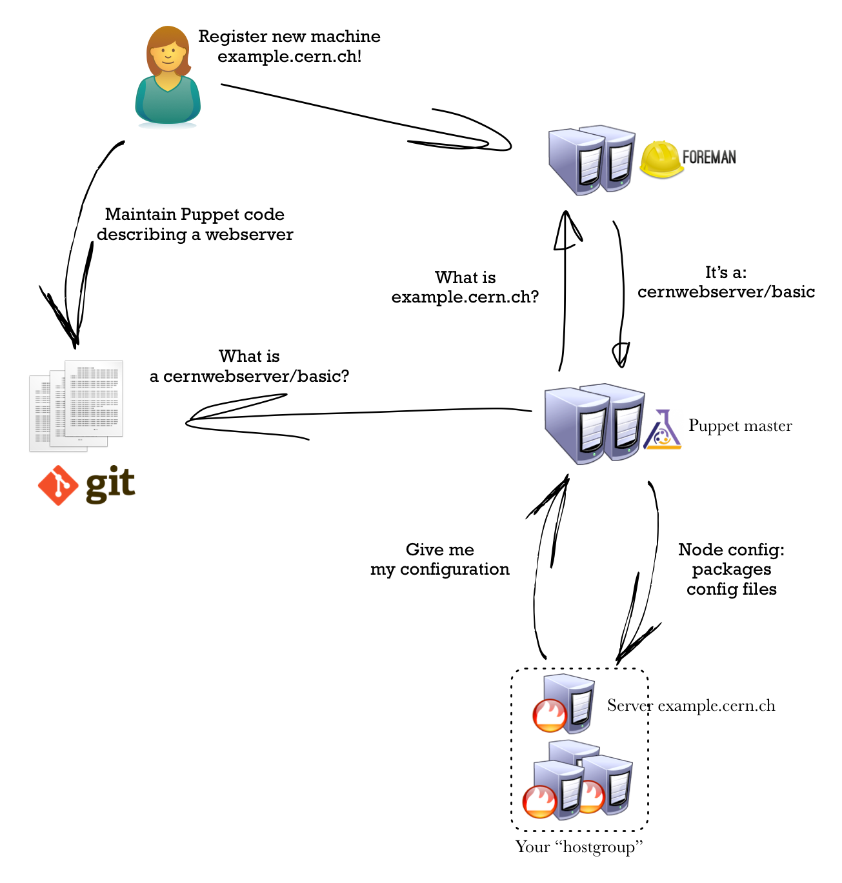
Puppet “manifests”
- module: Puppet code describing something
- heira: configuration data describing something

Slide 17
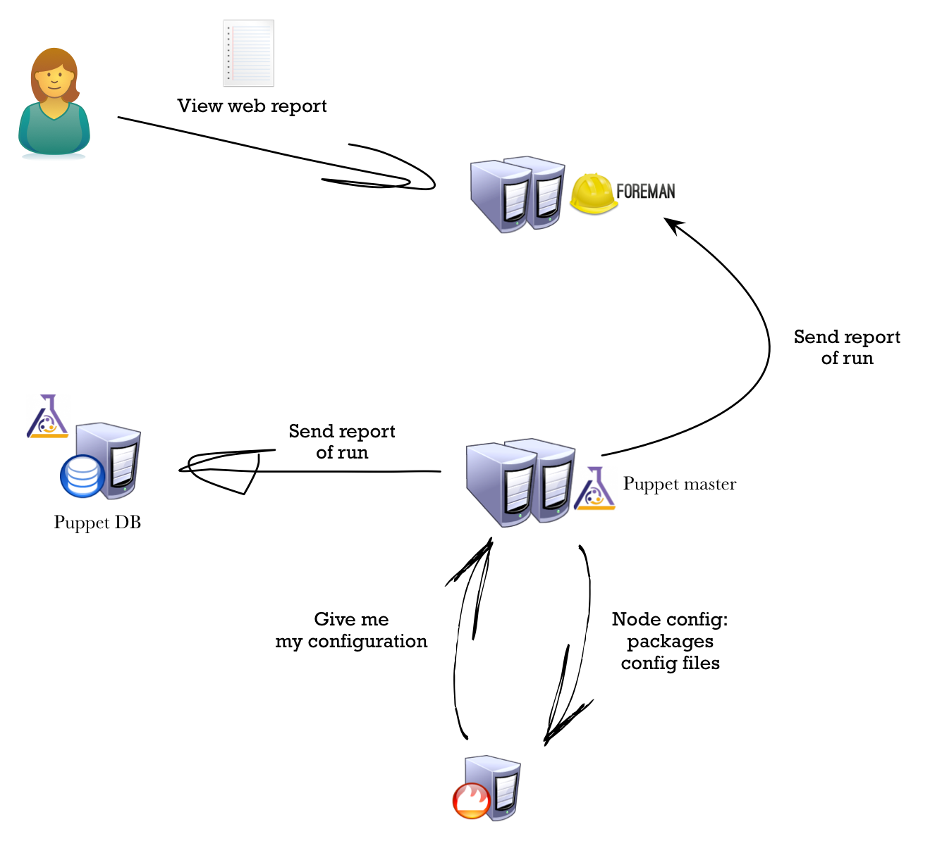

Slide 18
CM keyword review
Hostgroup: a group of machines with similar configuration (i.e. a cluster or service)
Foreman: the service that you define your hostgroups inside and view the Puppet reports from
Puppet master: the service all machines contact for their configuration every ~hour or so
Manifest: a Puppet code file, written in Puppet DSL language, versioned in git
  Hostgroup manifest: the code that defines your service
  Module: a reusable set of files and Puppet manifests to configure something specific (e.g. mysql, apache…)
Hiera: configuration data for modules and hostgroups, also stored in git

Slide 19
Hostgroup
All machines assigned to a hostgroup will be configured accordingly to that hostgroup configuration
A hostgroup must always represent a service
ACLs (Foreman and git) are at the hostgroup level
Each hostgroup has its own git repository, in the CERN git service. All the configuration files related with the hostgroup are located there:
it-puppet-hostgroup-HOSTGROUP_NAME
Content of the Git repository
  code/ – Puppet manifests, files and templates
  data/hostgroup/ – the hieradata for the hostgroup

Slide 20
Subhostgroup
It is possible to have subhostgroups to configure particular cases that are not covered by the base configuration of the hostgroup
  the base configuration of the hostgroup is applied plus the configuration of the subhostgroup
  The configurations are applied hierarchically
e.g.
  webstuff
  webstuff/production
  webstuff/production/balancer
  webstuff/production/backend
Later on you’ll be working in the ‘playground’ hostgroup, with a personal sub-hostgroup

Slide 21
Puppet manifests applied hierarchically
Puppet code lives in Puppet classes and you can have one class
for every level in your hostgroup/sub-hostgroup hierarchy
Hostgroup classes define the structure of your service
(and are not reusable for other things)
Hostgroup | Puppet Class | File (inside it-puppet-hostgroup-<HOSTGROUP_NAME>)
webstuff | hg_webstuff | code/manifests/init.pp
webstuff/production | hg_webstuff::production | code/manifests/production.pp
webstuff/production/balancer | hg_webstuff::production::balancer | code/manifests/production/balancer.pp
webstuff/production/backend | hg_webstuff::production::backend | code/manifests/production/backend.pp
webstuff/testing | hg_webstuff::testing | code/manifests/testing.pp
webstuff/testing/balancer | hg_webstuff::testing::balancer | code/manifests/testing/balancer.pp

Slide 22
Modules
Packages of reusable Puppet code
  Library of reusable software configurations that can be used to configure CERN’s machines and can be called from your hostgroup manifests
Two types:
  shared module: used by more than one hostgroup, e.g.
    base stuff: ntp, hardware, kerberos, sssd, afs, lemon
    standard services: apache, squid, mysql, rabbitmq
  individual module: used in only one hostgroup
  (modularised for convenience)

Slide 23
Modules
As per hostgroups, each module also has its own Git repository
it-puppet-module-MODULE_NAME
Content of the Git repository
  code/ – manifests, files and templates
  data/ – module-level hiera data

Slide 24
Modules installed by default
We provide a minimum base set of modules that all machines use
  cernfw
  certmgr
  hardware
  ipmi
  kerberos
  keytab
  firewall
  mcollective
  motd
  nscd
  ntp
Check the ‘base’ module, which imports these and sets standard defaults
An otherwise empty hostgroup manifest will still have a “standard CERN node” configuration

Slide 25
Code is fine: what about data?
Manifest provide ‘code’
Puppet also has ‘data’ via Hiera
  …where the code can reference a value that gets looked up dependent on the hostgroup (or machine name)
Allows for reusability of manifest code
Look back to ‘webstuff/production’, ‘webstuff/testing’
    The code can be the same, living in top-level ‘webstuff’ manifest
    They only differ by the data
    Imagine you had 50 distinct ‘webstuff’ instances, all part of same service
  Stored in git (data/) inside structured YAML key-value files

Slide 26
Hiera lookup order, first wins!
Hiera looks for a “key” e.g.
  webroot => hiera(’webstuff_webroot', ’/var/www/html’)
YAML files in git follow similar hostgroup hierachy
  Hiera search starts are most specific and works up: first match wins
Machine-specific settings in
  data/fqdns/<machine>.cern.ch.yaml
..then sub-hostgroups, most specific first
  data/hostgroup/webstuff/production/backend.yaml
  data/hostgroup/webstuff/production.yaml
  data/hostgroup/webstuff.yaml

Slide 27
Environments
Environments in Puppet allow you test stuff before deploying into production
Hostgroup and module code can be branched in git to make a patch (i.e. a change you want to apply) – the same way you’d make a feature branch in normal code in whatever version control you use
An environment can then be created to test that individual change
Each machine has an ‘environment’ property
  e.g. production, qa, myspecialtest
  Move one of your nodes to the new environment to test the change

Slide 28
Two standard environments
production:
  controlled and stable environment. Most machines in the CC live here. Corresponds to the master branch of all manifest code
qa:
  incubator environment for changes to shared modules that are ‘in the pipeline’
  corresponds to qa branch of all manifest code
  you should have some machines here

Slide 29
Environment definition
  Changes will typically only affect one or two modules or hostgroups; the rest will be the same
  Normally, we define an environment which says “use master (production) for everything except module X that I’m testing”
e.g.
---
default: master
notifications: service-superweb@cern.ch
overrides:
hostgroups:
superweb: superweb_test
modules:
apache: superweb_test

Slide 30
Recommended flow for any change
Use standard topic branch and code release flow
Branch code for your change (topic branch)
Make the environment including change
Move a machine in there and test
… Iterate until you’re happy …
Merge the code into ‘qa’ branch for your module with git
Allow your ‘qa’ machines to upgrade
… Wait a while, until your ‘qa’ services are happy …
Merge the code into ‘master’ branch with git

Slide 31
QA process
The process is formalised for shared modules
Shared module maintainers in CERN IT will test and merge to ‘qa’ their changes
  Improvements / fixes needed to local modules
  New upstream versions (e.g. apache)
Changes are announced widely and kept in QA for a week before being pushed to production, pipeline style
New Linux packages are QA’d first
Press the “STOP” button if your machines are affected

Slide 32

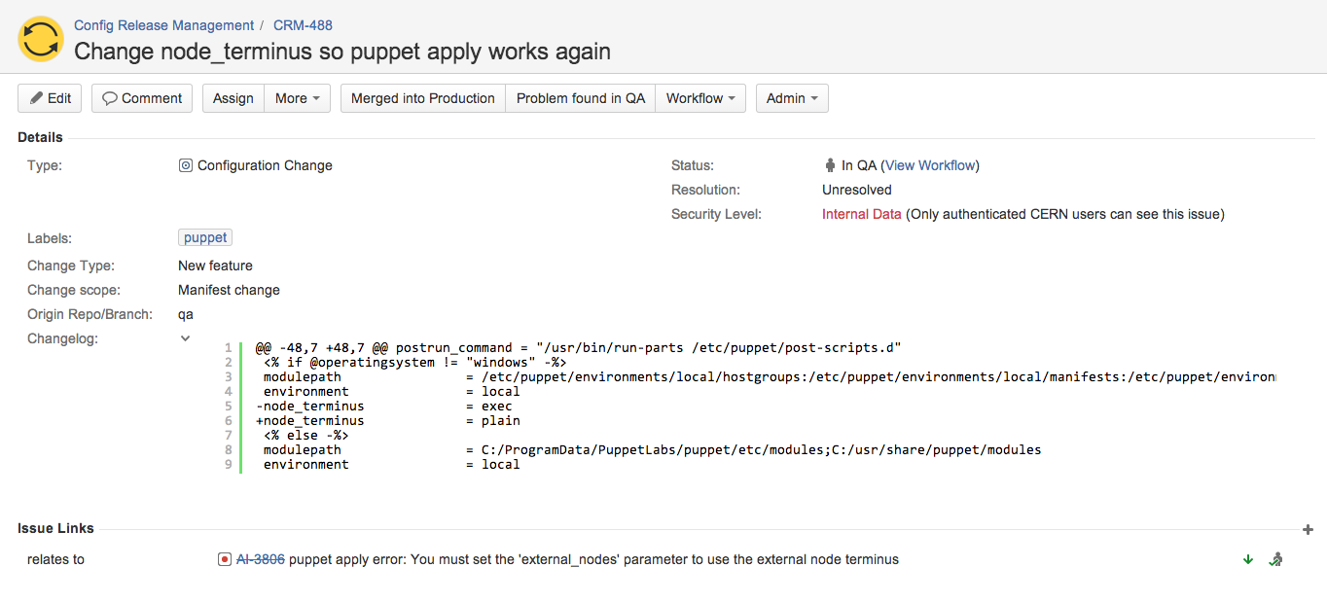
QA process
Everyone should have nodes in QA
Changes in pipeline announced by mail and Thursday AI meeting

Slide 33
Misc things

Slide 34
State management
The roger service is used to maintain state of a box
  Alarm masking (i.e. whether a node will raise an alarm to SNOW if it has a problem) – see Monitoring Talk
  State management: user managed ‘state’ of box, e.g. ‘production’, ‘draining’, …
    Allows triggered actions on state changes
    Can also notify subscribers via a message bus
Read about it at http://cern.ch/config

Slide 35
Secrets
Not everything can be in a git manifest, notably passwords
The tbag service is a key-value store for secure data
Puppet manifests can request a specific secret by its key name (similar to hiera)
Key is securely handed over to the node on Puppet run
Secrets heavily ACLed (admins, relevant hostgroup/nodes)
Read about it:
  http://configdocs.web.cern.ch/configdocs/secrets/README.html

Slide 36
Check how others do it
Example
  Many production service managed by Puppet
Where?
  You can view and grep existing modules and hostgroups in /mnt/puppetnfsdir/environments/<name of the enviroment>
  available in all aiadm nodes
Example:
  /mnt/puppetnfsdir/environments/production contains the exact same tree that the production masters see for the production environment

Slide 37
Support
Incidents, interventions published on the IT Service Status Board
Puppet, configuration management
  e.g. need/suggest a specific Puppet module, problems with Puppet, Git, Foreman…
  Configuration Management in Service-Now
Informal chat channel
  XMPP conference.jabber.cern.ch/ai-discuss

Slide 38
Vital bookmarks
Configuration service documentation:
  http://cern.ch/config
Puppet documentation
  http://puppetlabs.com/puppet/what-is-puppet
Puppet language reference
  http://docs.puppetlabs.com/puppet/latest/reference/lang_summary.html

Slide 39
Let’s play with the
Configuration Management System

Slide 40
Reminder: Git repositories
All CM repositories are hosted on the CERN’s Git central service
it-puppet-hostgroup-NAME (name of the hostgroup)
it-puppet-module-NAME (name of the module)
it-puppet-environments (definition of the puppet environments)
it-puppet-*

Slide 41
AI Configuration Management tools
Installed in aiadm (aiadm.cern.ch)
ai-bs-vm
ai-create-environment-metadata
ai-dump
ai-hiera
ai-kill-vm
ai-pdb
roger
For Puppet-managed nodes, use these tools instead of the “nova-” ones, since they do the necessary for both the Config and Cloud system at the same time

Slide 42
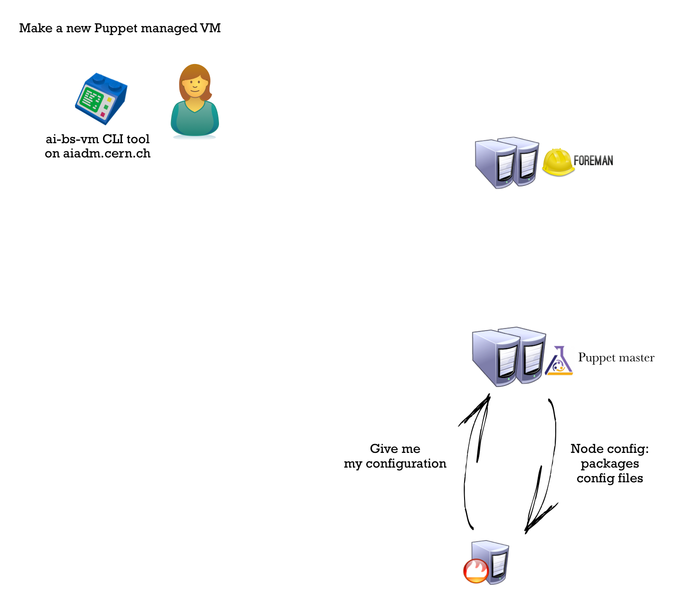

Slide 43
