Slide 1
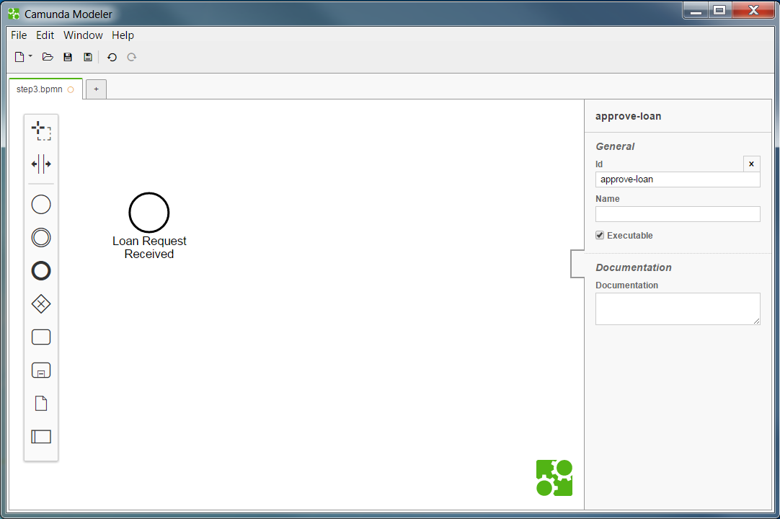
Double click on element to edit label
(Type SHIFT+ENTER for line break)

Slide 2
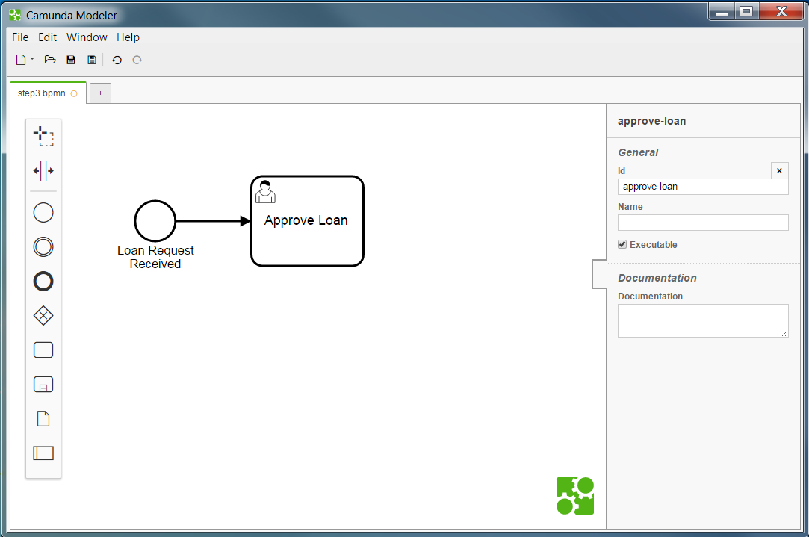
Select start event
Click and drag activity shape (oval)
3. Select activity
4. Click wrench icon and change type to user task

Slide 3
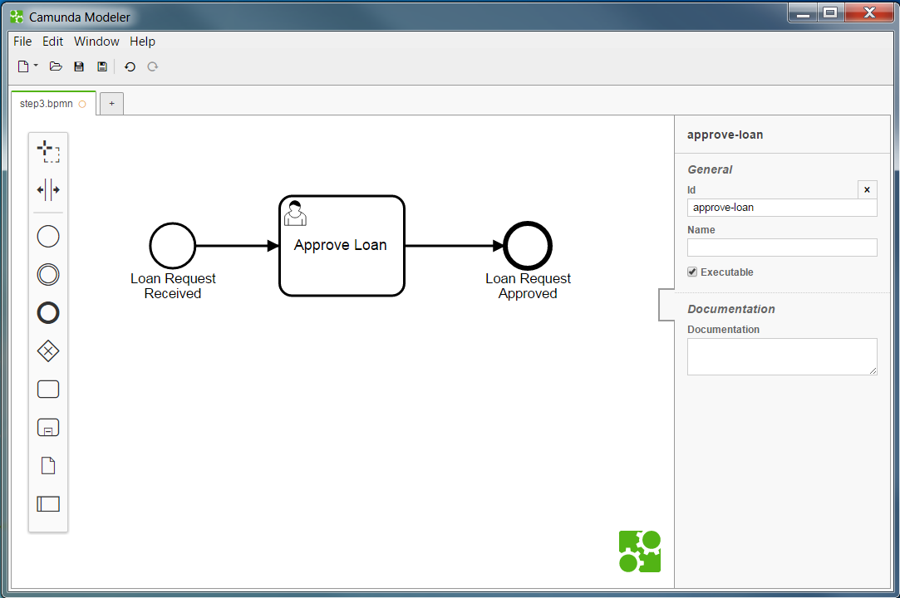

Slide 4
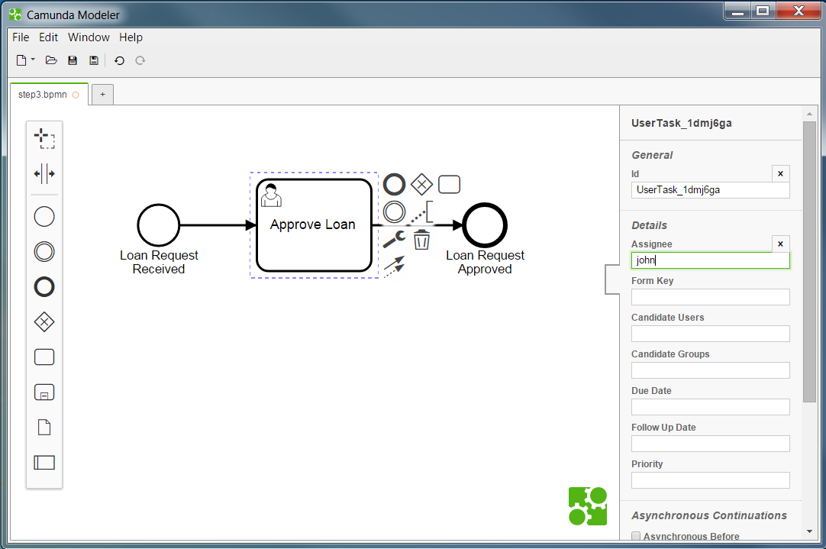
This User Task will be assigned to john

Slide 5
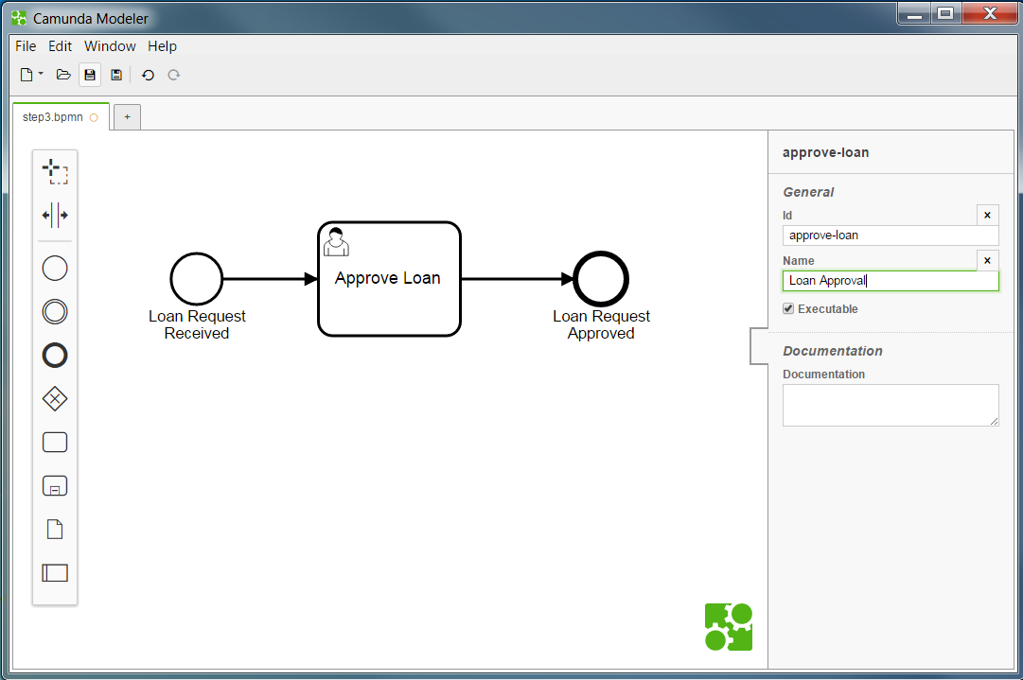
Change the process id
Set a name
Mark the process to be executable

Slide 6
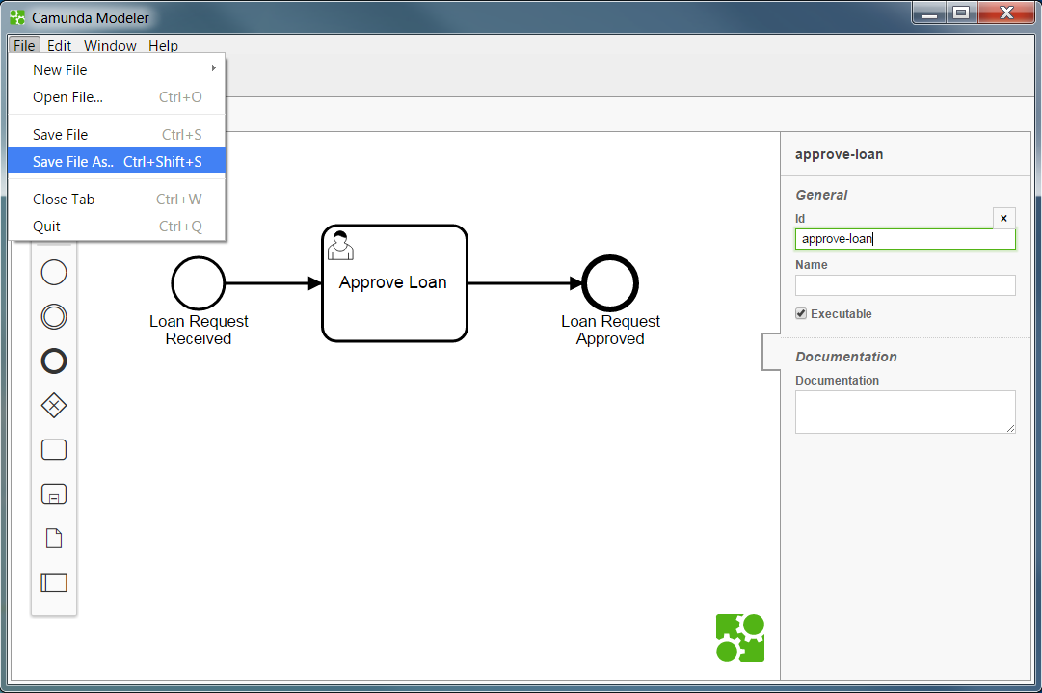

Slide 7
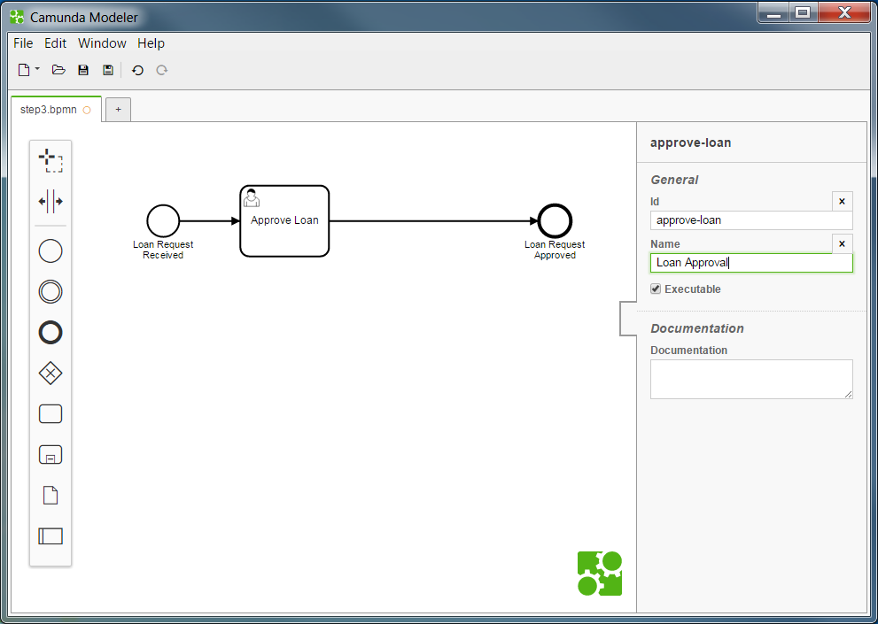
1. Make Room
For accomodating the
Service Task
2. Drop
Service Task on Sequence Flow

Slide 8
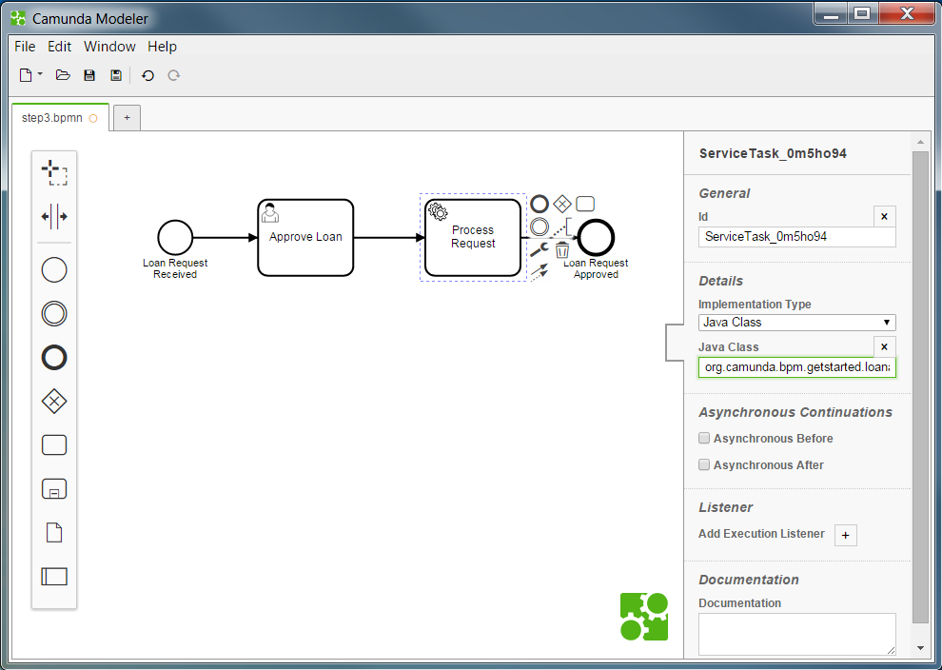
Set the implementation class

Slide 9
