Slide 1
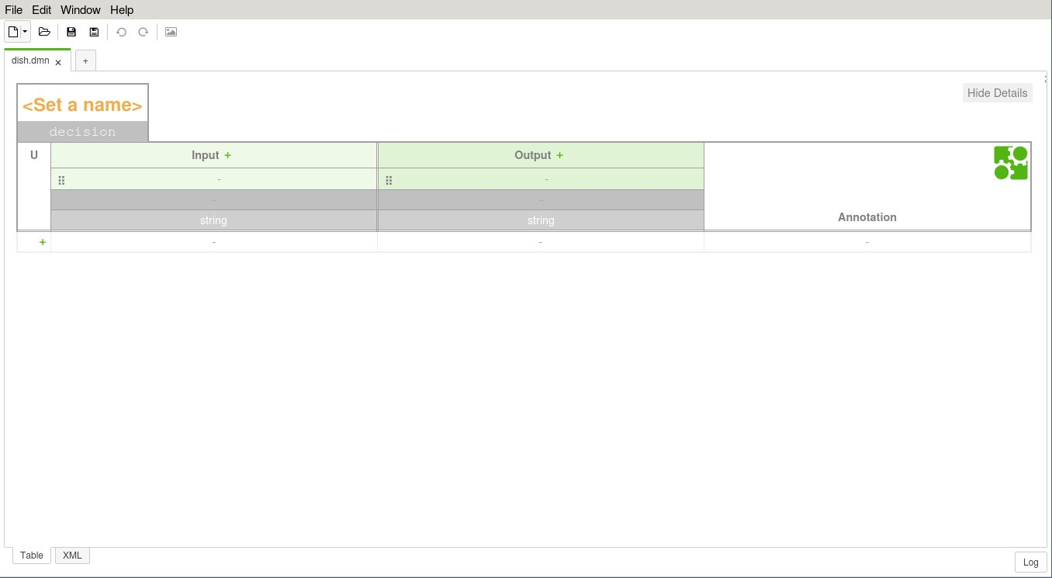
Set a name
Change the decision id

Slide 2
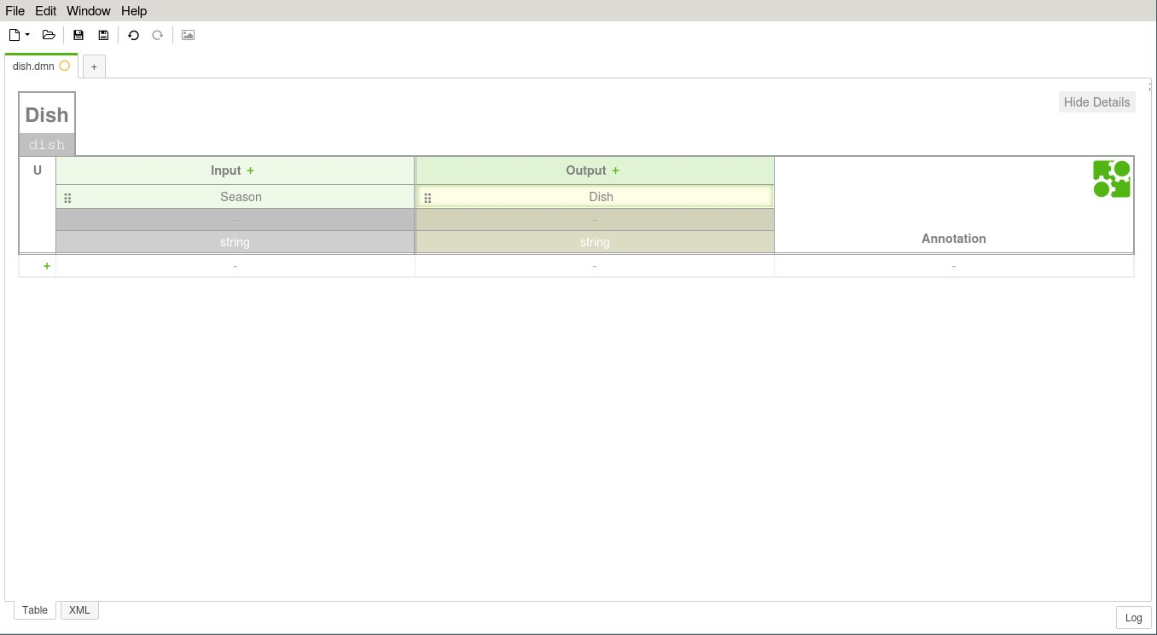
Set an input label
Set an output label

Slide 3
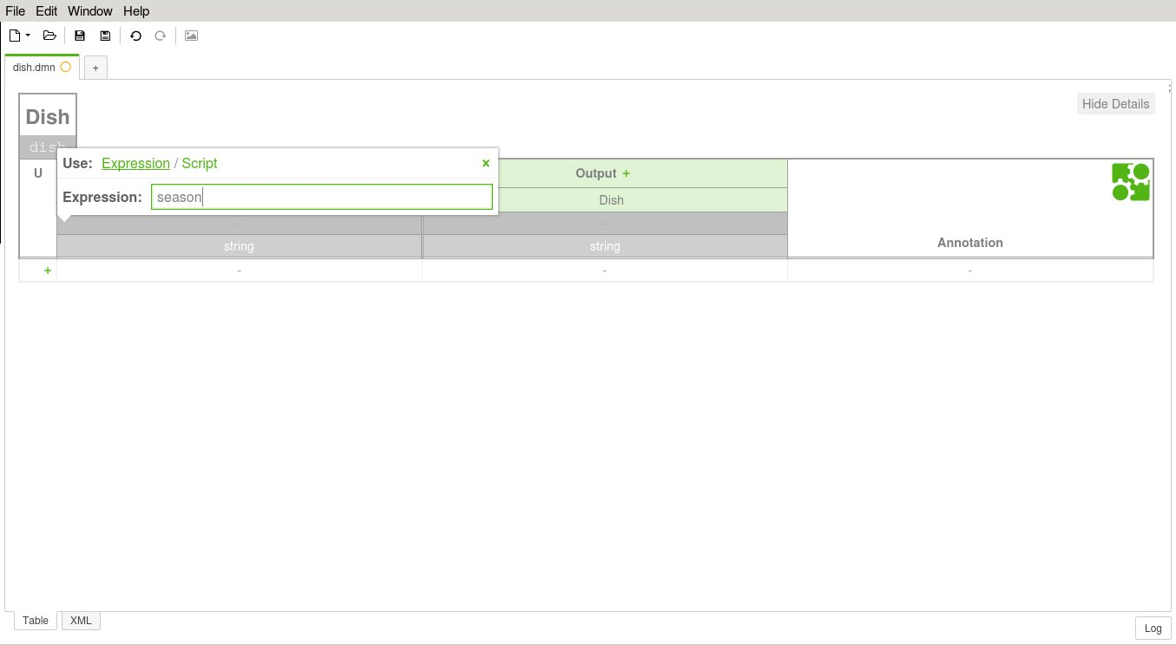
Set an output name
Click on the field
Set an input expression
Close the pop-up

Slide 4
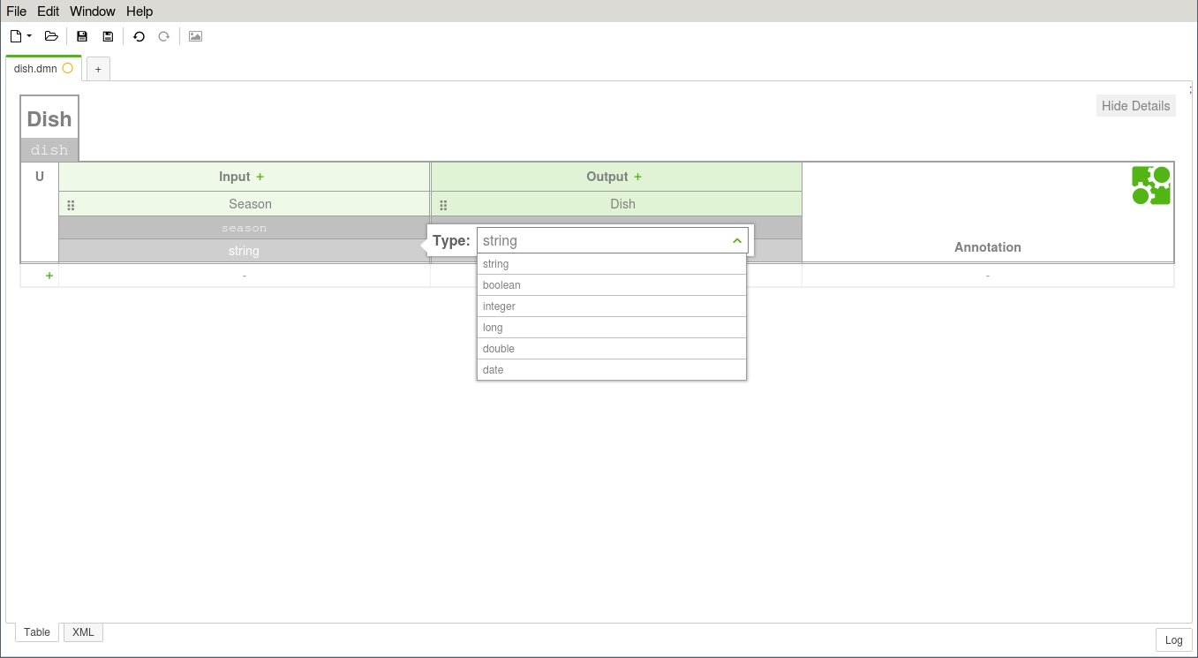
1. Click on the field
2. Choose a type

Slide 5
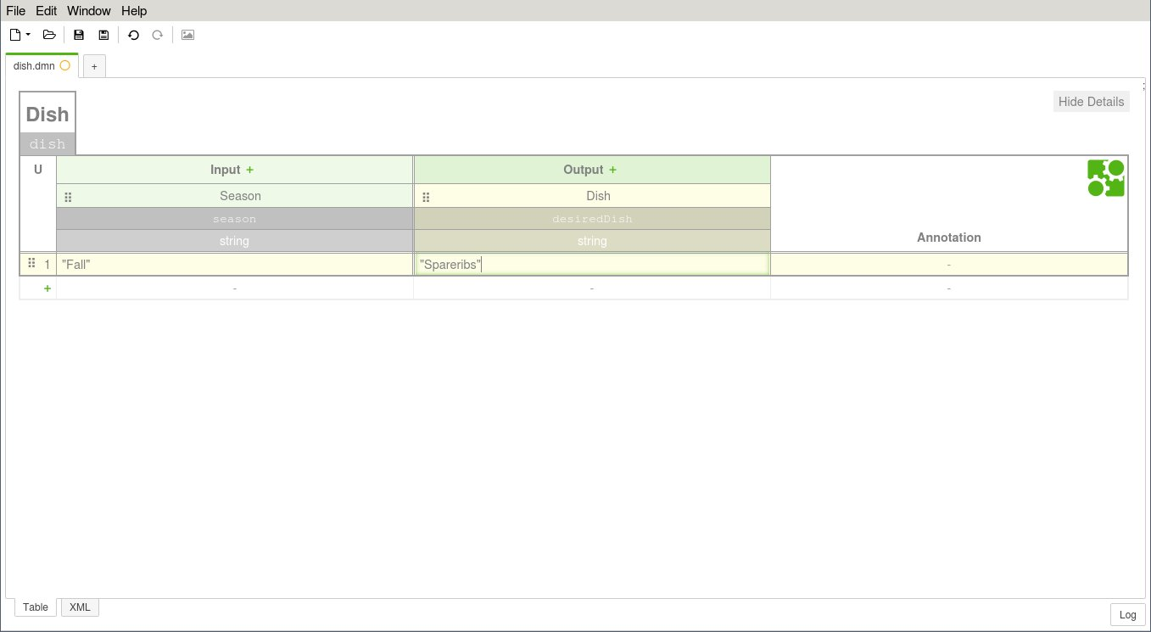
3. Set a conclusion
2. Set a condition
1. Click on the „+“ button

Slide 6
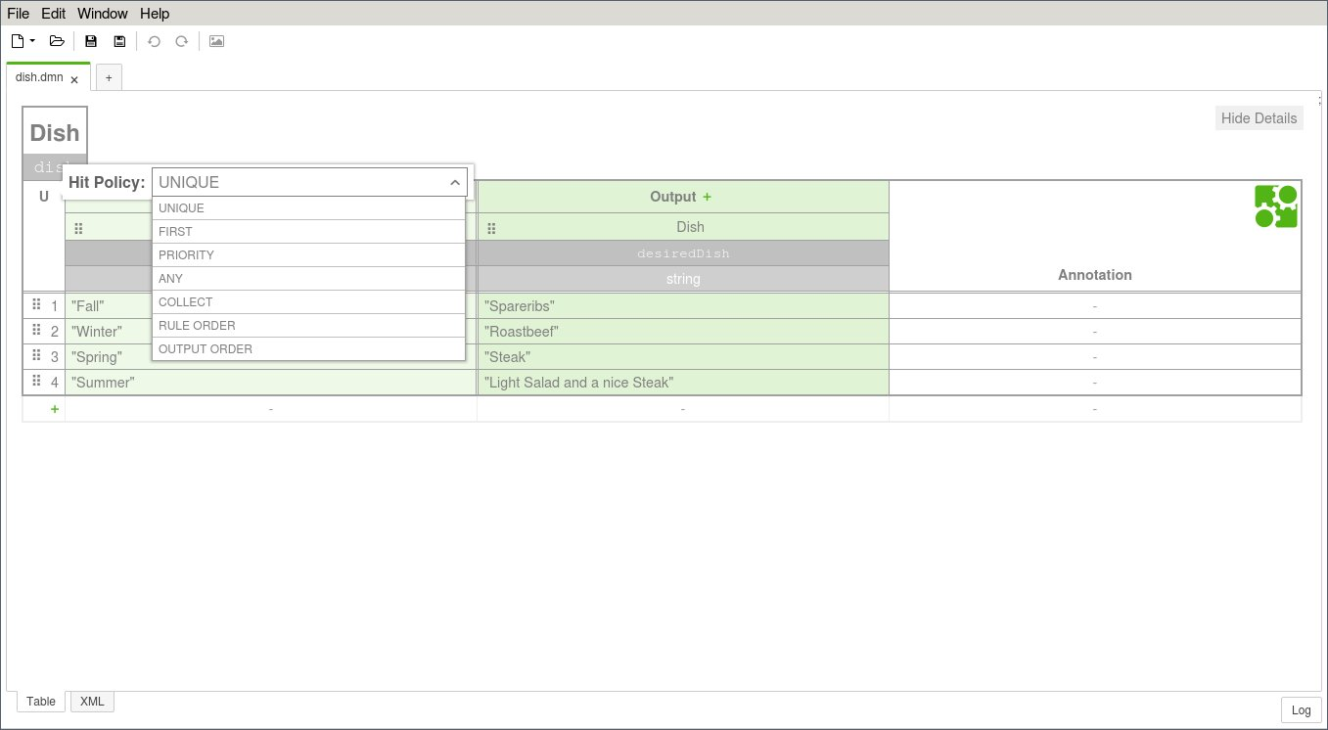
1.Click on the field
2. Choose a hit policy

