Slide 1
[This slide is not meant to be presented. For speaker prep only.]
Thanks again for being part of this season’s events! This deck has been prepared for you to use at a local user group, meetup, or community event. If there are demos (code or pre-recorded video) associated with this deck, you’ll find them in the GitHub repo: https://aka.ms/CommunityContentRepo
Tips:
Update the title slide with your name, title (and consider adding your own bio slide to the deck)
Go through the slides at least once or twice before presenting. Get comfortable with the content and flow. Feel free to remix/reorder slides to fit your presentation time limits or style.
If you are using pre-recorded video demos (if available), download them locally and make sure they work before your presentation.
If you are using live demos, practice and make sure you’re comfortable with the things you’ll be showing (and consider downloading the videos as a backup).
If you get stuck or have questions, please use Discussions on the GitHub repo
Don’t forget to ask attendees to complete the attendee survey so Microsoft can learn more about how to improve this content in the future!

Slide 2
The goal of this talk is to act as an overview of the different things you can do with GenAI + .NET, particularly focusing on the RAG pattern for building intelligent apps.
It aims to be a mix of slides for theory and demos to implement that theory, using either your own RAG app or https://github.com/aaronpowell/hanselminutesbot if you desire (Hanselman has given permission to use that data). If you want to use HanselminutesBot, reach out to Aaron on how to set it up
Consider this deck as the primary and create a copy to edit/adapt for your specific audience needs.
Intended duration – 60 minutes.

Slide 3
Intro to AI with .NET, OpenAI, and Semantic Kernel
Speaker Name
Speaker Title

Slide 4
Speaker Bio Slide

Slide 5

Microsoft wants to hear from YOU!
Attendee Survey
Season of AI | Microsoft Community
aka.ms/AttendeeSurveySeasonOfAI
2024
Notes:
Remind attendees to participate in the event survey

Slide 6
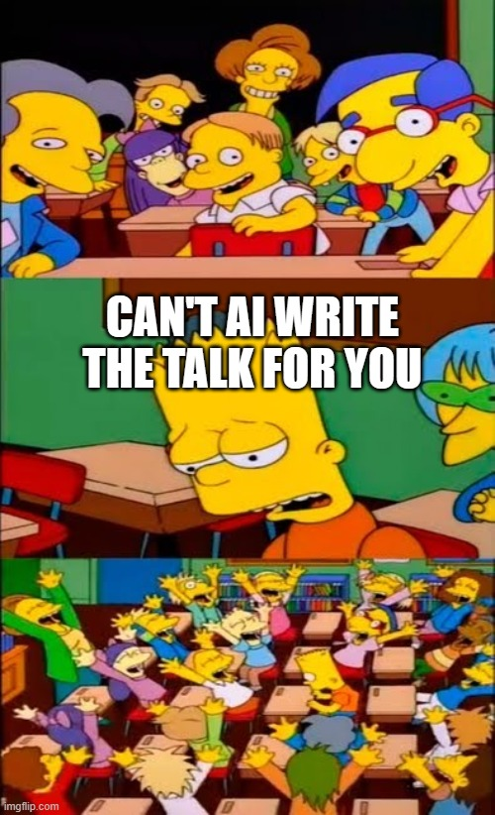
Notes:
It’s a pretty standard joke that when you’re working with AI, AI can just do everything for you right?
Well I’ll pose this question for you to consider as we go through this talk, how much of it do you think was created by AI?

Slide 7
Demo
Notes:
Let’s start with a demo of what we can do with OpenAI by using semantic Kernel. https://github.com/jamesmontemagno/AIDemo

Slide 8
Generative AI
Notes:
Well, that demo had a lot of moving parts in it, let’s break it down into a few smaller pieces to learn just how it did what it did.
Underpinning all of it though was Generative AI, so before we go into the .NET aspect of it, let’s have a look at just how Generative AI works.

Slide 9


Large Language Models (LLMs)
“Once upon a time,
GPT 3.5
GPT 4
“In a quaint village nestled between rolling hills and meandering streams, there existed […]. ”
N-token Prompt
M-token Completion
Notes:
First, let’s define a Large Language Model, commonly abbreviated as LLMs. LLMs are a type of generative AI model that can generate and understand natural language by learning statistical patterns of natural language from huge volumes of text – books, articles, web pages, and social media - basically anything that is text.
An LLM works by estimating the probability of a word, or token or a sequence of tokens, given some previous tokens or context. They can also generate whole sequences of tokens, such as a paragraph or a story through an expanding window pattern.
LLMs repeatedly predict the next token using context and its prior predictions until a stop condition is met.
Phrased another way, you can think of these models as being training on a large chunk of the Internet, so their parameters represent something like a 100x compression of all the knowledge contained on the Internet into a ~140GB file. By optimizing the model on the next-word prediction task as part of self-supervised training loop – meaning hiding parts of input text and asking the model to predict the missing parts - the model learns about the world just to predict that next word.
[Ready the audience/vibe: joke] Learning about the world just to predict the next word in a sentence sounds like a lot of work, right?
You interact with these models by inputting a prompt, which is a series of words or tokens. LLMs make predictions based on your prompt and output a completion, which is a series of words or tokens again.

Slide 10
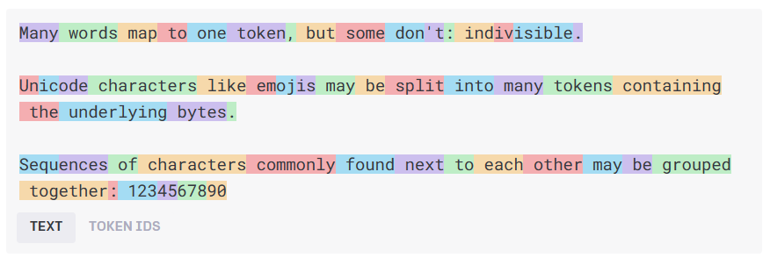
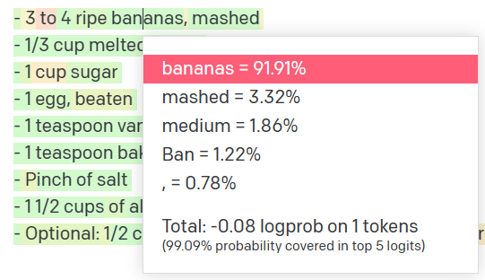
How language models work
Natural language input
Pre-processing
Tokens
Natural language output
Model
Get results
Decoding + Post-processing
Probability distribution
Notes:
The language model receives raw text, then tokenizes the text, tokens are chunks of text depicted by the different colored boxes in the image above, and these tokens are then transformed into integers that are fed to the model.
The model is a transformer architecture-based neural network, which we don’t have time to dive into here, but essentially the goal of this model is to predict the next word in a sequence, which leads to the model sampling a probability distribution that results in the final text/token output.
General idea:
Text -> token
Token (are numbers) Numbers go into the model
Model samples a probability distribution, then outputs natural language (a single token)

Slide 11
How language models work
n tokens in
1 tokens out
Notes:
The simplified idea is….
N tokens in
1 token out

Slide 12
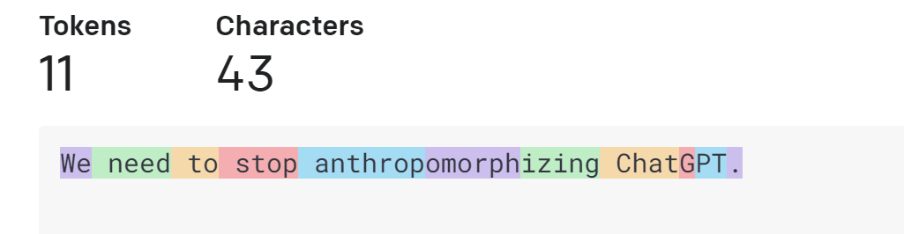
How language models work
Tokens
https://platform.openai.com/tokenizer
Notes:
To clarify on what a token is….
A token is not a letter
Or a word
In case of openAI
A token is a short sequence of letters
For example a token can be “we”, “of”, “need” => because they are short and commonly used But a token can also be part of a word like anthropromorphisized takes 3 tokens, because it is a long word and not commonly used
This is how the tokenizer in OpenAI works

Slide 13
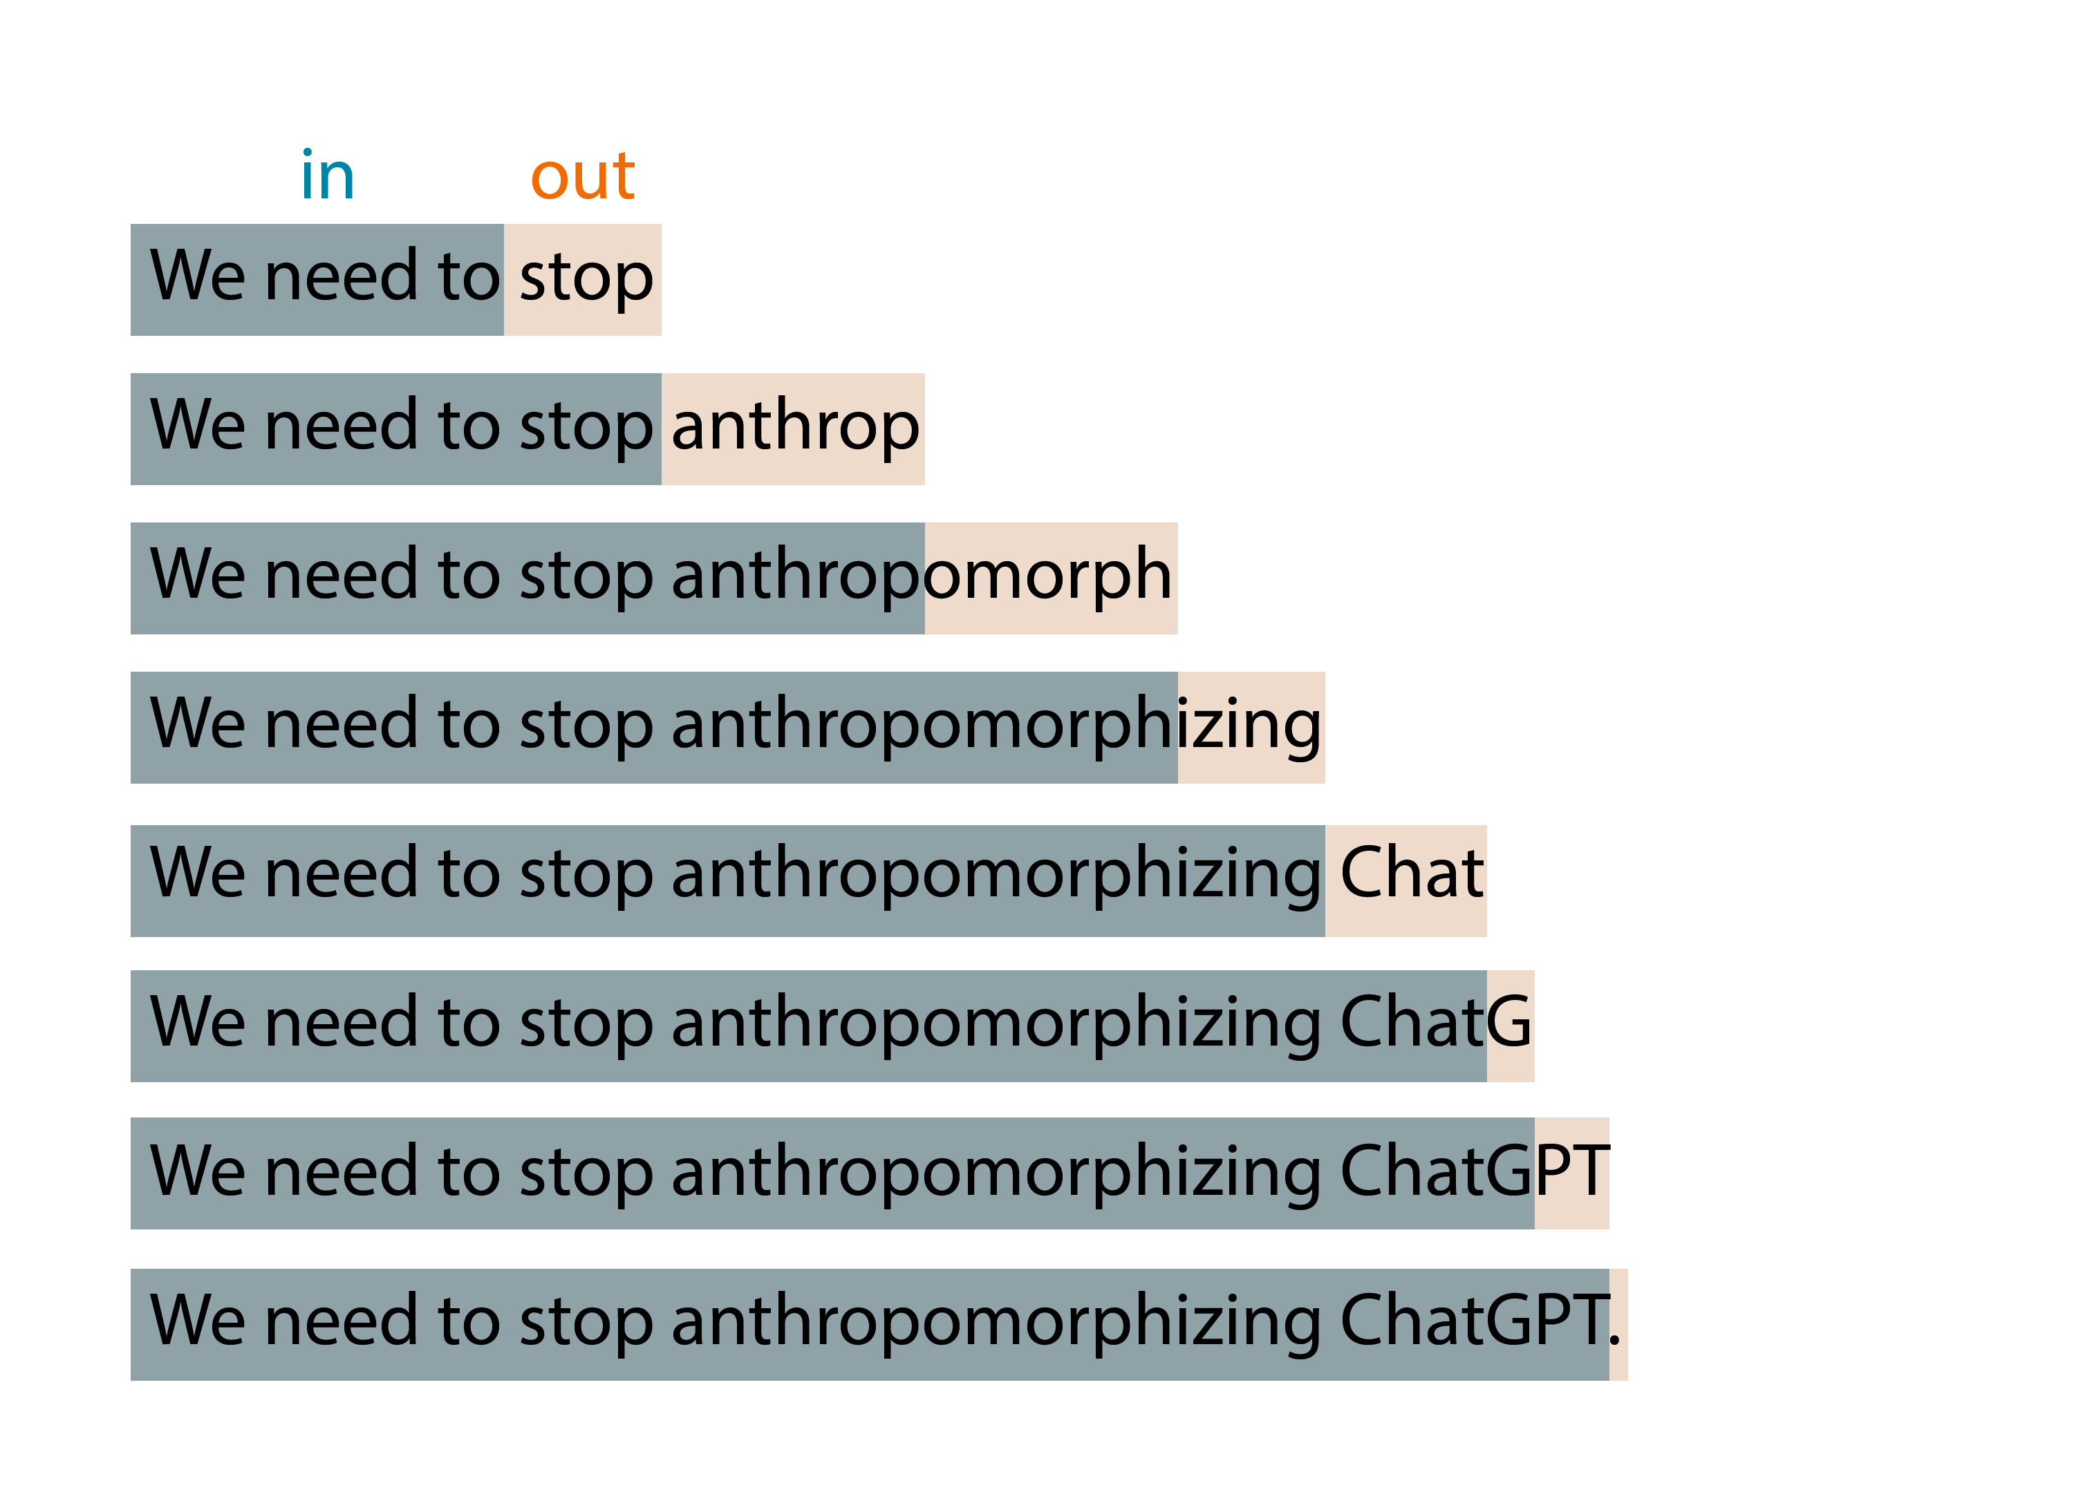
How language models work
Notes:
That’s because this basic idea is applied in an expanding-window pattern.
You give it tokens in, it produces one token out,
then it incorporates that output token as part of the input of the next iteration,
and so on until you reach some stopping condition
Is it determistic?

Slide 14
How language models work
0.01
0.005
0.003
0.013
0.077
…
0.006
do
say
try
anthrop
buy
zux
We
need
to
stop
n tokens in
1 tokens out
p
Notes:
Do I get the same result twice? The answer is no. What is actually returns is a probability distributions of possible tokens
It assigns a possibility to each token returned And then you sample from that distribution
2 methods of measurement that you can adjust to affect output
Temperature - You will often see from a scale of 0 to 1 and controls creativity or randomness. Lowering the temperature will create more deterministic results whereas increasing it will increase randomness.
p_top value – You will also see on a scale from 0 to 1, but this essentially limits the distribution to whatever specified. 0.1 will limit the sampling to the top 10 % of likely values (deterministic & focused) whereas setting it to 0.5 will allow the model to sample from a broader set of possibilities (more creative). What you need will depend on your usecase.
0.1 = top 10% values (deterministic & focused)
0.5 = 50% (creative writing)

Slide 15
Prompt Engineering

Slide 16
Prompt engineering
You can create your model prompt using different styles:
Instruction
e.g., “Translate the following code from Python to C# […]”
Completion
e.g., “Machine Learning is a field of artificial intelligence that”
Question
e.g., “What is Artificial Intelligence?”
Notes:
We have talked about prompts as natural language instructions to these models so far. Let's talk more specifically about how to communicate with these models through “prompt engineering”.
Prompt engineering is configuring the model for your scenario, ensuring the output is as closest as possible to your expectations.
There’s different ways you can draft your prompt:
You can provide an instruction + a primary content (e.g. translate this content, summarize this content..). You can also add examples (few-shot learning)
You can provide an input of a text to complete
You can also ask direct question. Note that if no additional context is provided, the model can rely only on the knowledge it has from training to answer your question (public information, up to the date of training; for example, GPT4 Turbo is trained up through April 2023)

Slide 17
Prompt engineering
You can create your model prompt using different styles:
Instruction
e.g., “Translate the following code from Python to C# […]”
Completion
e.g., “Machine Learning is a field of artificial intelligence that”
Question
e.g., “What is Artificial Intelligence?”
TIP – Imaging you are speaking to an untrained intern
Avoid assumptions
Break down problems
Provide details
Notes:
My key recommendation for you with prompt engineering is write your prompt imaging you are speaking to an untrained intern. Make sure to avoid assumptions, break down problems into multiple parts, and provide clear and concise detailed instructions.

Slide 18

System prompt vs user prompt
System prompt
You are an AI assistant that helps people find information and responds in rhyme. If the user asks you a question you don't know the answer to, say so.
User prompt
What can you tell about me, John Doe?
Assistant
Dear John, I'm sorry to say,
But I don't have info on you today.
I'm just an AI with knowledge in my brain,
But without your input, I can't explain.
So please tell me more about what you seek,
And I'll do my best to give you an answer unique.
Notes:
In the latest models like GPT 3.5 and GPT 4 we have a system prompt
The system prompt is typically not visible to the user but is fed into the models context before the user prompt to help steer the model in a specific direction.
Tell the model how to behave steer the model
Talk about finetuning > system message combined with examples get very far
First for a brief look at the interface that developers use to build with GPT-4 and 3.5 turbo.
Delightful interface that works for all scenarios, like summarization, content generation as well as chat.
New system message field. More steerable. Nuanced instructions.
Examples go into the User and Assistant field.

Slide 19
Talking in text

Slide 20

Common use cases
Content generation
Summarization
Code generation
Semantic search
Chat
Notes:
This list is by no means exhaustive, but here are the most common text generation use cases I encounter when working with startups.
Startups are building on top of models like ChatGPT-4 Turbo for:
Creating diverse texts for websites, social media marketing, and product descriptions.
Summarizing company documents to generate product manuals, legal briefs, and regulatory filings.
Assisting engineers write code to build and debug new applications.
Helping end-users find the most relevant e-commerce products.
And developing chatbots for customer support, sales, and personal assistance.

Slide 21
Prompt engineering for text generation
Defining assistant persona, its tone and style, and the chat history
1
Providing examples, context and data (meta-grounding)
2
Providing guardrails and mitigating fabrications
3
Notes:
There are 3 key approaches to prompt engineering for text generation that we will see in our upcoming demo:
1. Defining assistant persona, its tone and style, and the chat history. E.g. ‘you are an assistant helping with employee handbook questions; be precise and short in your answers’
2. Providing examples, context and data (meta-grounding) -> E.g. providing examples in your system prompt or augmenting your model with retrieval augmented generation (RAG) with external data.
3. Providing guardrails and mitigating fabrications. E.g. ‘Use only the data provided to answer user’s question, if the answer cannot be retrieved from this data source, please reply you don’t have an answer’

Slide 22
Talking in numbers

Slide 23
GenAI Features: Embeddings
[-0.006655829958617687, 0.0026128944009542465, 0.008792596869170666, -0.02446001023054123, -0.008540431968867779, 0.022071078419685364, -0.010703742504119873, 0.003311325330287218, -0.011632772162556648, -0.02187200076878071, ...]
“Today we are going to learn about Azure AI Studio”
Text Embedding Ada
Notes:
Computers ultimately speak numbers and need to convert text to into a numerical form to understand relationships between words and concepts.
Embedding models transform text into an array of numbers which is the representation of the original text into the semantic space.
The OpenAI ADA model is a large multimodal model, commonly abbreviated as LMM, that can understand both text and images.
It can generate embeddings or vectors of numbers, to encode both the meaning and context of your input prompt.
For example, ADA will take your prompt “Today we are going to learn about Azure AI Studio” and generates a length 10 numerical vector shown on the screen, which captures the meaning of each of those 10 words and concepts like “today” and “Azure AI Studio”.
This is useful for tasks such as semantic search and sentence similarity.

Slide 24
Adding knowledge to the prompt
Meta Prompt
Prompt
Prompt
Response
## Task
You are an AI agent for the Contoso Trek outdoor products retailer. As the agent, you answer questions briefly, succinctly, and in a personable manner using markdown and even add some personal flair with appropriate emojis.
Sure, I'd be happy to help! 😊 Based on the available documentation, I can recommend two choices from the Contoso Trek catalog.
Product: TrailWalker Hiking Shoes ID: 36244753 Brand: TrekReady […]
I need warm waterproof shoes
to go on a hike.
## Documents The following documentation should be used in the response. The response should specifically include the product id.
TrailWalker hiking Shoes
The Adventurer Pro Backpack is designed to provide comfort, durability, and ample storage space for your outdoor adventures. Familiarize yourself with the key features of the backpack […]
TrekHiker Walking Booths The Adventurer Pro Backpack is designed to provide comfort, durability, and ample storage space for your outdoor adventures. Familiarize yourself with the key features of the backpack […]
Notes:
We can add new knowledge in our system prompt
- Specifying the task - Adding the documents / new knowledge
- Ask the question and now we get results about our data

Slide 25
Retrieval Augmented Generation
User Question
Workflow
Query My Data
Retriever over Knowledge Base
Add Results to Prompt
Query Model
Large Language Model
Send Results
Notes:
Adding knowledge that we retrieve from data source into the prompt we call "Retrieval Augmented Generation"
Retrieval-augmented generation (RAG) allows for incorporating data directly into prompts without retraining models.
RAG is efficient and cost-effective due to its relatively quick process and inexpensive indexing.
Internal tests show that RAG is effective at adding knowledge to AI experiences.
Both RAG and fine-tuning are complementary technologies, not mutually exclusive.

Slide 26
Demo – Creating our own GitHub Copilot Chat
Notes:
Let’s create a GitHub Copilot Chat

Slide 27
In closing
AI means a lot, but right now it’s mostly Generative AI
Azure OpenAI Service for GPT models
https://github.com/jamesmontemagno/AIDemo

Slide 28
Microsoft wants to hear from YOU!
Attendee Survey
Season of AI | Microsoft Community
aka.ms/AttendeeSurveySeasonOfAI
2024
Notes:
Remind attendees to participate in the event survey

Slide 29
Thank you

