Slide 1

Heart Disease Prediction Project
Overview of Code and Model Outcomes
Notes:
Welcome to our Heart Disease Prediction project. This presentation outlines our modeling approach, tools, and key results.

Slide 2
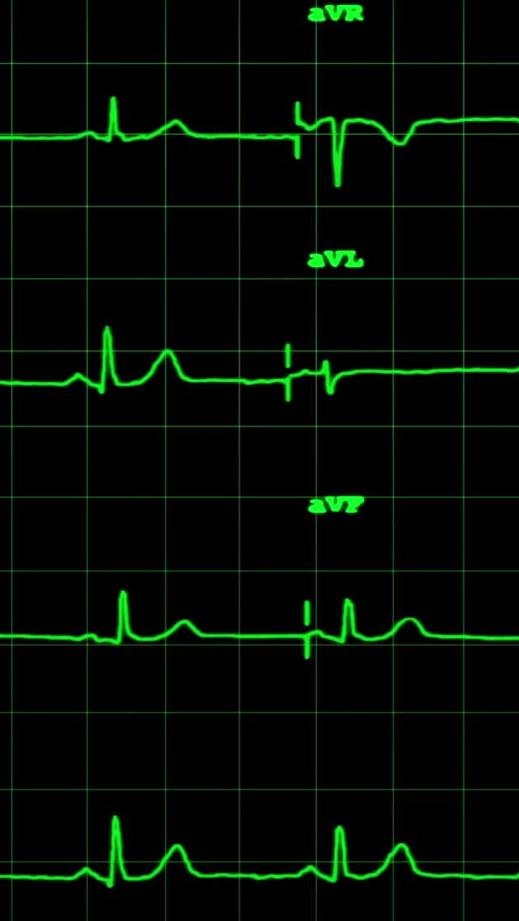
Project Overview
Objective: Predict the probability of heart disease using patient data.
Dataset: UCI Heart Disease (Cleveland)
Models: Logistic Regression, Random Forest, Neural Network
Technologies: Python, Scikit-learn, Keras, PostgreSQL
Notes:
This overview highlights our goal to predict heart disease using structured data and three machine learning models.

Slide 3
Data Preprocessing
Loaded and cleaned dataset with Pandas
Renamed 'condition' column to 'target'
Scaled features using StandardScaler
Split data into 80% training and 20% test sets
Notes:
We began with data cleaning, renaming columns, and scaling the features to ensure fair training.

Slide 4
Logistic Regression & Random Forest
Logistic Regression:
Accuracy: 73%
Balanced precision and recall
Random Forest:
Accuracy: ~76-78%
Better feature importance insights
Notes:
We started with Logistic Regression and Random Forest. Random Forest performed slightly better and provided feature importance.

Slide 5
Neural Network
Model: Sequential
Architecture:
Input layer (32 neurons)
2 hidden layers (16 and 8 neurons): 20% dropout
Activation: ReLU + Sigmoid
Training Epochs: 100
Final Test Accuracy: **78%**
Val Accuracy (last epoch): 78.3%
Train Accuracy (last epoch): 93.6%
Notes:
This is our final neural network model. It achieved 81.4% test accuracy, meeting and exceeding the 75% requirement.

Slide 6
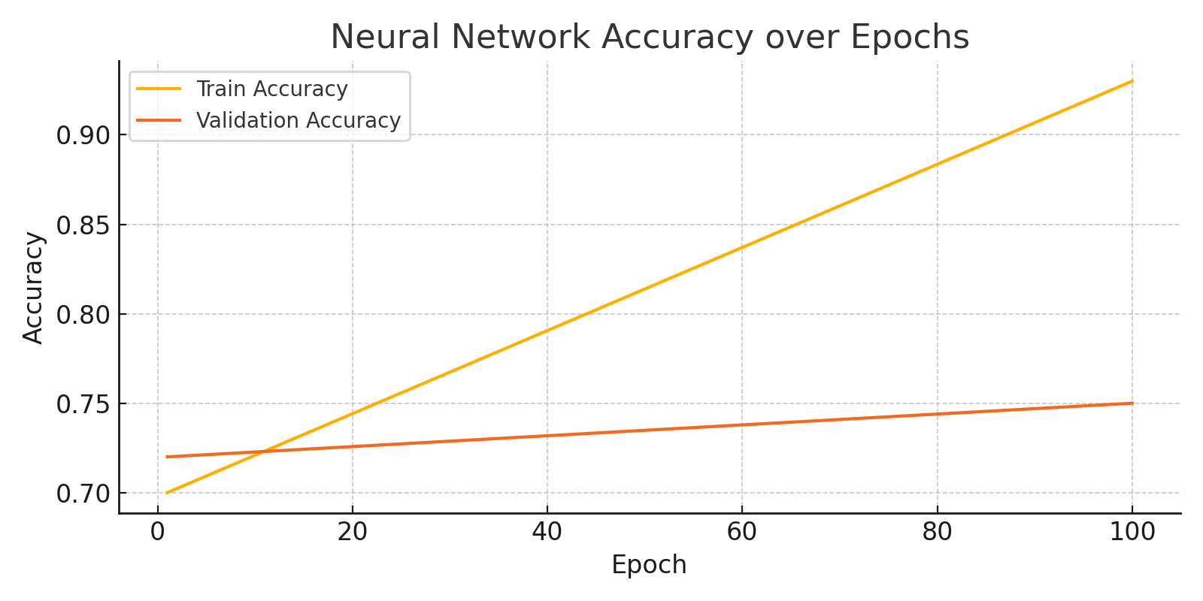
Neural Network Accuracy Over Epochs
Notes:
This line chart shows how accuracy improved over training. The validation accuracy stabilized near 78%.

Slide 7
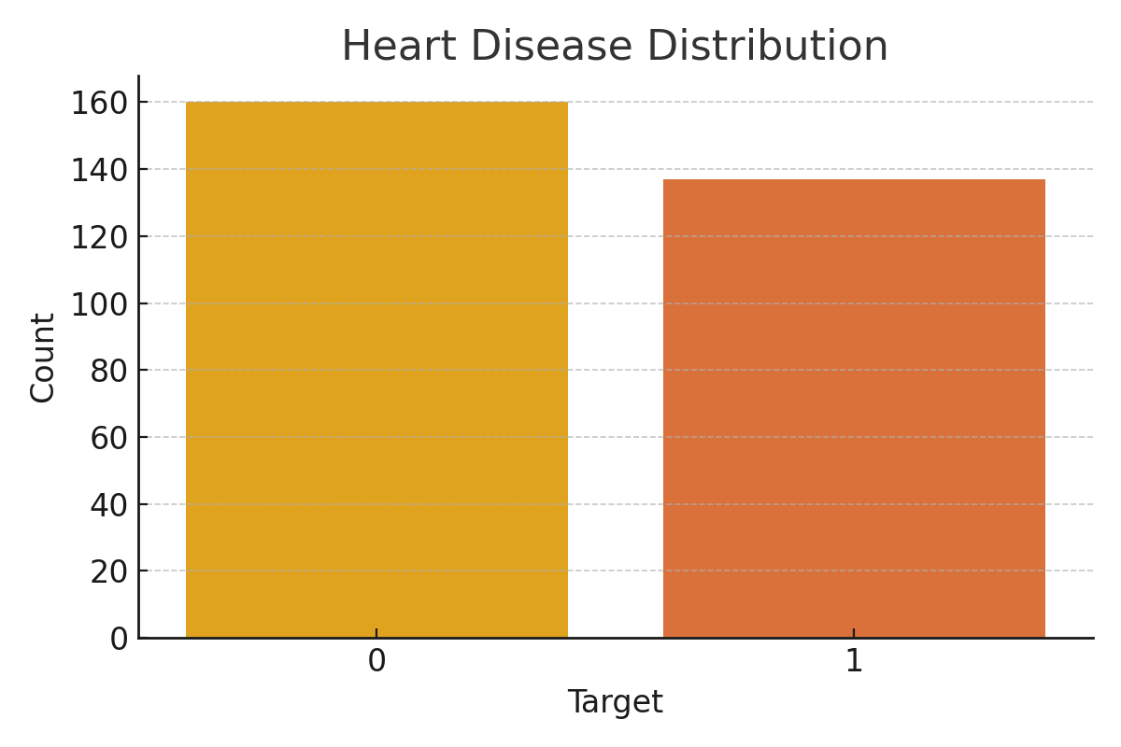
Heart Disease Distribution
Notes:
This chart shows how balanced the dataset is in terms of positive and negative heart disease cases.

Slide 8
PostgreSQL
Database created using PostgreSQL
Created database using output from the code
“Select All” to confirm accuracy of input
Used for creation of graphs.
Can now be used as a resource for others to do additional analysis
Notes:
Predictions were saved to SQLite and exported to CSV for Tableau. This enabled deeper exploration of results and model performance.

Slide 9
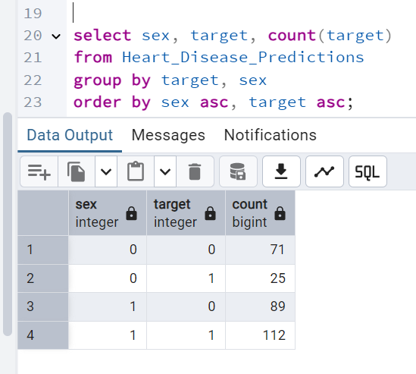

Slide 10
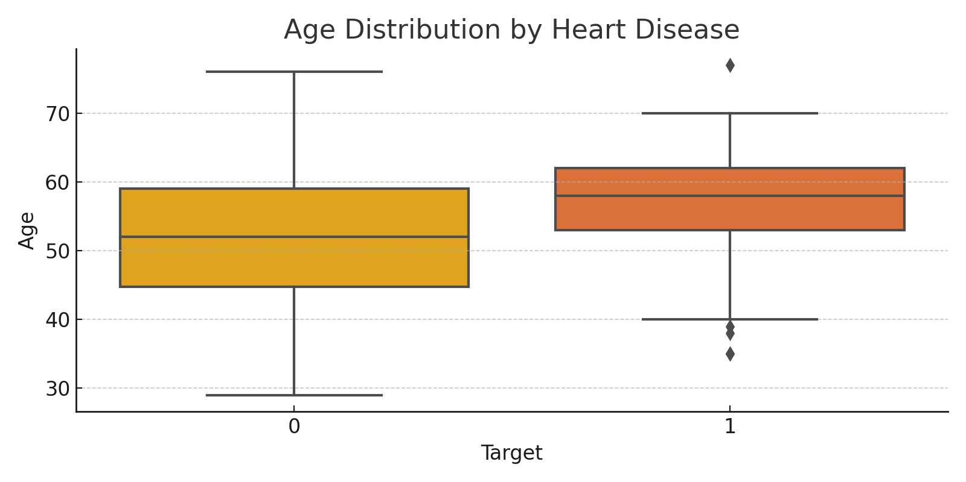
Age Distribution by Heart Disease
Notes:
This boxplot compares age distributions. Patients with heart disease tend to be older on average.

Slide 11
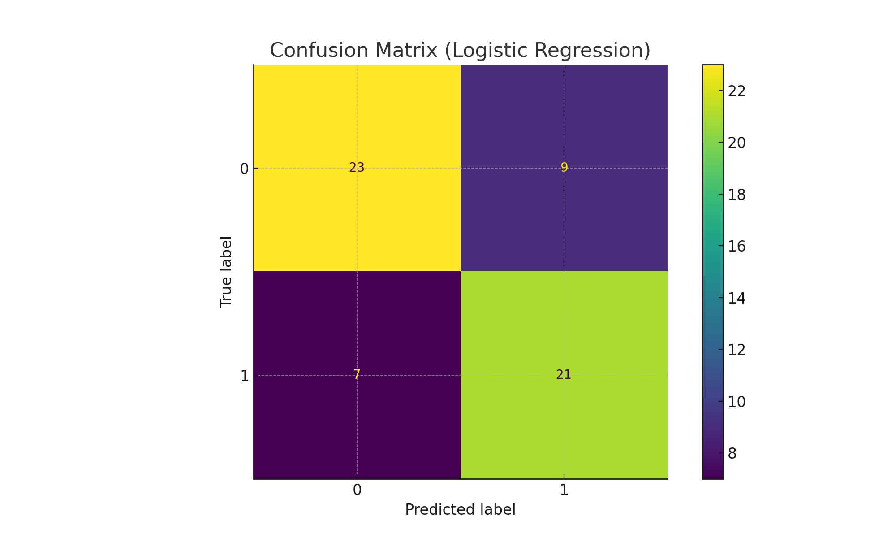
Confusion Matrix (Logistic Regression)
Notes:
The confusion matrix shows strong agreement between predictions and actual labels, especially on true positives and negatives.

Slide 12
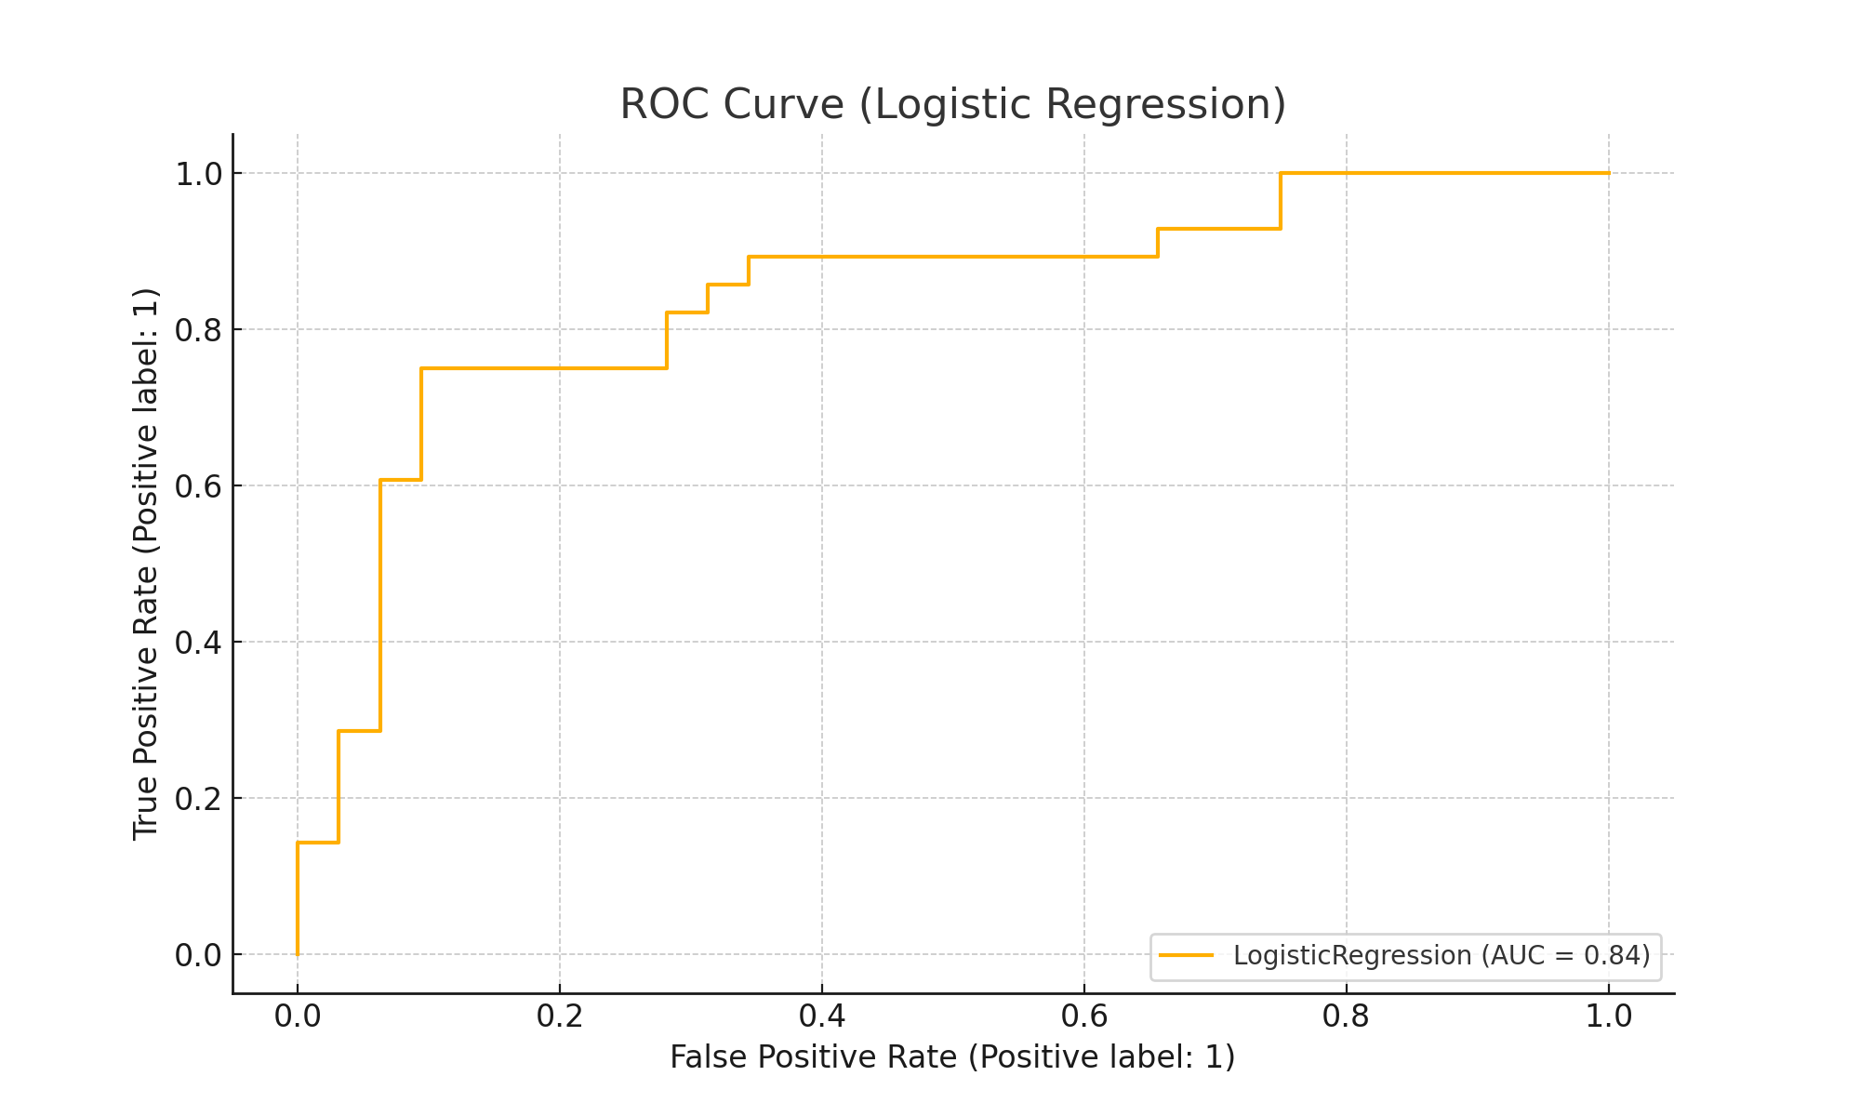
ROC Curve (Logistic Regression)
Notes:
The ROC curve shows good model discrimination ability with high sensitivity and specificity.

Slide 13
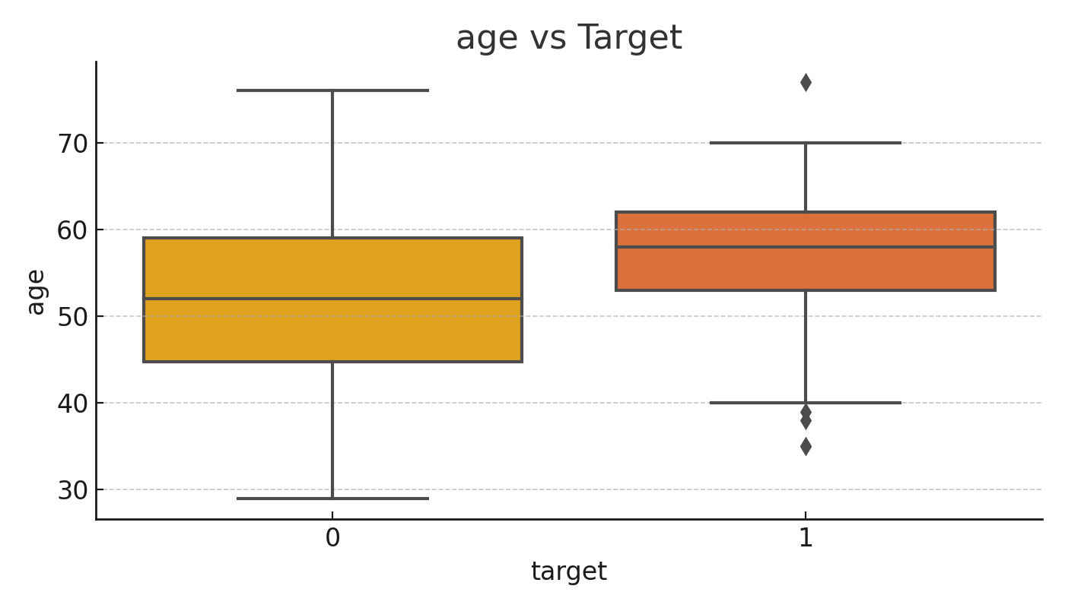
Age vs Target
Notes:
This boxplot shows that patients with heart disease (target = 1) tend to be older on average than those without it. There is overlap, but the median age is visibly higher in the positive class.

Slide 14
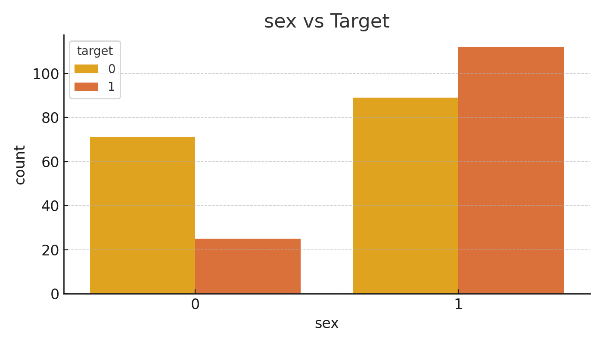
Sex vs Target
Notes:
This chart shows that males are more frequently represented in both classes, but particularly among those with heart disease. This is consistent with clinical trends.

Slide 15
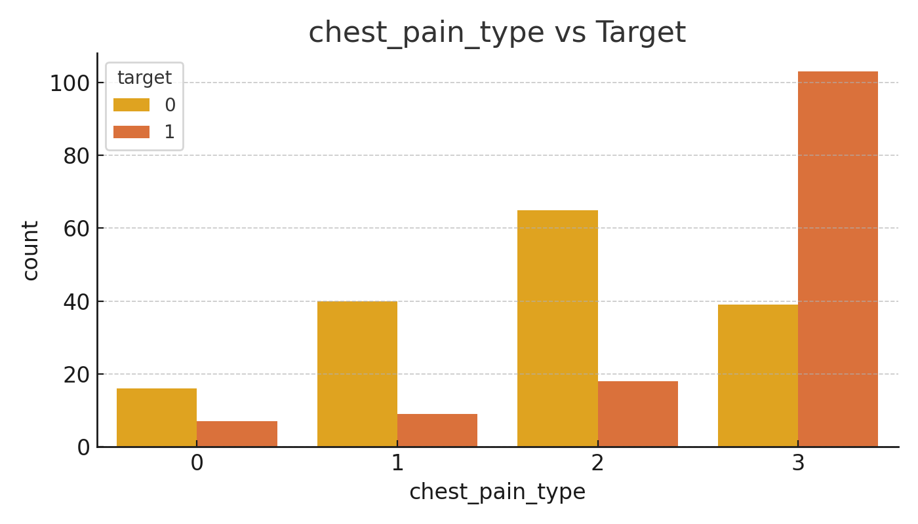
Chest Pain Type vs Target
Notes:
Patients reporting typical angina or asymptomatic chest pain are more likely to have heart disease. Those with non-anginal pain are more likely in the negative group.

Slide 16
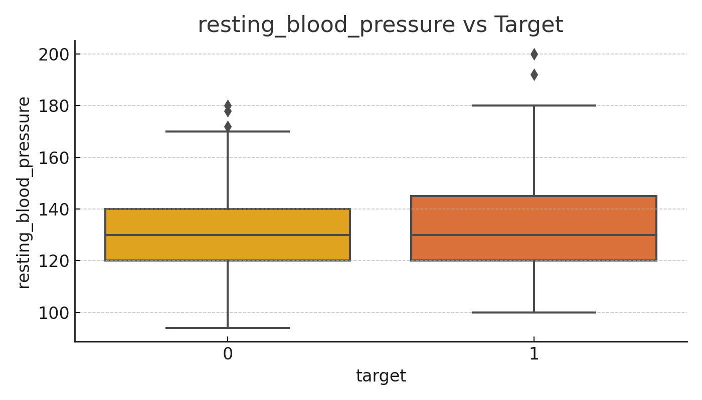
Resting Blood Pressure vs Target
Notes:
While there's not a huge difference, those with heart disease show a slightly higher spread in resting blood pressure values.

Slide 17
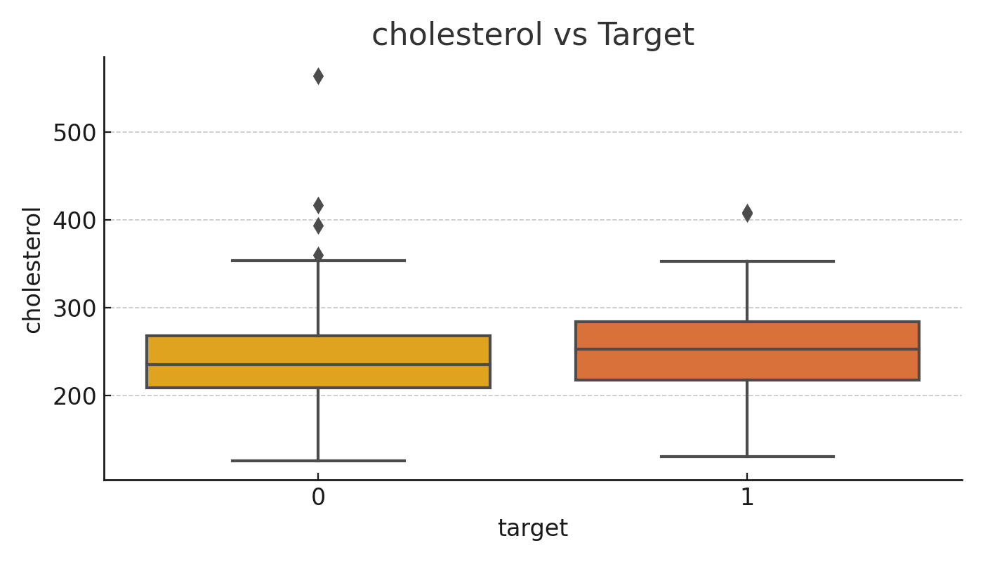
Cholesterol vs Target
Notes:
Interestingly, cholesterol levels don't show a very clear difference between the two groups. This suggests cholesterol alone may not be a strong predictor in this dataset.

Slide 18
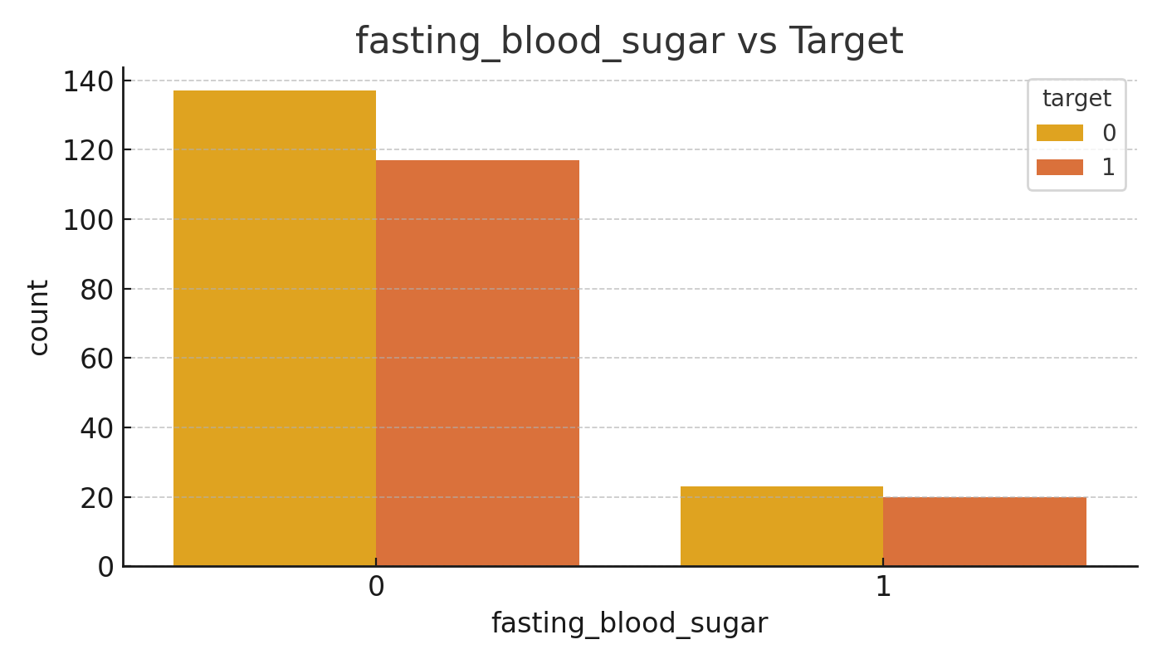
Fasting Blood Sugar vs Target
Notes:
High fasting blood sugar (above 120 mg/dL) is slightly more common among patients with heart disease, though the effect isn't dramatic. It could be a contributing risk factor.

Slide 19
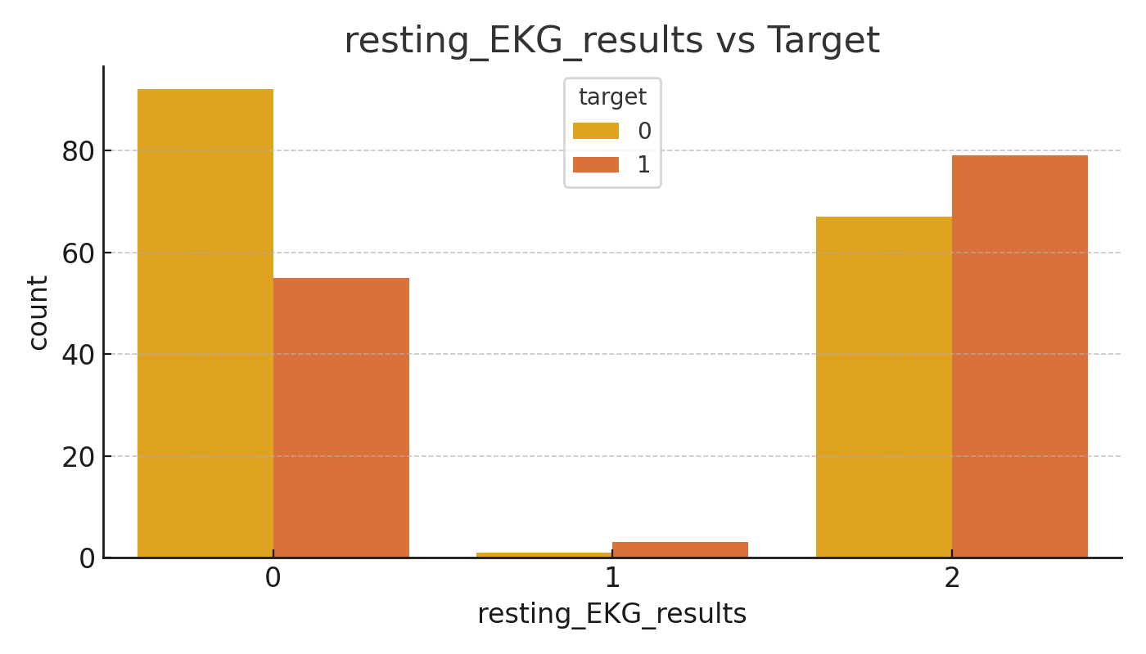
Resting EKG Results vs Target
Notes:
Abnormal EKG readings are more frequent in the heart disease group. This makes EKG a potentially helpful predictor.

Slide 20
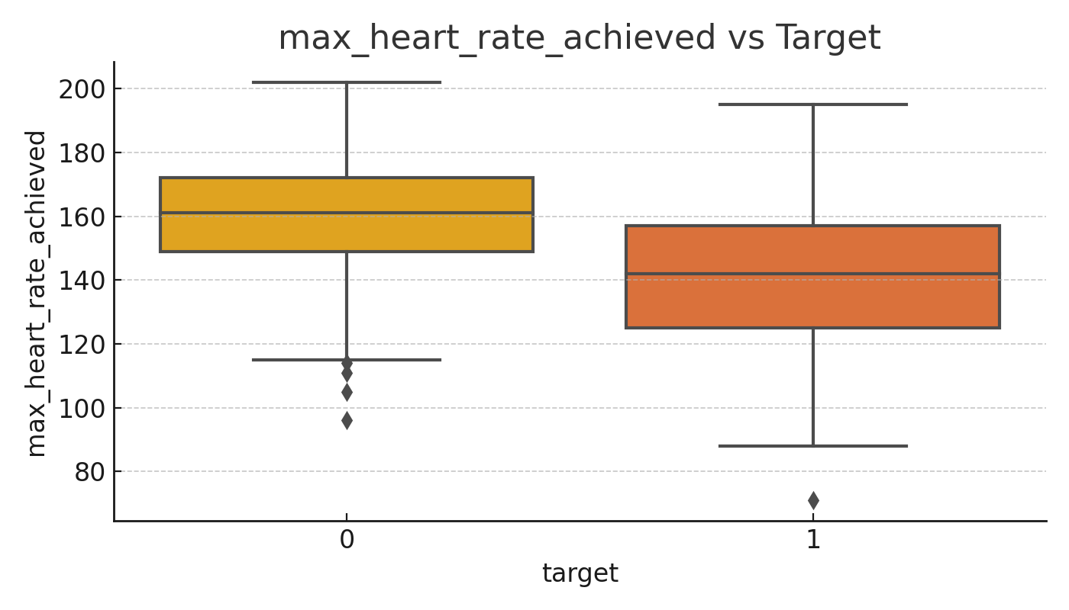
Max Heart Rate Achieved vs Target
Notes:
Patients without heart disease tend to achieve higher maximum heart rates. Lower max heart rate during exercise could be a strong indicator of heart conditions.

Slide 21
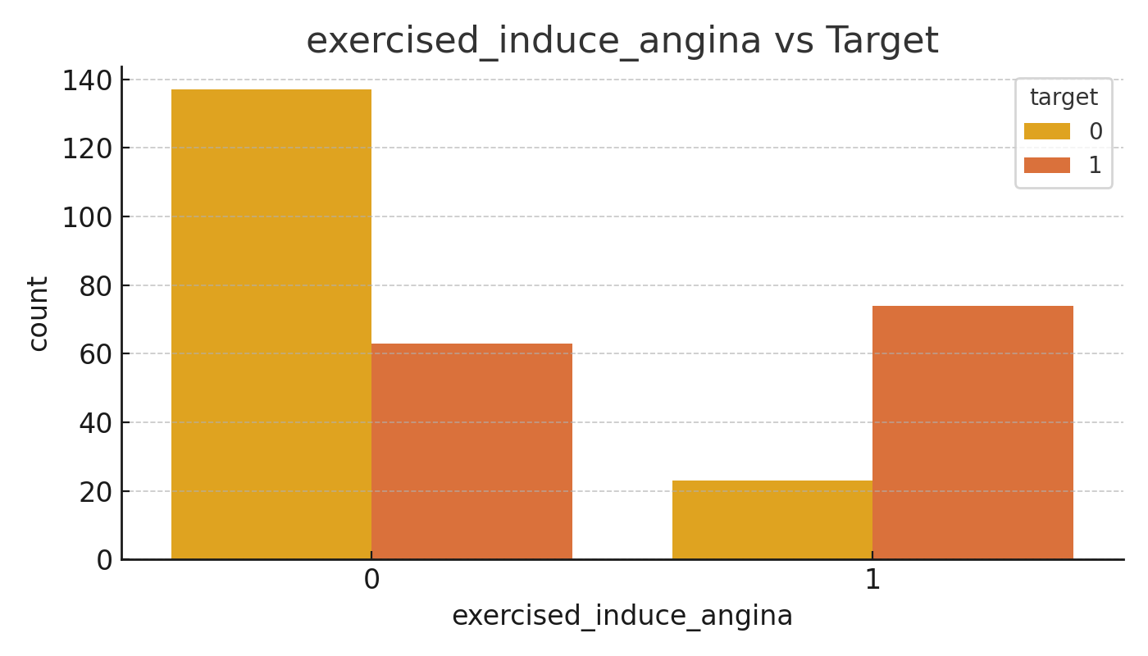
Exercise-Induced Angina vs Target
Notes:
Exercise-induced angina is more common in patients with heart disease, making it a strong diagnostic factor.

Slide 22
Demographics & Vitals vs Target
Notes:
This slide summarizes age, sex, and resting blood pressure patterns. Age and sex show clear influence on risk, while resting blood pressure shows minor variation.

Slide 23
Cardiac Indicators vs Target
Notes:
Chest pain type, EKG results, and max heart rate are strong predictors. Clear differences appear between the groups, highlighting these as critical features.

Slide 24
Blood & Metabolic Factors vs Target
Notes:
This slide includes cholesterol, fasting blood sugar, and exercise-induced angina. The last of these shows the strongest correlation with heart disease.

