Slide 1

Heart Disease Prediction Project
Overview of Code and Model Outcomes
Notes:
Sebastian
Welcome to our Heart Disease Prediction project. This presentation outlines our code, neural network modeling approach, tools, and key results

Slide 2
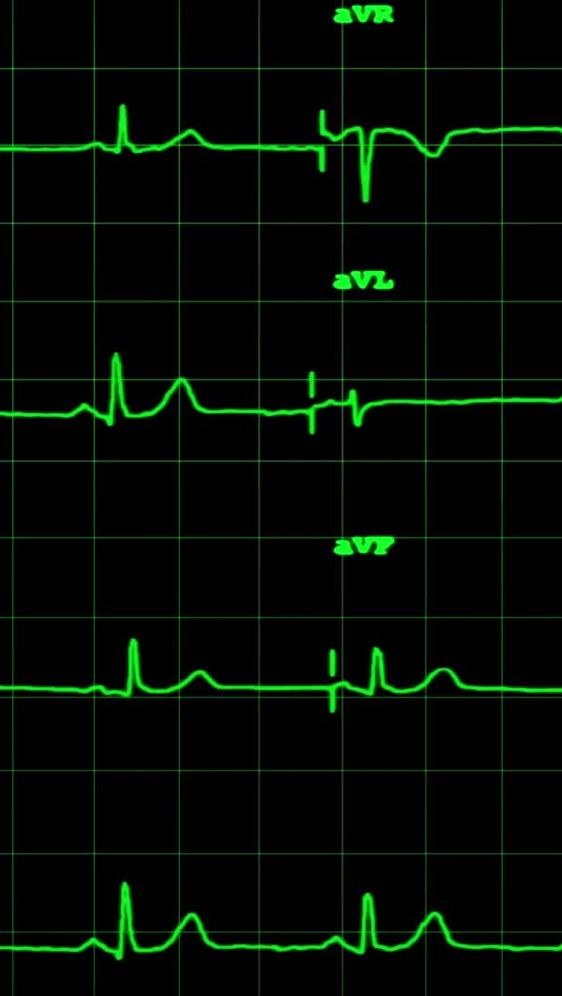
Project Overview
Objective: Predict the probability of heart disease using patient data.
Dataset: UCI Heart Disease (Cleveland)
Models: Logistic Regression, Random Forest, Neural Network
Technologies: Python, Scikit-learn, Keras, PostgreSQL
Notes:
Sebastian
The objective was to create a model that could predict heart disease based on demographic and health metrics
We used the UCI Heart Disease dataset which is popular for training and evaluating classification models in machine learning — especially for predicting the presence of heart disease.
We used three different models: Logistic Regression, Random Forest and Neural network to test the accuracy of predictions made using the model.

Slide 3
Data Preprocessing
Loaded and cleaned dataset with Pandas
Renamed 'condition' column to 'target'
Scaled features using StandardScaler
Split data into 80% training and 20% test sets
Notes:
Sebastian
Before getting started, the data was loaded and cleaned using Pandas. This include identifying the target and renaming several columns to be more user friendly. We used StandardScaler to scale the data and finally split the data into training and test sets with an 80/20 split.

Slide 4
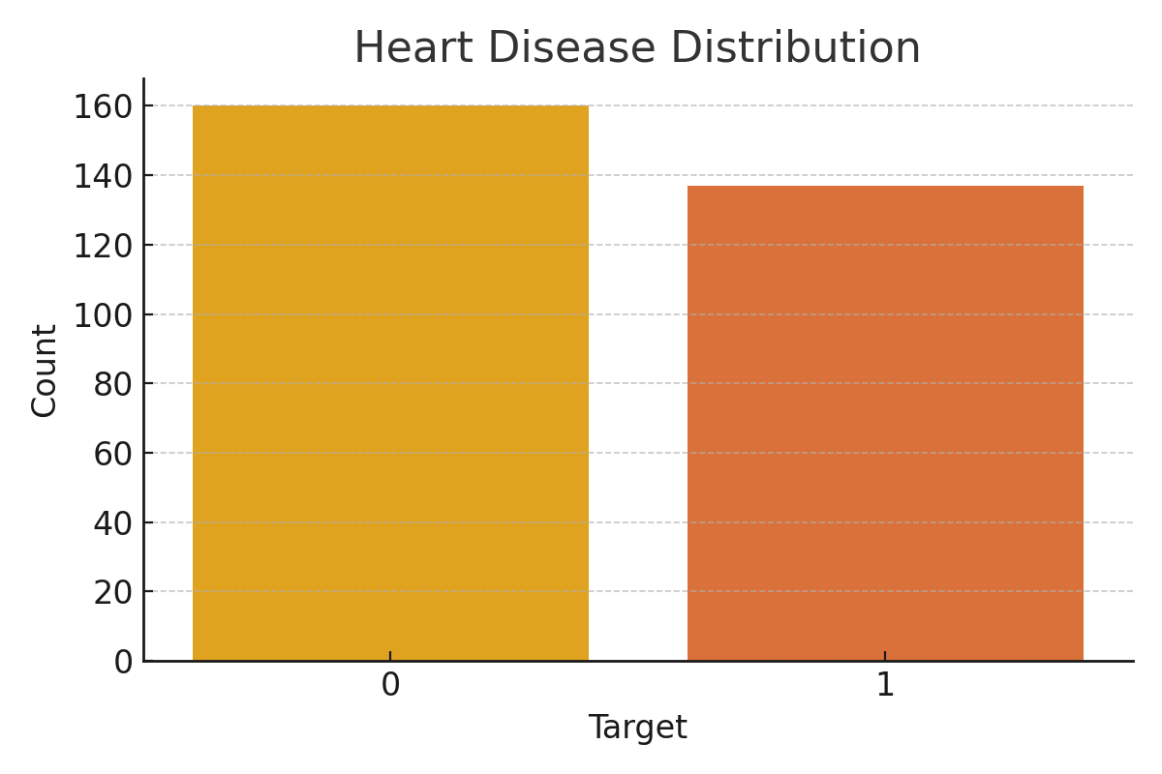
Heart Disease Distribution
No Disease
Disease
Notes:
Sebastian
This chart shows the balance of our dataset. You can see that it was split fairly evenly between those patients with heart disease and those without.

Slide 5
Three Models Used
Logistic Regression
Random Forest
Neural Network
Notes:
Sebastian
We used three models on our data logistic regression, random forest and neural network.
We will show the results of each model.

Slide 6
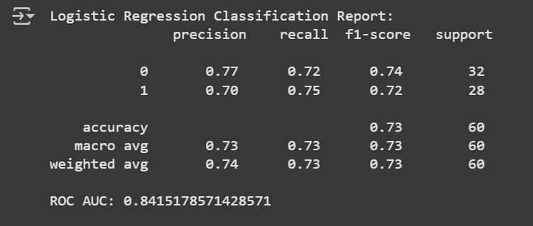
Logistic Regression Results
Notes:
Sebastian
First logistic regression.
In the model 0 represents no heart disease and 1 represents the presence of heart disease
Starting with no heart disease, which is class 0, Precision of 77% means that of the patients predicted to be health 77% were actually healthy.
Recall means that the model caught 72% of the actually health patients. The f-1 score, combines precision and recall and shows the model is well balanced. That means that model does not have too many false positives or false negatives.
For class 1, those with heart disease, the precision was slight less at 70% compared to 77%.
However, the recall was a bit higher at 75% compared to 72% and the F1 scores was close.
Overall the model is little better at predicting most of the disease cases, but it will have some false positives.
The overall accuracy of the model was 73%. A bit less than the 75% threshold.

Slide 7
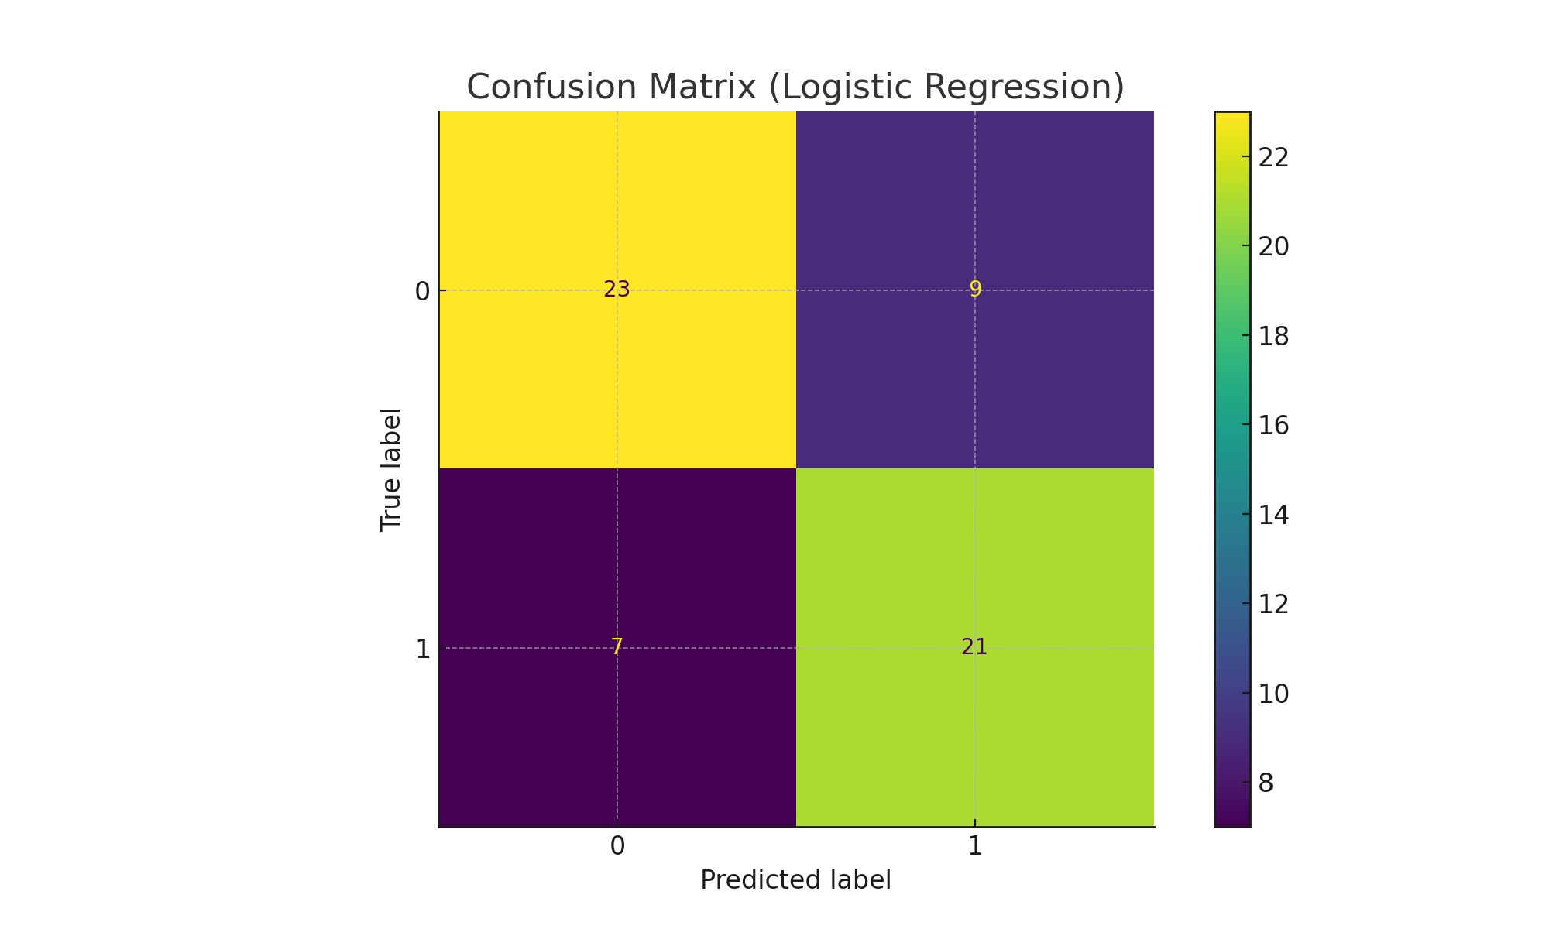
Confusion Matrix (Logistic Regression)
Correct Prediction of no disease
Incorrect Prediction of no disease
Incorrect Prediction of disease
Correct Prediction of disease
Notes:
Sebastian
The confusion matrix shows strong agreement between predictions and actual labels, especially on true positives and negatives.

Slide 8
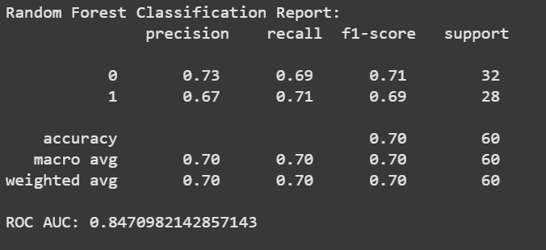
Random Forest Results
Notes:
Cori
Random Forest did not perform as well overall
Starting with no heart disease, which is class 0, Precision of 73% compared to 77% for logistic regression.
Recall means that the model caught 69% of the actually health patients which is slight less than the 71% from the logistic regression model. The f-1 score, combines precision and recall and shows the model is well balanced. That means that model does not have too many false positives or false negatives. Though a bit less balanced the logistic regression
For class 1, the results were also poorer than logistic regression.
Overall the model is little better at predicting most of the disease cases, but it will have some false positives.
The overall accuracy of the model was 70%. A bit less than the 75% threshold.

Slide 9
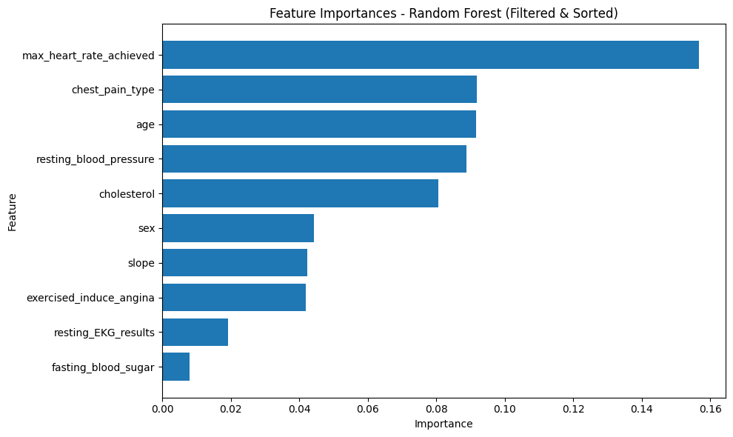
Random Forest Feature Importance
Notes:
Cori
We did take a look at the feature importance from Random Forest. And when looking at the neural network, this will prove to be pretty accurate with max heart rate achieved, chest pain type and age being important features for predicting heart disease.

Slide 10
Neural Network
Model: Sequential
Architecture:
Input layer (32 neurons)
2 hidden layers (16 and 8 neurons): 20% dropout
Activation: ReLU + Sigmoid
Training Epochs: 100
Final Test Accuracy: **78%**
Validation Accuracy (last epoch): 78.3%
Training Accuracy (last epoch): 93.6%
Notes:
Cori
This is our final neural network model. It achieved 78% test accuracy, meeting and exceeding the 75% requirement.

Slide 11
Training Accuracy | 93.6% | Learning was excellent
Validation Accuracy | 78.3% | Slightly lower than training, shows some generalization (as opposed to memorizing)
Test Accuracy | 80.3% | Model performs well on new, unseen data
Loss comparison | Training < Validation > Test | Overfitting even with the dropout
Notes:
Cori
By the last epoch, training accuracy was very high at 93.6%
Validation accuracy, as expected was lower than the training accuracy but performed well. Validation accuracy represents how the model is performing on data it hasn’t seen but it is still being used to learn when to stop or adjust.
Test accuracy is the performance on unseen data.

Slide 12
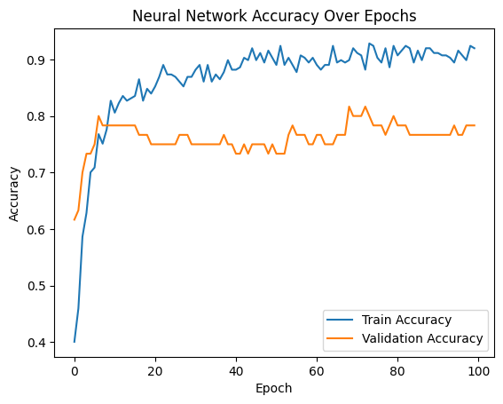
Neural Network Accuracy Over Epochs
Notes:
Cori
This line chart shows how accuracy improved over training. The validation accuracy stabilized near 78%.

Slide 13
PostgreSQL
Database created using PostgreSQL
Created database using output from the code
“Select All” to confirm accuracy of input
Used for creation of graphs.
Can now be used as a resource for others to do additional analysis
Notes:
Cori
Predictions were saved to SQLite and exported to CSV. This enabled deeper exploration of results and model performance.

Slide 14
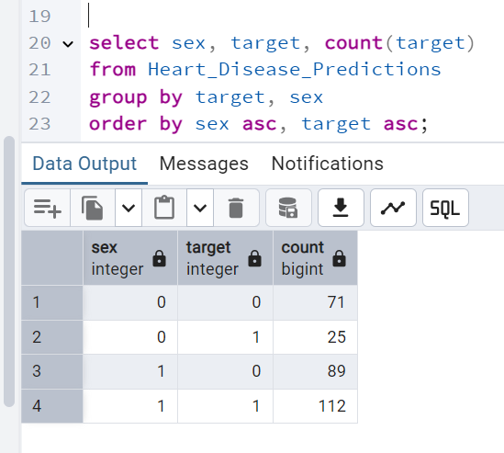
Notes:
Cori
Multiple tables were created using the various factors used in the model.

Slide 15
After running our code, we were able to look at each feature and determine whether it was a good predictor of heart disease.
We will go through some of those with charts to share the outcome.

Slide 16
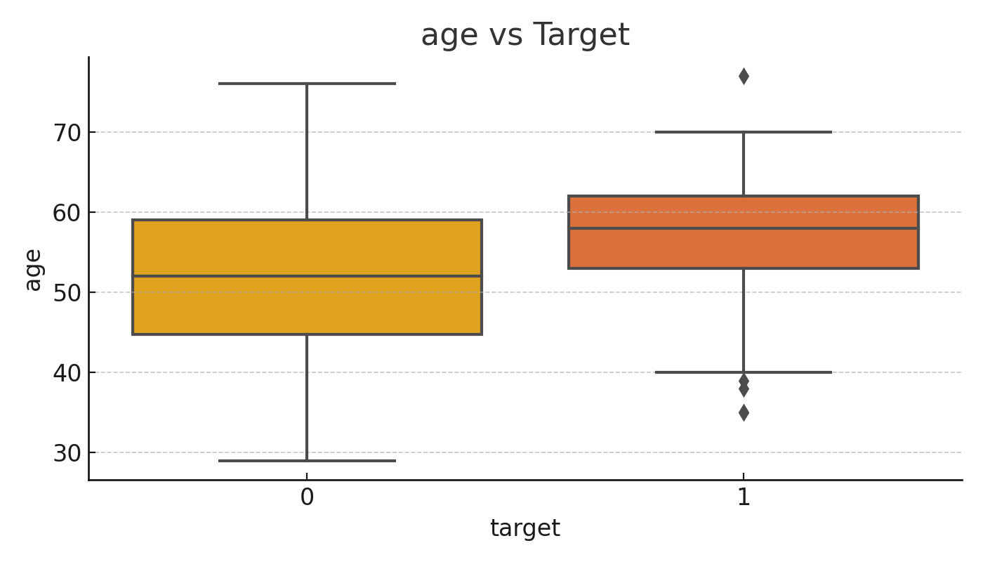
Age vs Target
No Disease
Disease
Notes:
Brandon
This boxplot shows that patients with heart disease (target = 1) tend to be older on average than those without it. There is overlap, but the median age is visibly higher in the positive class.

Slide 17
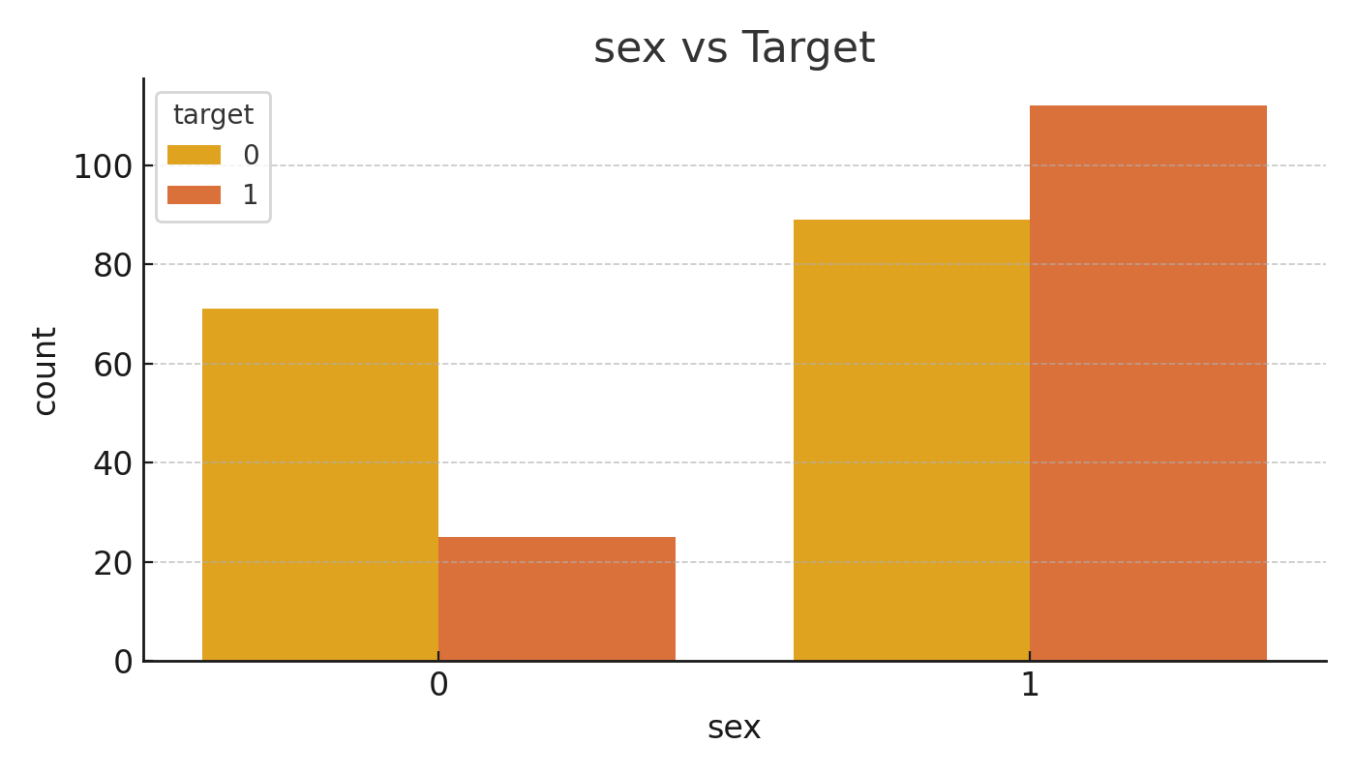
Sex vs Target
Disease
No Disease
No Disease
No Disease
Male
Female
Disease
Female
Male
Notes:
Brandon
This chart shows that males are more frequently represented in both classes, but particularly among those with heart disease. This is consistent with clinical trends.

Slide 18
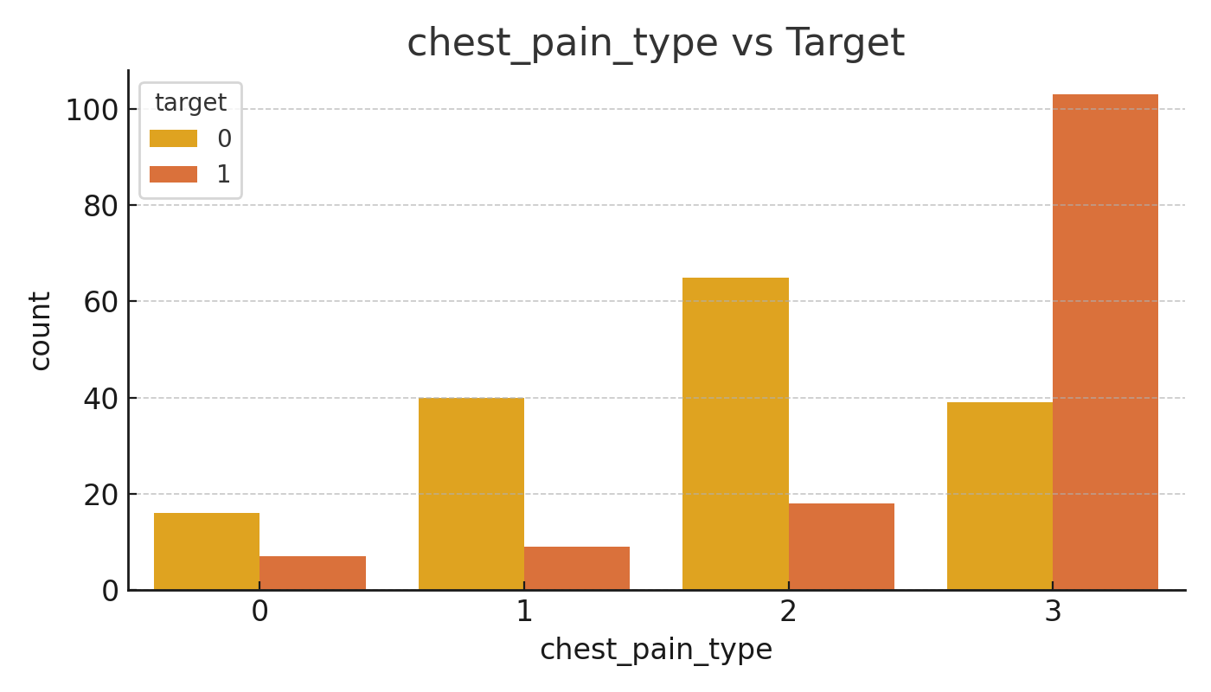
Chest Pain Type vs Target
Disease
No
disease
No
disease
No
disease
No
disease
Disease
Disease
Disease
Typical Angina
Atypical Angina
Non-Anginal
No symptoms
Notes:
Brandon
Here is where it gets interesting. Those with no chest pain symptoms are more likely to have heart disease than those with chest pain.
Key Facts About Angina:
Feels like: Pressure, squeezing, heaviness, tightness, or pain in the chest
Can also occur in: Shoulders, arms, neck, jaw, or back
Usually triggered by: Physical activity, stress, cold temperatures, or heavy meals
Goes away with: Rest or medication like nitroglycerin
Patients labeled as "asymptomatic" often turn out to have higher rates of significant heart disease, because:
Their condition may go unnoticed longer,
They don’t seek care until more severe issues arise.
So ironically, “asymptomatic” in this case doesn’t mean healthy — it may actually signal a higher risk if the disease progresses undetected.

Slide 19
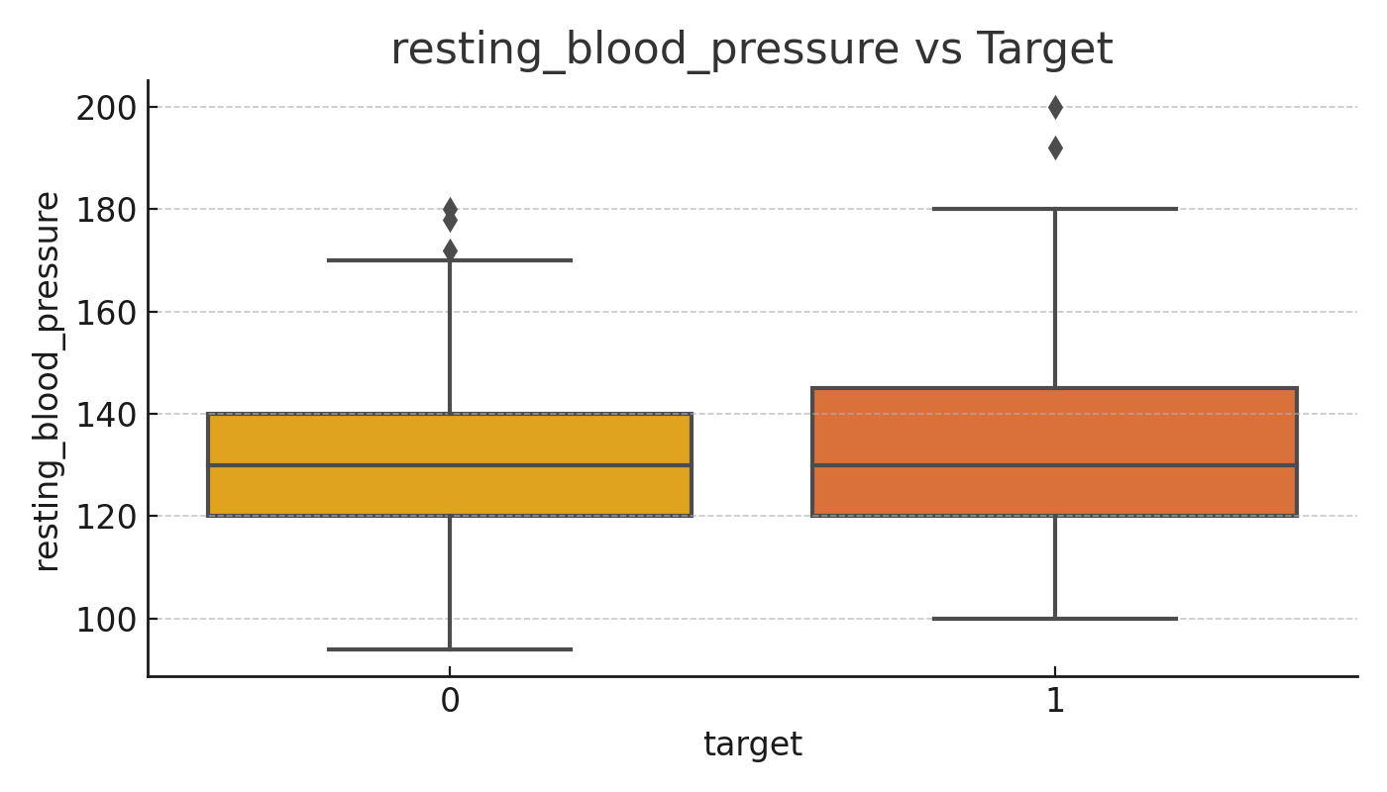
Resting Blood Pressure vs Target
No Disease
Disease
Notes:
Brandon
While there's not a huge difference, those with heart disease show a slightly higher spread in resting blood pressure values.

Slide 20
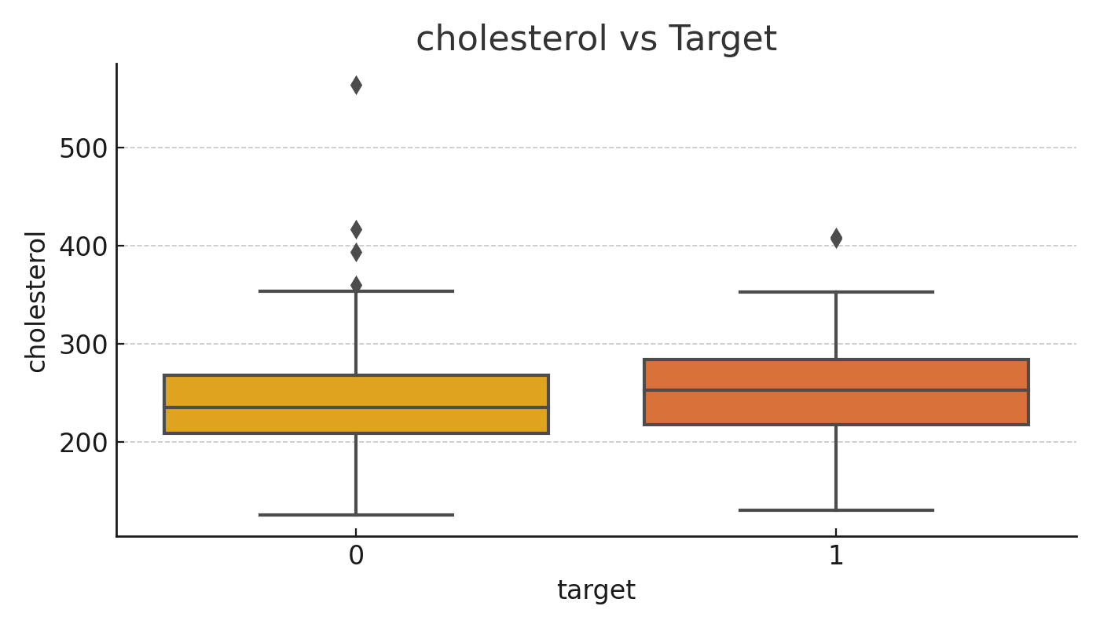
Cholesterol vs Target
No Disease
Disease
Notes:
Andrea
Interestingly, cholesterol levels don't show a very clear difference between the two groups. This suggests cholesterol alone may not be a strong predictor in this dataset.

Slide 21
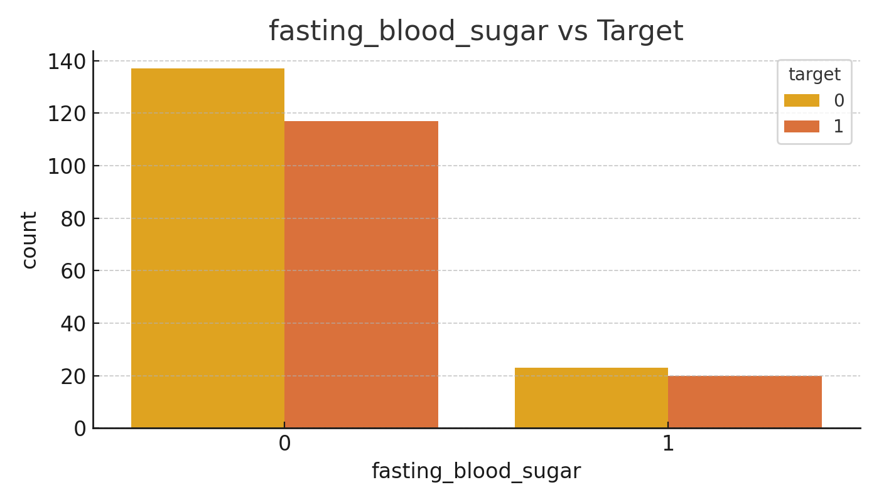
Fasting Blood Sugar vs Target
No Disease
Disease
No Disease
Disease
Greater than 120mg/dl
Less than 120mg/dl
Disease
Notes:
Andrea
High fasting blood sugar (above 120 mg/dL) is slightly more common among patients with heart disease, though the effect isn't dramatic. It could be a contributing risk factor.

Slide 22
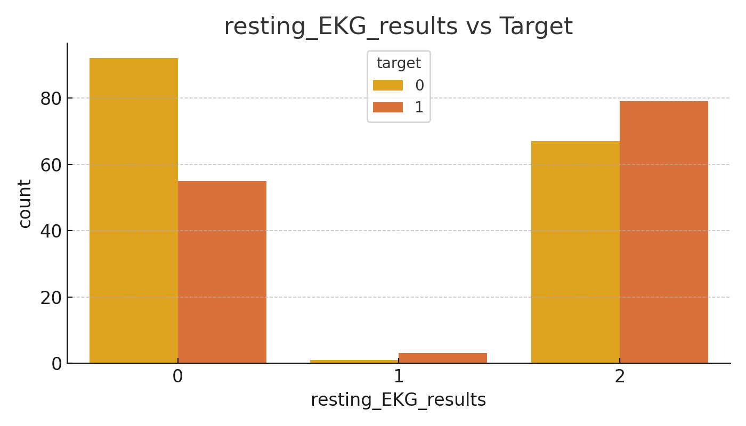
Resting EKG Results vs Target
No Disease
Disease
No Disease
Disease
No Disease
Disease
Normal
Electrical Abnormality
Muscle Wall Abnormality
Notes:
Andrea
Abnormal EKG readings are more frequent in the heart disease group. This makes EKG a potentially helpful predictor.

Slide 23
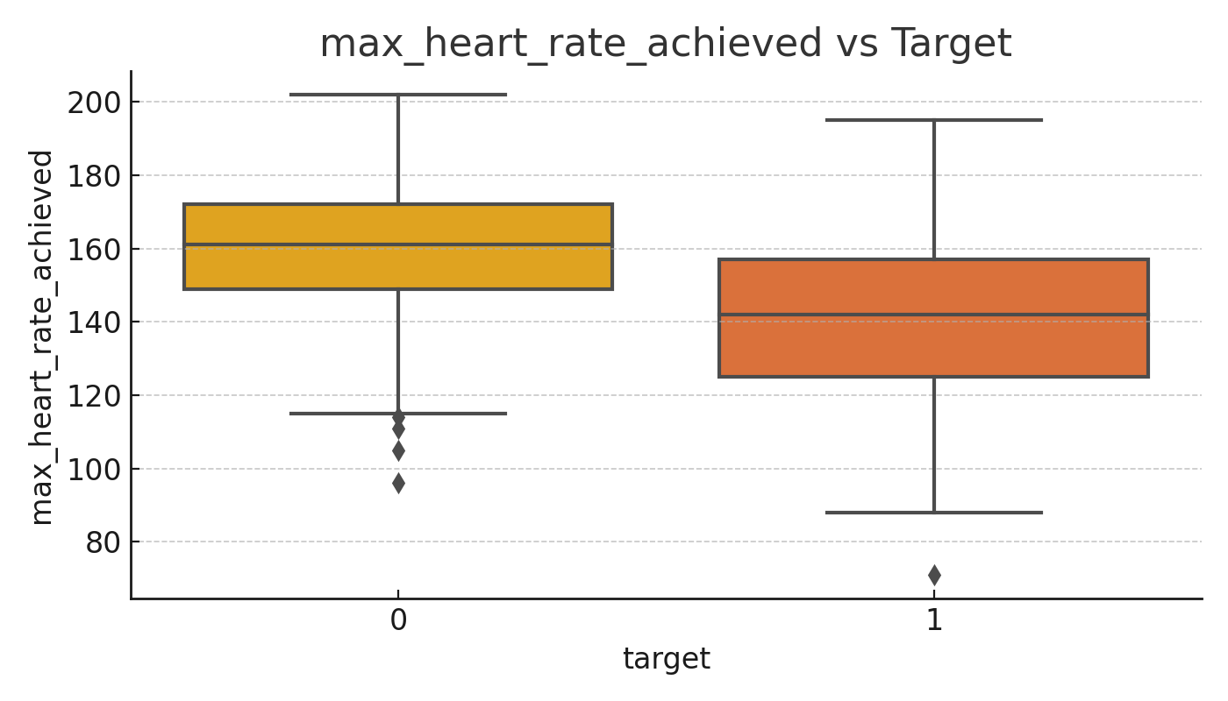
Max Heart Rate Achieved vs Target
No Disease
Disease
Notes:
Andrea
Patients without heart disease tend to achieve higher maximum heart rates. Lower max heart rate during exercise could be a strong indicator of heart conditions.

Slide 24
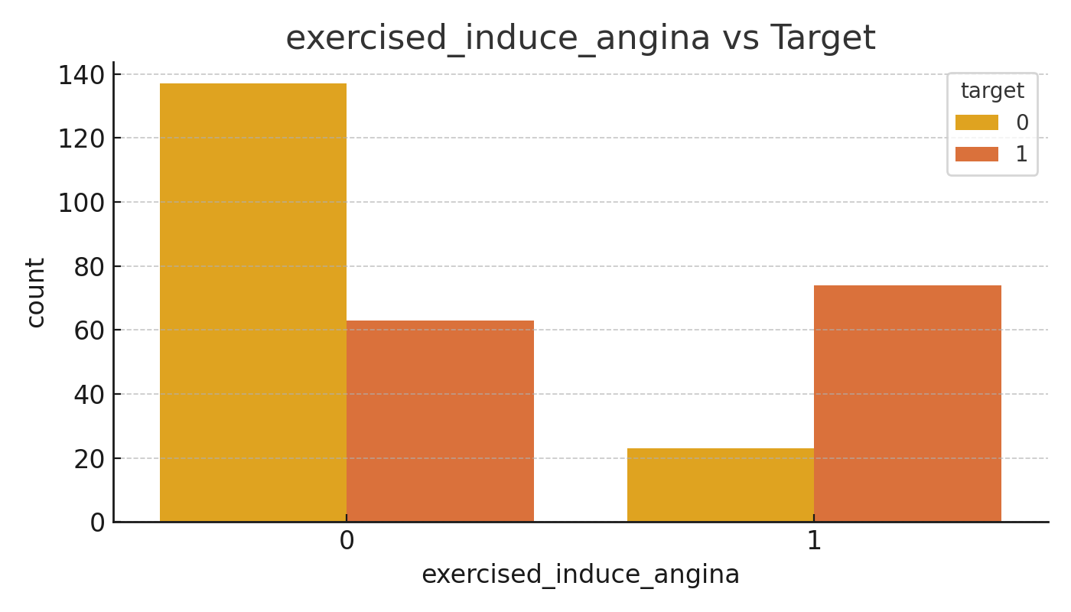
Exercise-Induced Angina vs Target
No Disease
Disease
Disease
No Disease
No
Yes
Notes:
Andrea
Exercise-induced angina is more common in patients with heart disease, making it a strong diagnostic factor. Angina is a type of chest pain.

Slide 25
Demographics & Vitals vs Target
Age and gender more predictive than resting blood pressure
Notes:
Andrea
Age and sex show clear influence on risk, while resting blood pressure shows minor variation.

Slide 26
Cardiac Indicators vs Target (Strong predictors)
Notes:
Andrea
Chest pain type, EKG results, and max heart rate are strong predictors. Clear differences appear between the groups, highlighting these as critical features.

Slide 27
Blood & Metabolic Factors vs Target
Notes:
Andrea
This slide includes cholesterol, fasting blood sugar, and exercise-induced angina. The last of these shows the strongest correlation with heart disease.

