Slide 1
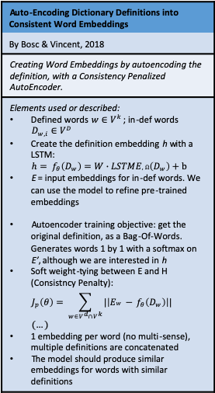
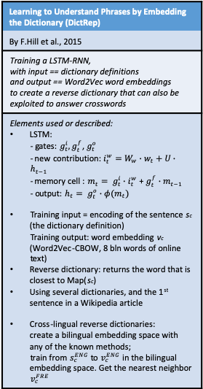
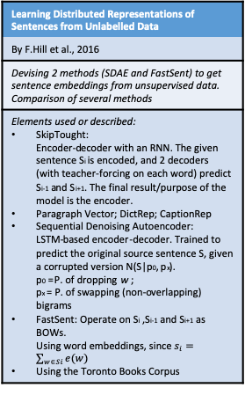
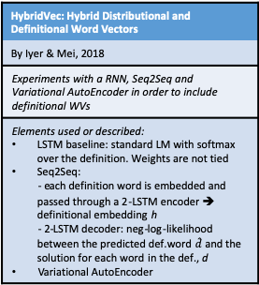
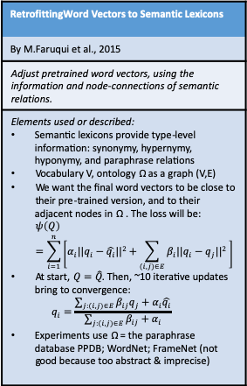
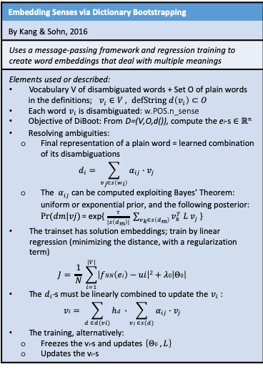
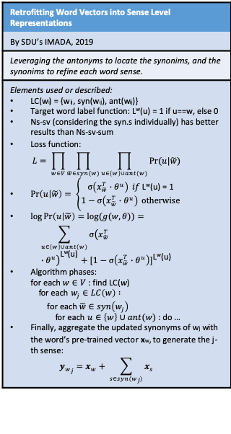
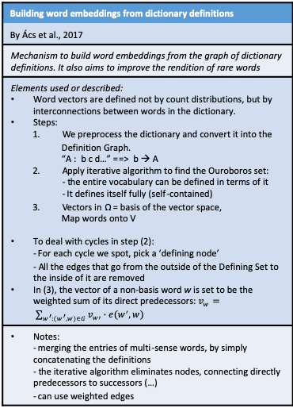
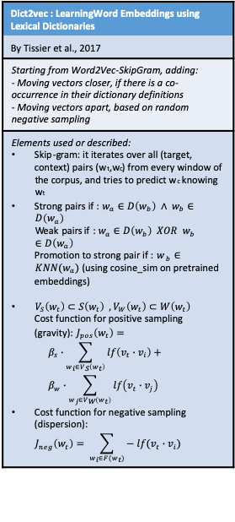
Research Direction 2 (section: Dictionaries)
Learning to Understand Phrases by Embedding the Dictionary (DictRep)
By F.Hill et al., 2015
Training a LSTM-RNN, with input == dictionary definitions and output == Word2Vec word embeddings to create a reverse dictionary that can also be exploited to answer crosswords
Elements used or described: LSTM: - gates: $g_{t}^{i},g_{t}^{f}$, $g_{t}^{o}$ - new contribution: $i_{t}^{w}=W_{w}∙w_{t}+U∙h_{t−1}$ - memory cell : $m_{t}= g_{t}^{i}∙i_{t}^{w}$ + $g_{t}^{f}{∙m}_{t−1}$ - output: $h_{t}= g_{t}^{o}{∙φ(m}_{t})$ Training input = encoding of the sentence s_{c} (the dictionary definition) Training output: word embedding v_{c} (Word2Vec-CBOW, 8 bln words of online text) Reverse dictionary: returns the word that is closest to Map(s_{c}) Using several dictionaries, and the 1st sentence in a Wikipedia article Cross-lingual reverse dictionaries: create a bilingual embedding space with any of the known methods; train from $s_{c}^{ENG}$ to $v_{c}^{ENG}$ in the bilingual embedding space. Get the nearest neighbor $v_{c}^{FRE}$
Embedding Senses via Dictionary Bootstrapping
By Kang & Sohn, 2016
Uses a message-passing framework and regression training to create word embeddings that deal with multiple meanings
Elements used or described: Vocabulary V of disambiguated words + Set O of plain words in the definitions; $v_{i}∈V , defString d\left(v_{i}\right)⊂O$ Each word $v_{i}$ is disambiguated: w.POS.n_sense Objective of DiBoot: From D=(V,O,d()), compute the e_{i}-s $∈ℝ^{n}$ Resolving ambiguities: Final representation of a plain word = learned combination of its disambiguations $d_{i}= \sum_{v_{j}∈s\left(w_{i}\right)}{α_{ij}∙v_{j}}$ The $α_{ij}$ can be computed exploiting Bayes’ Theorem: uniform or exponential prior, and the following posterior: $Pr⁡(dm|vj)$ = exp{ $\frac{τ}{|s\left(d_{m}\right)|} \sum_{v_{k}∈s\left(d_{m}\right)}{v_{k}^{T} L v_{j}}$ } The trainset has solution embeddings; train by linear regression (minimizing the distance, with a regularization term) $J= \frac{1}{N} \sum_{i=1}^{|V|}{\left|fNN\left(ei\right)−ui\right|2+λ0\left|Θ0\right|}$ The $d_{i}$-s must be linearly combined to update the $v_{i}$ : $vi= \sum_{d ∈d(vi)}{hd} ∙\sum_{vj ∈s(d)}{α_{ij}∙v_{j}}$ The training, alternatively: Freezes the v_{i}-s and updates $\left\{Θ0 , L\right\}$ Updates the v_{i}-s
Learning Distributed Representations of Sentences from Unlabelled Data
By F.Hill et al., 2016
Devising 2 methods (SDAE and FastSent) to get sentence embeddings from unsupervised data. Comparison of several methods
Elements used or described: SkipTought: Encoder-decoder with an RNN. The given sentence S_{i} is encoded, and 2 decoders (with teacher-forcing on each word) predict S_{i-1} and S_{i+1}. The final result/purpose of the model is the encoder. Paragraph Vector; DictRep; CaptionRep Sequential Denoising Autoencoder: LSTM-based encoder-decoder. Trained to predict the original source sentence S, given a corrupted version N(S|p₀, p_{x}). p₀ = P. of dropping w ; p_{x} = P. of swapping (non-overlapping) bigrams FastSent: Operate on S_{i} ,S_{i-1} and S_{i+1} as BOWs. Using word embeddings, since $s_{i}=\sum_{w∈Si}{e(w)}$ Using the Toronto Books Corpus
Auto-Encoding Dictionary Definitions into Consistent Word Embeddings
By Bosc & Vincent, 2018
Creating Word Embeddings by autoencoding the definition, with a Consistency Penalized AutoEncoder.
Elements used or described: Defined words $w∈V^{k}$ ; in-def words $D_{w,i}∈V^{D}$ Create the definition embedding h with a LSTM: $h= f_{θ}\left(D_{w}\right)=W∙LSTME,Ω\left(D_{w}\right)+b$ E = input embeddings for in-def words. We can use the model to refine pre-trained embeddings Autoencoder training objective: get the original definition, as a Bag-Of-Words. Generates words 1 by 1 with a softmax on E’, although we are interested in h Soft weight-tying between E and H (Consistncy Penalty): $J_{p}\left(θ\right)= \sum_{w∈V^{d}∩V^{k}}{|\left|Ew − f_{θ}\left(D_{w}\right)\right||}$ $(…)$ 1 embedding per word (no multi-sense), multiple definitions are concatenated The model should produce similar embeddings for words with similar definitions
Retrofitting Word Vectors into Sense Level Representations
By SDU’s IMADA, 2019
Leveraging the antonyms to locate the synonims, and the synonims to refine each word sense.
Elements used or described: LC(w_{i}) = {w_{ij}, syn(w_{ij}), ant(w_{ij})} Target word label function: L^{w}(u) = 1 if u==w, else 0 Ns-sv (considering the syn.s individually) has better results than Ns-sv-sum Loss function: $L= \prod_{w∈V}{\prod_{\tilde{w}∈syn(w)}{\prod_{u∈\left\{w\right\}∪ant(w)}{Pr⁡(u|\tilde{w})}}}$ $\operatorname{Pr}\left(u | \tilde{w}\right)= \left\{\begin{aligned}σ\left(x_{\tilde{w}}^{T}∙θ^{u}\right) if \text{L}\text{w}\text{(}\text{u}\text{) = 1} \\ 1−σ\left(x_{\tilde{w}}^{T}∙θ^{u}\right) otherwise\end{aligned}\right.$ $\log{\operatorname{Pr}\left(u | \tilde{w}\right)=\log{(g(w,θ))}}=$ $\sum_{u∈\left\{w\right\}∪ant(w)}{{σ\left(x_{\tilde{w}}^{T}∙θ^{u}\right)}^{\text{L}\text{w}\text{(}\text{u}\text{)}}+{[1−σ\left(x_{\tilde{w}}^{T}∙θ^{u}\right)]}^{\text{L}\text{w}\text{(}\text{u}\text{)}}}$ Algorithm phases: for each $w∈V$ : find LC(w) for each $w_{j}∈LC\left(w\right) :$ for each $\tilde{w}∈syn\left(w_{j}\right)$ for each $u∈\left\{w\right\}∪ant(w)$ : do … Finally, aggregate the updated synonyms of w_{j} with the word’s pre-trained vector x_{w}, to generate the j-th sense: $y_{w_{j}}=x_{w}+ \sum_{s∈syn(w_{j})}{x_{s}}$
Dict2vec : LearningWord Embeddings using Lexical Dictionaries
By Tissier et al., 2017
Starting from Word2Vec-SkipGram, adding: - Moving vectors closer, if there is a co-occurrence in their dictionary definitions - Moving vectors apart, based on random negative sampling
Elements used or described: Skip-gram: it iterates over all (target, context) pairs (w_{t},w_{c}) from every window of the corpus, and tries to predict w_{c} knowing w_{t} Strong pairs if : $w_{a}∈D\left(w_{b}\right) ∧ w_{b}∈D\left(w_{a}\right)$ $\text{Weak} \text{pairs} \text{if}\text{ : }w_{a}∈D\left(w_{b}\right) XOR w_{b}∈D\left(w_{a}\right)$ Promotion to strong pair if : $w_{ b}∈KNN(w_{a})$ (using cosine_sim on pretrained embeddings) $V_{S}\left(w_{t}\right)⊂S\left(w_{t}\right) ,V_{W}\left(w_{t}\right)⊂W\left(w_{t}\right)$ Cost function for positive sampling (gravity): $J_{pos}\left(w_{t}\right)=$ $β_{s}∙\sum_{w_{i}∈V_{S}\left(w_{t}\right)}{lf\left(v_{t}∙v_{i}\right)+ }$ $β_{w}∙\sum_{w_{j}∈V_{W}\left(w_{t}\right)}{lf\left(v_{t}∙v_{j}\right) }$ Cost function for negative sampling (dispersion): $J_{neg}\left(w_{t}\right)= \sum_{w_{i}∈F(w_{t})}{− lf(v_{t}∙v_{i})}$
Building word embeddings from dictionary definitions
By Ács et al., 2017
Mechanism to build word embeddings from the graph of dictionary definitions. It also aims to improve the rendition of rare words
Elements used or described: Word vectors are defined not by count distributions, but by interconnections between words in the dictionary. Steps: We preprocess the dictionary and convert it into the Definition Graph. “A : b c d…” ==> b → A Apply iterative algorithm to find the Ouroboros set: - the entire vocabulary can be defined in terms of it - It defines itself fully (self-contained) Vectors in Ω = basis of the vector space, Map words onto V To deal with cycles in step (2): - For each cycle we spot, pick a ‘defining node’ - All the edges that go from the outside of the Defining Set to the inside of it are removed In (3), the vector of a non-basis word w is set to be the weighted sum of its direct predecessors: $v_{w}= \sum_{w^{′}:(w^{′},w)∈G}{v_{w′}∙e(w^{′},w)}$
Notes: - merging the entries of multi-sense words, by simply concatenating the definitions - the iterative algorithm eliminates nodes, connecting directly predecessors to successors (…) - can use weighted edges
Building word embeddings from dictionary definitions
What about using a Graph Neural Network?
“Another avenue of research we intend to pursue is to consolidate prediction- and dictionary-based embeddings into a hybrid model that combines the advantages of both.”
RetrofittingWord Vectors to Semantic Lexicons
By M.Faruqui et al., 2015
Adjust pretrained word vectors, using the information and node-connections of semantic relations.
Elements used or described: Semantic lexicons provide type-level information: synonymy, hypernymy, hyponymy, and paraphrase relations Vocabulary V, ontology Ω as a graph (V,E) We want the final word vectors to be close to their pre-trained version, and to their adjacent nodes in Ω . The loss will be: $ψ\left(Q\right)=\sum_{i=1}^{n}{\left[α_{i}||q_{i}−\hat{q_{i}}||2+\sum_{(i,j)∈E}{β_{i}||q_{i}−q_{j}||2} \right]}$ At start, $Q=\hat{Q}$. Then, ~10 iterative updates bring to convergence: $q_{i}=\frac{\sum_{j:(i,j)∈E}{β_{ij}q_{j}+α_{i}\hat{q_{i}}}}{\sum_{j:(i,j)∈E}{β_{ij}+α_{i}}}$ Experiments use Ω = the paraphrase database PPDB; WordNet; FrameNet (not good because too abstract & imprecise)
HybridVec: Hybrid Distributional and Definitional Word Vectors
By Iyer & Mei, 2018
Experiments with a RNN, Seq2Seq and Variational AutoEncoder in order to include definitional WVs
Elements used or described: LSTM baseline: standard LM with softmax over the definition. Weights are not tied Seq2Seq: - each definition word is embedded and passed through a 2-LSTM encoder ➔ definitional embedding h - 2-LSTM decoder: neg-log-likelihood between the predicted def.word $\hat{d}$ and the solution for each word in the def., d Variational AutoEncoder

