Slide 1
Perplexity
Evaluating Rewards for Question Generation Models
By Hoskin & Riedel et al., 2019
Using several different evaluation measures on a Question Generation Architecture (also with LM and adversarial discriminator). Higher scores (NOT(==)) Better quality
Elements used or described: Task: generate a question, given a doc (context), and the answer marked in it Idea: instead of using as the objective only the ground-truth solution, add a fine-tuning phase with other scores (eg. BLEU, LM perplexity) Model: Seq2Seq, with attention, and answer encoder. Uses beam search + Adversarial training: Generate questions Train a discriminator, that must distinguish between generated Qs and ground-truth Qs Fine-tune the generator, with a reward for fooling the discrim. Through old-fashioned human evaluation, we discover 3 failures: LM metric QA metric The discriminator is useless
Note:
Can you compare perplexity across different segmentations?
Blog, By Sebastian J. Mielke
Perplexities over different segmentation granularities (i.e., words, subwords, or characters) aren't directly comparable, but the log-likelihoods that are hidden inside them are — and those can always be converted to perplexities for any given level.
Elements used or described: ppl_{word} = exp( - log (p(text)) / N_{words}) ppl_{char} = exp( - log (p(text)) / N_{char}) We can compute log(p(text)) with the product of probabilities over any decompositions (words, chars, …) Word-level models are closed-Vocab., whereas open-V models can potentially predict any sequence of units, thus spreading their probability mass. We can only compare distributions on perplexity if they have the same support set of strings. With subwords: while the ppl-per-prediction token is not comparable, we can still compute ppl_{word} and ppl_{char}
Notes: The logarithm of the product is the sum of logarithms, so -log(p(text)) = -[ log (p(w1)) + log(p(w2)) +…] Bits Per Character: -log₂ P(x_{t+1} | y_{t}) Also as: -1/T * Σ_{t=1}^{T} log₂ P(x_{t})
Are All Languages Equally Hard to Language-Model?
By Cotterell, Mielke et al., 2018
Introducing Multi-Text evaluation (across translated utterances) and BPEC. Comparing LMs on different languages
Elements used or described: Fixed-V LMs use <unk> tokens to represent OOV words. Here, we compare open-V char-level LSTM-LMs Multi-text: k-way translations of the same content Bits Per English Character; BPEC = 1/(|h_{ENG}|+1) * Σ_{i=1}^{|h|+1} P(c_{i}|h) can also be aggregated over utterances There is a significant BPEC difference when 1 of the 2 languages has a greater inflectional morphology (either 1) more difficult or 2) our models can’t cope) The difference disappears when lemmatizing
Note:

Slide 2
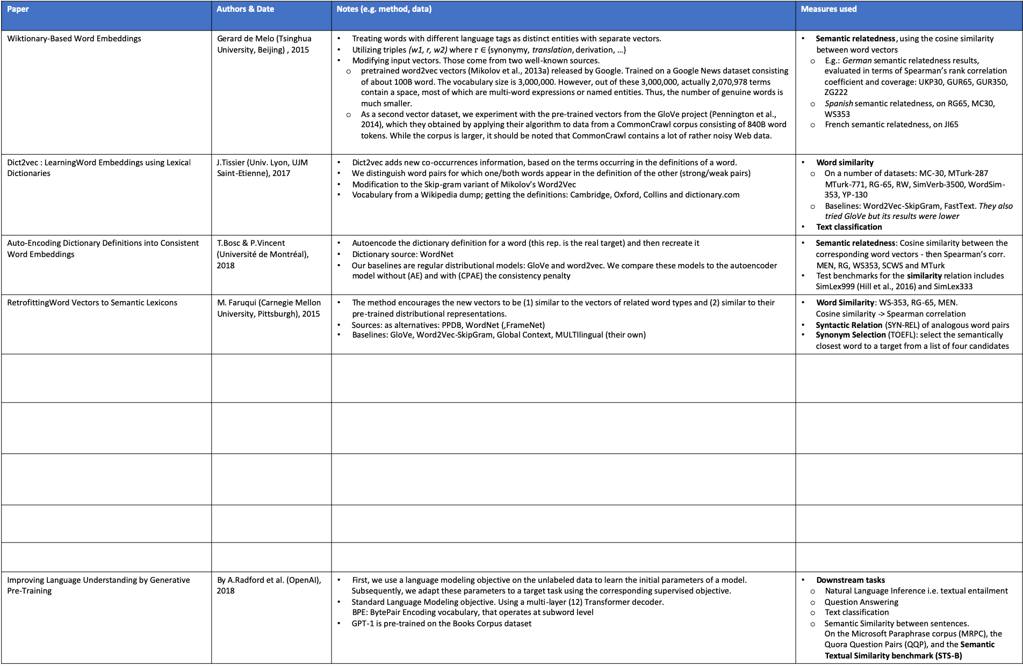
Evaluation measures for Word Embeddings
Paper | Authors & Date | Notes (e.g. method, data) | Measures used
Wiktionary-Based Word Embeddings | Gerard de Melo (Tsinghua University, Beijing) , 2015 | Treating words with different language tags as distinct entities with separate vectors. Utilizing triples (w1, r, w2) where $r∈$ {synonymy, translation, derivation, …} Modifying input vectors. Those come from two well-known sources. pretrained word2vec vectors (Mikolov et al., 2013a) released by Google. Trained on a Google News dataset consisting of about 100B word. The vocabulary size is 3,000,000. However, out of these 3,000,000, actually 2,070,978 terms contain a space, most of which are multi-word expressions or named entities. Thus, the number of genuine words is much smaller. As a second vector dataset, we experiment with the pre-trained vectors from the GloVe project (Pennington et al., 2014), which they obtained by applying their algorithm to data from a CommonCrawl corpus consisting of 840B word tokens. While the corpus is larger, it should be noted that CommonCrawl contains a lot of rather noisy Web data. | Semantic relatedness, using the cosine similarity between word vectors E.g.: German semantic relatedness results, evaluated in terms of Spearman’s rank correlation coefficient and coverage: UKP30, GUR65, GUR350, ZG222 Spanish semantic relatedness, on RG65, MC30, WS353 French semantic relatedness, on JI65
Dict2vec : LearningWord Embeddings using Lexical Dictionaries | J.Tissier (Univ. Lyon, UJM Saint-Etienne), 2017 | Dict2vec adds new co-occurrences information, based on the terms occurring in the definitions of a word. We distinguish word pairs for which one/both words appear in the definition of the other (strong/weak pairs) Modification to the Skip-gram variant of Mikolov’s Word2Vec Vocabulary from a Wikipedia dump; getting the definitions: Cambridge, Oxford, Collins and dictionary.com | Word similarity On a number of datasets: MC-30, MTurk-287 MTurk-771, RG-65, RW, SimVerb-3500, WordSim-353, YP-130 Baselines: Word2Vec-SkipGram, FastText. They also tried GloVe but its results were lower Text classification
Auto-Encoding Dictionary Definitions into Consistent Word Embeddings | T.Bosc & P.Vincent (Université de Montréal), 2018 | Autoencode the dictionary definition for a word (this rep. is the real target) and then recreate it Dictionary source: WordNet Our baselines are regular distributional models: GloVe and word2vec. We compare these models to the autoencoder model without (AE) and with (CPAE) the consistency penalty | Semantic relatedness: Cosine similarity between the corresponding word vectors - then Spearman’s corr. MEN, RG, WS353, SCWS and MTurk Test benchmarks for the similarity relation includes SimLex999 (Hill et al., 2016) and SimLex333
RetrofittingWord Vectors to Semantic Lexicons | M. Faruqui (Carnegie Mellon University, Pittsburgh), 2015 | The method encourages the new vectors to be (1) similar to the vectors of related word types and (2) similar to their pre-trained distributional representations. Sources: as alternatives: PPDB, WordNet (,FrameNet) Baselines: GloVe, Word2Vec-SkipGram, Global Context, MULTIlingual (their own) | Word Similarity: WS-353, RG-65, MEN. Cosine similarity -> Spearman correlation Syntactic Relation (SYN-REL) of analogous word pairs Synonym Selection (TOEFL): select the semantically closest word to a target from a list of four candidates
Improving Language Understanding by Generative Pre-Training | By A.Radford et al. (OpenAI), 2018 | First, we use a language modeling objective on the unlabeled data to learn the initial parameters of a model. Subsequently, we adapt these parameters to a target task using the corresponding supervised objective. Standard Language Modeling objective. Using a multi-layer (12) Transformer decoder. BPE: BytePair Encoding vocabulary, that operates at subword level GPT-1 is pre-trained on the Books Corpus dataset | Downstream tasks Natural Language Inference i.e. textual entailment Question Answering Text classification Semantic Similarity between sentences. On the Microsoft Paraphrase corpus (MRPC), the Quora Question Pairs (QQP), and the Semantic Textual Similarity benchmark (STS-B)

Slide 3
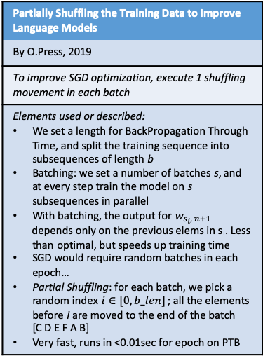
Misc items
Partially Shuffling the Training Data to Improve Language Models
By O.Press, 2019
To improve SGD optimization, execute 1 shuffling movement in each batch
Elements used or described: We set a length for BackPropagation Through Time, and split the training sequence into subsequences of length b Batching: we set a number of batches s, and at every step train the model on s subsequences in parallel With batching, the output for $w_{s_{i}, n+1}$ depends only on the previous elems in s_{i}. Less than optimal, but speeds up training time SGD would require random batches in each epoch… Partial Shuffling: for each batch, we pick a random index $i∈[0,b_len]$ ; all the elements before i are moved to the end of the batch [C D E F A B] Very fast, runs in <0.01sec for epoch on PTB

Slide 4
Map: Neural Machine Translation
Learning Phrase Representations using RNN Encoder–Decoder for Statistical Machine Translation
By Cho et al, 2014
Proposal of the Encoder-Decoder model for NMT
One RNN encodes a sequence of symbols into a fixed-length vector representation, and the other decodes the representation into another sequence of symbols.
In addition to a novel model architecture, we also propose a new type of hidden unit that has been motivated by the LSTM unit but is much simpler to compute and implement. It has a reset gate r and an update gate z.
Sequence to Sequence Learning with Neural Networks
By Sutskever et al, 2014
Using LSTM-RNNs as Encoder-Decoder, and a fixed-dimensional vector
We were able to do well on long sentences because we reversed the order of words in the source sentence but not the target sentences in the training and test set.
Although LSTMs tend to not suffer from the vanishing gradient problem, they can have exploding gradients. Thus we enforced a hard constraint on the norm of the gradient by scaling it when its norm exceeded a threshold.
NEURAL MACHINE TRANSLATION BY JOINTLY LEARNING TO ALIGN AND TRANSLATE
By Bahdanau et al, 2016
Soft attention when operating with RNNs for NMT
This approach does not attempt to encode a whole input sentence into a single fixed-length vector. Instead, it encodes the input sentence into a sequence of vectors and chooses a subset of these vectors adaptively while decoding the translation.
The context vector ci depends on a sequence of annotations (h₁, …, h_{Tx}) to which an encoder maps the input sentence. Each annotation h_{i} contains information about the whole input sequence, with a strong focus on the parts surrounding the i-th word of the input sequence.

Slide 5
Map: N-grams and statistical methods
Class-Based n-gram Models of Natural Language
By Brown et al., 1992
The original proposal to use word-based (or potentially class-based) n-grams to build a language model
Uses Sequential Maximum Likelihood Estimation
It is possible to partition the vocabulary in classes / clusters
By itself, it does not address Smoothing
Class-Based Language Modeling for Translating into Morphologically Rich Languages
By Bisazza and Monz et al., 2015
Describes several alternatives to define classes in a LM, and to combine models
Simpler deterministic class mappings can be derived by using shallow linguistic knowledge, such as suffixes or orthographic features
… where the word emission is also conditioned on the class history rather than on the current class alone. The resulting model is called fullibm
An Empirical Study of Smoothing Techniques for Language Modeling
By Chen and Goodman et al., 1998
Recap of smoothing techniques, and Modified Kneser-Ney Smoothing
Finally, we use the detailed analysis of different algorithms to motivate a modification to Kneser-Ney smoothing; the resulting algorithm consistently outperforms all other algorithms evaluated.
Additive s., Good-Turing Estimate, Jelinek-Mercer s., Katz s., Witten-Bell s., Absolute discounting, Kneser-Ney s., Modified Kneser-Ney s.

