Slide 1
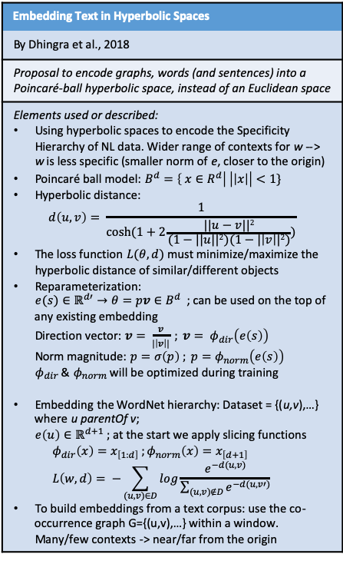
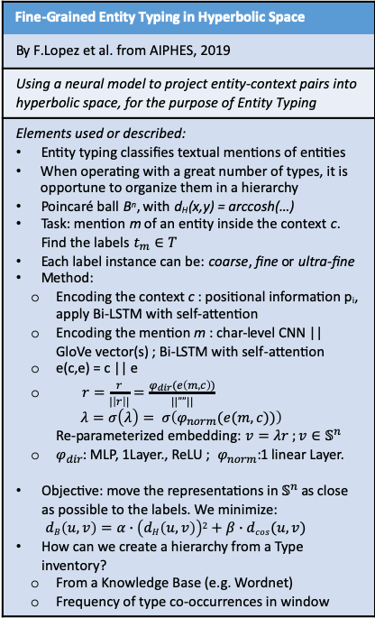
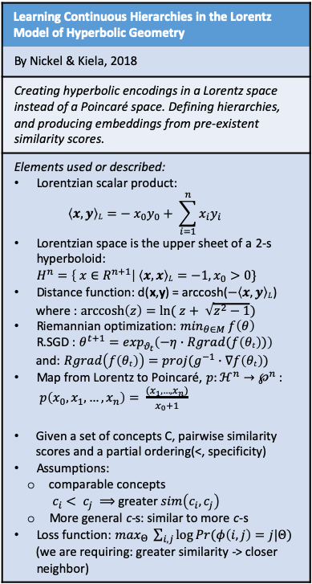
Research Direction 2 (section: Hyperbolic embeddings)
Embedding Text in Hyperbolic Spaces
By Dhingra et al., 2018
Proposal to encode graphs, words (and sentences) into a Poincaré-ball hyperbolic space, instead of an Euclidean space
Elements used or described: Using hyperbolic spaces to encode the Specificity Hierarchy of NL data. Wider range of contexts for w --> w is less specific (smaller norm of e, closer to the origin) Poincaré ball model: $B^{d}=\left\{ x∈R^{d}\right| \left|\left|x\right|\right|<1\}$ Hyperbolic distance: $d\left(u,v\right)= \frac{1}{cosh⁡(1+2\frac{||u−v||2}{(1−||u||2)(1−|\left|v\right||2)})}$ The loss function $L(θ,d)$ must minimize/maximize the hyperbolic distance of similar/different objects Reparameterization: ${e(s)∈ℝ}^{d′}→{θ=pv∈B}^{d}$ ; can be used on the top of any existing embedding Direction vector: $v= \frac{\overline{v}}{|\left|\overline{v}\right||} ; \overline{v}= φ_{dir}\left(e\left(s\right)\right)$ Norm magnitude:$p=σ\left(\overline{p}\right) ; \overline{p}=φ_{norm}\left(e\left(s\right)\right)$ $φ_{dir}$ & $φ_{norm}$ will be optimized during training Embedding the WordNet hierarchy: Dataset = {(u,v),…} where u parentOf v; $e\left(u\right)∈ℝ^{d+1} ;$ at the start we apply slicing functions $φ_{dir}\left(x\right)=x_{\left[1:d\right]} ;φ_{norm}\left(x\right)=x_{\left[d+1\right]}$ $L\left(w,d\right)= −\sum_{(u,v)∈D}{log\frac{e^{−d(u,v)}}{\sum_{(u,v)∉D}{e^{−d(u,v′)}}}}$ To build embeddings from a text corpus: use the co-occurrence graph G={(u,v),…} within a window. Many/few contexts -> near/far from the origin
Embedding Text in Hyperbolic Spaces
Meaningful nearest neighbors are found using cosine distance
“Ultimately, the usefulness of an embedding method depends on its performance on downstream tasks of interest…” What about Language Modeling?
The hierarchical structure is not usually annotated in text corpora. Instead, we hypothesize that this structure is encoded implicitly, in the range of contexts in which a concept appears.
Learning Continuous Hierarchies in the Lorentz Model of Hyperbolic Geometry
By Nickel & Kiela, 2018
Creating hyperbolic encodings in a Lorentz space instead of a Poincaré space. Defining hierarchies, and producing embeddings from pre-existent similarity scores.
Elements used or described: Lorentzian scalar product: $\left\langle x,y\right\rangle L=− x_{0}y_{0}+ \sum_{i=1}^{n}{x_{i}y_{i}}$ Lorentzian space is the upper sheet of a 2-s hyperboloid: $H^{n}=\left\{ x∈R^{n+1}\right| \left\langle x,x\right\rangle L=−1, x_{0}>0\}$ Distance function: d(x,y) = arccosh($−\left\langle x,y\right\rangle L$) where : $\operatorname{arccosh}\left(z\right)=ln⁡( z+ \sqrt{z^{2}−1})$ Riemannian optimization: $\min_{θ∈M} f\left(θ\right)$ R.SGD : $θ^{t+1}=\exp_{θ_{t}}\left(−η∙Rgrad(f\left(θt\right))\right)$ and: $Rgrad\left(f\left(θt\right)\right)=proj(g^{−1}∙∇f\left(θt\right))$ Map from Lorentz to Poincaré, $p:ℋ^{n}→℘^{n}$ : $p\left(x_{0},x_{1},…,x_{n}\right)= \frac{(x_{1},…,x_{n})}{x_{0}+1}$ Given a set of concepts C, pairwise similarity scores and a partial ordering(<, specificity) Assumptions: comparable concepts $c_{i}< c_{j} ⟹$ greater $sim\left(c_{i},c_{j}\right)$ More general c-s: similar to more c-s Loss function: $\max_{Θ} \sum_{i,j}{\log{Pr(φ\left(i,j\right)=j|Θ)}}$ (we are requiring: greater similarity -> closer neighbor)
Fine-Grained Entity Typing in Hyperbolic Space
By F.Lopez et al. from AIPHES, 2019
Using a neural model to project entity-context pairs into hyperbolic space, for the purpose of Entity Typing
Elements used or described: Entity typing classifies textual mentions of entities When operating with a great number of types, it is opportune to organize them in a hierarchy Poincaré ball B^{n}, with d_{H}(x,y) = arccosh(…) Task: mention m of an entity inside the context c. Find the labels $t_{m}∈T$ Each label instance can be: coarse, fine or ultra-fine Method: Encoding the context c : positional information p_{i}, apply Bi-LSTM with self-attention Encoding the mention m : char-level CNN || GloVe vector(s) ; Bi-LSTM with self-attention e(c,e) = c || e $r=\frac{\overline{r}}{|\left|\overline{r}\right||}=\frac{φ_{dir}(e\left(m,c\right))}{||””||}$ $λ=σ\left(\overline{λ}\right)= σ\left(φ_{norm}(e(m,c))\right)$ Re-parameterized embedding: $v=λr ;v∈𝕊^{n}$ $φ_{dir}$: MLP, 1Layer., ReLU ; $φ_{norm}$:1 linear Layer. Objective: move the representations in $𝕊^{n}$ as close as possible to the labels. We minimize: $dB\left(u,v\right)=α∙\left(dH\left(u,v\right)\right)2+β∙dcos(u,v)$ How can we create a hierarchy from a Type inventory? From a Knowledge Base (e.g. Wordnet) Frequency of type co-occurrences in window

Slide 2
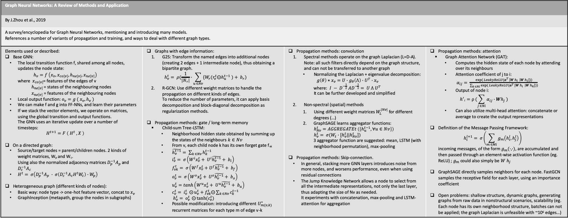
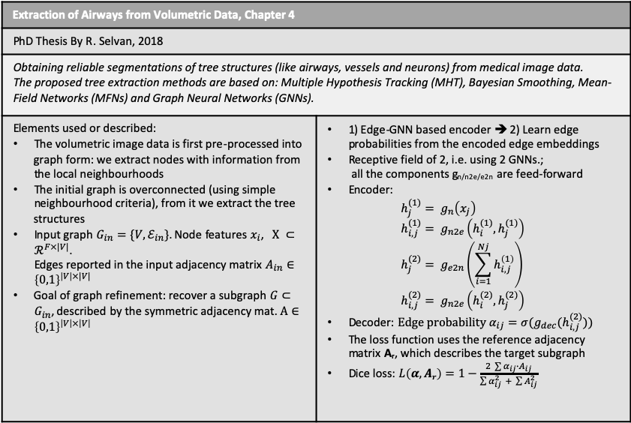
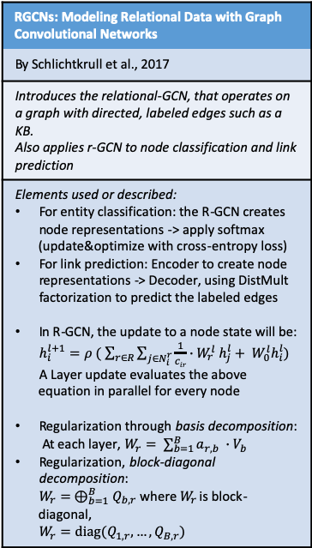
Research Direction 2 (section: GraphNNs)
Graph Neural Networks: A Review of Methods and Application
By J.Zhou et al., 2019
A survey/encyclopedia for Graph Neural Networks, mentioning and introducing many models. References a number of variants of propagation and training, and ways to deal with different graph types.
Elements used or described: Base GNN: The local transition function f, shared among all nodes, updates the node state: $h_{v}=f \left(x_{v}, x_{co\left[v\right]},h_{ne\left[v\right]}, x_{ne\left[v\right]}\right)$ where $x_{co\left[v\right]}$= features of the edges of v $h_{ne\left[v\right]}$ = states of the neighbouring nodes $x_{ne\left[v\right]}$ = features of the neighbouring nodes Local output function: $o_{v}=g ( x_{v}, h_{v} )$ We can make f and g into FF-NNs, and learn their parameters If we stack the vector elements, we operate on matrices, using the global transition and output functions. The GNN uses an iterative update over a number of timesteps: $H^{t+1}=F \left( H^{t} , X \right)$ On a directed graph: Source/target nodes = parent/children nodes. 2 kinds of weight matrices, W_{p} and W_{c}. Using also the normalized adjacency matrices $D_{p}^{−1}A_{p}$ and $D_{c}^{−1}A_{c}$ $H^{t}= σ\left(D_{p}^{−1}A_{p} ∙ σ\left(D_{c}^{−1}A_{c}H^{t}W_{c}\right)∙W_{p}\right)$ Heterogeneous graph (different kinds of nodes): Basic way: node type -> one-hot feature vector, concat to $x_{v}$ GraphInception (metapath, group the nodes in subgraphs) | Graphs with edge information: G2S: Transform the named edges into additional nodes (creating 2 edges + 1 intermediate node), thus obtaining a bipartite graph. $h_{v}^{t}= ρ(\frac{1}{\left|Nv\right|}∙\sum_{u ∈Nv}{{\{W}_{r}(r_{v}^{t}⨀h_{u}^{t−1} )+ b_{r})}$ R-GCN: Use different weight matrices to handle the propagation on different kinds of edges. To reduce the number of parameters, it can apply basis decomposition and block-diagonal decomposition as regularization methods. Propagation methods: gate / long-term memory Child-sum Tree-LSTM: Neighborhood hidden state obtained by summing up the states of the neighbours $k∈Nv$ From v, each child node k has its own forget gate f_{vk} $\tilde{h_{v}^{t−1}}= \sum_{k ∈Nv}{h_{k}^{t−1}}$ $i_{v}^{t}= σ\left(W^{i}x_{v}^{t}+ U^{i}\tilde{h_{v}^{t−1}}+ b_{i}\right)$ $f_{vk}^{t}= σ\left(W^{f}x_{v}^{t}+U^{f}\tilde{h_{v}^{t−1}}+ b_{f}\right)$ $o_{v}^{t}= σ\left(W^{o}x_{v}^{t}+ U^{o}\tilde{h_{v}^{t−1}}+ b_{o}\right)$ $u_{v}^{t}=tanh\left(W^{u}x_{v}^{t}+ U^{u}\tilde{h_{v}^{t−1}}+ b_{u}\right)$ $c_{v}^{t}= i_{v}^{t} ⨀{u_{v}^{t}}+f_{vk}^{t}⨀\sum_{k ∈Nv}{c_{k}^{t−1}}$ $h_{v}^{t}= o_{v}^{t} ⨀{tanh⁡(c_{v}^{t})}$ Possible modification: introducing different $U_{m(v,k)}^{∗}$ recurrent matrices for each type m of edge v-k | Propagation methods: convolution Spectral methods operate on the graph Laplacian (L=D-A). Note: all such filters directly depend on the graph structure, and can not be transferred to another graph Normalizing the Laplacian + eigenvalue decomposition: $g\left(θ\right)⋆x_{v}=U∙g_{θ}\left(Λ\right)∙U^{T}∙x_{v}$ where: $I − D^{−\frac{1}{2}} AD^{−\frac{1}{2}}= U Λ U^{T}$ It can be further developed and simplified Non-spectral (spatial) methods Using different weight matrices $W_{L}^{|Nv|}$ for different degrees (…) GraphSAGE learns aggregator functions: $h_{Nv}^{t}=AGGREGATEt \left(\left\{h_{u}^{t−1}, ∀u∈Nv\right\}\right)$ $h_{v}^{t}= σ(W_{t}∙[h_{v}^{t}||h_{Nv}^{t}])$ 3 aggregator function are suggested: mean, LSTM (with neighborhood permutation), max-pooling Propagation methods: Skip-connection. In general, stacking more GNN layers introduces noise from more nodes, and worsens performance, even when using residual connections The Jump Knowledge Network allows a node to select from all the intermediate representations, not only the last layer, thus adapting the size of Nv as needed. It experiments with concatenation, max-pooling and LSTM-attention for aggregation | Propagation methods: attention Graph Attention Network (GAT): Computes the hidden state of each node by attending over its neighbours Attention coefficient of j to i: $α_{ij}= \frac{exp⁡( LeakyReLU(a^{T }\left[W h_{i} \right|W h_{j}]))}{\sum_{k ∈Ni}{exp⁡( LeakyReLU(a^{T }\left[W h_{i} \right|W h_{k}]))}}$ Output of node i: $h^{′}i=ρ (\sum_{j ∈Ni}{α_{ij}∙Wh_{j}} )$ Can also utilize multi-head attention: concatenate or average to create the output representations Definition of the Message Passing Framework: $h_{i}^{l+1}= σ\left(\sum_{m ∈Mi}{g_{m}\left(h_{i}^{l},h_{j}^{l}\right)}\right)$ incoming messages, of the form $g_{m}(∙,∙)$, are accumulated and then passed through an element-wise activation function (eg. ReLU) ; $g_{m}$ could also simply be $W h_{j}$ GraphSAGE directly samples neighbors for each node. FastGCN samples the receptive field for each layer, using an importance coefficient Open problems: shallow structure, dynamic graphs, generating graphs from raw data in nonstructural scenarios, scalability (eg. Each node has its own neighborhood structure, batches can not be applied; the graph Laplacian is unfeasible with ~10⁶ edges…)
RGCNs: Modeling Relational Data with Graph Convolutional Networks
By Schlichtkrull et al., 2017
Introduces the relational-GCN, that operates on a graph with directed, labeled edges such as a KB. Also applies r-GCN to node classification and link prediction
Elements used or described: For entity classification: the R-GCN creates node representations -> apply softmax (update&optimize with cross-entropy loss) For link prediction: Encoder to create node representations -> Decoder, using DistMult factorization to predict the labeled edges In R-GCN, the update to a node state will be: $h_{i}^{l+1}=ρ ( \sum_{r∈R}{\sum_{j∈N_{i}^{r}}{\frac{1}{cir}∙W_{r}^{l} h_{j}^{l}+ W_{0}^{l}h_{i}^{l}}})$ A Layer update evaluates the above equation in parallel for every node Regularization through basis decomposition: At each layer, $W_{r}= \sum_{b=1}^{B}{a_{r,b} ∙V_{b}}$ Regularization, block-diagonal decomposition: $W_{r}= ⊕_{b=1}^{B}Q_{b,r}$ where $W_{r}$ is block-diagonal, $W_{r}=diag(Q_{1,r}, …,Q_{B,r})$
Modeling Relational Data with Graph Convolutional Networks
General idea, applicable to different types of GNN: What about building the output not only from the last layer, but from a weighted combination of all the layers? (Following the mechanism used in ELMo) This would solve the problem of being unable to build GNNs with many layers, because the last ones aggregate information from a too large neighbourhood and introduce noise. Note: may partially coincide with Layer Aggregation
Should be put together with the Densely Connected GCN’s input, as well.
Extraction of Airways from Volumetric Data, Chapter 4
PhD Thesis By R. Selvan, 2018
Obtaining reliable segmentations of tree structures (like airways, vessels and neurons) from medical image data. The proposed tree extraction methods are based on: Multiple Hypothesis Tracking (MHT), Bayesian Smoothing, Mean-Field Networks (MFNs) and Graph Neural Networks (GNNs).
Elements used or described: The volumetric image data is first pre-processed into graph form: we extract nodes with information from the local neighbourhoods The initial graph is overconnected (using simple neighbourhood criteria), from it we extract the tree structures Input graph $G_{in}=\{V, ℰ_{in}\}$. Node features $x_{i}$, $X ⊂ℛ^{F×|V|}$. Edges reported in the input adjacency matrix $A_{in}∈{\left\{0,1\right\}}^{\left|V\right|×|V|}$ Goal of graph refinement: recover a subgraph $G⊂G_{in}$, described by the symmetric adjacency mat. $A∈{\left\{0,1\right\}}^{\left|V\right|×\left|V\right|}$ | 1) Edge-GNN based encoder ➔ 2) Learn edge probabilities from the encoded edge embeddings Receptive field of 2, i.e. using 2 GNNs.; all the components g_{n/n2e/e2n} are feed-forward Encoder: $h_{j}^{(1)}= g_{n}\left(x_{j}\right)$ $h_{i,j}^{(1)}= g_{n2e}\left(h_{i}^{(1)},h_{j}^{(1)}\right)$ $h_{j}^{(2)}= g_{e2n}\left(\sum_{i=1}^{Nj}{h_{i,j}^{\left(1\right)}}\right)$ $h_{i,j}^{(2)}= g_{n2e}\left(h_{i}^{(2)},h_{j}^{(2)}\right)$ Decoder: $Edge probability α_{ij}=σ(g_{dec}(h_{i,j}^{(2)}))$ The loss function uses the reference adjacency matrix A_{r}, which describes the target subgraph Dice loss: $L\left(α,Ar\right)=1−\frac{2 \sum{α_{ij}∙A_{ij}}}{\sum{α_{ij}^{2}} + \sum{A_{ij}^{2}}}$

Slide 3
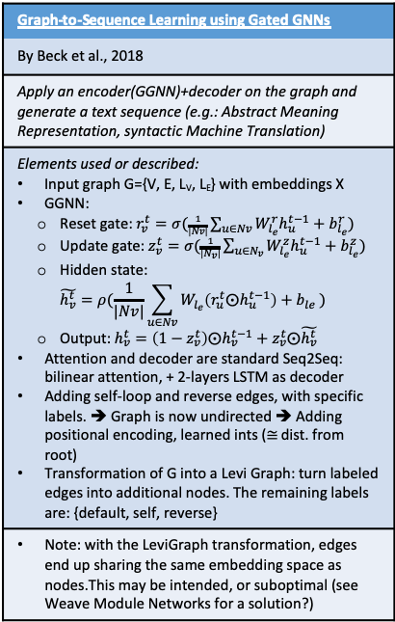
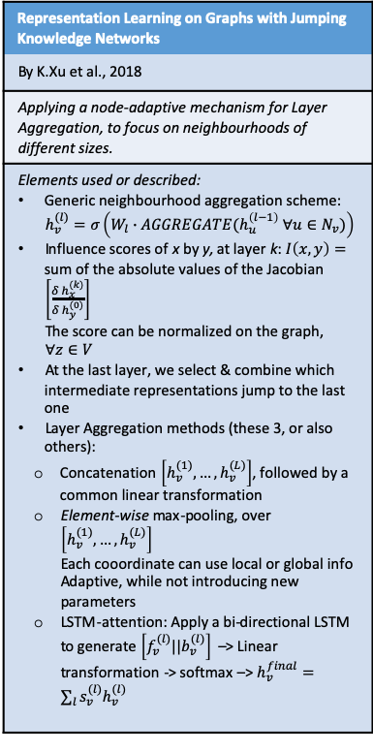
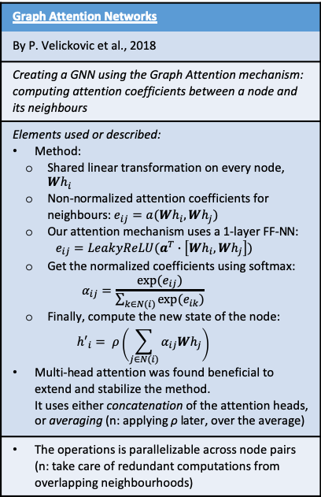
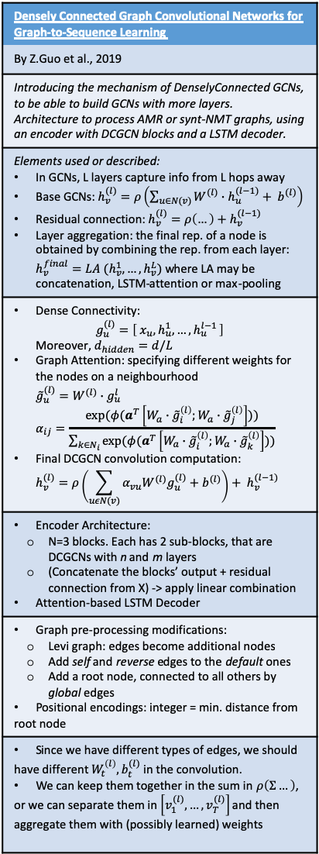
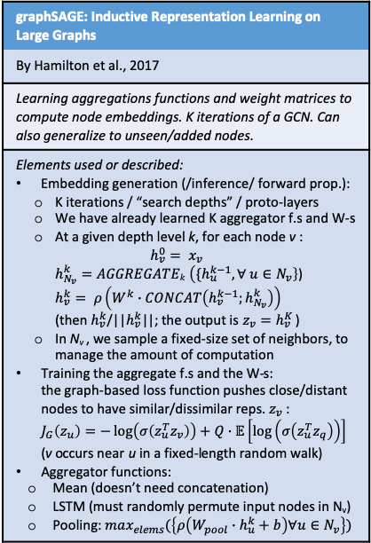
Research Direction 2 (section: GraphNNs)
Graph-to-Sequence Learning using Gated GNNs
By Beck et al., 2018
Apply an encoder(GGNN)+decoder on the graph and generate a text sequence (e.g.: Abstract Meaning Representation, syntactic Machine Translation)
Elements used or described: Input graph G={V, E, L_{V}, L_{E}} with embeddings X GGNN: Reset gate: $r_{v}^{t}=σ(\frac{1}{|Nv|}\sum_{u∈Nv}{W_{l_{e}}^{r}h_{u}^{t−1}+b_{l_{e}}^{r}})$ Update gate: $z_{v}^{t}=σ(\frac{1}{|N_{v}|}\sum_{u∈N_{v}}{W_{l_{e}}^{z}h_{u}^{t−1}+b_{l_{e}}^{z}})$ Hidden state: $\tilde{h_{v}^{t}}=ρ(\frac{1}{|Nv|}\sum_{u∈Nv}{W_{l_{e}}\left(r_{u}^{t}⨀h_{u}^{t−1}\right)+b_{le} })$ Output: $h_{v}^{t}=\left(1−z_{v}^{t}\right)⨀h_{v}^{t−1}+z_{v}^{t}⨀\tilde{h_{v}^{t}}$ Attention and decoder are standard Seq2Seq: bilinear attention, + 2-layers LSTM as decoder Adding self-loop and reverse edges, with specific labels. ➔ Graph is now undirected ➔ Adding positional encoding, learned ints ($≅$ dist. from root) Transformation of G into a Levi Graph: turn labeled edges into additional nodes. The remaining labels are: {default, self, reverse}
Note: with the LeviGraph transformation, edges end up sharing the same embedding space as nodes.This may be intended, or suboptimal (see Weave Module Networks for a solution?)
Graph Attention Networks
By P. Velickovic et al., 2018
Creating a GNN using the Graph Attention mechanism: computing attention coefficients between a node and its neighbours
Elements used or described: Method: Shared linear transformation on every node, $Wh_{i}$ Non-normalized attention coefficients for neighbours: $e_{ij}=a(Wh_{i},Wh_{j})$ Our attention mechanism uses a 1-layer FF-NN: $e_{ij}=LeakyReLU(a^{T}∙\left[Wh_{i}, Wh_{j}\right])$ Get the normalized coefficients using softmax: $α_{ij}=\frac{exp⁡(e_{ij})}{\sum_{k∈N(i)}{exp⁡(e_{ik})}}$ Finally, compute the new state of the node: ${h′}_{i}= ρ\left(\sum_{j∈N(i)}{α_{ij}Wh_{j}}\right)$ Multi-head attention was found beneficial to extend and stabilize the method. It uses either concatenation of the attention heads, or averaging (n: applying ρ later, over the average)
The operations is parallelizable across node pairs (n: take care of redundant computations from overlapping neighbourhoods)
Discussion
In all spectral approaches, the learned filters depend on the Laplacian (L=D-A…) eigenbasis, which depends on the graph structure. Thus, a model trained on a specific structure can not be directly applied to a graph with a different structure.
graphSAGE samples a fixed-size neighbourhood of each node, and then applies the aggregator function.
Moreover, graphSAGE achieved some of its better results when using a LSTM aggregator, which is sequential and thus needs to receive a random permutation of the neighbours
Nevertheless, in graphSAGE the max-pooling operation, that employs a linear transformation, implicitly selects important nodes
As opposed to basic GCNs, our model allows for (implicitly) assigning different importances to nodes of a same neighborhood, enabling a leap in model capacity.
Densely Connected Graph Convolutional Networks for Graph-to-Sequence Learning
By Z.Guo et al., 2019
Introducing the mechanism of DenselyConnected GCNs, to be able to build GCNs with more layers. Architecture to process AMR or synt-NMT graphs, using an encoder with DCGCN blocks and a LSTM decoder.
Elements used or described: In GCNs, L layers capture info from L hops away Base GCNs: $h_{v}^{(l)}=ρ\left(\sum_{u∈N(v)}{W^{(l)}∙h_{u}^{(l−1)}}+ b^{(l)}\right)$ Residual connection: $h_{v}^{(l)}=ρ\left(…\right)+h_{v}^{(l−1)}$ Layer aggregation: the final rep. of a node is obtained by combining the rep. from each layer: $h_{v}^{final}=LA (h_{v}^{1},…,h_{v}^{L})$ where LA may be concatenation, LSTM-attention or max-pooling
Dense Connectivity: $g_{u}^{(l)}=\left[ x_{u}, h_{u}^{1},…,h_{u}^{l−1 }\right]$ Moreover, $d_{hidden}=d/L$ Graph Attention: specifying different weights for the nodes on a neighbourhood ${\tilde{g}}_{u}^{(l)}=W^{(l)}∙g_{u}^{l}$ $α_{ij}=\frac{exp⁡(φ(a^{T}\left[W_{a}∙{\tilde{g}}_{i}^{\left(l\right)};W_{a}∙{\tilde{g}}_{j}^{\left(l\right)}\right]))}{\sum_{k∈N_{i}}{exp⁡(φ(a^{T}\left[W_{a}∙{\tilde{g}}_{i}^{\left(l\right)};W_{a}∙{\tilde{g}}_{k}^{\left(l\right)}\right]))}}$ Final DCGCN convolution computation: $h_{v}^{(l)}=ρ\left(\sum_{uεN(v)}{α_{vu}W^{(l)}g_{u}^{(l)}+b^{(l)}}\right)+ h_{v}^{(l−1)}$
Encoder Architecture: N=3 blocks. Each has 2 sub-blocks, that are DCGCNs with n and m layers (Concatenate the blocks’ output + residual connection from X) -> apply linear combination Attention-based LSTM Decoder
Graph pre-processing modifications: Levi graph: edges become additional nodes Add self and reverse edges to the default ones Add a root node, connected to all others by global edges Positional encodings: integer = min. distance from root node
Since we have different types of edges, we should have different $W_{t}^{\left(l\right)},b_{t}^{(l)}$ in the convolution. We can keep them together in the sum in $ρ\left(Σ…\right)$, or we can separate them in $\left[v_{1}^{(l)},…,v_{T}^{(l)}\right]$ and then aggregate them with (possibly learned) weights
graphSAGE: Inductive Representation Learning on Large Graphs
By Hamilton et al., 2017
Learning aggregations functions and weight matrices to compute node embeddings. K iterations of a GCN. Can also generalize to unseen/added nodes.
Elements used or described: Embedding generation (/inference/ forward prop.): K iterations / “search depths” / proto-layers We have already learned K aggregator f.s and W-s At a given depth level k, for each node v : $h_{v}^{0}= x_{v}$ $h_{N_{v}}^{k}=AGGREGATEk \left({\{h}_{u}^{k−1}, ∀ u∈N_{v}\right\}$) $h_{v}^{k}= ρ\left(W^{k}∙CONCAT\left(h_{v}^{k−1};h_{N_{v}}^{k}\right)\right)$ (then $h_{v}^{k}$/||$h_{v}^{k}$||; the output is $z_{v}=h_{v}^{K}$ ) In N_{v} , we sample a fixed-size set of neighbors, to manage the amount of computation Training the aggregate f.s and the W-s: the graph-based loss function pushes close/distant nodes to have similar/dissimilar reps. $z_{v}$ : $J_{G}\left(z_{u}\right)=−\log\left(σ\left(z_{u}^{T}z_{v}\right)\right)+Q∙𝔼\left[\log\left(σ\left(z_{u}^{T}z_{q}\right)\right)\right]$ (v occurs near u in a fixed-length random walk) Aggregator functions: Mean (doesn’t need concatenation) LSTM (must randomly permute input nodes in N_{v}) Pooling: $\max_{elems}(\left\{ρ\left(W_{pool}∙h_{u}^{k}+b\right)∀u∈N_{v}\right\})$
Representation Learning on Graphs with Jumping Knowledge Networks
By K.Xu et al., 2018
Applying a node-adaptive mechanism for Layer Aggregation, to focus on neighbourhoods of different sizes.
Elements used or described: Generic neighbourhood aggregation scheme: $h_{v}^{(l)}=σ\left(W_{l}∙AGGREGATE(h_{u}^{\left(l−1\right)} ∀u∈N_{v})\right)$ Influence scores of x by y, at layer k: $I\left(x,y\right)=$ sum of the absolute values of the Jacobian $\left[\frac{δ h_{x}^{(k)}}{δ h_{y}^{(0)}}\right]$ The score can be normalized on the graph, $∀z∈V$ At the last layer, we select & combine which intermediate representations jump to the last one Layer Aggregation methods (these 3, or also others): Concatenation $\left[h_{v}^{(1)},…,h_{v}^{(L)}\right]$, followed by a common linear transformation Element-wise max-pooling, over $\left[h_{v}^{(1)},…,h_{v}^{(L)}\right]$ Each cooordinate can use local or global info Adaptive, while not introducing new parameters LSTM-attention: Apply a bi-directional LSTM to generate $\left[f_{v}^{(l)}||b_{v}^{(l)}\right]$ –> Linear transformation -> softmax –> $h_{v}^{final}=\sum_{l}{s_{v}^{(l)}h_{v}^{(l)}}$
Jumping Knowledge Networks
Observation: in any GNN, each layer increases the radius of the Influence Distribution, by aggregating neighbourhoods from the previous layer.
Concatenation does not have node adaptability. It is suitable for small graphs, or graphs with regular structure. Using a common linear transformation also reduces the number of parameters, and counters overfitting
LSTM LA is more complex, and thus better for larger graphs
Experiments: On small graphs (Citeseer and Cora citation networks) JK-Maxpool and JK-Concat bring a small improvement, JK-LSTM causes a considerable loss On vast but regular subset of Reddit data: only JK-C offers consistent improvement On the wide and complex P-P.I. data, JK-LSTM brings a consistent improvement over graphSAGE, and a slight one over GAT

Slide 4
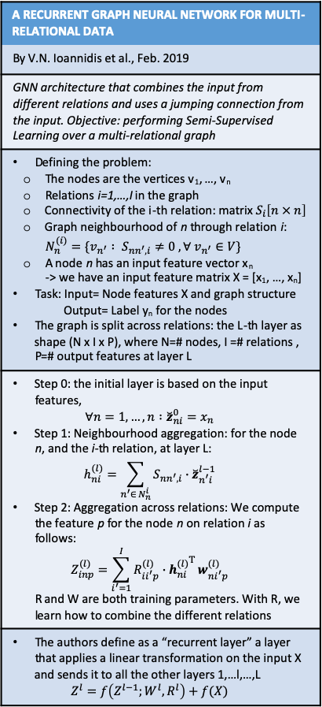
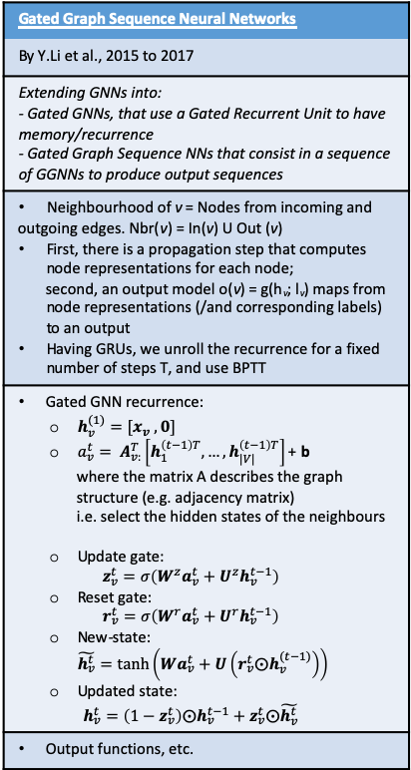
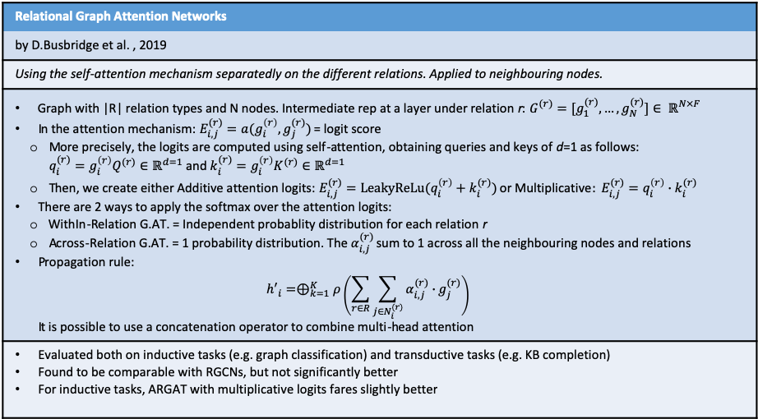
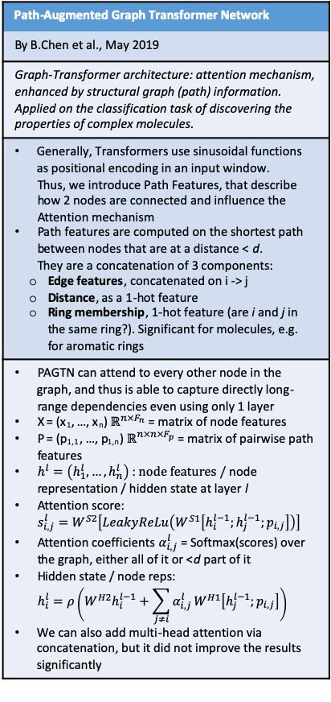
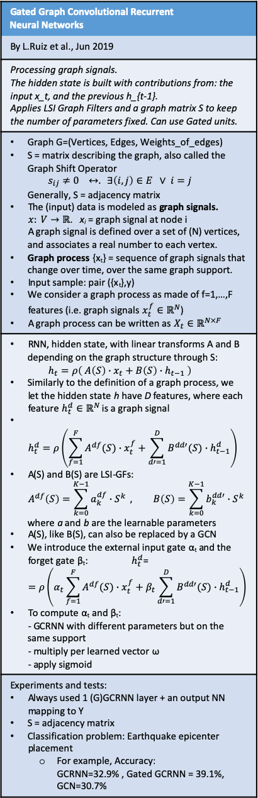
Research Direction 2 (section: GraphNNs)
Gated Graph Sequence Neural Networks
By Y.Li et al., 2015 to 2017
Extending GNNs into: - Gated GNNs, that use a Gated Recurrent Unit to have memory/recurrence - Gated Graph Sequence NNs that consist in a sequence of GGNNs to produce output sequences
Neighbourhood of v = Nodes from incoming and outgoing edges. Nbr(v) = In(v) U Out (v) First, there is a propagation step that computes node representations for each node; second, an output model o(v) = g(h_{v}; l_{v}) maps from node representations (/and corresponding labels) to an output Having GRUs, we unroll the recurrence for a fixed number of steps T, and use BPTT
Gated GNN recurrence: $h_{v}^{(1)}=[x_{v} ,0]$ $a_{v}^{t}= A_{v:}^{T}\left[h_{1}^{\left(t−1\right)T},…,h_{|V|}^{\left(t−1\right)T}\right]$ + b where the matrix A describes the graph structure (e.g. adjacency matrix) i.e. select the hidden states of the neighbours Update gate: $z_{v}^{t}=σ\left(W^{z}a_{v}^{t}+U^{z}h_{v}^{t−1}\right)$ Reset gate: $r_{v}^{t}=σ\left(W^{r}a_{v}^{t}+U^{r}h_{v}^{t−1}\right)$ New-state: $\tilde{h_{v}^{t}}=tanh⁡\left(Wa_{v}^{t}+U\left(r_{v}^{t}⨀h_{v}^{(t−1)}\right)\right)$ Updated state: $h_{v}^{t}=\left(1−z_{v}^{t}\right)⨀h_{v}^{t−1}+z_{v}^{t}⨀\tilde{h_{v}^{t}}$
Output functions, etc.
A RECURRENT GRAPH NEURAL NETWORK FOR MULTI-RELATIONAL DATA
By V.N. Ioannidis et al., Feb. 2019
GNN architecture that combines the input from different relations and uses a jumping connection from the input. Objective: performing Semi-Supervised Learning over a multi-relational graph
Defining the problem: The nodes are the vertices v₁, …, v_{n} Relations i=1,…,I in the graph Connectivity of the i-th relation: matrix $S_{i}\left[n × n\right]$ Graph neighbourhood of n through relation i: $N_{n}^{(i)}=\{v_{n^{′}} : S_{nn^{′},i}≠0 , ∀ v_{n^{′}}∈V\}$ A node n has an input feature vector x_{n} -> we have an input feature matrix X = [x₁, …, x_{n}] Task: Input= Node features X and graph structure Output= Label y_{n} for the nodes The graph is split across relations: the L-th layer as shape (N x I x P), where N=# nodes, I =# relations , P=# output features at layer L
Step 0: the initial layer is based on the input features, $∀n=1,…,n :{\breve{z}}_{ni}^{0}=x_{n}$ Step 1: Neighbourhood aggregation: for the node n, and the i-th relation, at layer L: $h_{ni}^{(l)}=\sum_{n^{′}∈ N_{n}^{i}}{S_{nn^{′},i}∙{\breve{z}}_{n^{′}i}^{l−1}}$ Step 2: Aggregation across relations: We compute the feature p for the node n on relation i as follows: $Z_{inp}^{(l)}=\sum_{i^{′}=1}^{I}{R_{ii^{′}p}^{(l)}∙{h_{ni}^{(l)}}^{Τ}}w_{ni^{′}p}^{(l)}$ R and W are both training parameters. With R, we learn how to combine the different relations
The authors define as a “recurrent layer” a layer that applies a linear transformation on the input X and sends it to all the other layers 1,…l,…,L $Z^{l}=f\left(Z^{l−1};W^{l}, R^{l}\right)+f(X)$
Gated Graph Convolutional Recurrent Neural Networks
By L.Ruiz et al., Jun 2019
Processing graph signals. The hidden state is built with contributions from: the input x_t, and the previous h_{t-1}. Applies LSI Graph Filters and a graph matrix S to keep the number of parameters fixed. Can use Gated units.
Graph G=(Vertices, Edges, Weights_of_edges) S = matrix describing the graph, also called the Graph Shift Operator $s_{ij}≠0 ↔. ∃\left(i,j\right)∈E ∨ i=j$ Generally, S = adjacency matrix The (input) data is modeled as graph signals. $x: V→ℝ$. x_{i} = graph signal at node i A graph signal is defined over a set of (N) vertices, and associates a real number to each vertex. Graph process {x_{t}} = sequence of graph signals that change over time, over the same graph support. Input sample: pair ({x_{t}},y) We consider a graph process as made of f=1,…,F features (i.e. graph signals $x_{t}^{f}∈ℝ^{N}$) A graph process can be written as $X_{t}∈ℝ^{N×F}$
RNN, hidden state, with linear transforms A and B depending on the graph structure through S: $h_{t}=ρ\left( A\left(S\right)∙x_{t}+B\left(S\right)∙h_{t−1} \right)$ Similarly to the definition of a graph process, we let the hidden state h have D features, where each feature $h_{t}^{d}∈ℝ^{N}$ is a graph signal $h_{t}^{d}=ρ\left(\sum_{f=1}^{F}{A^{df}(S)∙x_{t}^{f}}+\sum_{d′=1}^{D}{B^{dd′}(S)∙h_{t−1}^{d}}\right)$ A(S) and B(S) are LSI-GFs: $A^{df}\left(S\right)=\sum_{k=0}^{K−1}{a_{k}^{df}∙S^{k}} , B\left(S\right)=\sum_{k=0}^{K−1}{b_{k}^{dd′}∙S^{k}}$ where a and b are the learnable parameters A(S), like B(S), can also be replaced by a GCN We introduce the external input gate α_{t} and the forget gate β_{t}: $h_{t}^{d}$= $=ρ\left(α_{t}\sum_{f=1}^{F}{A^{df}(S)∙x_{t}^{f}}+β_{t}\sum_{d′=1}^{D}{B^{dd′}(S)∙h_{t−1}^{d}}\right)$ To compute α_{t} and β_{t}: - GCRNN with different parameters but on the same support - multiply per learned vector ω - apply sigmoid
Experiments and tests: Always used 1 (G)GCRNN layer + an output NN mapping to Y S = adjacency matrix Classification problem: Earthquake epicenter placement For example, Accuracy: GCRNN=32.9% , Gated GCRNN = 39.1%, GCN=30.7%
Path-Augmented Graph Transformer Network
By B.Chen et al., May 2019
Graph-Transformer architecture: attention mechanism, enhanced by structural graph (path) information. Applied on the classification task of discovering the properties of complex molecules.
Generally, Transformers use sinusoidal functions as positional encoding in an input window. Thus, we introduce Path Features, that describe how 2 nodes are connected and influence the Attention mechanism Path features are computed on the shortest path between nodes that are at a distance < d. They are a concatenation of 3 components: Edge features, concatenated on i -> j Distance, as a 1-hot feature Ring membership, 1-hot feature (are i and j in the same ring?). Significant for molecules, e.g. for aromatic rings
PAGTN can attend to every other node in the graph, and thus is able to capture directly long-range dependencies even using only 1 layer X = (x₁, …, x_{n}) $ℝ^{n×F_{n}}$ = matrix of node features P = (p_{1,1}, …, p_{1,n}) $ℝ^{n×n×F_{p}}$ = matrix of pairwise path features $h^{l}=\left(h_{1}^{l},…,h_{n}^{l}\right)$ : $node features /$ node representation / hidden state at layer l Attention score: $s_{i,j}^{l}=W^{S2}\left[LeakyReLu\left(W^{S1}\left[h_{i}^{l−1};h_{j}^{l−1};p_{i,j}\right]\right)\right]$ Attention coefficients $α_{i,j}^{l}$ = Softmax(scores) over the graph, either all of it or <d part of it Hidden state / node reps: $h_{i}^{l}=ρ\left(W^{H2}h_{i}^{l−1}+\sum_{j≠i}{α_{i,j}^{l}}W^{H1}\left[h_{j}^{l−1};p_{i,j}\right]\right)$ We can also add multi-head attention via concatenation, but it did not improve the results significantly
Relational Graph Attention Networks
by D.Busbridge et al. , 2019
Using the self-attention mechanism separatedly on the different relations. Applied to neighbouring nodes.
Graph with |R| relation types and N nodes. Intermediate rep at a layer under relation r: $G^{(r)}=[g_{1}^{(r)},…,g_{N}^{(r)}]∈ ℝ^{N×F}$ In the attention mechanism: $E_{i,j}^{(r)}=a(g_{i}^{\left(r\right)},g_{j}^{(r)})$ = logit score More precisely, the logits are computed using self-attention, obtaining queries and keys of d=1 as follows: $q_{i}^{(r)}=g_{i}^{\left(r\right)}Q^{(r)}∈ℝ^{d=1}$ and $k_{i}^{(r)}=g_{i}^{\left(r\right)}K^{(r)}∈ℝ^{d=1}$ Then, we create either Additive attention logits: $E_{i,j}^{(r)}=LeakyReLu(q_{i}^{\left(r\right)}+k_{i}^{(r)})$ or Multiplicative$: E_{i,j}^{(r)}=q_{i}^{\left(r\right)}∙k_{i}^{(r)}$ There are 2 ways to apply the softmax over the attention logits: WithIn-Relation G.AT. = Independent probablity distribution for each relation r Across-Relation G.AT. = 1 probability distribution. The $α_{i,j}^{(r)}$ sum to 1 across all the neighbouring nodes and relations Propagation rule: ${h′}_{i}=⊕_{k=1}^{K}ρ\left(\sum_{r∈R}{\sum_{j∈N_{i}^{(r)}}{α_{i,j}^{(r)}∙}}g_{j}^{(r)}\right)$ It is possible to use a concatenation operator to combine multi-head attention
Evaluated both on inductive tasks (e.g. graph classification) and transductive tasks (e.g. KB completion) Found to be comparable with RGCNs, but not significantly better For inductive tasks, ARGAT with multiplicative logits fares slightly better

