Slide 1
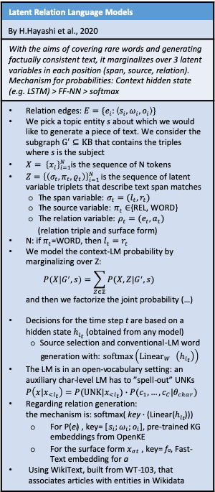
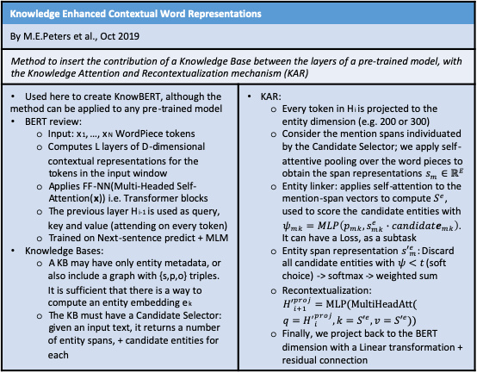
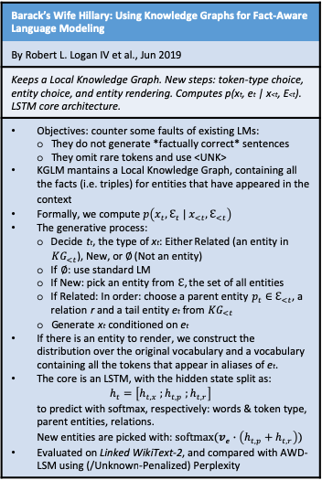
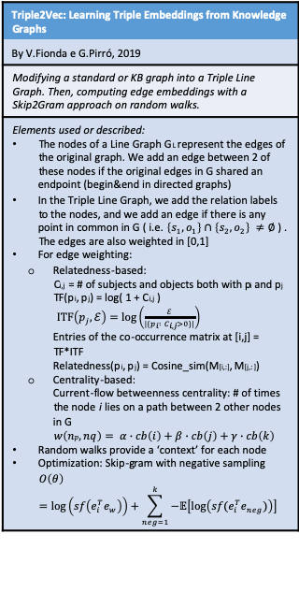
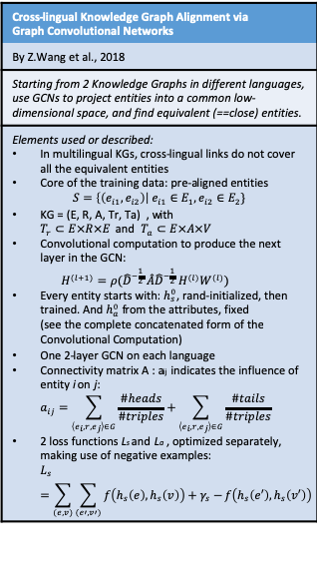
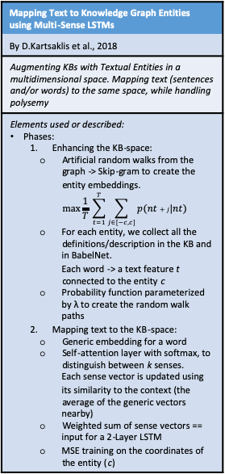
Research Direction 2 (section: Knowledge bases)
Latent Relation Language Models
By H.Hayashi et al., 2020
With the aims of covering rare words and generating factually consistent text, it marginalizes over 3 latent variables in each position (span, source, relation). Mechanism for probabilities: Context hidden state (e.g. LSTM) > FF-NN > softmax
Relation edges: $E=\{e_{i}:\left\langle s_{i},ω_{i},o_{i}\right\rangle \}$ We pick a topic entity s about which we would like to generate a piece of text. We consider the subgraph $G^{′}⊆KB$ that contains the triples where s is the subject $X= {\left\{x_{i}\right\}}_{i=1}^{N}$is the sequence of N tokens $Z={\left\{\left(σ_{t},π_{t},ρ_{t}\right)\right\}}_{i=1 }^{N}$is the sequence of latent variable triplets that describe text span matches The span variable: $σ_{t}=(l_{t},r_{t})$ The source variable: $π_{t}∈${REL, WORD} The relation variable: $ρ_{t}=(e_{t},a_{t})$ (relation triple and surface form) N: if $π_{t}$=WORD, then $l_{t}=r_{t}$ We model the context-LM probability by marginalizing over Z: $P\left(X | G^{′},s\right)=\sum_{Z∈ℤ}{P(X,Z|G^{′},s)}$ and then we factorize the joint probability (…) Decisions for the time step t are based on a hidden state $h_{l_{t}}$ (obtained from any model) Source selection and conventional-LM word generation with: $softmax\left({Linear}_{W_{}}\left(h_{l_{t}}\right)\right)$ The LM is in an open-vocabulary setting: an auxiliary char-level LM has to ”spell-out” UNKs $P\left(x|x_{<l_{t}}\right)=P(UNK|x_{<l_{t}})∙P(c_{1},…,c_{C}|θ_{char})$ Regarding relation generation: the mechanism is: softmax( key$∙$(Linear($h_{l_{t}}$))) For P(e_{i}) , key= [$s_{i};ω_{i};o_{i}$], pre-trained KG embeddings from OpenKE For the surface form $x_{σt}$ , key= f_{a}, Fast-Text embedding for a Using WikiText, built from WT-103, that associates articles with entities in Wikidata
Cross-lingual Knowledge Graph Alignment via Graph Convolutional Networks
By Z.Wang et al., 2018
Starting from 2 Knowledge Graphs in different languages, use GCNs to project entities into a common low-dimensional space, and find equivalent (==close) entities.
Elements used or described: In multilingual KGs, cross-lingual links do not cover all the equivalent entities Core of the training data: pre-aligned entities $S=\left\{\left(e_{i1}, e_{i2}\right)\right| e_{i1}∈E_{1},e_{i2}∈E_{2}\}$ KG = (E, R, A, Tr, Ta) , with $T_{r}⊂E×R×E$ and $T_{a}⊂E×A×V$ Convolutional computation to produce the next layer in the GCN: $H^{(l+1)}=ρ({\hat{D}}^{−\frac{1}{2}} \hat{A}{\hat{D}}^{−\frac{1}{2}} H^{(l)}W^{(l)})$ Every entity starts with: $h_{s}^{0}$, rand-initialized, then trained. And $h_{a}^{0}$ from the attributes, fixed (see the complete concatenated form of the Convolutional Computation) One 2-layer GCN on each language Connectivity matrix A : a_{ij} indicates the influence of entity i on j: $a_{ij}=\sum_{\left\langle e_{i},r,e_{j}\right\rangle ∈G}{\frac{\#heads}{\#triples}}+\sum_{\left\langle e_{i},r,e_{j}\right\rangle ∈G}{\frac{\#tails}{\#triples}}$ 2 loss functions L_{s} and L_{a} , optimized separately, making use of negative examples: $L_{s}=\sum_{(e,v)}{\sum_{(e′,v′)}{f\left(h_{s}\left(e\right),h_{s}\left(v\right)\right)+γ_{s}−}f\left(h_{s}\left(e′\right),h_{s}\left(v′\right)\right)}$
Mapping Text to Knowledge Graph Entities using Multi-Sense LSTMs
By D.Kartsaklis et al., 2018
Augmenting KBs with Textual Entities in a multidimensional space. Mapping text (sentences and/or words) to the same space, while handling polysemy
Elements used or described: Phases: Enhancing the KB-space: Artificial random walks from the graph -> Skip-gram to create the entity embeddings. $\max{\frac{1}{T} \sum_{t=1}^{T}{\sum_{j∈[−c,c]}{p(nt+j|nt)}}}$ For each entity, we collect all the definitions/description in the KB and in BabelNet. Each word -> a text feature t connected to the entity c Probability function parameterized by λ to create the random walk paths Mapping text to the KB-space: Generic embedding for a word Self-attention layer with softmax, to distinguish between k senses. Each sense vector is updated using its similarity to the context (the average of the generic vectors nearby) Weighted sum of sense vectors == input for a 2-Layer LSTM MSE training on the coordinates of the entity (c)
Mapping Text to Knowledge Graph Entities using Multi-Sense LSTMs
MS-LSTM > LSTM, confirmed. However, this model has to rigidly pre-define k, the number of possible senses for each word.
What about applying the mapping-to-a-KB from text in different languages? It is possible that we may have to use different KBs?
Different domains could also use this methodology (medical, legal etc.)
Triple2Vec: Learning Triple Embeddings from Knowledge Graphs
By V.Fionda e G.Pirró, 2019
Modifying a standard or KB graph into a Triple Line Graph. Then, computing edge embeddings with a Skip2Gram approach on random walks.
Elements used or described: The nodes of a Line Graph G_{L} represent the edges of the original graph. We add an edge between 2 of these nodes if the original edges in G shared an endpoint (begin&end in directed graphs) In the Triple Line Graph, we add the relation labels to the nodes, and we add an edge if there is any point in common in G ( i.e. $\left\{s_{1},o_{1}\right\}∩\left\{s_{2},o_{2}\right\} ≠∅$ ) . The edges are also weighted in [0,1] For edge weighting: Relatedness-based: C_{i,j} = # of subjects and objects both with p_{i} and p_{j} TF(p_{i}, p_{j}) = log( 1 + C_{i,j} ) $ITF\left(p_{j},ℰ\right)=\log\left(\frac{ℰ}{|\{p_{i} : C_{i,j}>0\}|}\right)$ Entries of the co-occurrence matrix at [i,j] = TF*ITF Relatedness(p_{i}, p_{j}) = Cosine_sim(M_{[i,:]}, M_{[j,:]}) Centrality-based: Current-flow betweenness centrality: # of times the node i lies on a path between 2 other nodes in G $w\left(np,nq\right)= α∙cb\left(i\right)+β∙cb\left(j\right)+γ∙cb\left(k\right)$ Random walks provide a ‘context’ for each node Optimization: Skip-gram with negative sampling $O\left(θ\right)=\log\left(sf\left(e_{i}^{T}e_{w}\right)\right)+\sum_{neg=1}^{k}{−𝔼\left[\log\left(sf(e_{i}^{T}e_{neg})\right)\right]}$
On Wikipedia: pre-trained entity embeddings, using Skip-Gram on Wiki pages. No graph structure. On WordNet: 28 relations, on both lemmas and synsets. We used TuckER to compute 200-d vectors for each synset and lemma, using the relationship graph, + sentence embedding on the gloss to get 2048d
Barack’s Wife Hillary: Using Knowledge Graphs for Fact-Aware Language Modeling
By Robert L. Logan IV et al., Jun 2019
Keeps a Local Knowledge Graph. New steps: token-type choice, entity choice, and entity rendering. Computes p(x_{t}, e_{t} | x_{<t}, E_{<t}). LSTM core architecture.
Objectives: counter some faults of existing LMs: They do not generate *factually correct* sentences They omit rare tokens and use <UNK> KGLM mantains a Local Knowledge Graph, containing all the facts (i.e. triples) for entities that have appeared in the context Formally, we compute $p\left(x_{t},ℇ_{t} | x_{<t},ℇ_{<t}\right)$ The generative process: Decide t_{t}, the type of x_{t}: Either Related (an entity in ${KG}_{<t}$), New, or $∅$ (Not an entity) If $∅$: use standard LM If New: pick an entity from $ℇ$, the set of all entities If Related: In order: choose a parent entity $p_{t}∈$ $ℇ_{<t}$, a relation r and a tail entity e_{t} from ${KG}_{<t}$ Generate x_{t} conditioned on e_{t} If there is an entity to render, we construct the distribution over the original vocabulary and a vocabulary containing all the tokens that appear in aliases of e_{t}. The core is an LSTM, with the hidden state split as: $h_{t}=\left[h_{t,x} ;h_{t,p} ;h_{t,r}\right]$ to predict with softmax, respectively: words & token type, parent entities, relations. New entities are picked with: $softmax(v_{e}∙\left(h_{t,p}+h_{t,r}\right))$ Evaluated on Linked WikiText-2, and compared with AWD-LSM using (/Unknown-Penalized) Perplexity
Knowledge Enhanced Contextual Word Representations
By M.E.Peters et al., Oct 2019
Method to insert the contribution of a Knowledge Base between the layers of a pre-trained model, with the Knowledge Attention and Recontextualization mechanism (KAR)
Used here to create KnowBERT, although the method can be applied to any pre-trained model BERT review: Input: x₁, …, x_{N} WordPiece tokens Computes L layers of D-dimensional contextual representations for the tokens in the input window Applies FF-NN(Multi-Headed Self-Attention(x)) i.e. Transformer blocks The previous layer H_{i-1} is used as query, key and value (attending on every token) Trained on Next-sentence predict + MLM Knowledge Bases: A KB may have only entity metadata, or also include a graph with {s,p,o} triples. It is sufficient that there is a way to compute an entity embedding e_{k} The KB must have a Candidate Selector: given an input text, it returns a number of entity spans, + candidate entities for each | KAR: Every token in H_{i} is projected to the entity dimension (e.g. 200 or 300) Consider the mention spans individuated by the Candidate Selector; we apply self-attentive pooling over the word pieces to obtain the span representations $s_{m}∈ℝ^{E}$ Entity linker: applies self-attention to the mention-span vectors to compute $S^{e}$, used to score the candidate entities with $ψ_{mk}=MLP\left(p_{mk}, s_{mk}^{e}∙candidate_{mk}\right)$. It can have a Loss, as a subtask Entity span representation ${s′}_{m}^{e}$: Discard all candidate entities with $ψ<t$ (soft choice) -> softmax -> weighted sum Recontextualization: ${H′}_{i+1}^{proj}=MLP(MultiHeadAtt($ $q={H^{′}}_{i}^{proj},k={S′}^{e}, v={S′}^{e}))$ Finally, we project back to the BERT dimension with a Linear transformation + residual connection
TuckER: Tensor Factorization for Knowledge Graph Completion
By I Balazevic et al., 2019
a
a | a

