Slide 1
Neural Language models
Recurrent neural network based language model
By Mikolov et al., 2010
Description of the Simple Recurrent Neural Network, and its use for a Language Model
Elements used or described: Basic RNN: - input(t) = x(t) ++ s(t-1) - sigmoid hidden layer, softmax output Backprop + SGD, dynamic model
Note: Dynamic model: the model gets updated (just once) also as it processes testing data, not only in the training phase
Regularizing and Optimizing LSTM Language Models
By Merity et al., 2017
Encyclopedia of modifications and optimizations to improve the effectiveness of LSTM-RNNs for LMs
Elements used or described: LSTM Averaged SGD (over the last iterations >T) DropConnect on the hidden-to-hidden weight matrices U_ Randomized sequence length in truncated BPTT Variational dropout: dropped connections are defined for a full sequence Weight tying (embeddings and softmax, S=V=U) Independent embedding size and hidden size (easier to train smaller embeddings in the first place) Activation Regularization (AR and TAR)
Note: In TBPTT, we rescale the learning rate depending on the random length of the sequence
Regularizing and Optimizing LSTM Language Models
Regarding Truncated BPTT: The paper proposes to make the window size h random with a normal distribution around seq. What about using punctuation signs, and <BOS> and <EOS> markers, as TBPTT window delimiters? Already done, check… I am not finding the source Additional point: using the doc
The Temporal Activation Regularization is applied only on h_{t} - If we applied AR and TAR to the long-term memory c_{t}, would it be beneficial? -Any pre-existing work?
An Analysis of Neural Language Modeling at Multiple Scales
By Merity et al., 2018
Further analysis of optimizations to LSTMs and QRNNs, on larger datasets
Elements used or described: Longer TBPTT windows (eg. 140) Adaptive softmax (short-list + clusters)
Note: Analyzing the impact of hyperparams.: Dropouts on weights and embeddings have the greatest impact, whereas the n. of layers has the least
QUASI-RECURRENT NEURAL NETWORKS
By Bradbury et al., 2016
Proposing QRNNs
Elements used or described: Input = sequence of T words x_{i} Masked convolution : bank of m filters, producing m candidate vectors z_{i} z_{t} = tanh(conv_{Wz}(x_{t} , ..., x_{t - k + 1})) Pooling uses a forget gate, and possibly adds output and input gates: h_{t} = f_{t} . h_{t-1} + (1 - f_{t}) . z_{t} Zoneout on the pooling layer Skip-connections between conv.layers (dense convolution)
FRAGE: Frequency-AgnosticWord Representation
By Gong et al., 2018
Excluding frequency information from word embeddings, using an Adversarial Training framework
Elements used or described: 2 models with competing objectives Both models (Task-specific and Discriminator) use word embeddings as their input Discriminator: outputs a score [0,1] on ‘is w a rare word’? Mechanism: - L_{T} = task-specific loss - L_{D} = discriminator loss (log-loss on popular and rare words) - The optimization step for the main model is: min L_{T} – λL_{D} Train Main model and Discriminator in separate steps, iteratively on minibatches
FRAGE: Frequency-AgnosticWord Representation
“Explanation: For a rare word, the sample rate is low and its embedding rarely updates. According to our study, on average, the moving distance of the embedding for a popular word is twice longer than that of a rare word during training. As all word embeddings are usually initialized around the origin…” So an equivalent effect could be obtained by simply scaling/amplifying the update to a word embedding, in a way inversely propotional to the word frequency? Could also use a different learning rate
DYNAMIC EVALUATION OF NEURAL SEQUENCE MODELS
By Krause et al., 2017
More complex version of the basic Dynamic Evaluation at test time
Elements used or described: A long test sequence is split up into sub-sequences s_{i} of length n Initial adapted parameters θ_{l} = end-of-training params. θg Update uses gradient over s_{i} : -η∇L(s_{i}) Decay towards global params. RMSprop-derived update rule, that uses mean-squared gradient on training batches
BREAKING THE SOFTMAX BOTTLENECK: A HIGH-RANK RNN LANGUAGE MODEL
By Yang et al., 2018
Viewing a soft-max based LM as a problem of matrix factorization. Proposal of Mixture-of-Softmaxes to regain expressiveness beyond the rank
Elements used or described: MoS distribution: P(X|c) = = Σ_{k} π_{c,k} * softmax(h_{c,k}, w_{x}, _{x’-s}) i.e. compute K softmax distributions and use a weighted average to predict the next token
Note: L ~= { (c₁, P(X|c₁), … , (c_{N}, P(X|c_{N}) } Vocabulary(L) = { x1, x2, …, xM} True data distribution P*(X|c) Softmax model distribution: P(X|c) = exp(h(c)*w(x)) / Σ exp (h(c)* w(x’)) A = matrix of log.probs. of P*(X|c) Objective: H * W = A’ Rank(H) == Rank(W) == d if d < rank(A’), we can not solve
IMPROVING NEURAL LANGUAGE MODELS WITH A CONTINUOUS CACHE
By Grave et al., 2016
Adding a cache to NN-LMs, that stores (h_{t}, x_{t+1}) to memorize words encountered recently
Note: p_{cache} = Σ__{i=1^}^{t-1} I(x_{i+1} )*exp(θ<h_{t},h_{i}>)
Note: Can use linear interpolation with λ, or also consider a softmax between the LM and the words in the cache
IMPROVING NEURAL LANGUAGE MODELS WITH A CONTINUOUS CACHE
Once a word appears, it is more likely to appear again in the same section (see the Tiger article example). Could one add a normal contribution to the probability of that word in the time-space interval? Even if we use the cache as-it-is, could we ignore it for stopwords (e.g. Keep them out of it)? V, but check if someone done it

Slide 2
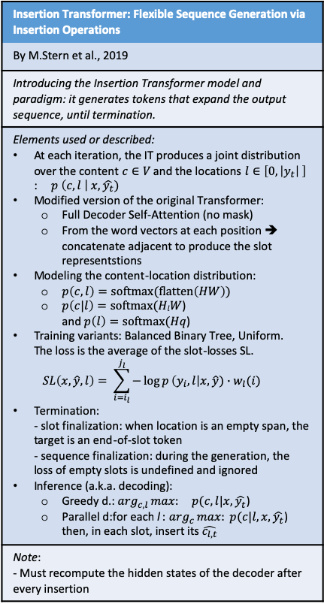
Transformer instruments
Attention Is All You Need
By Vaswani et al., 2017
Introducing the Transformer instrument for Seq2Seq tasks (using Attention alone instead of recursion)
Elements used or described: Encoder + Decoder structure Multi-head self-attention, where: Attention(Q,K,V) = softmax(Q*K^{T} / sqrt(d_{k}) ) * V Layer normalization Feed-forward NNs Positional encoding (adding sinusoidal functions) Adam optimizer Dropout with p_{drop}=0.1 on the output of each sublayer and on (embeddings+PosEncoding) Label smoothing
Note: The model is auto-regressive: when generating text, we include the previous output elements as input
Attention Is All You Need
Mixture-of-Softmaxes (MoS) could be used to go from the word embeddings to the softmax probabilities
What about frequency-agnostic word embeddings (FRAGE) as well?
Character-Level Language Modeling with Deeper Self-Attention
By Al-Rfou et al., 2018
Alternative transformer structure, used for character-level LM
Elements used or described: Transformer layers = 1 multi-head masked self-attention unit + 1 2-layers feed-forward NN 64 transformer layers Auxiliary losses are added during training: - Predicting the intermediate positions in the sequence - Intermediate layers’ predictions - Multiple targets (eg. The 2 subsequent chars at each position) Learned vector of d(eg.512) elements = positional encoding, x L x N
Note: There is no state passed between predictions as in RNN models, so for each character predicted we have to process the context from scratch.
TRANSFORMER-XL: ATTENTIVE LANGUAGE MODELS BEYOND A FIXED-LENGTH CONTEXT
By Dai et al., 2019
Modifying the application of the transformer to LMs: Adding recurrence and relative pos-encoding to extend the context
Elements used or described: Layer h_{(τ+1)}^{n} = FF-NN(self-attention(q, k, v) - q = h_{(τ+1)}^{(n-1)} * W_{q} - k, v = h’_{(τ+1)}^{(n-1)} * W_{k,v} - h’_{(τ+1)}^{(n-1)} = [SG(h_{τ}^{(n-1)} ) ++ h_{(τ+1)}^{(n-1)}] We go from absolute in-segment PosEnc to Relative PosEnc, using a (sinusoidal) predefined matrix R and 2 learned terms u,v Ascore_{τ,i,j}^{n} = q_{i}*k_{j} + q_{i}*W_{k,R}*R_{i-j}+ u*k_{j} + u*W_{k,R}*R_{i-j} Moreover: softmax(A)*v, layerNormalization + skip-connection, FF-NN
Note: Problems addressed: inability to see beyond fixed context length + context fragmentation
Dynamic Evaluation of Transformer Language Models
By Krause et al., 2019
Examining the application of Dynamic Evaluation on the segments of Transformer-XL
Elements used or described: Observe loss on x_{t} at test-time, then use ∇L_{t} to update Sequence segments used for Dyn.Eval. = Sequence segments used to train the Transformer-XL SGD Dynamic Eval, RMS Dynamic Eval (on word-level, without Decay rate)
Note: - On character-level datasets, using L=128 and mCache=3800 - On word-level WikiText -103, using Adaptive Softmax
Dynamic Evaluation of Transformer Language Models
Hybridizing Dynamic Eval & Adaptive Softmax with the Neural Cache Method (n: it may be a current line of research)
Insertion Transformer: Flexible Sequence Generation via Insertion Operations
By M.Stern et al., 2019
Introducing the Insertion Transformer model and paradigm: it generates tokens that expand the output sequence, until termination.
Elements used or described: At each iteration, the IT produces a joint distribution over the content $c∈V$ and the locations $l∈\left[0,\left|y_{t}\right| \right]$ : $p \left(c,l \right| x, \hat{y_{t}})$ Modified version of the original Transformer: Full Decoder Self-Attention (no mask) From the word vectors at each position ➔ concatenate adjacent to produce the slot representstions Modeling the content-location distribution: $p\left(c,l\right)=softmax(flatten\left(HW\right))$ $p\left(c|l\right)=softmax(HlW$) and $p\left(l\right)=softmax(Hq$) Training variants: Balanced Binary Tree, Uniform. The loss is the average of the slot-losses SL. $SL\left(x,\hat{y},l\right)= \sum_{i=i_{l}}^{j_{l}}{−\log{p}\left(y_{i},l\right|x,\hat{y})∙w_{l}(i)}$ Termination: - slot finalization: when location is an empty span, the target is an end-of-slot token - sequence finalization: during the generation, the loss of empty slots is undefined and ignored Inference (a.k.a. decoding): Greedy d.: $\arg_{c,l}max:{ p(c,l|x, \hat{y_{t}}}$) Parallel d:for each l : $\arg_{c}max:{ p(c|l,x, \hat{y_{t}}}$) then, in each slot, insert its $\hat{c_{l,t}}$
Note: - Must recompute the hidden states of the decoder after every insertion
Insertion Transformer
Can be useful for translation. I would not think that the next-word prediction of Language Modeling needs this; to catch words in the sentence that the user has deleted, we may just use a Masked LM (similarly to BERT)

Slide 3
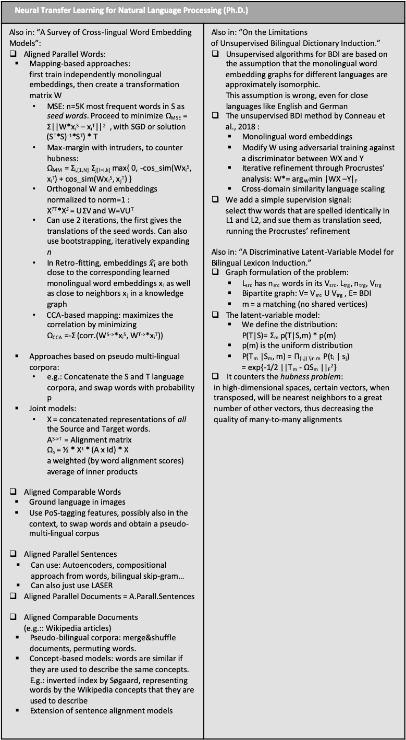
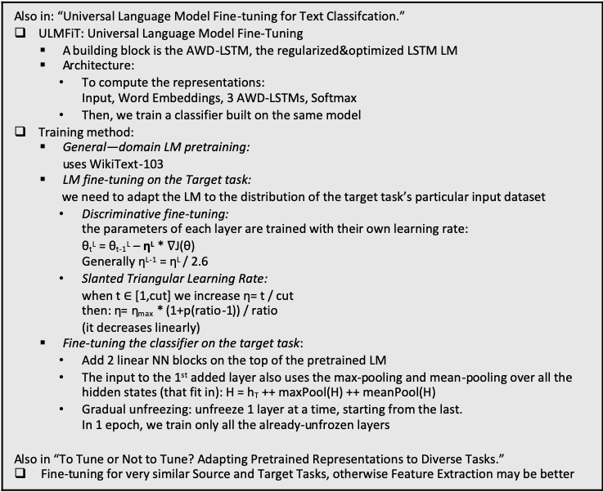
Transfer Learning
Neural Transfer Learning for Natural Language Processing (Ph.D.)
By Sebastian Ruder, February 2019
Transfer Learning is defined over domains {X, P(X)} and tasks {Y,P(Y)}, of a source and a target problem. P(Xs) != P(Xt) --> Domain adaptation Ys != Yt --> different tasks, Multi-Task Learning or Sequential Learning Xs != Xt --> Cross-lingual learning (n: Pretrained word representations == Implicit transfer learning).
Also in: “An Overview of Multi-Task Learning in Deep Neural Networks” MTL in NNs: - Hard parameter sharing: m layers of the NN are fully shared, followed by separate task-specific layers - Soft parameter sharing: m layers are not shared, but they are constrained, we minimize the distance between them (eg. L2 regularization) MTL in non-neural models: we define a matrix A_{dxT} of features x models. - Block-sparse L1Lq regularization - Clustering of tasks: we can use the following penalties: Ω_{mean} = ||ā||² Ω_{Ccloseness} = Σ |C_{k}|*||ā_{k} - ā||² Ω_{within} = Σ_{k} Σ_{t_in_k} ||ā_{.,t} - ā_{k}||² It is possible to use a hierarchy of tasks, and/or weights λ Types of auxiliary tasks: - Statistical a.ts.: predicting aspects of the input data - Selective unsupervised a.ts.: focusing on specific features/elements, such as sentiment words - Supervised a.ts.: Adversarial, Inverse task, Quantization smoothing - Unsupervised a.ts.: Representation Learning, Conditioning the Initial state | On Sequential Learning: - Source and Target Task are performed separately, in sequence - Pretraining phase -> Adaptation phase - Ideal: universal representations Unsupervised pretraining: - LSA: Latent Semantic Analysis C → P → UΣV → U_{k}Σ_{k} = X - Brown clustering: P(w_{i+1}|w_{i}) = P(c_{i+1}|c_{i})*P(w_{i+1}|c_{i+1}) & greedy algorithm for classes (s. AMI) - Word2vec: SGNS and CBOW - GLObal Vectors: uses the ratios of probabilities of occurrence in a context, for a NN loss function - Deep pretrained LMs, eg. Autoencoding on sentences Distantly supervised pretraining: - The model can focus on/learn one element (eg. Emoticons in sentiment analysis, punctuation in tokenization) Supervised pretraining: eg. Train NMT on 2 high-resource languages, then transfer Adaptation: can be: - Feature extraction: we freeze the source M, and provide its representations as additional input to the target M - Fine-tuning: the pretrained reps. Are used as initialization - Residual adapters: interleave mini-layers Lifelong learning: sequential chain of multiple tasks, stores info in KB
Neural Transfer Learning for Natural Language Processing (Ph.D.)
Also in: “A Survey of Cross-lingual Word Embedding Models”: Aligned Parallel Words: Mapping-based approaches: first train independently monolingual embeddings, then create a transformation matrix W MSE: n=5K most frequent words in S as seed words. Proceed to minimize Ω_{MSE} = Σ||W*x_{i}^{S} – x_{i}^{T}||² , with SGD or solution (S^{T}*S)⁻¹*S^{T}) * T Max-margin with intruders, to counter hubness: Ω_{MM} = Σ_{i,[1,N]} Σ_{j[!=i,k]} max{ 0, -cos_sim(Wx_{i}^{S}, x_{i}^{T}) + cos_sim(Wx_{i}^{S}, x_{j}^{T}) } Orthogonal W and embeddings normalized to norm=1 : X^{TT}*X^{S} = UΣV and W=VU^{T} Can use 2 iterations, the first gives the translations of the seed words. Can also use bootstrapping, iteratively expanding n In Retro-fitting, embeddings $\hat{x_{i}}$are both close to the corresponding learned monolingual word embeddings x_{i} as well as close to neighbors x_{j} in a knowledge graph CCA-based mapping: maximizes the correlation by minimizing Ω_{CCA} =-Σ (corr.(W^{S->}*x_{i}^{S}, W^{T->}*x_{i}^{T})) Approaches based on pseudo multi-lingual corpora: e.g.: Concatenate the S and T language corpora, and swap words with probability p Joint models: X = concatenated representations of all the Source and Target words. A^{S->T} = Alignment matrix Ω_{s} = ½ * X^{t} * (A x Id) * X a weighted (by word alignment scores) average of inner products Aligned Comparable Words Ground language in images Use PoS-tagging features, possibly also in the context, to swap words and obtain a pseudo-multi-lingual corpus Aligned Parallel Sentences Can use: Autoencoders, compositional approach from words, bilingual skip-gram… Can also just use LASER Aligned Parallel Documents = A.Parall.Sentences Aligned Comparable Documents (e.g.:: Wikipedia articles) Pseudo-bilingual corpora: merge&shuffle documents, permuting words. Concept-based models: words are similar if they are used to describe the same concepts. E.g.: inverted index by Søgaard, representing words by the Wikipedia concepts that they are used to describe Extension of sentence alignment models | Also in: “On the Limitations of Unsupervised Bilingual Dictionary Induction.” Unsupervised algorithms for BDI are based on the assumption that the monolingual word embedding graphs for different languages are approximately isomorphic. This assumption is wrong, even for close languages like English and German The unsupervised BDI method by Conneau et al., 2018 : Monolingual word embeddings Modify W using adversarial training against a discriminator between WX and Y Iterative refinement through Procrustes’ analysis: W*= arg_{W}min |WX –Y|_{F} Cross-domain similarity language scaling We add a simple supervision signal: select thw words that are spelled identically in L1 and L2, and sue them as translation seed, running the Procrustes’ refinement Also in: “A Discriminative Latent-Variable Model for Bilingual Lexicon Induction.” Graph formulation of the problem: L_{src} has n_{src} words in its V_{src}. L_{trg}, n_{trg}, V_{trg} Bipartite graph: V= V_{src} U V_{trg} , E= BDI m = a matching (no shared vertices) The latent-variable model: We define the distribution: P(T|S)= Σ_{m} p(T|S,m) * p(m) p(m) is the uniform distribution P(T_{m} |S_{m}, m) = Π_{(i,j) \in m} P(t_{i} | s_{j}) = exp{-1/2 ||T_{m} - ΩS_{m} ||_{F}²} It counters the hubness problem: in high-dimensional spaces, certain vectors, when transposed, will be nearest neighbors to a great number of other vectors, thus decreasing the quality of many-to-many alignments
Neural Transfer Learning for Natural Language Processing (Ph.D.)
More references: Smith et al. [2017] and Hauer et al. [2017] propose a method that creates seed lexicons by identifying cognates in the vocabularies of related languages. Retro-fitting [Faruqui et al., 2015], which is used to inject knowledge from semantic lexicons into pretrained word embeddings. Mrksic et al. [2017] similarly derive cross-lingual synonymy and antonymy constraints from BabelNet An off-the-shelf word embedding algorithm [Bojanowski et al., 2017 From a practical point of view, bilingual dictionaries have found uses in a myriad of NLP tasks ranging from machine translation [Klementiev et al., 2012a] to cross-lingual named entity recognition [Mayhew et al., 2017] Søgaard et al. [2018] demonstrated that monolingual embedding spaces are not approximately isomorphic and that there is a complex relationship between word form and meaning, which is only inadequately modeled by current approaches, which for example cannot model polysemy
Ideas: - Using retro-fitting or similar on a knowledge graph, or KB
Note: the method they propose is for Bilingual Dictionary Induction.
But since I can use Ordbogen’s dictionaries and others(BabelNet,etc.), then BDI is redundant. I can already work with its solution, and focus on something else (LM, NMT, etc.)
Also in: “Universal Language Model Fine-tuning for Text Classifcation.” ULMFiT: Universal Language Model Fine-Tuning A building block is the AWD-LSTM, the regularized&optimized LSTM LM Architecture: To compute the representations: Input, Word Embeddings, 3 AWD-LSTMs, Softmax Then, we train a classifier built on the same model Training method: General—domain LM pretraining: uses WikiText-103 LM fine-tuning on the Target task: we need to adapt the LM to the distribution of the target task’s particular input dataset Discriminative fine-tuning: the parameters of each layer are trained with their own learning rate: θ_{t}^{L} = θ_{t-1}^{L} – η^{L} * $∇\text{J}\text{(}\text{θ}\text{)}$ Generally η^{L-1} = η^{L} / 2.6 Slanted Triangular Learning Rate: when t $∈$ [1,cut] we increase η= t / cut then: η= η_{max} * (1+p(ratio-1)) / ratio (it decreases linearly) Fine-tuning the classifier on the target task: Add 2 linear NN blocks on the top of the pretrained LM The input to the 1st added layer also uses the max-pooling and mean-pooling over all the hidden states (that fit in): H = h_{T} ++ maxPool(H) ++ meanPool(H) Gradual unfreezing: unfreeze 1 layer at a time, starting from the last. In 1 epoch, we train only all the already-unfrozen layers Also in “To Tune or Not to Tune? Adapting Pretrained Representations to Diverse Tasks.” Fine-tuning for very similar Source and Target Tasks, otherwise Feature Extraction may be better
Some basic Concepts | NLP Tasks
Pearson correlation coefficient: Pcc(X,Y) = Covariance(X,Y) / (σ_{x} σ_{y}) Self-information of an event x : I(x)= -log P(x) Entropy : H(x) = E_{x~P}[I(x)] = - E_{x~P}[log P(x)] KL divergence = E_{x~P}[ log( P(x)/Q(x) )] RNNs, LSTMs CNNs: operates on the concatenation of input word embeddings x_{i}. 1 filter over the window x_{i}:x_{i+K-1} produces a value c_{i}. Having obtained a feature map (vector) c, we apply max-pooling or avg-pooling. Multiple filters -> multiple values ç. Autoencoder: x->z->x’, minimize reconstruction loss | PoS tagging: tags are noun, verb, adjective, etc. They can very between languages Named Entity Recognition: Person, Location etc. Current Systems do not generalize well to specific domains, so there are legal/medical/etc. corpora Semantic Role Labeling: defining entities as Agent/Goal/Result in the predicate-argument structure of a sentence Dependency parsing Topic classification, and Sentiment Analysis Language Modeling Blingual dictionary induction: word-to-word translation, generally from dictionaries not from sentences, does not account for multiple meanings

Slide 4
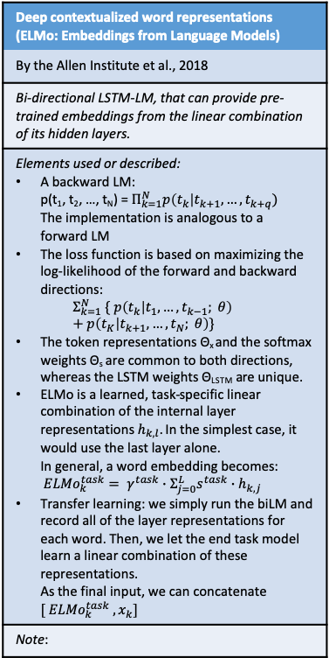
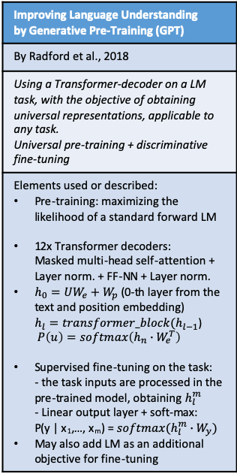
On Word Embeddings and Transfer Learning
BERT: Pre-training of Deep Bidirectional Transformers for Language Understanding
By Devlin et al., 2017
Transformer-based architecture for pre-training in Sequential Learning. Through MLM, a bidirectional language model incorporates both left and right side of the context.
Elements used or described: 2 phases: pre-train on unlabeled data + fine-tune on labeled data of target task Multi-layer transformer encoder Input = Position encoding + sentence ID + token embedding ; start with [CLS], separate sentences with [SEP] Pretraining 1: Masked Language Model Randomly mask 15% of the input tokens, and predict them Pretraining 2: Binarized Next Sentence Prediction For Finetuning: we add 1 output layer with Softmax, and just plug in the target task’s inputs and outputs
Note:
BERT
In Write-assistant, a possible use case is that the user deletes a word in the middle of an already-written sentence. If there is context on both sides, a BERT-line LM could predict that word.
Improving Language Understanding by Generative Pre-Training (GPT)
By Radford et al., 2018
Using a Transformer-decoder on a LM task, with the objective of obtaining universal representations, applicable to any task. Universal pre-training + discriminative fine-tuning
Elements used or described: Pre-training: maximizing the likelihood of a standard forward LM 12x Transformer decoders: Masked multi-head self-attention + Layer norm. + FF-NN + Layer norm. $h_{0}=UW_{e}+W_{p}$ (0-th layer from the text and position embedding) $h_{l}=transformer_block(h_{l−1}$) $P\left(u\right)=softmax\left(h_{n}∙W_{e}^{T}\right)$ Supervised fine-tuning on the task: - the task inputs are processed in the pre-trained model, obtaining $h_{l}^{m}$ - Linear output layer + soft-max: P(y | x₁,…, x_{m}) = $softmax(h_{l}^{m}∙W_{y})$ May also add LM as an additional objective for fine-tuning
Language Models are Unsupervised Multitask Learners (GPT-2)
By Radford, Wu et al., 2019
Training a large-scale LM on a new large dataset (WebText), and using it as an unsupervised instrument for different tasks.
Elements used or described: WebText: obtained by scraping all the outbound Reddit links with 3+ karma. Removed Wikipedia pages to avoid overlaps. 8+ million documents Model: transformer, based on the OpenAI GPT. Byte Pair Encoding, that uses both word-level and char-level input 12/24/36/48 layers, going from 117M to 1542M parameters Improves: WT2, PTB. Worse: 1BillW ~(improves only on largest): WT103
Deep contextualized word representations (ELMo: Embeddings from Language Models)
By the Allen Institute et al., 2018
Bi-directional LSTM-LM, that can provide pre-trained embeddings from the linear combination of its hidden layers.
Elements used or described: A backward LM: p(t₁, t₂, …, t_{N}) = $Π_{k=1}^{N}p\left(t_{k}\right|t_{k+1}, …, t_{k+q})$ The implementation is analogous to a forward LM The loss function is based on maximizing the log-likelihood of the forward and backward directions: $Σ_{k=1}^{N} \{ p\left(t_{k} | t_{1},…,t_{k−1}; θ\right)+p\left(t_{K} | t_{k+1},…,t_{N}; θ\right)\}$ The token representations Θ_{x} and the softmax weights Θ_{s} are common to both directions, whereas the LSTM weights Θ_{LSTM} are unique. ELMo is a learned, task-specific linear combination of the internal layer representations $h_{k,l}$. In the simplest case, it would use the last layer alone. In general, a word embedding becomes: ${ELMo}_{k}^{task}= γ^{task}∙Σ_{j=0}^{L}s^{task}∙h_{k,j}$ Transfer learning: we simply run the biLM and record all of the layer representations for each word. Then, we let the end task model learn a linear combination of these representations. As the final input, we can concatenate $[ {{ELMo}_{k}^{task} ,x}_{k}]$
Note:
ELMo
Here bi-directional means only (forward + backward). A Masked LM, like in BERT, can be considered superior for filling spots in the text.

Slide 5
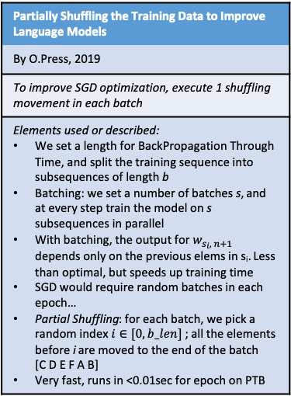
Perplexity & other misc items
Evaluating Rewards for Question Generation Models
By Hoskin & Riedel et al., 2019
Using several different evaluation measures on a Question Generation Architecture (also with LM and adversarial discriminator). Higher scores (NOT(==)) Better quality
Elements used or described: Task: generate a question, given a doc (context), and the answer marked in it Idea: instead of using as the objective only the ground-truth solution, add a fine-tuning phase with other scores (eg. BLEU, LM perplexity) Model: Seq2Seq, with attention, and answer encoder. Uses beam search + Adversarial training: Generate questions Train a discriminator, that must distinguish between generated Qs and ground-truth Qs Fine-tune the generator, with a reward for fooling the discrim. Through old-fashioned human evaluation, we discover 3 failures: LM metric QA metric The discriminator is useless
Note:
Can you compare perplexity across different segmentations?
Blog, By Sebastian J. Mielke
Perplexities over different segmentation granularities (i.e., words, subwords, or characters) aren't directly comparable, but the log-likelihoods that are hidden inside them are — and those can always be converted to perplexities for any given level.
Elements used or described: ppl_{word} = exp( - log (p(text)) / N_{words}) ppl_{char} = exp( - log (p(text)) / N_{char}) We can compute log(p(text)) with the product of probabilities over any decompositions (words, chars, …) Word-level models are closed-Vocab., whereas open-V models can potentially predict any sequence of units, thus spreading their probability mass. We can only compare distributions on perplexity if they have the same support set of strings. With subwords: while the ppl-per-prediction token is not comparable, we can still compute ppl_{word} and ppl_{char}
Notes: The logarithm of the product is the sum of logarithms, so -log(p(text)) = -[ log (p(w1)) + log(p(w2)) +…] Bits Per Character: -log₂ P(x_{t+1} | y_{t}) Also as: -1/T * Σ_{t=1}^{T} log₂ P(x_{t})
Are All Languages Equally Hard to Language-Model?
By Cotterell, Mielke et al., 2018
Introducing Multi-Text evaluation (across translated utterances) and BPEC. Comparing LMs on different languages
Elements used or described: Fixed-V LMs use <unk> tokens to represent OOV words. Here, we compare open-V char-level LSTM-LMs Multi-text: k-way translations of the same content Bits Per English Character; BPEC = 1/(|h_{ENG}|+1) * Σ_{i=1}^{|h|+1} P(c_{i}|h) can also be aggregated over utterances There is a significant BPEC difference when 1 of the 2 languages has a greater inflectional morphology (either 1) more difficult or 2) our models can’t cope) The difference disappears when lemmatizing
Note:
Partially Shuffling the Training Data to Improve Language Models
By O.Press, 2019
To improve SGD optimization, execute 1 shuffling movement in each batch
Elements used or described: We set a length for BackPropagation Through Time, and split the training sequence into subsequences of length b Batching: we set a number of batches s, and at every step train the model on s subsequences in parallel With batching, the output for $w_{s_{i}, n+1}$ depends only on the previous elems in s_{i}. Less than optimal, but speeds up training time SGD would require random batches in each epoch… Partial Shuffling: for each batch, we pick a random index $i∈[0,b_len]$ ; all the elements before i are moved to the end of the batch [C D E F A B] Very fast, runs in <0.01sec for epoch on PTB

Slide 6
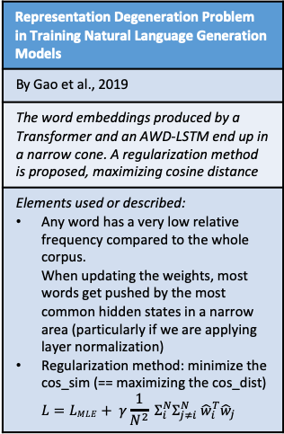
Research Direction 1: FRAGE and subsequent work
FRAGE: Frequency-AgnosticWord Representation
By Gong et al., 2018
Excluding frequency information from word embeddings, using an Adversarial Training framework
Elements used or described: 2 models with competing objectives Both models (Task-specific and Discriminator) use word embeddings as their input Discriminator: outputs a score [0,1] on ‘is w a rare word’? Mechanism: - L_{T} = task-specific loss - L_{D} = discriminator loss (log-loss on popular and rare words) - The optimization step for the main model is: min L_{T} – λL_{D} Train Main model and Discriminator in separate steps, iteratively on minibatches
FRAGE: Frequency-AgnosticWord Representation
“Explanation: For a rare word, the sample rate is low and its embedding rarely updates. According to our study, on average, the moving distance of the embedding for a popular word is twice longer than that of a rare word during training. As all word embeddings are usually initialized around the origin…” So an equivalent effect could be obtained by simply scaling/amplifying the update to a word embedding, in a way inversely proportional to the word frequency? E.g. Could use a different learning rate
Calibration, Entropy Rates, and Memory in Language Models
By Braverman et al., 2019
Among the long-term properties of language models when generating text, we quantify the amplification in the entropy rate of generations…
We first use the entropy rate calibration algorithm to fix an LSTM language model, resulting in a drop of around 20 perplexity points in the generated text. Then, we empirically estimate and compare the long-term memory of state-of-the- art language models. Our insights point towards new ways of assessing (and fixing) language models, in a manner complementary to existing metrics like perplexity.
Classification of Semantic Paraphasias- Optimization of a Word Embedding Model
By McKinney-Bock & Bedrick et al., 2019
We engage in the interdiscplinary question of how semantic relations can be modeled in a clinical domain, and present an application of word embedding models for assessing semantic impairment.
IMPROVED LANGUAGE MODELING BY DECODING THE PAST
By Siddhartha Brahma, 2019
It can be cast as a (pseudo) language modeling problem in “reverse”, where the future prediction w_{t+1} acts as the input and the last token x_{t} acts as the target of prediction.
The loss function becomes : L = L_{CE} + λ_{PDR}L_{PDR} Applied over AWD-LSTM+
Citing this paper on Google Scholar
Language Models are Unsupervised Multitask Learners (GPT-2)
By Radford, Wu et al., 2019
Training a large-scale LM on a new large dataset (WebText), and using it as an unsupervised instrument for different tasks.
Elements used or described: WebText: obtained by scraping all the outbound Reddit links with 3+ karma. Removed Wikipedia pages to avoid overlaps. 8+ million documents Model: transformer, based on the OpenAI GPT. Byte Pair Encoding, that uses both word-level and char-level input 12/24/36/48 layers, going from 117M to 1542M parameters Improves: WT2, PTB. Worse: 1BillW ~(improves only on largest): WT103
Linguistically-Informed Specificity and Semantic Plausibility for Dialogue Generation
By Ko et al., 2019
Applying a specificity metric to generate more useful and pertinent responses in a Dialogue generation task. Examining emerging problems in the answers, and using a reranking method to counter them.
Improving Neural Language Modeling via Adversarial Training
By Wang, Gong and Liu, 2019
Adding adversarial noise on the (multi-)softmax layer, to counter overfitting in RNN-LMs
Elements used or described: Weight-tying trick (input embeddings tied to the output embeddings) We optimize alternatively: the parameters θ and W of the LM loss the adversarial perturbation δ on the softmax Closed formula for δ: δ = arg_{δi}min (w_{i} + δ_{i})^{T} h = -εh/||h||
Semi-Supervised Entity Alignment via Knowledge Graph Embedding with Awareness of Degree Difference
By Pei et al., 2019
Representation Degeneration Problem in Training Natural Language Generation Models
By Gao et al., 2019
The word embeddings produced by a Transformer and an AWD-LSTM end up in a narrow cone. A regularization method is proposed, maximizing cosine distance
Elements used or described: Any word has a very low relative frequency compared to the whole corpus. When updating the weights, most words get pushed by the most common hidden states in a narrow area (particularly if we are applying layer normalization) Regularization method: minimize the cos_sim (== maximizing the cos_dist) $L=LMLE+ γ\frac{1}{N^{2}} Σ_{i}^{N}Σ_{j≠i}^{N} {\hat{w}}_{i}^{T}{\hat{w}}_{j}$
Representation Degeneration Problem in Training Natural Language Generation Models
WARNING: “In the future, we will apply our method to more language generation tasks. Our proposed regularization term is based on cosine similarity. There may exist some better regularization terms. Furthermore, it is interesting to combine with other approaches, e.g. (Gong et al., 2018), to enrich the representation of word embeddings.”
They may already be combining FRAGE and the analysis on rare vs. popular words with this work
The direction may still be valid: alternative to FRAGE + examining other word embedding methods (Transformer-based, etc.), adding the 2D representation not only to colour popular vs rare, but also to examine the spread
And what about the embeddings of other languages?
Telephonetic: Making Neural Language Models Robust to ASR and Semantic Noise
By Larson et al., 2019
A bootstrapping technique for transferring neural language models to the speech domain.
Sentence-wise Smooth Regularization for Sequence to Sequence Learning
By Gong et al., 2019
In Seq2Seq learning (e.g.: Machine Translation), often the probability distribution across tokens is non-smooth. There are tokens with very high P, and others with disproportionately low P (including useful tokens such as conjuctions and pronouns). A new loss function, with a regularization term added to MLE, is defined to address the problem.
Natural languages understanding by a compositional alignment of word embeddings
By Z.Zhu, 2019

Slide 7
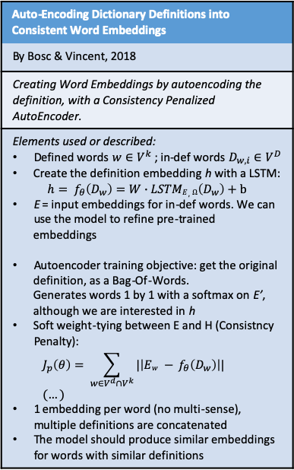
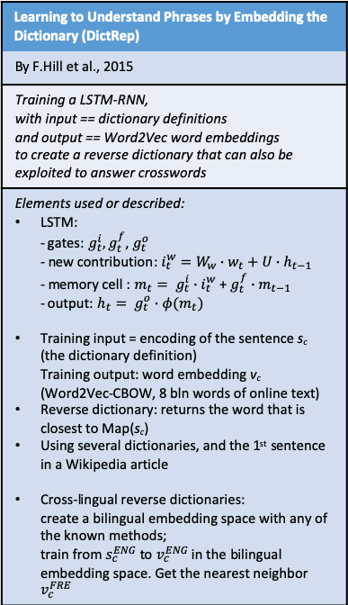
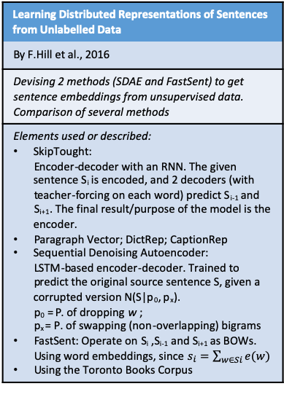
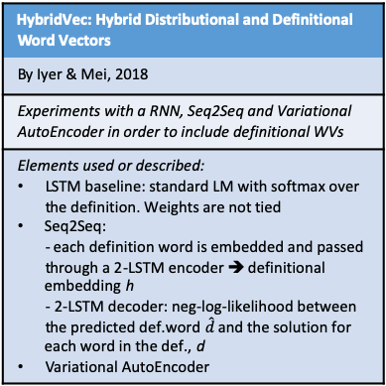
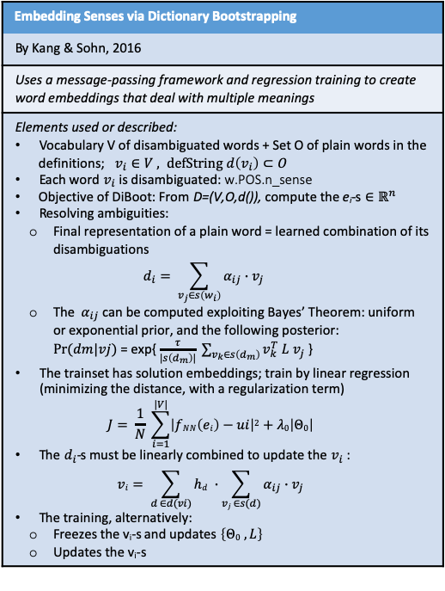
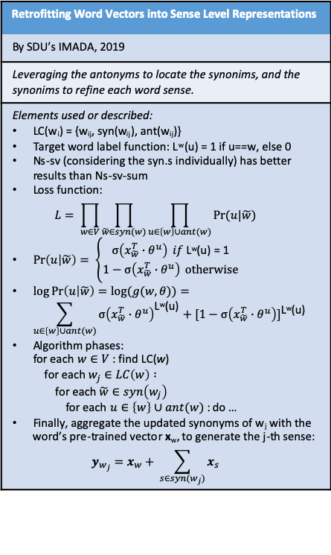
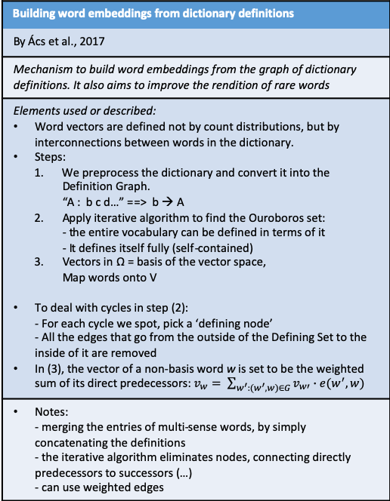
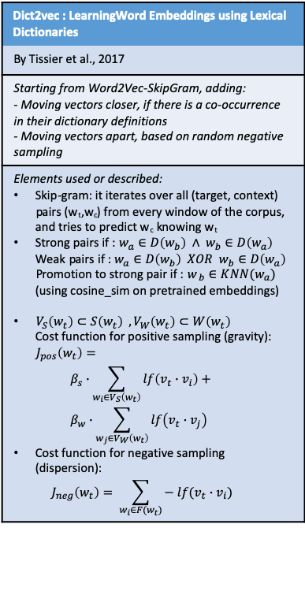
Research Direction 2 (section: Dictionaries)
Learning to Understand Phrases by Embedding the Dictionary (DictRep)
By F.Hill et al., 2015
Training a LSTM-RNN, with input == dictionary definitions and output == Word2Vec word embeddings to create a reverse dictionary that can also be exploited to answer crosswords
Elements used or described: LSTM: - gates: $g_{t}^{i},g_{t}^{f}$, $g_{t}^{o}$ - new contribution: $i_{t}^{w}=W_{w}∙w_{t}+U∙h_{t−1}$ - memory cell : $m_{t}= g_{t}^{i}∙i_{t}^{w}$ + $g_{t}^{f}{∙m}_{t−1}$ - output: $h_{t}= g_{t}^{o}{∙φ(m}_{t})$ Training input = encoding of the sentence s_{c} (the dictionary definition) Training output: word embedding v_{c} (Word2Vec-CBOW, 8 bln words of online text) Reverse dictionary: returns the word that is closest to Map(s_{c}) Using several dictionaries, and the 1st sentence in a Wikipedia article Cross-lingual reverse dictionaries: create a bilingual embedding space with any of the known methods; train from $s_{c}^{ENG}$ to $v_{c}^{ENG}$ in the bilingual embedding space. Get the nearest neighbor $v_{c}^{FRE}$
Embedding Senses via Dictionary Bootstrapping
By Kang & Sohn, 2016
Uses a message-passing framework and regression training to create word embeddings that deal with multiple meanings
Elements used or described: Vocabulary V of disambiguated words + Set O of plain words in the definitions; $v_{i}∈V , defString d\left(v_{i}\right)⊂O$ Each word $v_{i}$ is disambiguated: w.POS.n_sense Objective of DiBoot: From D=(V,O,d()), compute the e_{i}-s $∈ℝ^{n}$ Resolving ambiguities: Final representation of a plain word = learned combination of its disambiguations $d_{i}= \sum_{v_{j}∈s\left(w_{i}\right)}{α_{ij}∙v_{j}}$ The $α_{ij}$ can be computed exploiting Bayes’ Theorem: uniform or exponential prior, and the following posterior: $Pr⁡(dm|vj)$ = exp{ $\frac{τ}{|s\left(d_{m}\right)|} \sum_{v_{k}∈s\left(d_{m}\right)}{v_{k}^{T} L v_{j}}$ } The trainset has solution embeddings; train by linear regression (minimizing the distance, with a regularization term) $J= \frac{1}{N} \sum_{i=1}^{|V|}{\left|fNN\left(ei\right)−ui\right|2+λ0\left|Θ0\right|}$ The $d_{i}$-s must be linearly combined to update the $v_{i}$ : $vi= \sum_{d ∈d(vi)}{hd} ∙\sum_{vj ∈s(d)}{α_{ij}∙v_{j}}$ The training, alternatively: Freezes the v_{i}-s and updates $\left\{Θ0 , L\right\}$ Updates the v_{i}-s
Learning Distributed Representations of Sentences from Unlabelled Data
By F.Hill et al., 2016
Devising 2 methods (SDAE and FastSent) to get sentence embeddings from unsupervised data. Comparison of several methods
Elements used or described: SkipTought: Encoder-decoder with an RNN. The given sentence S_{i} is encoded, and 2 decoders (with teacher-forcing on each word) predict S_{i-1} and S_{i+1}. The final result/purpose of the model is the encoder. Paragraph Vector; DictRep; CaptionRep Sequential Denoising Autoencoder: LSTM-based encoder-decoder. Trained to predict the original source sentence S, given a corrupted version N(S|p₀, p_{x}). p₀ = P. of dropping w ; p_{x} = P. of swapping (non-overlapping) bigrams FastSent: Operate on S_{i} ,S_{i-1} and S_{i+1} as BOWs. Using word embeddings, since $s_{i}=\sum_{w∈Si}{e(w)}$ Using the Toronto Books Corpus
Auto-Encoding Dictionary Definitions into Consistent Word Embeddings
By Bosc & Vincent, 2018
Creating Word Embeddings by autoencoding the definition, with a Consistency Penalized AutoEncoder.
Elements used or described: Defined words $w∈V^{k}$ ; in-def words $D_{w,i}∈V^{D}$ Create the definition embedding h with a LSTM: $h= f_{θ}\left(D_{w}\right)=W∙LSTME,Ω\left(D_{w}\right)+b$ E = input embeddings for in-def words. We can use the model to refine pre-trained embeddings Autoencoder training objective: get the original definition, as a Bag-Of-Words. Generates words 1 by 1 with a softmax on E’, although we are interested in h Soft weight-tying between E and H (Consistncy Penalty): $J_{p}\left(θ\right)= \sum_{w∈V^{d}∩V^{k}}{|\left|Ew − f_{θ}\left(D_{w}\right)\right||}$ $(…)$ 1 embedding per word (no multi-sense), multiple definitions are concatenated The model should produce similar embeddings for words with similar definitions
Dict2vec : LearningWord Embeddings using Lexical Dictionaries
By Tissier et al., 2017
Starting from Word2Vec-SkipGram, adding: - Moving vectors closer, if there is a co-occurrence in their dictionary definitions - Moving vectors apart, based on random negative sampling
Elements used or described: Skip-gram: it iterates over all (target, context) pairs (w_{t},w_{c}) from every window of the corpus, and tries to predict w_{c} knowing w_{t} Strong pairs if : $w_{a}∈D\left(w_{b}\right) ∧ w_{b}∈D\left(w_{a}\right)$ $\text{Weak} \text{pairs} \text{if}\text{ : }w_{a}∈D\left(w_{b}\right) XOR w_{b}∈D\left(w_{a}\right)$ Promotion to strong pair if : $w_{ b}∈KNN(w_{a})$ (using cosine_sim on pretrained embeddings) $V_{S}\left(w_{t}\right)⊂S\left(w_{t}\right) ,V_{W}\left(w_{t}\right)⊂W\left(w_{t}\right)$ Cost function for positive sampling (gravity): $J_{pos}\left(w_{t}\right)=$ $β_{s}∙\sum_{w_{i}∈V_{S}\left(w_{t}\right)}{lf\left(v_{t}∙v_{i}\right)+ }$ $β_{w}∙\sum_{w_{j}∈V_{W}\left(w_{t}\right)}{lf\left(v_{t}∙v_{j}\right) }$ Cost function for negative sampling (dispersion): $J_{neg}\left(w_{t}\right)= \sum_{w_{i}∈F(w_{t})}{− lf(v_{t}∙v_{i})}$
Retrofitting Word Vectors into Sense Level Representations
By SDU’s IMADA, 2019
Leveraging the antonyms to locate the synonims, and the synonims to refine each word sense.
Elements used or described: LC(w_{i}) = {w_{ij}, syn(w_{ij}), ant(w_{ij})} Target word label function: L^{w}(u) = 1 if u==w, else 0 Ns-sv (considering the syn.s individually) has better results than Ns-sv-sum Loss function: $L= \prod_{w∈V}{\prod_{\tilde{w}∈syn(w)}{\prod_{u∈\left\{w\right\}∪ant(w)}{Pr⁡(u|\tilde{w})}}}$ $\operatorname{Pr}\left(u | \tilde{w}\right)= \left\{\begin{aligned}σ\left(x_{\tilde{w}}^{T}∙θ^{u}\right) if \text{L}\text{w}\text{(}\text{u}\text{) = 1} \\ 1−σ\left(x_{\tilde{w}}^{T}∙θ^{u}\right) otherwise\end{aligned}\right.$ $\log{\operatorname{Pr}\left(u | \tilde{w}\right)=\log{(g(w,θ))}}=$ $\sum_{u∈\left\{w\right\}∪ant(w)}{{σ\left(x_{\tilde{w}}^{T}∙θ^{u}\right)}^{\text{L}\text{w}\text{(}\text{u}\text{)}}+{[1−σ\left(x_{\tilde{w}}^{T}∙θ^{u}\right)]}^{\text{L}\text{w}\text{(}\text{u}\text{)}}}$ Algorithm phases: for each $w∈V$ : find LC(w) for each $w_{j}∈LC\left(w\right) :$ for each $\tilde{w}∈syn\left(w_{j}\right)$ for each $u∈\left\{w\right\}∪ant(w)$ : do … Finally, aggregate the updated synonyms of w_{j} with the word’s pre-trained vector x_{w}, to generate the j-th sense: $y_{w_{j}}=x_{w}+ \sum_{s∈syn(w_{j})}{x_{s}}$
Building word embeddings from dictionary definitions
By Ács et al., 2017
Mechanism to build word embeddings from the graph of dictionary definitions. It also aims to improve the rendition of rare words
Elements used or described: Word vectors are defined not by count distributions, but by interconnections between words in the dictionary. Steps: We preprocess the dictionary and convert it into the Definition Graph. “A : b c d…” ==> b → A Apply iterative algorithm to find the Ouroboros set: - the entire vocabulary can be defined in terms of it - It defines itself fully (self-contained) Vectors in Ω = basis of the vector space, Map words onto V To deal with cycles in step (2): - For each cycle we spot, pick a ‘defining node’ - All the edges that go from the outside of the Defining Set to the inside of it are removed In (3), the vector of a non-basis word w is set to be the weighted sum of its direct predecessors: $v_{w}= \sum_{w^{′}:(w^{′},w)∈G}{v_{w′}∙e(w^{′},w)}$
Notes: - merging the entries of multi-sense words, by simply concatenating the definitions - the iterative algorithm eliminates nodes, connecting directly predecessors to successors (…) - can use weighted edges
Building word embeddings from dictionary definitions
What about using a Graph Neural Network?
“Another avenue of research we intend to pursue is to consolidate prediction- and dictionary-based embeddings into a hybrid model that combines the advantages of both.”
HybridVec: Hybrid Distributional and Definitional Word Vectors
By Iyer & Mei, 2018
Experiments with a RNN, Seq2Seq and Variational AutoEncoder in order to include definitional WVs
Elements used or described: LSTM baseline: standard LM with softmax over the definition. Weights are not tied Seq2Seq: - each definition word is embedded and passed through a 2-LSTM encoder ➔ definitional embedding h - 2-LSTM decoder: neg-log-likelihood between the predicted def.word $\hat{d}$ and the solution for each word in the def., d Variational AutoEncoder

Slide 8
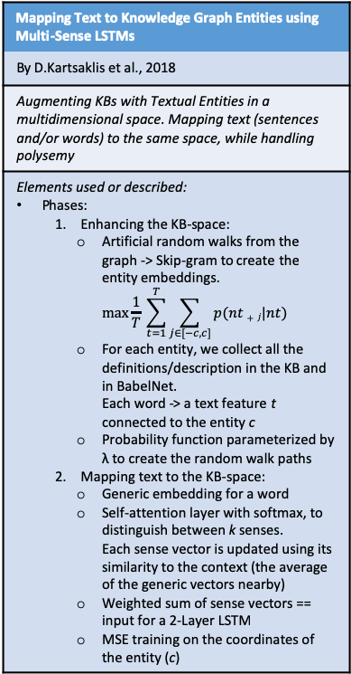
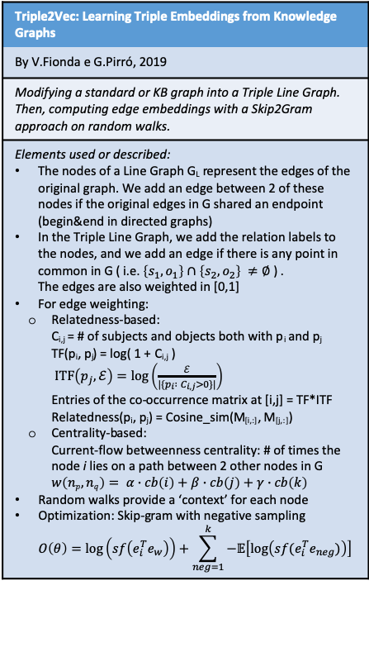
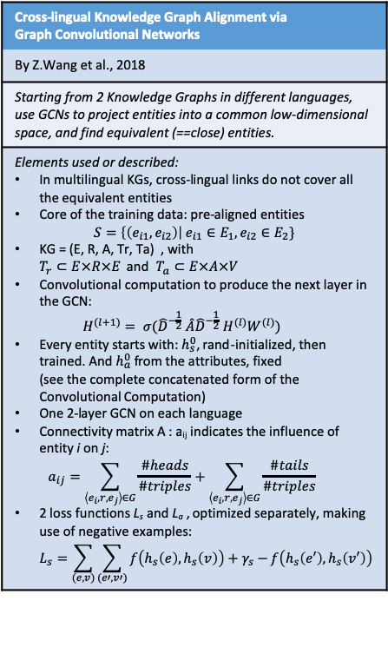
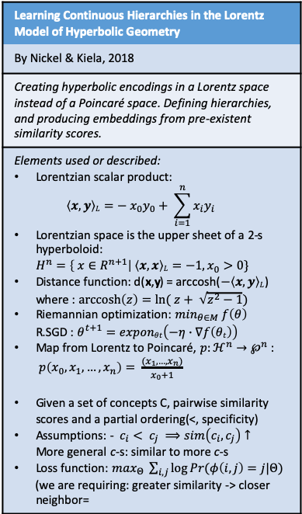
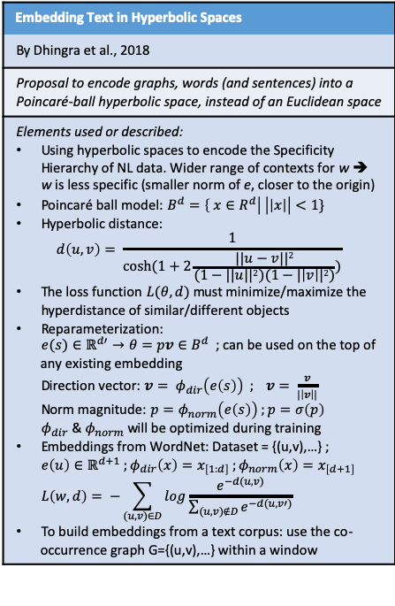
Research Direction 2 (section: Knowledge bases & hyperbolic embeddings)
Mapping Text to Knowledge Graph Entities using Multi-Sense LSTMs
By D.Kartsaklis et al., 2018
Augmenting KBs with Textual Entities in a multidimensional space. Mapping text (sentences and/or words) to the same space, while handling polysemy
Elements used or described: Phases: Enhancing the KB-space: Artificial random walks from the graph -> Skip-gram to create the entity embeddings. $\max{\frac{1}{T} \sum_{t=1}^{T}{\sum_{j∈[−c,c]}{p(nt+j|nt)}}}$ For each entity, we collect all the definitions/description in the KB and in BabelNet. Each word -> a text feature t connected to the entity c Probability function parameterized by λ to create the random walk paths Mapping text to the KB-space: Generic embedding for a word Self-attention layer with softmax, to distinguish between k senses. Each sense vector is updated using its similarity to the context (the average of the generic vectors nearby) Weighted sum of sense vectors == input for a 2-Layer LSTM MSE training on the coordinates of the entity (c)
Mapping Text to Knowledge Graph Entities using Multi-Sense LSTMs
MS-LSTM > LSTM, confirmed. However, this model has to rigidly pre-define k, the number of possible senses for each word.
What about applying the mapping-to-a-KB from text in different languages? It is possible that we may have to use different KBs?
Different domains could also use this methodology (medical, legal etc.)
Cross-lingual Knowledge Graph Alignment via Graph Convolutional Networks
By Z.Wang et al., 2018
Starting from 2 Knowledge Graphs in different languages, use GCNs to project entities into a common low-dimensional space, and find equivalent (==close) entities.
Elements used or described: In multilingual KGs, cross-lingual links do not cover all the equivalent entities Core of the training data: pre-aligned entities $S=\left\{\left(e_{i1}, e_{i2}\right)\right| e_{i1}∈E_{1},e_{i2}∈E_{2}\}$ KG = (E, R, A, Tr, Ta) , with $T_{r}⊂E×R×E$ and $T_{a}⊂E×A×V$ Convolutional computation to produce the next layer in the GCN: $H^{(l+1)}= σ({\hat{D}}^{−\frac{1}{2}} \hat{A}{\hat{D}}^{−\frac{1}{2}} H^{(l)}W^{(l)})$ Every entity starts with: $h_{s}^{0}$, rand-initialized, then trained. And $h_{a}^{0}$ from the attributes, fixed (see the complete concatenated form of the Convolutional Computation) One 2-layer GCN on each language Connectivity matrix A : a_{ij} indicates the influence of entity i on j: $a_{ij}=\sum_{\left\langle e_{i},r,e_{j}\right\rangle ∈G}{\frac{\#heads}{\#triples}}+\sum_{\left\langle e_{i},r,e_{j}\right\rangle ∈G}{\frac{\#tails}{\#triples}}$ 2 loss functions L_{s} and L_{a} , optimized separately, making use of negative examples: $L_{s}=\sum_{(e,v)}{\sum_{(e′,v′)}{f\left(h_{s}\left(e\right),h_{s}\left(v\right)\right)+γ_{s}−}f\left(h_{s}\left(e′\right),h_{s}\left(v′\right)\right)}$
Triple2Vec: Learning Triple Embeddings from Knowledge Graphs
By V.Fionda e G.Pirró, 2019
Modifying a standard or KB graph into a Triple Line Graph. Then, computing edge embeddings with a Skip2Gram approach on random walks.
Elements used or described: The nodes of a Line Graph G_{L} represent the edges of the original graph. We add an edge between 2 of these nodes if the original edges in G shared an endpoint (begin&end in directed graphs) In the Triple Line Graph, we add the relation labels to the nodes, and we add an edge if there is any point in common in G ( i.e. $\left\{s_{1},o_{1}\right\}∩\left\{s_{2},o_{2}\right\} ≠∅$ ) . The edges are also weighted in [0,1] For edge weighting: Relatedness-based: C_{i,j} = # of subjects and objects both with p_{i} and p_{j} TF(p_{i}, p_{j}) = log( 1 + C_{i,j} ) $ITF\left(p_{j},ℰ\right)=\log\left(\frac{ℰ}{|\{p_{i} : C_{i,j}>0\}|}\right)$ Entries of the co-occurrence matrix at [i,j] = TF*ITF Relatedness(p_{i}, p_{j}) = Cosine_sim(M_{[i,:]}, M_{[j,:]}) Centrality-based: Current-flow betweenness centrality: # of times the node i lies on a path between 2 other nodes in G $w\left(np,nq\right)= α∙cb\left(i\right)+β∙cb\left(j\right)+γ∙cb\left(k\right)$ Random walks provide a ‘context’ for each node Optimization: Skip-gram with negative sampling $O\left(θ\right)=\log\left(sf\left(e_{i}^{T}e_{w}\right)\right)+\sum_{neg=1}^{k}{−𝔼\left[\log\left(sf(e_{i}^{T}e_{neg})\right)\right]}$
Embedding Text in Hyperbolic Spaces
By Dhingra et al., 2018
Proposal to encode graphs, words (and sentences) into a Poincaré-ball hyperbolic space, instead of an Euclidean space
Elements used or described: Using hyperbolic spaces to encode the Specificity Hierarchy of NL data. Wider range of contexts for w ➔ w is less specific (smaller norm of e, closer to the origin) Poincaré ball model: $B^{d}=\left\{ x∈R^{d}\right| \left|\left|x\right|\right|<1\}$ Hyperbolic distance: $d\left(u,v\right)= \frac{1}{cosh⁡(1+2\frac{||u−v||2}{(1−||u||2)(1−|\left|v\right||2)})}$ The loss function $L(θ,d)$ must minimize/maximize the hyperdistance of similar/different objects Reparameterization: ${e(s)∈ℝ}^{d′}→{θ=pv∈B}^{d}$ ; can be used on the top of any existing embedding Direction vector: $\overline{v}= φ_{dir}\left(e\left(s\right)\right) ; v= \frac{\overline{v}}{|\left|\overline{v}\right||}$ Norm magnitude: $\overline{p}=φ_{norm}\left(e\left(s\right)\right) ;p=σ\left(p\right)$ $φ_{dir}$ & $φ_{norm}$ will be optimized during training Embeddings from WordNet: Dataset = {(u,v),…} ; $e\left(u\right)∈ℝ^{d+1} ;φ_{dir}\left(x\right)=x_{\left[1:d\right]} ;φ_{norm}\left(x\right)=x_{\left[d+1\right]}$ $L\left(w,d\right)= −\sum_{(u,v)∈D}{log\frac{e^{−d(u,v)}}{\sum_{(u,v)∉D}{e^{−d(u,v′)}}}}$ To build embeddings from a text corpus: use the co-occurrence graph G={(u,v),…} within a window
Embedding Text in Hyperbolic Spaces
Meaningful nearest neighbors are found using cosine distance
“Ultimately, the usefulness of an embedding method depends on its performance on downstream tasks of interest…” What about Language Modeling?
Learning Continuous Hierarchies in the Lorentz Model of Hyperbolic Geometry
By Nickel & Kiela, 2018
Creating hyperbolic encodings in a Lorentz space instead of a Poincaré space. Defining hierarchies, and producing embeddings from pre-existent similarity scores.
Elements used or described: Lorentzian scalar product: $\left\langle x,y\right\rangle L=− x_{0}y_{0}+ \sum_{i=1}^{n}{x_{i}y_{i}}$ Lorentzian space is the upper sheet of a 2-s hyperboloid: $H^{n}=\left\{ x∈R^{n+1}\right| \left\langle x,x\right\rangle L=−1, x_{0}>0\}$ Distance function: d(x,y) = arccosh($−\left\langle x,y\right\rangle L$) where : $\operatorname{arccosh}\left(z\right)=ln⁡( z+ \sqrt{z^{2}−1})$ Riemannian optimization: $\min_{θ∈M} f\left(θ\right)$ R.SGD : $θ^{t+1}=exponθt\left(−η∙∇f\left(θt\right)\right)$ Map from Lorentz to Poincaré, $p:ℋ^{n}→℘^{n}$ : $p\left(x_{0},x_{1},…,x_{n}\right)= \frac{(x_{1},…,x_{n})}{x_{0}+1}$ Given a set of concepts C, pairwise similarity scores and a partial ordering(<, specificity) Assumptions: - $c_{i}< c_{j} ⟹sim\left(c_{i},c_{j}\right)↑$ More general c-s: similar to more c-s Loss function: $\max_{Θ} \sum_{i,j}{\log{Pr(φ\left(i,j\right)=j|Θ)}}$ (we are requiring: greater similarity -> closer neighbor=

Slide 9
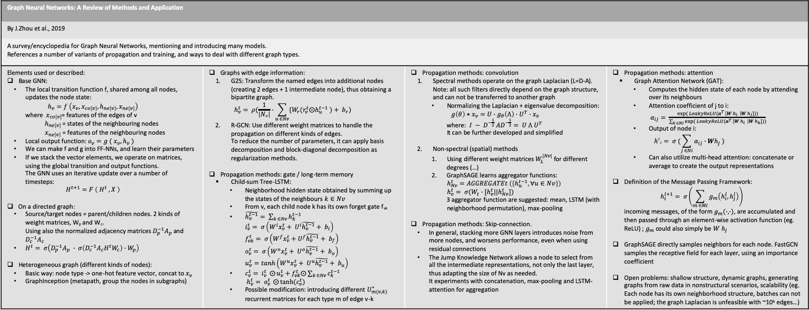
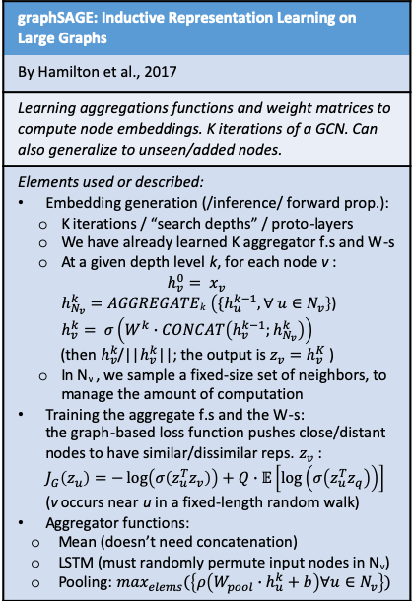
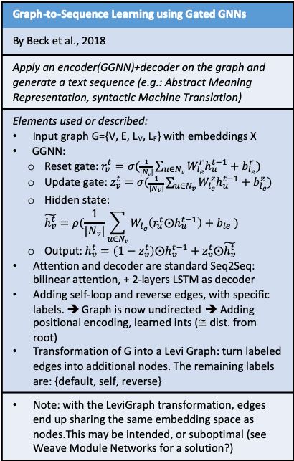
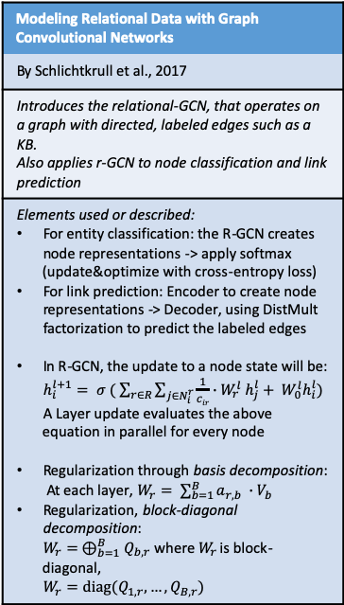
Research Direction 2 (section: GraphNNs)
Graph Neural Networks: A Review of Methods and Application
By J.Zhou et al., 2019
A survey/encyclopedia for Graph Neural Networks, mentioning and introducing many models. References a number of variants of propagation and training, and ways to deal with different graph types.
Elements used or described: Base GNN: The local transition function f, shared among all nodes, updates the node state: $h_{v}=f \left(x_{v}, x_{co\left[v\right]},h_{ne\left[v\right]}, x_{ne\left[v\right]}\right)$ where $x_{co\left[v\right]}$= features of the edges of v $h_{ne\left[v\right]}$ = states of the neighbouring nodes $x_{ne\left[v\right]}$ = features of the neighbouring nodes Local output function: $o_{v}=g ( x_{v}, h_{v} )$ We can make f and g into FF-NNs, and learn their parameters If we stack the vector elements, we operate on matrices, using the global transition and output functions. The GNN uses an iterative update over a number of timesteps: $H^{t+1}=F \left( H^{t} , X \right)$ On a directed graph: Source/target nodes = parent/children nodes. 2 kinds of weight matrices, W_{p} and W_{c}. Using also the normalized adjacency matrices $D_{p}^{−1}A_{p}$ and $D_{c}^{−1}A_{c}$ $H^{t}= σ\left(D_{p}^{−1}A_{p} ∙ σ\left(D_{c}^{−1}A_{c}H^{t}W_{c}\right)∙W_{p}\right)$ Heterogeneous graph (different kinds of nodes): Basic way: node type -> one-hot feature vector, concat to $x_{v}$ GraphInception (metapath, group the nodes in subgraphs) | Graphs with edge information: G2S: Transform the named edges into additional nodes (creating 2 edges + 1 intermediate node), thus obtaining a bipartite graph. $h_{v}^{t}= ρ(\frac{1}{\left|Nv\right|}∙\sum_{u ∈Nv}{{\{W}_{r}(r_{v}^{t}⨀h_{u}^{t−1} )+ b_{r})}$ R-GCN: Use different weight matrices to handle the propagation on different kinds of edges. To reduce the number of parameters, it can apply basis decomposition and block-diagonal decomposition as regularization methods. Propagation methods: gate / long-term memory Child-sum Tree-LSTM: Neighborhood hidden state obtained by summing up the states of the neighbours $k∈Nv$ From v, each child node k has its own forget gate f_{vk} $\tilde{h_{v}^{t−1}}= \sum_{k ∈Nv}{h_{k}^{t−1}}$ $i_{v}^{t}= σ\left(W^{i}x_{v}^{t}+ U^{i}\tilde{h_{v}^{t−1}}+ b_{i}\right)$ $f_{vk}^{t}= σ\left(W^{f}x_{v}^{t}+U^{f}\tilde{h_{v}^{t−1}}+ b_{f}\right)$ $o_{v}^{t}= σ\left(W^{o}x_{v}^{t}+ U^{o}\tilde{h_{v}^{t−1}}+ b_{o}\right)$ $u_{v}^{t}=tanh\left(W^{u}x_{v}^{t}+ U^{u}\tilde{h_{v}^{t−1}}+ b_{u}\right)$ $c_{v}^{t}= i_{v}^{t} ⨀{u_{v}^{t}}+f_{vk}^{t}⨀\sum_{k ∈Nv}{c_{k}^{t−1}}$ $h_{v}^{t}= o_{v}^{t} ⨀{tanh⁡(c_{v}^{t})}$ Possible modification: introducing different $U_{m(v,k)}^{∗}$ recurrent matrices for each type m of edge v-k | Propagation methods: convolution Spectral methods operate on the graph Laplacian (L=D-A). Note: all such filters directly depend on the graph structure, and can not be transferred to another graph Normalizing the Laplacian + eigenvalue decomposition: $g\left(θ\right)⋆x_{v}=U∙g_{θ}\left(Λ\right)∙U^{T}∙x_{v}$ where: $I − D^{−\frac{1}{2}} AD^{−\frac{1}{2}}= U Λ U^{T}$ It can be further developed and simplified Non-spectral (spatial) methods Using different weight matrices $W_{L}^{|Nv|}$ for different degrees (…) GraphSAGE learns aggregator functions: $h_{Nv}^{t}=AGGREGATEt \left(\left\{h_{u}^{t−1}, ∀u∈Nv\right\}\right)$ $h_{v}^{t}= σ(W_{t}∙[h_{v}^{t}||h_{Nv}^{t}])$ 3 aggregator function are suggested: mean, LSTM (with neighborhood permutation), max-pooling Propagation methods: Skip-connection. In general, stacking more GNN layers introduces noise from more nodes, and worsens performance, even when using residual connections The Jump Knowledge Network allows a node to select from all the intermediate representations, not only the last layer, thus adapting the size of Nv as needed. It experiments with concatenation, max-pooling and LSTM-attention for aggregation | Propagation methods: attention Graph Attention Network (GAT): Computes the hidden state of each node by attending over its neighbours Attention coefficient of j to i: $α_{ij}= \frac{exp⁡( LeakyReLU(a^{T }\left[W h_{i} \right|W h_{j}]))}{\sum_{k ∈Ni}{exp⁡( LeakyReLU(a^{T }\left[W h_{i} \right|W h_{k}]))}}$ Output of node i: $h^{′}i= σ (\sum_{j ∈Ni}{α_{ij}∙Wh_{j}} )$ Can also utilize multi-head attention: concatenate or average to create the output representations Definition of the Message Passing Framework: $h_{i}^{l+1}= σ\left(\sum_{m ∈Mi}{g_{m}\left(h_{i}^{l},h_{j}^{l}\right)}\right)$ incoming messages, of the form $g_{m}(∙,∙)$, are accumulated and then passed through an element-wise activation function (eg. ReLU) ; $g_{m}$ could also simply be $W h_{j}$ GraphSAGE directly samples neighbors for each node. FastGCN samples the receptive field for each layer, using an importance coefficient Open problems: shallow structure, dynamic graphs, generating graphs from raw data in nonstructural scenarios, scalability (eg. Each node has its own neighborhood structure, batches can not be applied; the graph Laplacian is unfeasible with ~10⁶ edges…)
Modeling Relational Data with Graph Convolutional Networks
By Schlichtkrull et al., 2017
Introduces the relational-GCN, that operates on a graph with directed, labeled edges such as a KB. Also applies r-GCN to node classification and link prediction
Elements used or described: For entity classification: the R-GCN creates node representations -> apply softmax (update&optimize with cross-entropy loss) For link prediction: Encoder to create node representations -> Decoder, using DistMult factorization to predict the labeled edges In R-GCN, the update to a node state will be: $h_{i}^{l+1}= σ ( \sum_{r∈R}{\sum_{j∈N_{i}^{r}}{\frac{1}{cir}∙W_{r}^{l} h_{j}^{l}+ W_{0}^{l}h_{i}^{l}}})$ A Layer update evaluates the above equation in parallel for every node Regularization through basis decomposition: At each layer, $W_{r}= \sum_{b=1}^{B}{a_{r,b} ∙V_{b}}$ Regularization, block-diagonal decomposition: $W_{r}= ⊕_{b=1}^{B}Q_{b,r}$ where $W_{r}$ is block-diagonal, $W_{r}=diag(Q_{1,r}, …,Q_{B,r})$
Modeling Relational Data with Graph Convolutional Networks
General idea, applicable to different types of GNN: What about building the output not only from the last layer, but from a weighted combination of all the layers? (Following the mechanism used in ELMo) This would solve the problem of being unable to build GNNs with many layers, because the last ones aggregate information from a too large neighbourhood and introduce noise.
Graph-to-Sequence Learning using Gated GNNs
By Beck et al., 2018
Apply an encoder(GGNN)+decoder on the graph and generate a text sequence (e.g.: Abstract Meaning Representation, syntactic Machine Translation)
Elements used or described: Input graph G={V, E, L_{V}, L_{E}} with embeddings X GGNN: Reset gate: $r_{v}^{t}=σ(\frac{1}{|Nv|}\sum_{u∈Nv}{W_{l_{e}}^{r}h_{u}^{t−1}+b_{l_{e}}^{r}})$ Update gate: $z_{v}^{t}=σ(\frac{1}{|N_{v}|}\sum_{u∈N_{v}}{W_{l_{e}}^{z}h_{u}^{t−1}+b_{l_{e}}^{z}})$ Hidden state: $\tilde{h_{v}^{t}}=ρ(\frac{1}{|Nv|}\sum_{u∈Nv}{W_{l_{e}}\left(r_{u}^{t}⨀h_{u}^{t−1}\right)+b_{le} })$ Output: $h_{v}^{t}=\left(1−z_{v}^{t}\right)⨀h_{v}^{t−1}+z_{v}^{t}⨀\tilde{h_{v}^{t}}$ Attention and decoder are standard Seq2Seq: bilinear attention, + 2-layers LSTM as decoder Adding self-loop and reverse edges, with specific labels. ➔ Graph is now undirected ➔ Adding positional encoding, learned ints ($≅$ dist. from root) Transformation of G into a Levi Graph: turn labeled edges into additional nodes. The remaining labels are: {default, self, reverse}
Note: with the LeviGraph transformation, edges end up sharing the same embedding space as nodes.This may be intended, or suboptimal (see Weave Module Networks for a solution?)
graphSAGE: Inductive Representation Learning on Large Graphs
By Hamilton et al., 2017
Learning aggregations functions and weight matrices to compute node embeddings. K iterations of a GCN. Can also generalize to unseen/added nodes.
Elements used or described: Embedding generation (/inference/ forward prop.): K iterations / “search depths” / proto-layers We have already learned K aggregator f.s and W-s At a given depth level k, for each node v : $h_{v}^{0}= x_{v}$ $h_{N_{v}}^{k}=AGGREGATEk \left({\{h}_{u}^{k−1}, ∀ u∈N_{v}\right\}$) $h_{v}^{k}= σ\left(W^{k}∙CONCAT\left(h_{v}^{k−1};h_{N_{v}}^{k}\right)\right)$ (then $h_{v}^{k}$/||$h_{v}^{k}$||; the output is $z_{v}=h_{v}^{K}$ ) In N_{v} , we sample a fixed-size set of neighbors, to manage the amount of computation Training the aggregate f.s and the W-s: the graph-based loss function pushes close/distant nodes to have similar/dissimilar reps. $z_{v}$ : $J_{G}\left(z_{u}\right)=−\log\left(σ\left(z_{u}^{T}z_{v}\right)\right)+Q∙𝔼\left[\log\left(σ\left(z_{u}^{T}z_{q}\right)\right)\right]$ (v occurs near u in a fixed-length random walk) Aggregator functions: Mean (doesn’t need concatenation) LSTM (must randomly permute input nodes in N_{v}) Pooling: $\max_{elems}(\left\{ρ\left(W_{pool}∙h_{u}^{k}+b\right)∀u∈N_{v}\right\})$

Slide 11
Map: Neural Machine Translation
Learning Phrase Representations using RNN Encoder–Decoder for Statistical Machine Translation
By Cho et al, 2014
Proposal of the Encoder-Decoder model for NMT
One RNN encodes a sequence of symbols into a fixed-length vector representation, and the other decodes the representation into another sequence of symbols.
In addition to a novel model architecture, we also propose a new type of hidden unit that has been motivated by the LSTM unit but is much simpler to compute and implement. It has a reset gate r and an update gate z.
Sequence to Sequence Learning with Neural Networks
By Sutskever et al, 2014
Using LSTM-RNNs as Encoder-Decoder, and a fixed-dimensional vector
We were able to do well on long sentences because we reversed the order of words in the source sentence but not the target sentences in the training and test set.
Although LSTMs tend to not suffer from the vanishing gradient problem, they can have exploding gradients. Thus we enforced a hard constraint on the norm of the gradient by scaling it when its norm exceeded a threshold.
NEURAL MACHINE TRANSLATION BY JOINTLY LEARNING TO ALIGN AND TRANSLATE
By Bahdanau et al, 2016
Soft attention when operating with RNNs for NMT
This approach does not attempt to encode a whole input sentence into a single fixed-length vector. Instead, it encodes the input sentence into a sequence of vectors and chooses a subset of these vectors adaptively while decoding the translation.
The context vector ci depends on a sequence of annotations (h₁, …, h_{Tx}) to which an encoder maps the input sentence. Each annotation h_{i} contains information about the whole input sequence, with a strong focus on the parts surrounding the i-th word of the input sequence.

Slide 12
Map: N-grams and statistical methods
Class-Based n-gram Models of Natural Language
By Brown et al., 1992
The original proposal to use word-based (or potentially class-based) n-grams to build a language model
Uses Sequential Maximum Likelihood Estimation
It is possible to partition the vocabulary in classes / clusters
By itself, it does not address Smoothing
Class-Based Language Modeling for Translating into Morphologically Rich Languages
By Bisazza and Monz et al., 2015
Describes several alternatives to define classes in a LM, and to combine models
Simpler deterministic class mappings can be derived by using shallow linguistic knowledge, such as suffixes or orthographic features
… where the word emission is also conditioned on the class history rather than on the current class alone. The resulting model is called fullibm
An Empirical Study of Smoothing Techniques for Language Modeling
By Chen and Goodman et al., 1998
Recap of smoothing techniques, and Modified Kneser-Ney Smoothing
Finally, we use the detailed analysis of different algorithms to motivate a modification to Kneser-Ney smoothing; the resulting algorithm consistently outperforms all other algorithms evaluated.
Additive s., Good-Turing Estimate, Jelinek-Mercer s., Katz s., Witten-Bell s., Absolute discounting, Kneser-Ney s., Modified Kneser-Ney s.
Language models:

