Slide 1
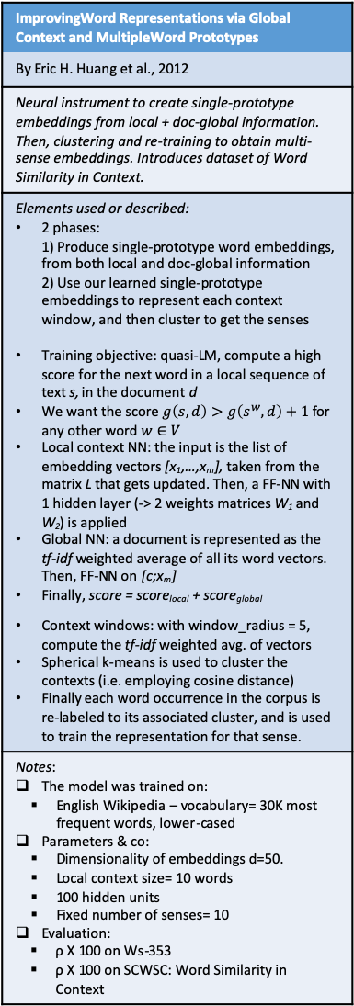
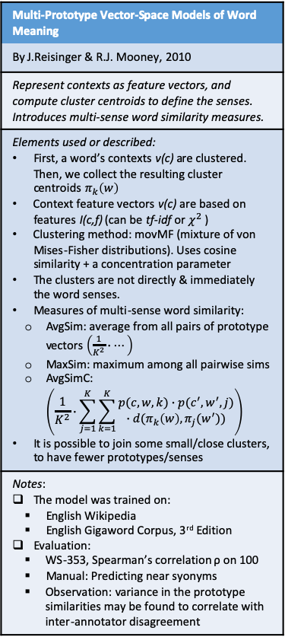
Multi-sense Word Embeddings
Multi-Prototype Vector-Space Models of Word Meaning
By J.Reisinger & R.J. Mooney, 2010
Represent contexts as feature vectors, and compute cluster centroids to define the senses. Introduces multi-sense word similarity measures.
Elements used or described: First, a word’s contexts v(c) are clustered. Then, we collect the resulting cluster centroids $π_{k}\left(w\right)$ Context feature vectors v(c) are based on features I(c,f) (can be tf-idf or $χ^{2}$ ) Clustering method: movMF (mixture of von Mises-Fisher distributions). Uses cosine similarity + a concentration parameter The clusters are not directly & immediately the word senses. Measures of multi-sense word similarity: AvgSim: average from all pairs of prototype vectors $\left(\frac{1}{K^{2}}∙⋯\right)$ MaxSim: maximum among all pairwise sims AvgSimC: $\left(\frac{1}{K^{2}}∙\sum_{j=1}^{K}{\sum_{k=1}^{K}{\begin{aligned}p(c,w,k)∙p(c^{′},w^{′},j) \\ ∙d(π_{k}\left(w\right),π_{j}(w^{′}))\end{aligned}}}\right)$ It is possible to join some small/close clusters, to have fewer prototypes/senses
Notes: The model was trained on: English Wikipedia English Gigaword Corpus, 3rd Edition Evaluation: WS-353, Spearman’s correlation ρ on 100 Manual: Predicting near syonyms Observation: variance in the prototype similarities may be found to correlate with inter-annotator disagreement
ImprovingWord Representations via Global Context and MultipleWord Prototypes
By Eric H. Huang et al., 2012
Neural instrument to create single-prototype embeddings from local + doc-global information. Then, clustering and re-training to obtain multi-sense embeddings. Introduces dataset of Word Similarity in Context.
Elements used or described: 2 phases: 1) Produce single-prototype word embeddings, from both local and doc-global information 2) Use our learned single-prototype embeddings to represent each context window, and then cluster to get the senses Training objective: quasi-LM, compute a high score for the next word in a local sequence of text s, in the document d We want the score $g\left(s,d\right)>g\left(s^{w},d\right)+1$ for any other word $w∈V$ Local context NN: the input is the list of embedding vectors [x₁,…,x_{m}], taken from the matrix L that gets updated. Then, a FF-NN with 1 hidden layer (-> 2 weights matrices W₁ and W₂) is applied Global NN: a document is represented as the tf-idf weighted average of all its word vectors. Then, FF-NN on [c;x_{m}] Finally, score = score_{local} + score_{global} Context windows: with window_radius = 5, compute the tf-idf weighted avg. of vectors Spherical k-means is used to cluster the contexts (i.e. employing cosine distance) Finally each word occurrence in the corpus is re-labeled to its associated cluster, and is used to train the representation for that sense.
Notes: The model was trained on: English Wikipedia – vocabulary= 30K most frequent words, lower-cased Parameters & co: Dimensionality of embeddings d=50. Local context size= 10 words 100 hidden units Fixed number of senses= 10 Evaluation: ρ Χ 100 on Ws-353 ρ Χ 100 on SCWSC: Word Similarity in Context
A Unified Model forWord Sense Representation and Disambiguation
By X.Chen et al., 2014
b
Elements used or described: a
Notes:
Word2Sense
By A.Panigrahi et al., 2019
b
Elements used or described: a
Notes:

Slide 2
Word Sense Disambiguation
Word2Sense
By A.Panigrahi et al., 2019
b
Elements used or described: a
Notes:

Slide 3
Multi-lingual multi-sense embeddings
Word2Sense
By A.Panigrahi et al., 2019
b
Elements used or described: a
Notes:

