Slide 1
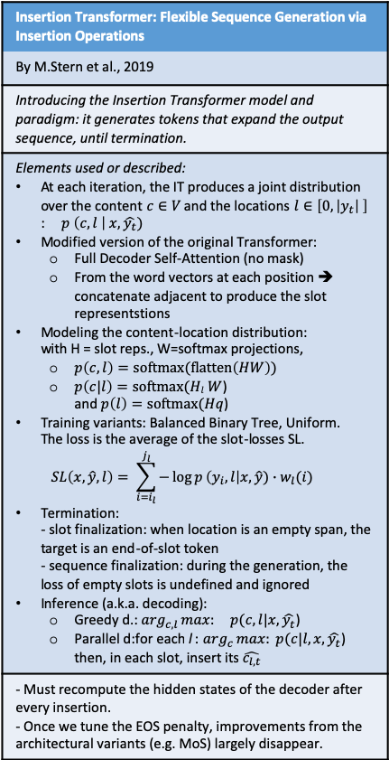
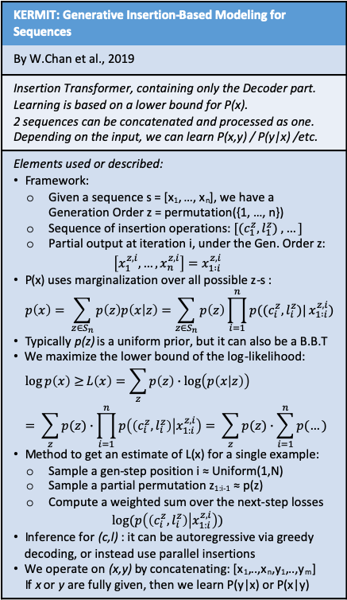
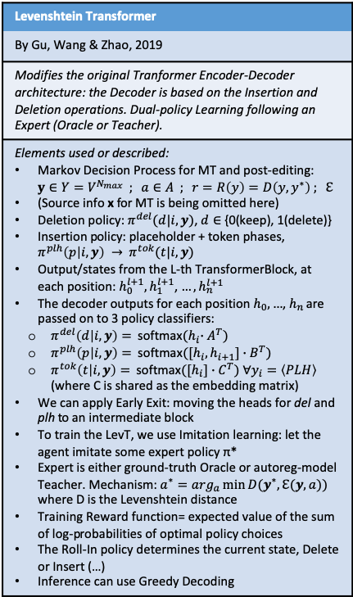
Transformer instruments
Attention Is All You Need
By Vaswani et al., 2017
Introducing the Transformer instrument for Seq2Seq tasks (using Attention alone instead of recursion)
Elements used or described: Encoder + Decoder structure Multi-head self-attention, where: Attention(Q,K,V) = softmax(Q*K^{T} / sqrt(d_{k}) ) * V Layer normalization Feed-forward NNs Positional encoding (adding sinusoidal functions) Adam optimizer Dropout with p_{drop}=0.1 on the output of each sublayer and on (embeddings+PosEncoding) Label smoothing
Note: The model is auto-regressive: when generating text, we include the previous output elements as input
Attention Is All You Need
Mixture-of-Softmaxes (MoS) could be used to go from the word embeddings to the softmax probabilities
What about frequency-agnostic word embeddings (FRAGE) as well?
Character-Level Language Modeling with Deeper Self-Attention
By Al-Rfou et al., 2018
Alternative transformer structure, used for character-level LM
Elements used or described: Transformer layers = 1 multi-head masked self-attention unit + 1 2-layers feed-forward NN 64 transformer layers Auxiliary losses are added during training: - Predicting the intermediate positions in the sequence - Intermediate layers’ predictions - Multiple targets (eg. The 2 subsequent chars at each position) Learned vector of d(eg.512) elements = positional encoding, x L x N
Note: There is no state passed between predictions as in RNN models, so for each character predicted we have to process the context from scratch.
TRANSFORMER-XL: ATTENTIVE LANGUAGE MODELS BEYOND A FIXED-LENGTH CONTEXT
By Dai et al., 2019
Modifying the application of the transformer to LMs: Adding recurrence and relative pos-encoding to extend the context
Elements used or described: Layer h_{(τ+1)}^{n} = FF-NN(self-attention(q, k, v) - q = h_{(τ+1)}^{(n-1)} * W_{q} - k, v = h’_{(τ+1)}^{(n-1)} * W_{k,v} - h’_{(τ+1)}^{(n-1)} = [SG(h_{τ}^{(n-1)} ) ++ h_{(τ+1)}^{(n-1)}] We go from absolute in-segment PosEnc to Relative PosEnc, using a (sinusoidal) predefined matrix R and 2 learned terms u,v Ascore_{τ,i,j}^{n} = q_{i}*k_{j} + q_{i}*W_{k,R}*R_{i-j}+ u*k_{j} + u*W_{k,R}*R_{i-j} Moreover: softmax(A)*v, layerNormalization + skip-connection, FF-NN
Note: Problems addressed: inability to see beyond fixed context length + context fragmentation
Dynamic Evaluation of Transformer Language Models
By Krause et al., 2019
Examining the application of Dynamic Evaluation on the segments of Transformer-XL
Elements used or described: Observe loss on x_{t} at test-time, then use ∇L_{t} to update Sequence segments used for Dyn.Eval. = Sequence segments used to train the Transformer-XL SGD Dynamic Eval, RMS Dynamic Eval (on word-level, without Decay rate)
Note: - On character-level datasets, using L=128 and mCache=3800 - On word-level WikiText -103, using Adaptive Softmax
Dynamic Evaluation of Transformer Language Models
Hybridizing Dynamic Eval & Adaptive Softmax with the Neural Cache Method (n: it may be a current line of research)
Insertion Transformer: Flexible Sequence Generation via Insertion Operations
By M.Stern et al., 2019
Introducing the Insertion Transformer model and paradigm: it generates tokens that expand the output sequence, until termination.
Elements used or described: At each iteration, the IT produces a joint distribution over the content $c∈V$ and the locations $l∈\left[0,\left|y_{t}\right| \right]$ : $p \left(c,l \right| x, \hat{y_{t}})$ Modified version of the original Transformer: Full Decoder Self-Attention (no mask) From the word vectors at each position ➔ concatenate adjacent to produce the slot representstions Modeling the content-location distribution: with H = slot reps., W=softmax projections, $p\left(c,l\right)=softmax(flatten\left(HW\right))$ $p\left(c|l\right)=softmax(Hl W$) and $p\left(l\right)=softmax(Hq$) Training variants: Balanced Binary Tree, Uniform. The loss is the average of the slot-losses SL. $SL\left(x,\hat{y},l\right)= \sum_{i=i_{l}}^{j_{l}}{−\log{p}\left(y_{i},l\right|x,\hat{y})∙w_{l}(i)}$ Termination: - slot finalization: when location is an empty span, the target is an end-of-slot token - sequence finalization: during the generation, the loss of empty slots is undefined and ignored Inference (a.k.a. decoding): Greedy d.: $\arg_{c,l}max:{ p(c,l|x, \hat{y_{t}}}$) Parallel d:for each l : $\arg_{c}max:{ p(c|l,x, \hat{y_{t}}}$) then, in each slot, insert its $\hat{c_{l,t}}$
- Must recompute the hidden states of the decoder after every insertion. - Once we tune the EOS penalty, improvements from the architectural variants (e.g. MoS) largely disappear.
Insertion Transformer
Can be useful for translation. I would not think that the next-word prediction of Language Modeling needs this; to catch words in the sentence that the user has deleted, we may just use a Masked LM (similarly to BERT)..
KERMIT: Generative Insertion-Based Modeling for Sequences
By W.Chan et al., 2019
Insertion Transformer, containing only the Decoder part. Learning is based on a lower bound for P(x). 2 sequences can be concatenated and processed as one. Depending on the input, we can learn P(x,y) / P(y|x) /etc.
Elements used or described: Framework: Given a sequence s = [x₁, …, x_{n}], we have a Generation Order z = permutation({1, …, n}) Sequence of insertion operations: $[(c_{1}^{z},l_{1}^{z}) , …]$ Partial output at iteration i, under the Gen. Order z: $\left[x_{1}^{z,i},…, x_{n}^{z,i}\right]=x_{1 :i}^{z,i}$ P(x) uses marginalization over all possible z-s : $p\left(x\right)= \sum_{z∈S_{n}}{p\left(z\right)p\left(x | z\right)}=\sum_{z∈S_{n}}{p\left(z\right)\prod_{i=1}^{n}{p((c_{i}^{z},l_{i}^{z})|}}x_{1 :i}^{z,i})$ Typically p(z) is a uniform prior, but it can also be a B.B.T We maximize the lower bound of the log-likelihood: $\log{p\left(x\right)≥}L\left(x\right)=\sum_{z}{p\left(z\right)∙\log\left(p\left(x | z\right)\right)}= \sum_{z}{p(z)∙\prod_{i=1}^{n}{p\left(\left(c_{i}^{z},l_{i}^{z}\right) | x_{1:i}^{z,i}\right)= \sum_{z}{p(z)∙\sum_{i=1}^{n}{p(…)}}}}$ Method to get an estimate of L(x) for a single example: Sample a gen-step position i ≈ Uniform(1,N) Sample a partial permutation z_{1:i-1} ≈ p(z) Compute a weighted sum over the next-step losses $log⁡(p\left(\left(c_{i}^{z},l_{i}^{z}\right) | x_{1:i}^{z,i}\right))$ Inference for (c,l) : it can be autoregressive via greedy decoding, or instead use parallel insertions We operate on (x,y) by concatenating: [x₁,..,x_{n},y₁,..,y_{m}] If x or y are fully given, then we learn P(y|x) or P(x|y)
Levenshtein Transformer
By Gu, Wang & Zhao, 2019
Modifies the original Tranformer Encoder-Decoder architecture: the Decoder is based on the Insertion and Deletion operations. Dual-policy Learning following an Expert (Oracle or Teacher).
Elements used or described: Markov Decision Process for MT and post-editing: $y∈Y=V^{N_{max}} ; a∈A ; r=R\left(y\right)=D\left(y,y^{∗}\right) ; ℇ$ (Source info x for MT is being omitted here) Deletion policy: $π^{del}(d|i,y)$, $d∈$ {0(keep), 1(delete)} Insertion policy: placeholder + token phases, $π^{plh}\left(p | i,y\right) →$ $π^{tok}(t|i,y)$ Output/states from the L-th TransformerBlock, at each position: $h_{0}^{l+1},h_{1}^{l+1}$,$…, h_{n}^{l+1}$ The decoder outputs for each position $h_{0}, …$, $h_{n}$are passed on to 3 policy classifiers: $π^{del}\left(d | i,y\right)=$ softmax${(h}_{i}∙A^{T})$ $π^{plh}\left(p | i,y\right)=$ softmax${([h}_{i},h_{i+1}]∙B^{T})$ $π^{tok}\left(t | i,y\right)=$ softmax${([h}_{i}]∙C^{T}) ∀y_{i}=\left\langle PLH\right\rangle$ (where C is shared as the embedding matrix) We can apply Early Exit: moving the heads for del and plh to an intermediate block To train the LevT, we use Imitation learning: let the agent imitate some expert policy π* Expert is either ground-truth Oracle or autoreg-model Teacher. Mechanism: $a^{∗}=\arg_{a}\min{D(y^{∗},ℇ(y,a))}$ where D is the Levenshtein distance Training Reward function= expected value of the sum of log-probabilities of optimal policy choices The Roll-In policy determines the current state, Delete or Insert (…) Inference can use Greedy Decoding

Slide 2
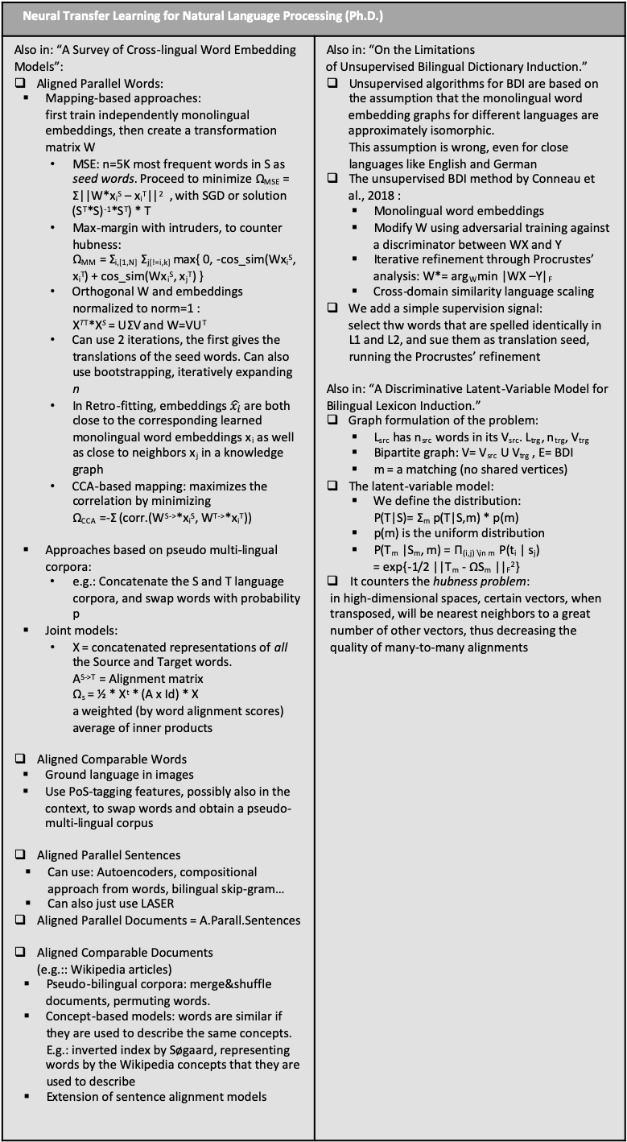
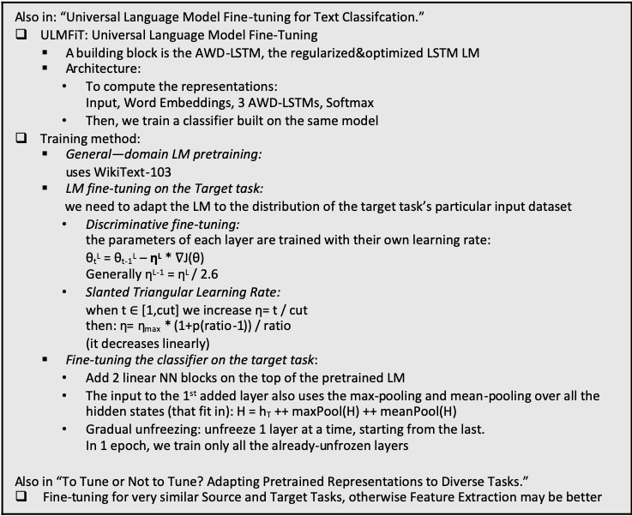
Transfer Learning
Neural Transfer Learning for Natural Language Processing (Ph.D.)
By Sebastian Ruder, February 2019
Transfer Learning is defined over domains {X, P(X)} and tasks {Y,P(Y)}, of a source and a target problem. P(Xs) != P(Xt) --> Domain adaptation Ys != Yt --> different tasks, Multi-Task Learning or Sequential Learning Xs != Xt --> Cross-lingual learning (n: Pretrained word representations == Implicit transfer learning).
Also in: “An Overview of Multi-Task Learning in Deep Neural Networks” MTL in NNs: - Hard parameter sharing: m layers of the NN are fully shared, followed by separate task-specific layers - Soft parameter sharing: m layers are not shared, but they are constrained, we minimize the distance between them (eg. L2 regularization) MTL in non-neural models: we define a matrix A_{dxT} of features x models. - Block-sparse L1Lq regularization - Clustering of tasks: we can use the following penalties: Ω_{mean} = ||ā||² Ω_{Ccloseness} = Σ |C_{k}|*||ā_{k} - ā||² Ω_{within} = Σ_{k} Σ_{t_in_k} ||ā_{.,t} - ā_{k}||² It is possible to use a hierarchy of tasks, and/or weights λ Types of auxiliary tasks: - Statistical a.ts.: predicting aspects of the input data - Selective unsupervised a.ts.: focusing on specific features/elements, such as sentiment words - Supervised a.ts.: Adversarial, Inverse task, Quantization smoothing - Unsupervised a.ts.: Representation Learning, Conditioning the Initial state | On Sequential Learning: - Source and Target Task are performed separately, in sequence - Pretraining phase -> Adaptation phase - Ideal: universal representations Unsupervised pretraining: - LSA: Latent Semantic Analysis C → P → UΣV → U_{k}Σ_{k} = X - Brown clustering: P(w_{i+1}|w_{i}) = P(c_{i+1}|c_{i})*P(w_{i+1}|c_{i+1}) & greedy algorithm for classes (s. AMI) - Word2vec: SGNS and CBOW - GLObal Vectors: uses the ratios of probabilities of occurrence in a context, for a NN loss function - Deep pretrained LMs, eg. Autoencoding on sentences Distantly supervised pretraining: - The model can focus on/learn one element (eg. Emoticons in sentiment analysis, punctuation in tokenization) Supervised pretraining: eg. Train NMT on 2 high-resource languages, then transfer Adaptation: can be: - Feature extraction: we freeze the source M, and provide its representations as additional input to the target M - Fine-tuning: the pretrained reps. Are used as initialization - Residual adapters: interleave mini-layers Lifelong learning: sequential chain of multiple tasks, stores info in KB
Neural Transfer Learning for Natural Language Processing (Ph.D.)
Also in: “A Survey of Cross-lingual Word Embedding Models”: Aligned Parallel Words: Mapping-based approaches: first train independently monolingual embeddings, then create a transformation matrix W MSE: n=5K most frequent words in S as seed words. Proceed to minimize Ω_{MSE} = Σ||W*x_{i}^{S} – x_{i}^{T}||² , with SGD or solution (S^{T}*S)⁻¹*S^{T}) * T Max-margin with intruders, to counter hubness: Ω_{MM} = Σ_{i,[1,N]} Σ_{j[!=i,k]} max{ 0, -cos_sim(Wx_{i}^{S}, x_{i}^{T}) + cos_sim(Wx_{i}^{S}, x_{j}^{T}) } Orthogonal W and embeddings normalized to norm=1 : X^{TT}*X^{S} = UΣV and W=VU^{T} Can use 2 iterations, the first gives the translations of the seed words. Can also use bootstrapping, iteratively expanding n In Retro-fitting, embeddings $\hat{x_{i}}$are both close to the corresponding learned monolingual word embeddings x_{i} as well as close to neighbors x_{j} in a knowledge graph CCA-based mapping: maximizes the correlation by minimizing Ω_{CCA} =-Σ (corr.(W^{S->}*x_{i}^{S}, W^{T->}*x_{i}^{T})) Approaches based on pseudo multi-lingual corpora: e.g.: Concatenate the S and T language corpora, and swap words with probability p Joint models: X = concatenated representations of all the Source and Target words. A^{S->T} = Alignment matrix Ω_{s} = ½ * X^{t} * (A x Id) * X a weighted (by word alignment scores) average of inner products Aligned Comparable Words Ground language in images Use PoS-tagging features, possibly also in the context, to swap words and obtain a pseudo-multi-lingual corpus Aligned Parallel Sentences Can use: Autoencoders, compositional approach from words, bilingual skip-gram… Can also just use LASER Aligned Parallel Documents = A.Parall.Sentences Aligned Comparable Documents (e.g.:: Wikipedia articles) Pseudo-bilingual corpora: merge&shuffle documents, permuting words. Concept-based models: words are similar if they are used to describe the same concepts. E.g.: inverted index by Søgaard, representing words by the Wikipedia concepts that they are used to describe Extension of sentence alignment models | Also in: “On the Limitations of Unsupervised Bilingual Dictionary Induction.” Unsupervised algorithms for BDI are based on the assumption that the monolingual word embedding graphs for different languages are approximately isomorphic. This assumption is wrong, even for close languages like English and German The unsupervised BDI method by Conneau et al., 2018 : Monolingual word embeddings Modify W using adversarial training against a discriminator between WX and Y Iterative refinement through Procrustes’ analysis: W*= arg_{W}min |WX –Y|_{F} Cross-domain similarity language scaling We add a simple supervision signal: select thw words that are spelled identically in L1 and L2, and sue them as translation seed, running the Procrustes’ refinement Also in: “A Discriminative Latent-Variable Model for Bilingual Lexicon Induction.” Graph formulation of the problem: L_{src} has n_{src} words in its V_{src}. L_{trg}, n_{trg}, V_{trg} Bipartite graph: V= V_{src} U V_{trg} , E= BDI m = a matching (no shared vertices) The latent-variable model: We define the distribution: P(T|S)= Σ_{m} p(T|S,m) * p(m) p(m) is the uniform distribution P(T_{m} |S_{m}, m) = Π_{(i,j) \in m} P(t_{i} | s_{j}) = exp{-1/2 ||T_{m} - ΩS_{m} ||_{F}²} It counters the hubness problem: in high-dimensional spaces, certain vectors, when transposed, will be nearest neighbors to a great number of other vectors, thus decreasing the quality of many-to-many alignments
Neural Transfer Learning for Natural Language Processing (Ph.D.)
More references: Smith et al. [2017] and Hauer et al. [2017] propose a method that creates seed lexicons by identifying cognates in the vocabularies of related languages. Retro-fitting [Faruqui et al., 2015], which is used to inject knowledge from semantic lexicons into pretrained word embeddings. Mrksic et al. [2017] similarly derive cross-lingual synonymy and antonymy constraints from BabelNet An off-the-shelf word embedding algorithm [Bojanowski et al., 2017 From a practical point of view, bilingual dictionaries have found uses in a myriad of NLP tasks ranging from machine translation [Klementiev et al., 2012a] to cross-lingual named entity recognition [Mayhew et al., 2017] Søgaard et al. [2018] demonstrated that monolingual embedding spaces are not approximately isomorphic and that there is a complex relationship between word form and meaning, which is only inadequately modeled by current approaches, which for example cannot model polysemy
Ideas: - Using retro-fitting or similar on a knowledge graph, or KB
Note: the method they propose is for Bilingual Dictionary Induction.
But since I can use Ordbogen’s dictionaries and others(BabelNet,etc.), then BDI is redundant. I can already work with its solution, and focus on something else (LM, NMT, etc.)
Also in: “Universal Language Model Fine-tuning for Text Classifcation.” ULMFiT: Universal Language Model Fine-Tuning A building block is the AWD-LSTM, the regularized&optimized LSTM LM Architecture: To compute the representations: Input, Word Embeddings, 3 AWD-LSTMs, Softmax Then, we train a classifier built on the same model Training method: General—domain LM pretraining: uses WikiText-103 LM fine-tuning on the Target task: we need to adapt the LM to the distribution of the target task’s particular input dataset Discriminative fine-tuning: the parameters of each layer are trained with their own learning rate: θ_{t}^{L} = θ_{t-1}^{L} – η^{L} * $∇\text{J}\text{(}\text{θ}\text{)}$ Generally η^{L-1} = η^{L} / 2.6 Slanted Triangular Learning Rate: when t $∈$ [1,cut] we increase η= t / cut then: η= η_{max} * (1+p(ratio-1)) / ratio (it decreases linearly) Fine-tuning the classifier on the target task: Add 2 linear NN blocks on the top of the pretrained LM The input to the 1st added layer also uses the max-pooling and mean-pooling over all the hidden states (that fit in): H = h_{T} ++ maxPool(H) ++ meanPool(H) Gradual unfreezing: unfreeze 1 layer at a time, starting from the last. In 1 epoch, we train only all the already-unfrozen layers Also in “To Tune or Not to Tune? Adapting Pretrained Representations to Diverse Tasks.” Fine-tuning for very similar Source and Target Tasks, otherwise Feature Extraction may be better
Some basic Concepts | NLP Tasks
Pearson correlation coefficient: Pcc(X,Y) = Covariance(X,Y) / (σ_{x} σ_{y}) Self-information of an event x : I(x)= -log P(x) Entropy : H(x) = E_{x~P}[I(x)] = - E_{x~P}[log P(x)] KL divergence = E_{x~P}[ log( P(x)/Q(x) )] RNNs, LSTMs CNNs: operates on the concatenation of input word embeddings x_{i}. 1 filter over the window x_{i}:x_{i+K-1} produces a value c_{i}. Having obtained a feature map (vector) c, we apply max-pooling or avg-pooling. Multiple filters -> multiple values ç. Autoencoder: x->z->x’, minimize reconstruction loss | PoS tagging: tags are noun, verb, adjective, etc. They can very between languages Named Entity Recognition: Person, Location etc. Current Systems do not generalize well to specific domains, so there are legal/medical/etc. corpora Semantic Role Labeling: defining entities as Agent/Goal/Result in the predicate-argument structure of a sentence Dependency parsing Topic classification, and Sentiment Analysis Language Modeling Blingual dictionary induction: word-to-word translation, generally from dictionaries not from sentences, does not account for multiple meanings

Slide 3
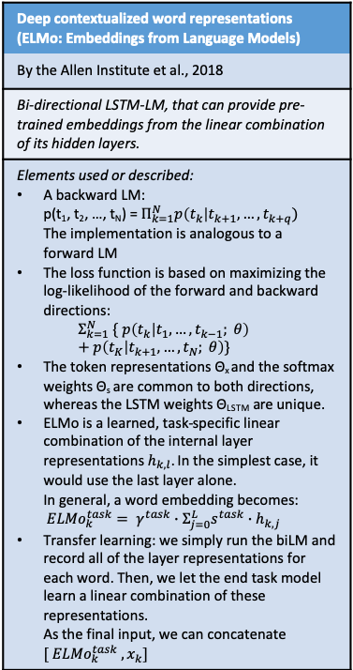
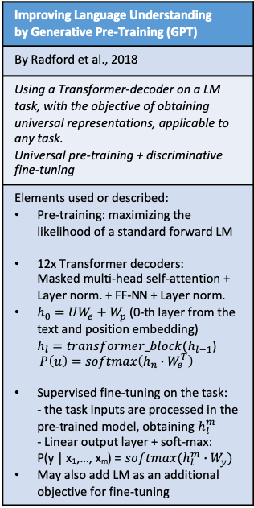
On Word Embeddings and Transfer Learning
Improving Language Understanding by Generative Pre-Training (GPT)
By Radford et al., 2018
Using a Transformer-decoder on a LM task, with the objective of obtaining universal representations, applicable to any task. Universal pre-training + discriminative fine-tuning
Elements used or described: Pre-training: maximizing the likelihood of a standard forward LM 12x Transformer decoders: Masked multi-head self-attention + Layer norm. + FF-NN + Layer norm. $h_{0}=UW_{e}+W_{p}$ (0-th layer from the text and position embedding) $h_{l}=transformer_block(h_{l−1}$) $P\left(u\right)=softmax\left(h_{n}∙W_{e}^{T}\right)$ Supervised fine-tuning on the task: - the task inputs are processed in the pre-trained model, obtaining $h_{l}^{m}$ - Linear output layer + soft-max: P(y | x₁,…, x_{m}) = $softmax(h_{l}^{m}∙W_{y})$ May also add LM as an additional objective for fine-tuning
Language Models are Unsupervised Multitask Learners (GPT-2)
By Radford, Wu et al., 2019
Training a large-scale LM on a new large dataset (WebText), and using it as an unsupervised instrument for different tasks.
Elements used or described: WebText: obtained by scraping all the outbound Reddit links with 3+ karma. Removed Wikipedia pages to avoid overlaps. 8+ million documents Model: transformer, based on the OpenAI GPT. Byte Pair Encoding, that uses both word-level and char-level input 12/24/36/48 layers, going from 117M to 1542M parameters Improves: WT2, PTB. Worse: 1BillW ~(improves only on largest): WT103
BERT: Pre-training of Deep Bidirectional Transformers for Language Understanding
By Devlin et al., 2017
Transformer-based architecture for pre-training in Sequential Learning. Through MLM, a bidirectional language model incorporates both left and right side of the context.
Elements used or described: 2 phases: pre-train on unlabeled data + fine-tune on labeled data of target task Multi-layer transformer encoder Input = Position encoding + sentence ID + token embedding ; start with [CLS], separate sentences with [SEP] Pretraining 1: Masked Language Model Randomly mask 15% of the input tokens, and predict them Pretraining 2: Binarized Next Sentence Prediction For Finetuning: we add 1 output layer with Softmax, and just plug in the target task’s inputs and outputs
Trained on BookCorpus + English Wikipedia Vocabulary size=30,000
BERT
In Write-assistant, a possible use case is that the user deletes a word in the middle of an already-written sentence. If there is context on both sides, a BERT-line LM could predict that word.
ALBERT- A Lite BERT for Self-supervised Learning of Language Representations
by Z.Lan et al. 2019
Modifying BERT’s architecture and loss, in order to achieve the same performance with fewer parameters (e.g. 18M vs 108M)
The backbone of the ALBERT architecture is similar to BERT, it uses transformer encoder blocks (Self-attention + FF-NN) BERT notation conventions: E=size of embeddings in the vocabulary L = n. of encoder layers H = size of the hidden layers Like in BERT, n. of attention heads = H/64
Modification 1: Factorized embedding parameterization. In BERT the WordPiece embedding size E is tied with the hidden layer size H, i.e. E = H We decompose the embedding parameters into two smaller matrices, reducing the n. of params. from O(V x H) to O(V x E + E x H). The reduction is significant when H >> E. Modification 2: Cross-layer parameter sharing Both FF-NNs and Self-attention Most of the performance drop appears to come from sharing the FFN-layer parameters, while sharing the attention parameters results in only a slight drop Modification 3: BERT‘s additional loss is the Next-Sentence Prediction. NSP is a binary classification loss for predicting whether two segments appear consecutively in the original text We use SOP, Sentence-Order Prediction loss. Positive es.: S1, S2. Negative es.: S2, S1
As BERT, Trained on BookCorpus + English Wikipedia ; Vocabulary size=30,000 MLM targets selected using n-gram masking (max n=3) Batch size=4096
Deep contextualized word representations (ELMo: Embeddings from Language Models)
By the Allen Institute et al., 2018
Bi-directional LSTM-LM, that can provide pre-trained embeddings from the linear combination of its hidden layers.
Elements used or described: A backward LM: p(t₁, t₂, …, t_{N}) = $Π_{k=1}^{N}p\left(t_{k}\right|t_{k+1}, …, t_{k+q})$ The implementation is analogous to a forward LM The loss function is based on maximizing the log-likelihood of the forward and backward directions: $Σ_{k=1}^{N} \{ p\left(t_{k} | t_{1},…,t_{k−1}; θ\right)+p\left(t_{K} | t_{k+1},…,t_{N}; θ\right)\}$ The token representations Θ_{x} and the softmax weights Θ_{s} are common to both directions, whereas the LSTM weights Θ_{LSTM} are unique. ELMo is a learned, task-specific linear combination of the internal layer representations $h_{k,l}$. In the simplest case, it would use the last layer alone. In general, a word embedding becomes: ${ELMo}_{k}^{task}= γ^{task}∙Σ_{j=0}^{L}s^{task}∙h_{k,j}$ Transfer learning: we simply run the biLM and record all of the layer representations for each word. Then, we let the end task model learn a linear combination of these representations. As the final input, we can concatenate $[ {{ELMo}_{k}^{task} ,x}_{k}]$
ELMo
Here bi-directional means only (forward + backward). A Masked LM, like in BERT, can be considered superior for filling spots in the text.

