Slide 1
Gamma-ray burst classification
Andrea Marcone
Introduction to Bayesian probability theory
21/04/2026

Slide 2
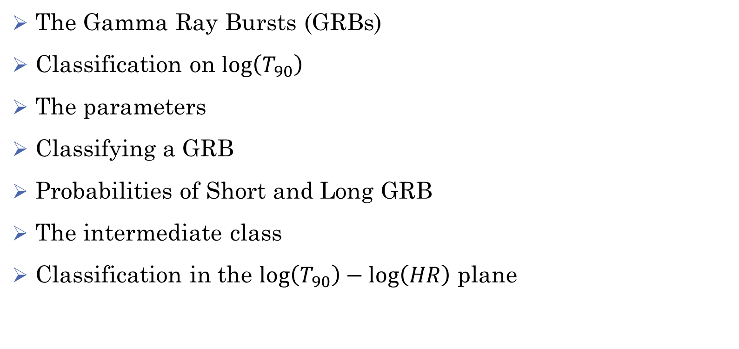
Index
The Gamma Ray Bursts (GRBs)
Classification on $\log\left(T_{90}\right)$
The parameters
Classifying a GRB
Probabilities of Short and Long GRB
The intermediate class
Classification in the $\log\left(T_{90}\right)−\log\left(HR\right)$ plane

Slide 3
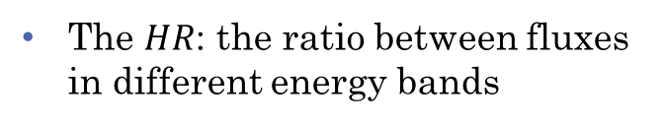
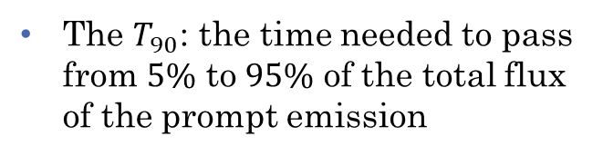
The Gamma Ray Bursts (GRBs)
They are transient events of high energy photons and extragalactic origin, discovered in 1973
They are usually composed of a first peak (prompt emission) and then an afterglow
We will use two proprieties to classify them:
The $T_{90}$: the time needed to pass from $5\%$ to $95\%$ of the total flux of the prompt emission
The $HR$: the ratio between fluxes in different energy bands
Tipical light curve of a GRB? Or artistic representation?

Slide 4
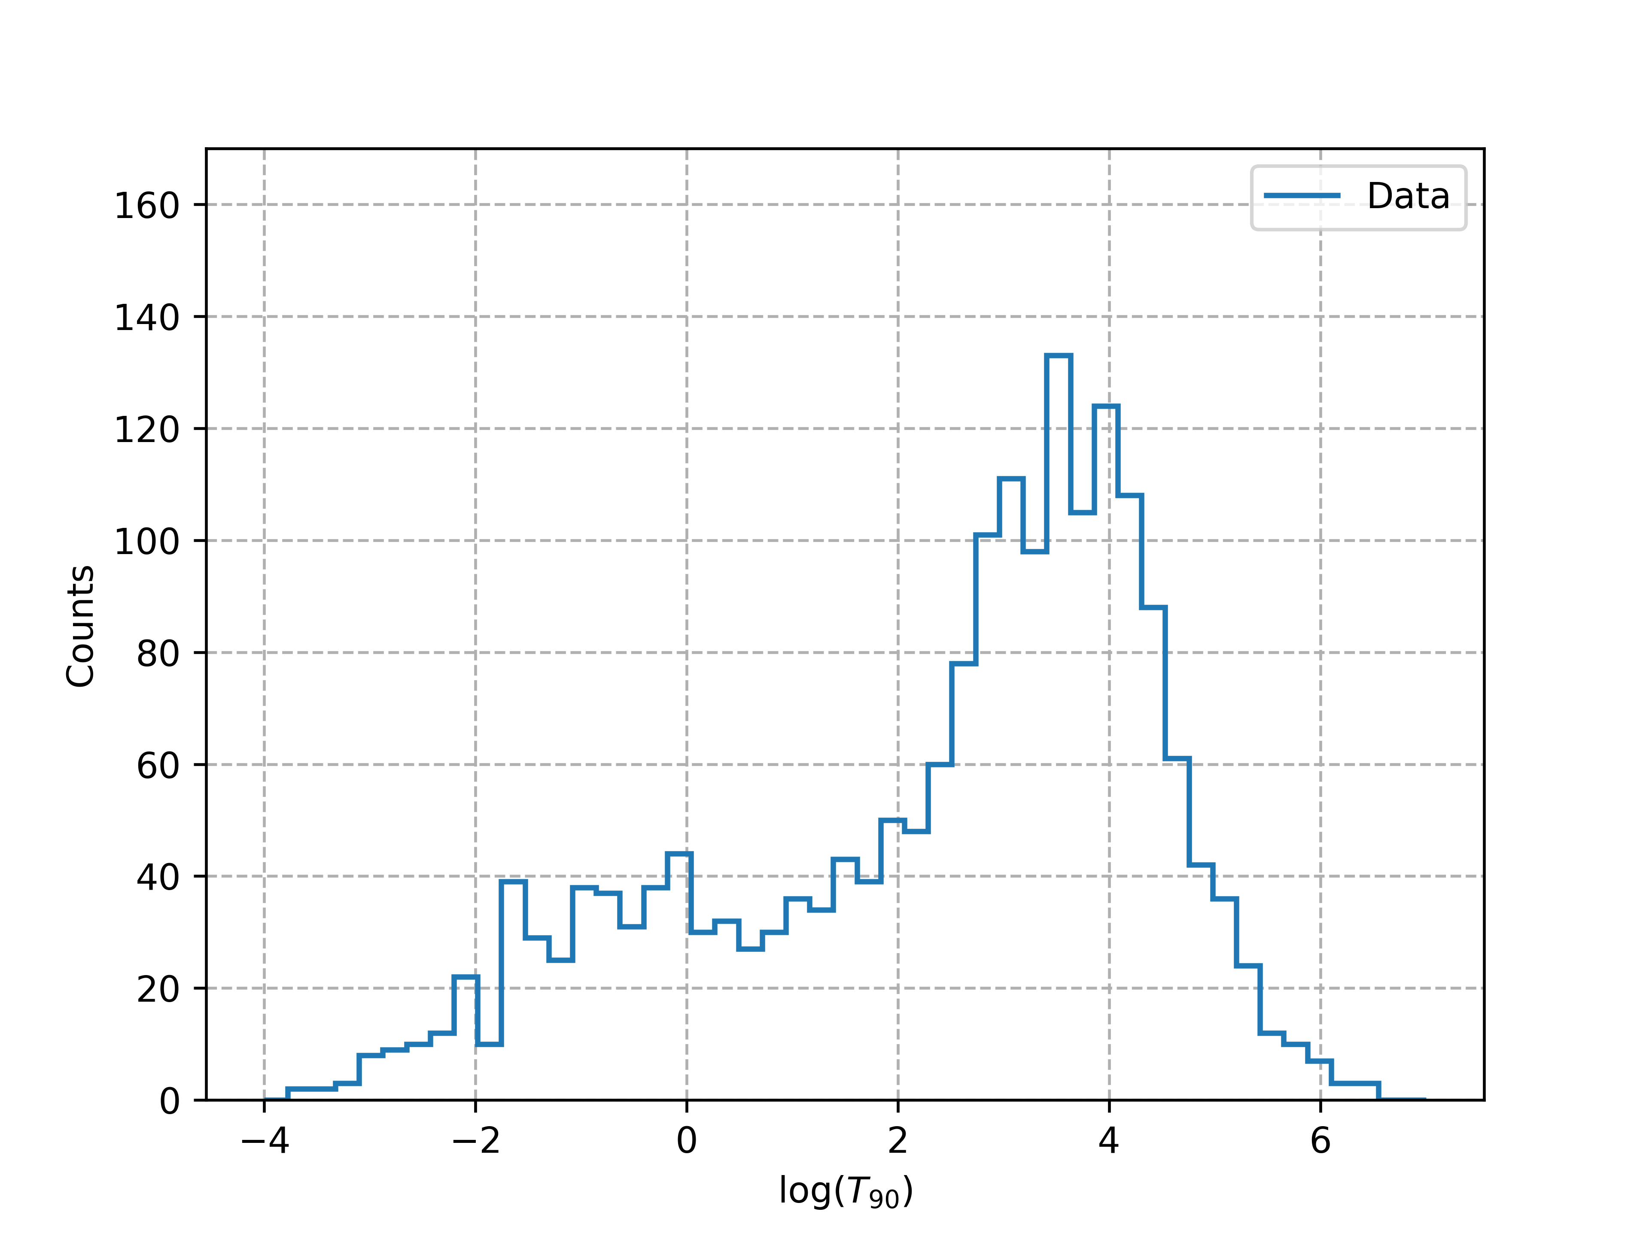



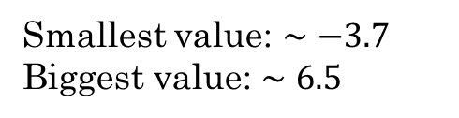
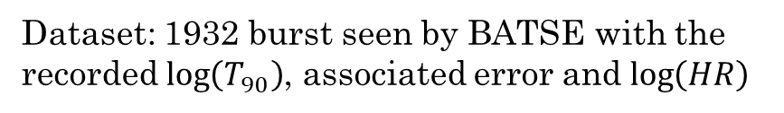
Classification on $\log\left(T_{90}\right)$: data
Dataset: 1932 burst seen by BATSE with the recorded $\log\left(T_{90}\right)$, associated error and $\log\left(HR\right)$
Histogram on $\log\left(T_{90}\right)$
Smallest value: $∼−3.7$ Biggest value: $∼6.5$
$50$ bins from $−4$to $7$
Mean error is: 0.174
Median error is: 0.0919
A bin is large 0.224

Slide 5

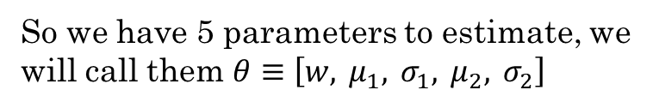
Classification on $\log\left(T_{90}\right)$: model
The model for the classification is the weighted sum of two log normal distribution
$$p\left(\log\left(T_{90}\right)\right)=w N\left(\log\left(T_{90}\right) | μ_{1}σ_{1}\right)+\left(1−w\right) N\left(\log\left(T_{90}\right) | μ_{2}σ_{2}\right)$$
So we have 5 parameters to estimate, we will call them $θ≡\left[w, μ_{1}, σ_{1}, μ_{2}, σ_{2}\right]$

Slide 6
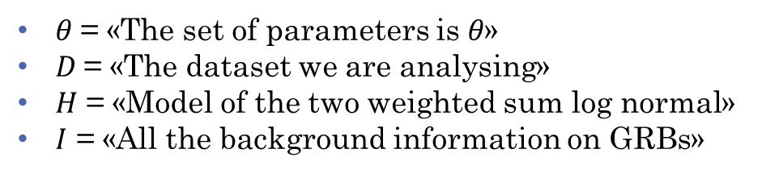

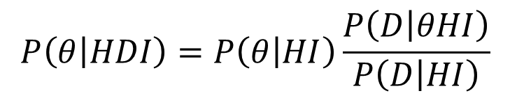
Classification on $\log\left(T_{90}\right)$: Bayes theorem
To estimate the parameters we will use Bayes theorem, define the propositions
$θ$= «The set of parameters is $θ$»
$D$= «The dataset we are analysing»
$H$ = «Model of the two weighted sum log normal»
$I$ = «All the background information on GRBs»
$$P\left(θ | HDI\right)=P\left(θ | HI\right)\frac{P\left(D | θHI\right)}{P\left(D | HI\right)}$$
Or in the log form:
$$\log{P}\left(θ | HDI\right)=\log{P}\left(θ | HI\right)+\log{P}\left(D | θHI\right)−\log{P}\left(D | HI\right)$$
Log prior
Log likelihood
Normalization costant

Slide 7







Classification on $\log\left(T_{90}\right)$: Prior
$$P\left(θ | HI\right)$$
Probability for a set of parameters given the model and background. Outside of the bounds is zero, inside?
For the weight and the means we chose a uniform prior
$$0<w<1$$
$$Prior ∝1$$
$$−4<μ_{i}<7$$
For the sigmas we chose a Jeffrey’s prior because this are scale parameters of the problem
$$0.01<σ_{i}<3$$
$$Prior ∝1/σ$$

Slide 8

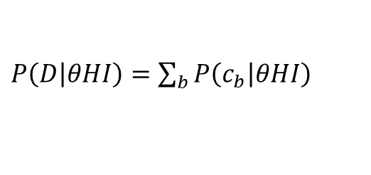

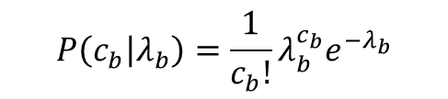
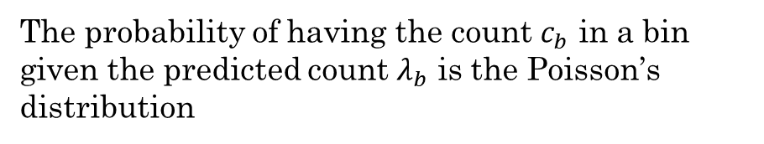

Classification on $\log\left(T_{90}\right)$: Likelihood
$$P\left(D | θHI\right)$$
Probability of seeing the dataset given a set of parameters, the model and background
Having the model, the parameters and the bins we can compute the predicted count in a bin by our model
$$λ_{b}=N⋅p{\left(\log\left(T_{90}\right)\right)}_{b}⋅db$$
The probability of having the count $c_{b}$ in a bin given the predicted count $λ_{b}$ is the Poisson’s distribution
$$P\left(c_{b} | λ_{b}\right)=\frac{1}{c_{b}!}λ_{b}^{c_{b}}e^{−λ_{b}}$$
The likelihood is the sum over all the bins!
$P\left(D | θHI\right)=\sum_{b}{P\left(c_{b} | θHI\right)}$

Slide 9


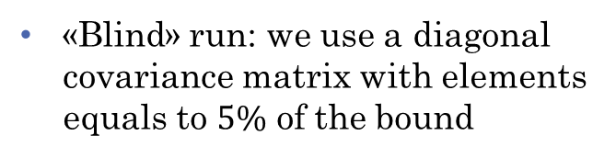
Sample the posterior: Metropolis-Hasting
Given a set of parameters we can now compute the posterior. How we find the set that maximize it?
5D grid search: not smart
Metropolis-Hasting algorithm!
$q\left(θ\right)$ is the proposal distribution
Base idea
We chose a 5D multivariate gaussian but how we chose his covariance matrix?
Sample a $θ_{t}$ from $q\left(θ_{0}\right)$
«Blind» run: we use a diagonal covariance matrix with elements equals to $5\%$ of the bound
«Not Blind» run: we use a covariance matrix estimated after a previous run

Slide 10
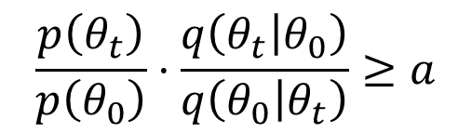
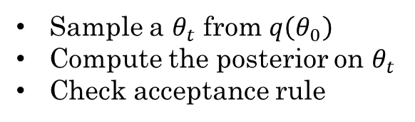
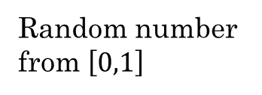
Sample the posterior: Metropolis-Hasting
Given a set of parameters we can now compute the posterior. How we find the set that maximize it?
5D grid search: not smart
Metropolis-Hasting algorithm!
Acceptance rule:
Base idea
$$\frac{p\left(θ_{t}\right)}{p\left(θ_{0}\right)}⋅\frac{q\left(θ_{t} | θ_{0}\right)}{q\left(θ_{0} | θ_{t}\right)}≥a$$
Sample a $θ_{t}$ from $q\left(θ_{0}\right)$
Compute the posterior on $θ_{t}$
Check acceptance rule
Random number from $\left[0,1\right]$
Posterior values
Proposal probability ratio
ours is symmetric so it’s one

Slide 11
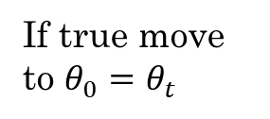
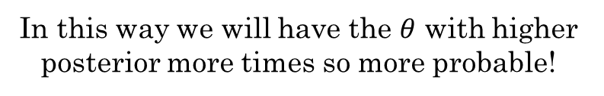

Sample the posterior: Metropolis-Hasting
Given a set of parameters we can now compute the posterior. How we find the set that maximize it?
5D grid search: not smart
Metropolis-Hasting algorithm!
Base idea
We make a first «blind» run of the algorithm with 10k steps to estimate the covariance
Sample a $θ_{t}$ from $q\left(θ_{0}\right)$
Compute the posterior on $θ_{t}$
Check acceptance rule
If true move to $θ_{0}=θ_{t}$
If false stay at $θ_{0}$
We then make the final run with 100k steps
In this way we will have the $θ$ with higher posterior more times so more probable!

Slide 12
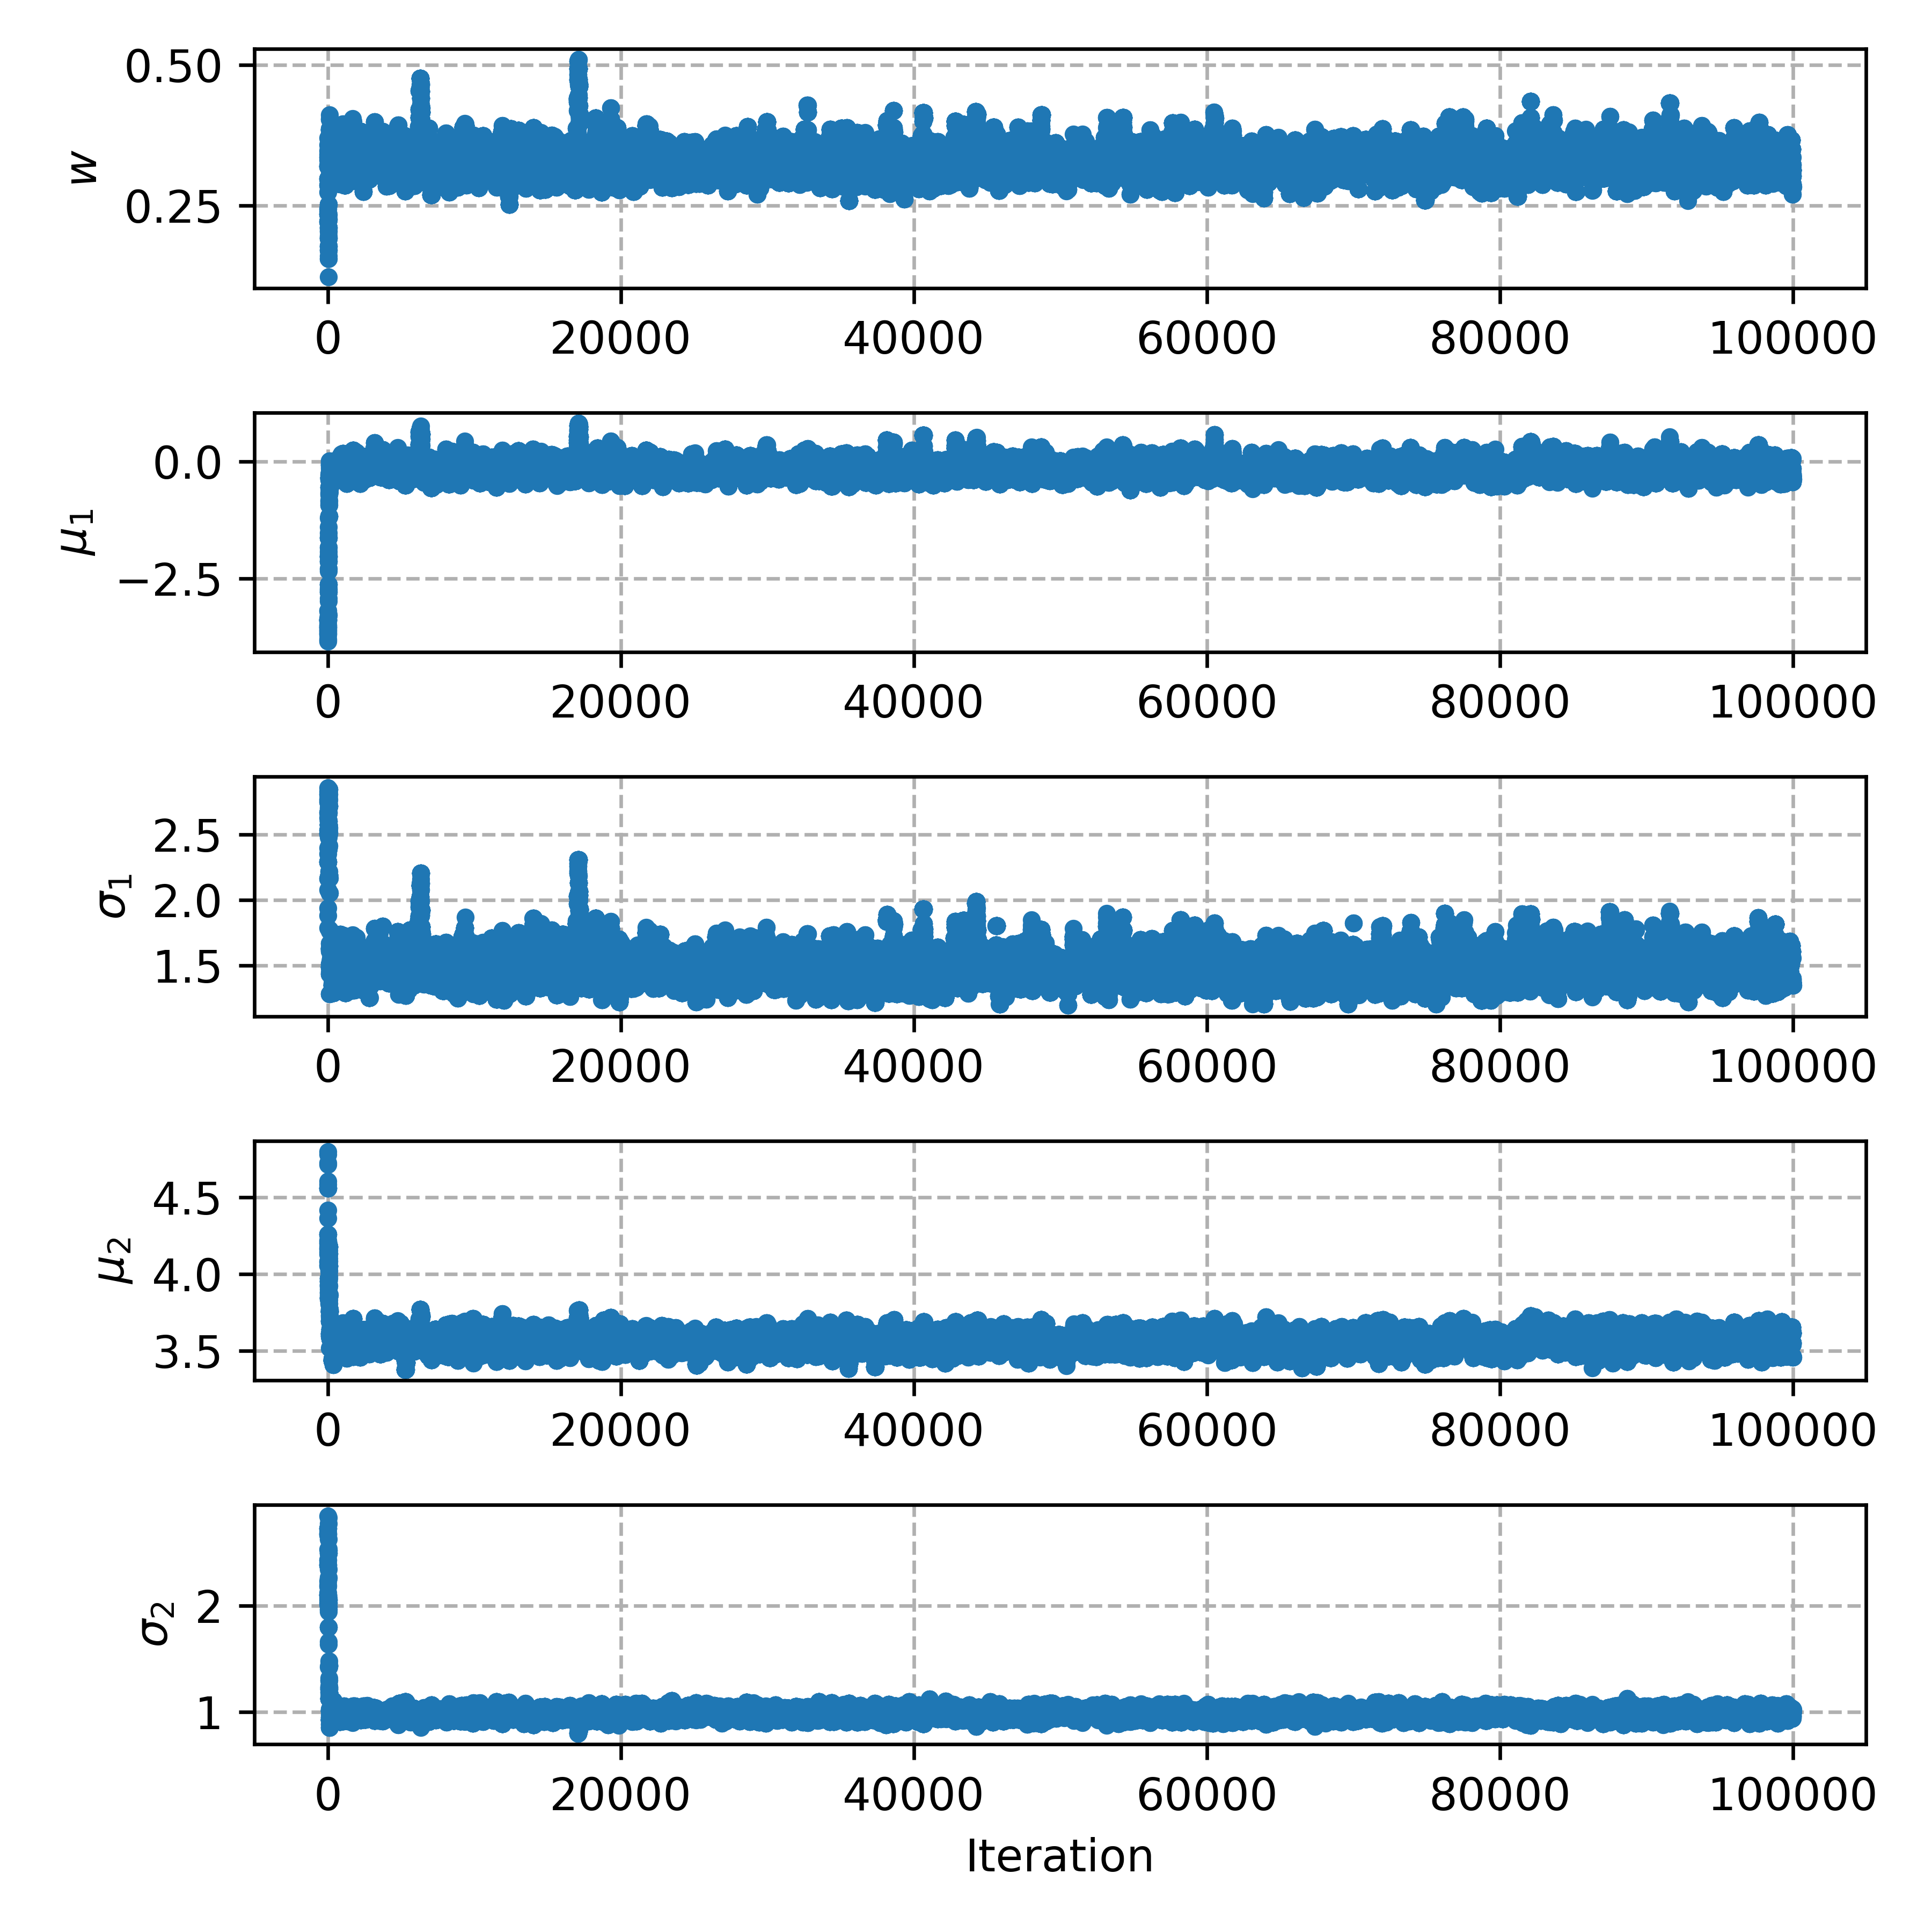
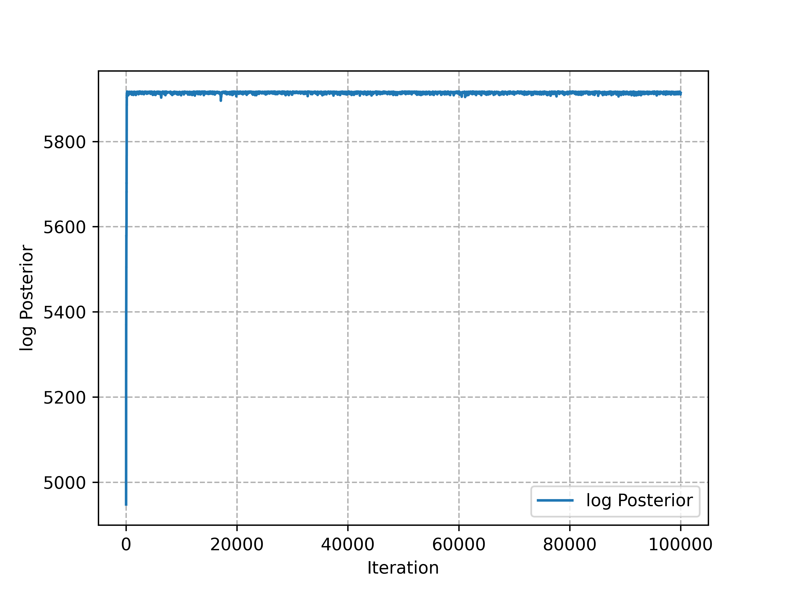

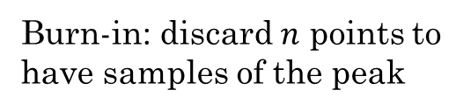
Classification on $\log\left(T_{90}\right)$: traces
We see that some steps are needed to find the peak
Burn-in: discard $n$ points to have samples of the peak

Slide 13
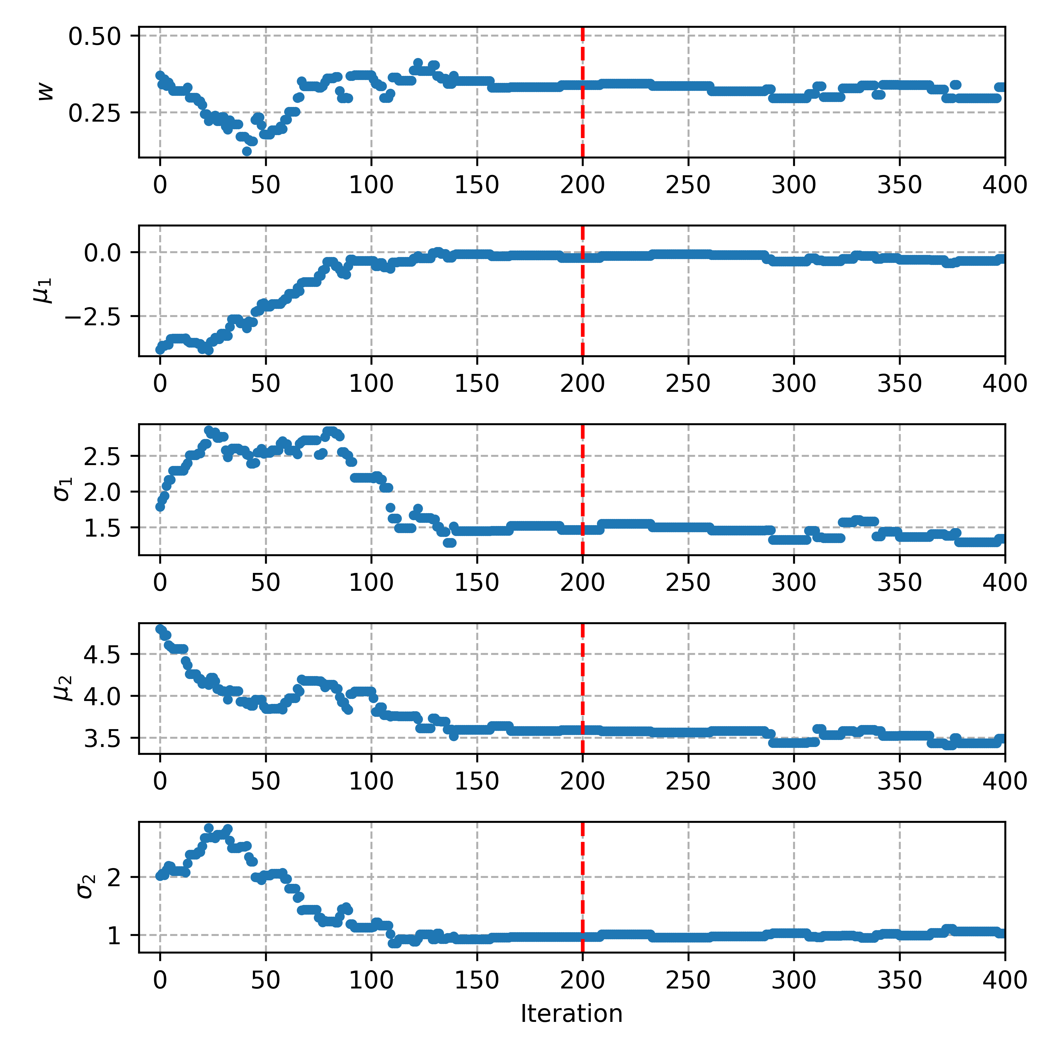
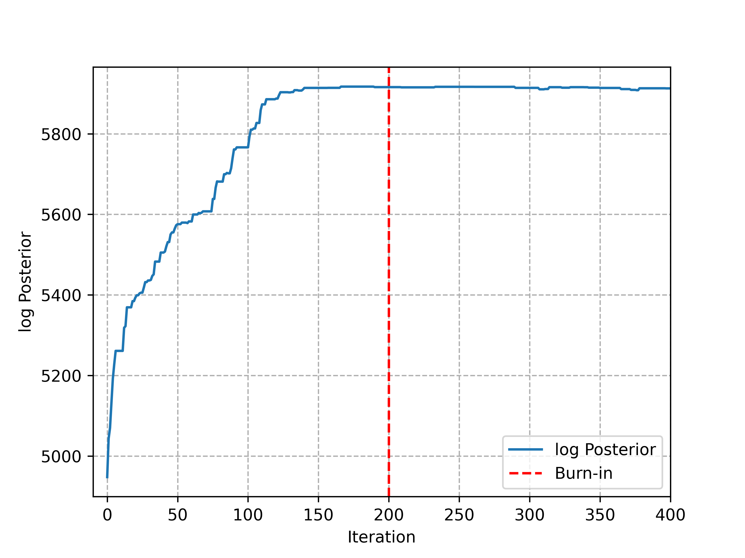

Classification on $\log\left(T_{90}\right)$: traces
We see that some steps are needed to find the peak
Burn-in: discard $n$ points to have samples of the peak
Burn-in $= 200$

Slide 14
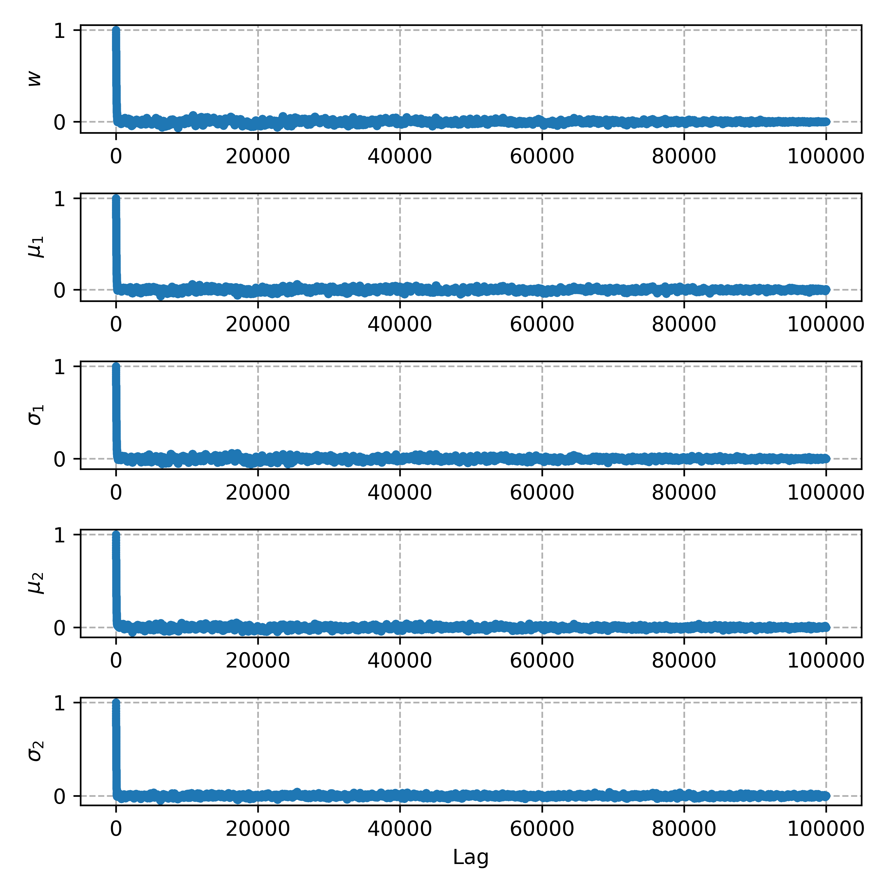
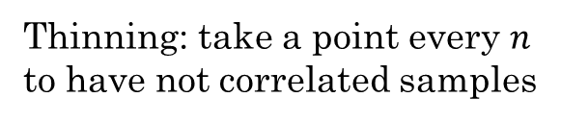

Classification on $\log\left(T_{90}\right)$: autocorrelation
We look at the autocorrelation for the parameters and we see that for small lag the samples are correlated
Thinning: take a point every $n$ to have not correlated samples

Slide 15
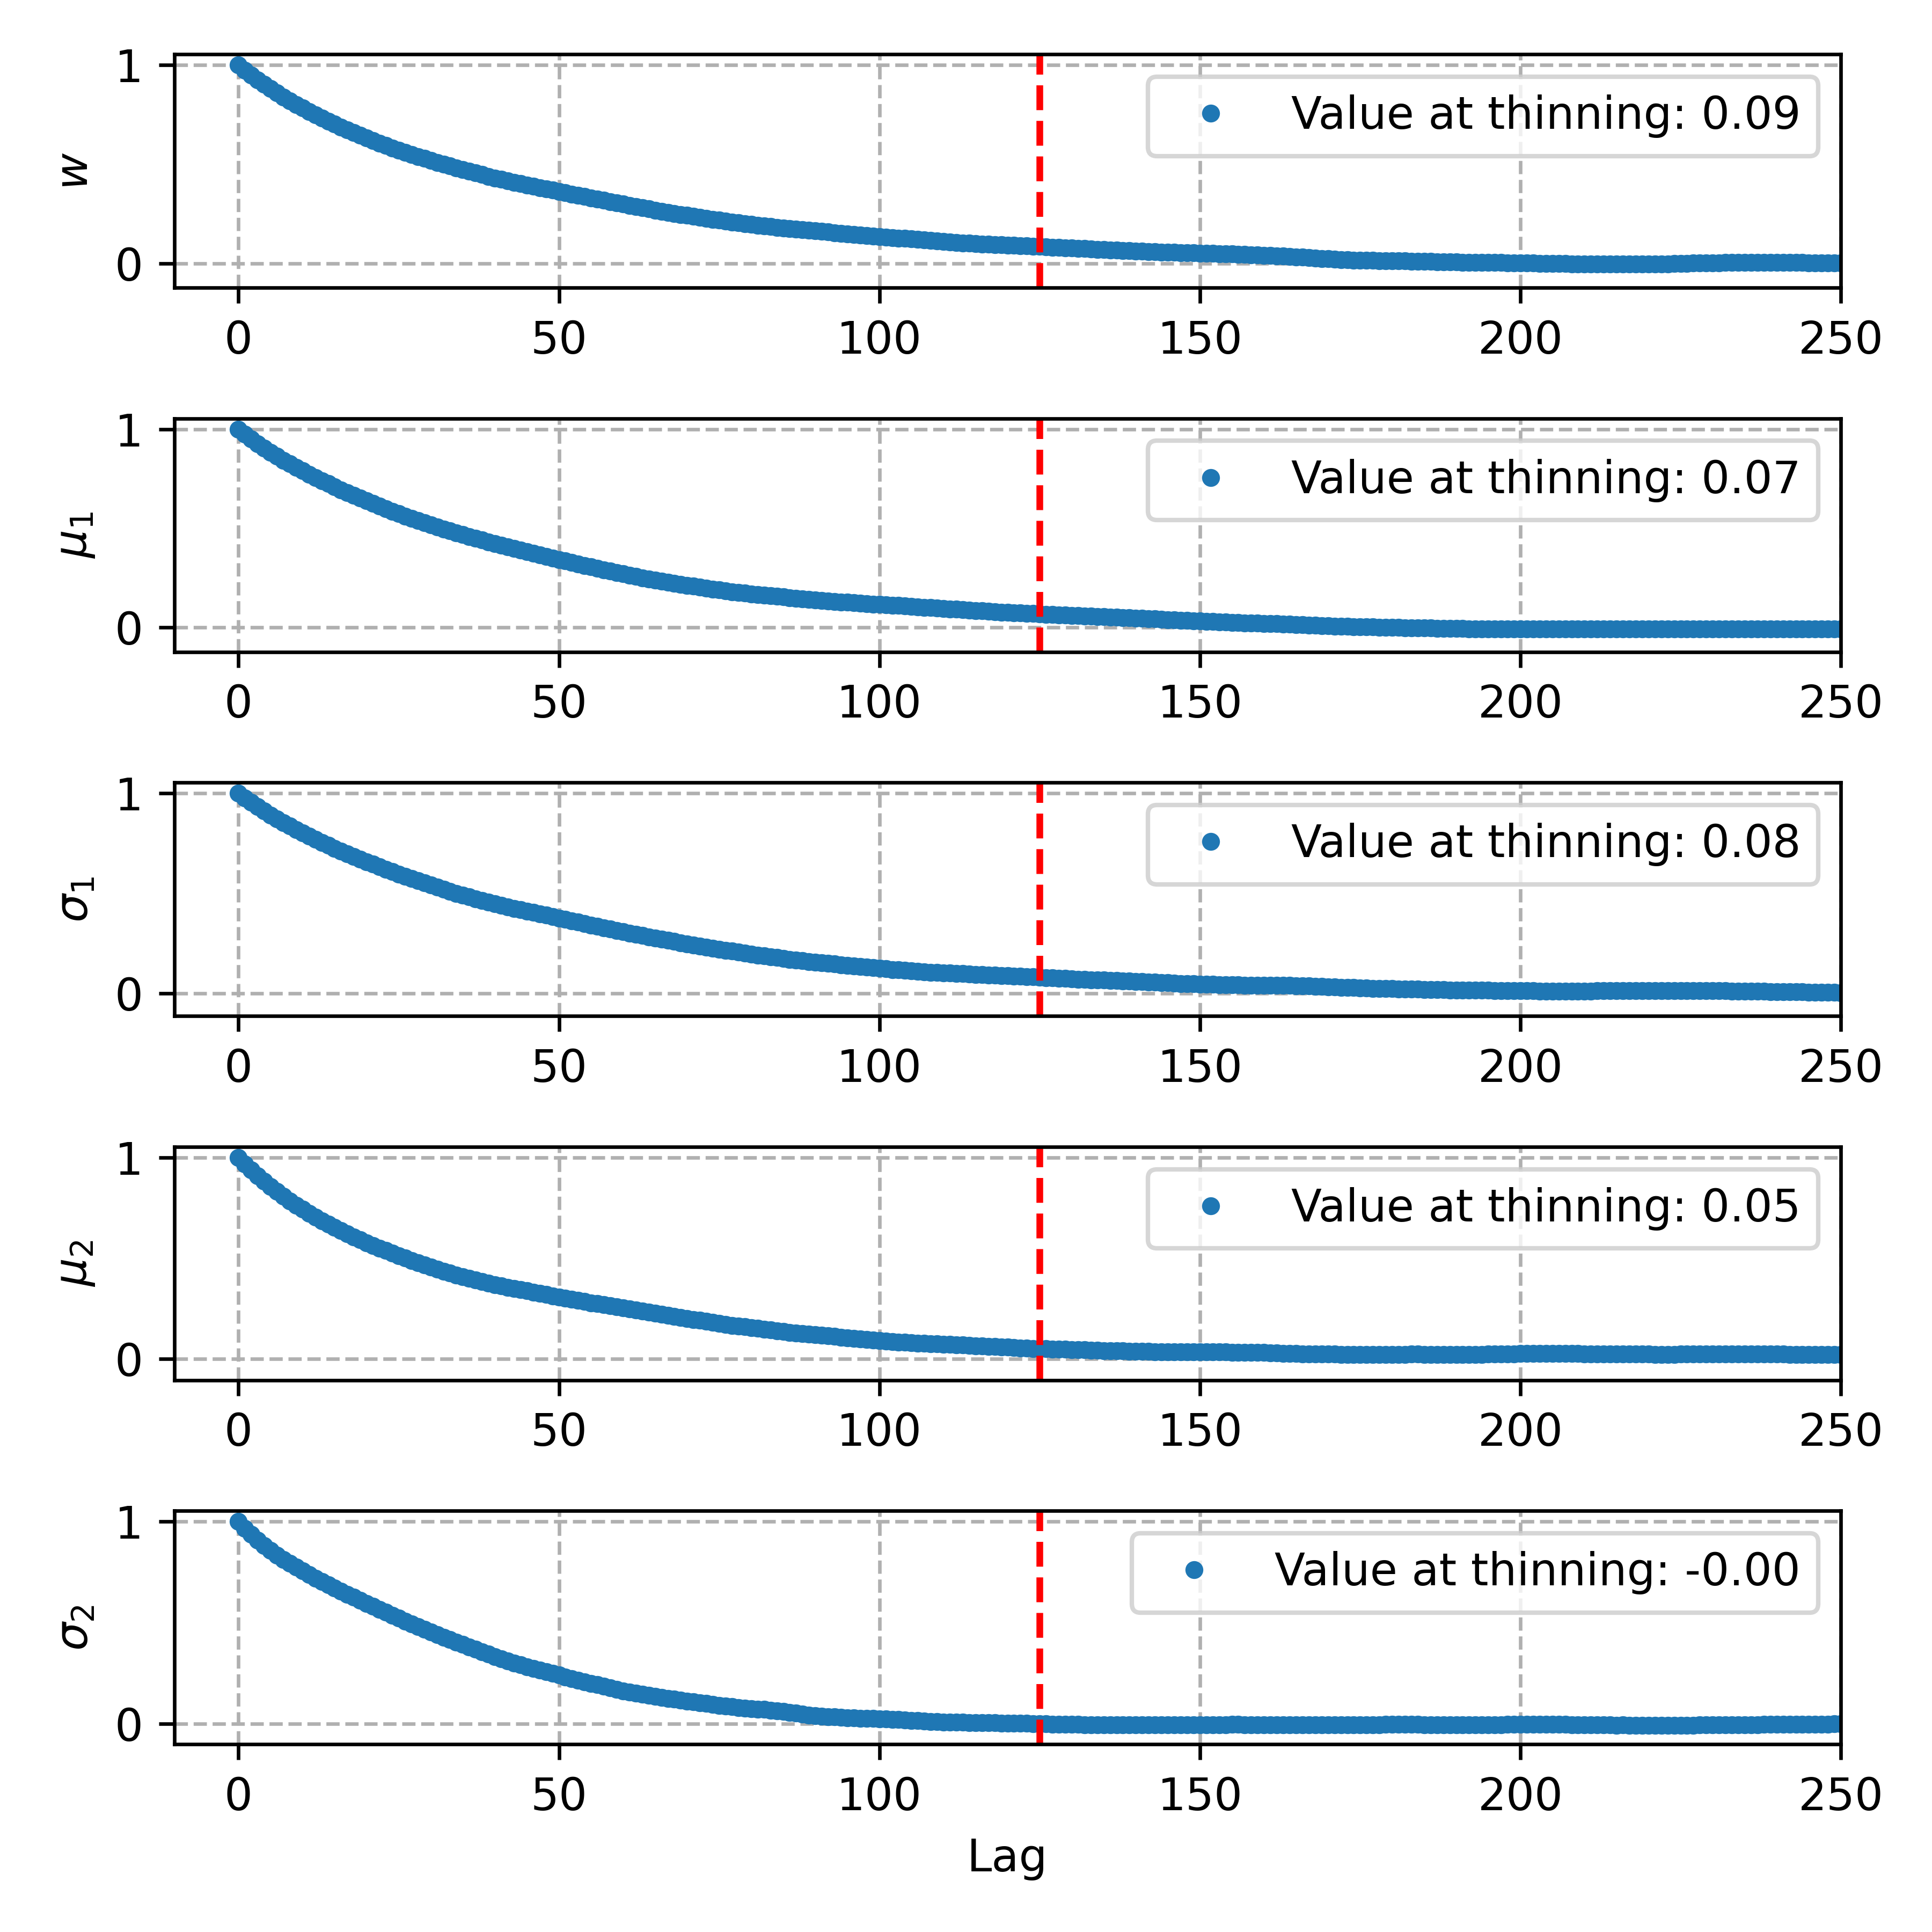

Classification on $\log\left(T_{90}\right)$: autocorrelation
We look at the autocorrelation for the parameters and we see that for small lag the samples are correlated
Thinning: take a point every $n$ to have not correlated samples
Thinning $= 125$

Slide 16
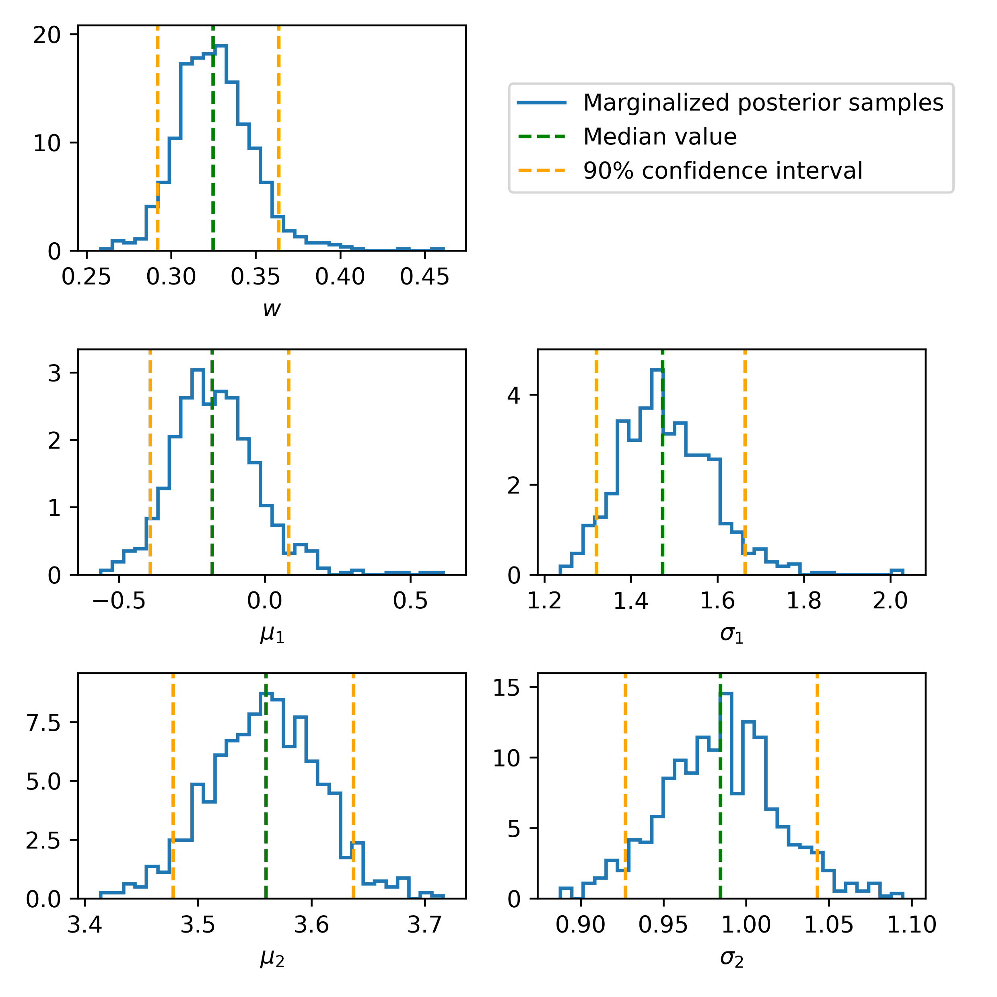

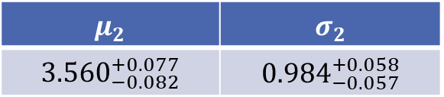
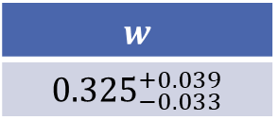
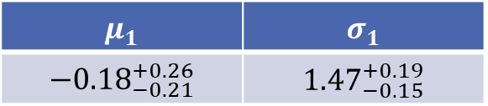
Classification on $\log\left(T_{90}\right)$: marginals
We make the histograms for each parameter We find the median value and the interval corresponding to 90% level of confidence
$$w$$
$${0.325}_{−0.033}^{+0.039}$$
$$μ_{1}$$ | $$σ_{1}$$
$$−{0.18}_{−0.21}^{+0.26}$$ | $${1.47}_{−0.15}^{+0.19}$$
$$μ_{2}$$ | $$σ_{2}$$
$${3.560}_{−0.082}^{+0.077}$$ | $${0.984}_{−0.057}^{+0.058}$$

Slide 17
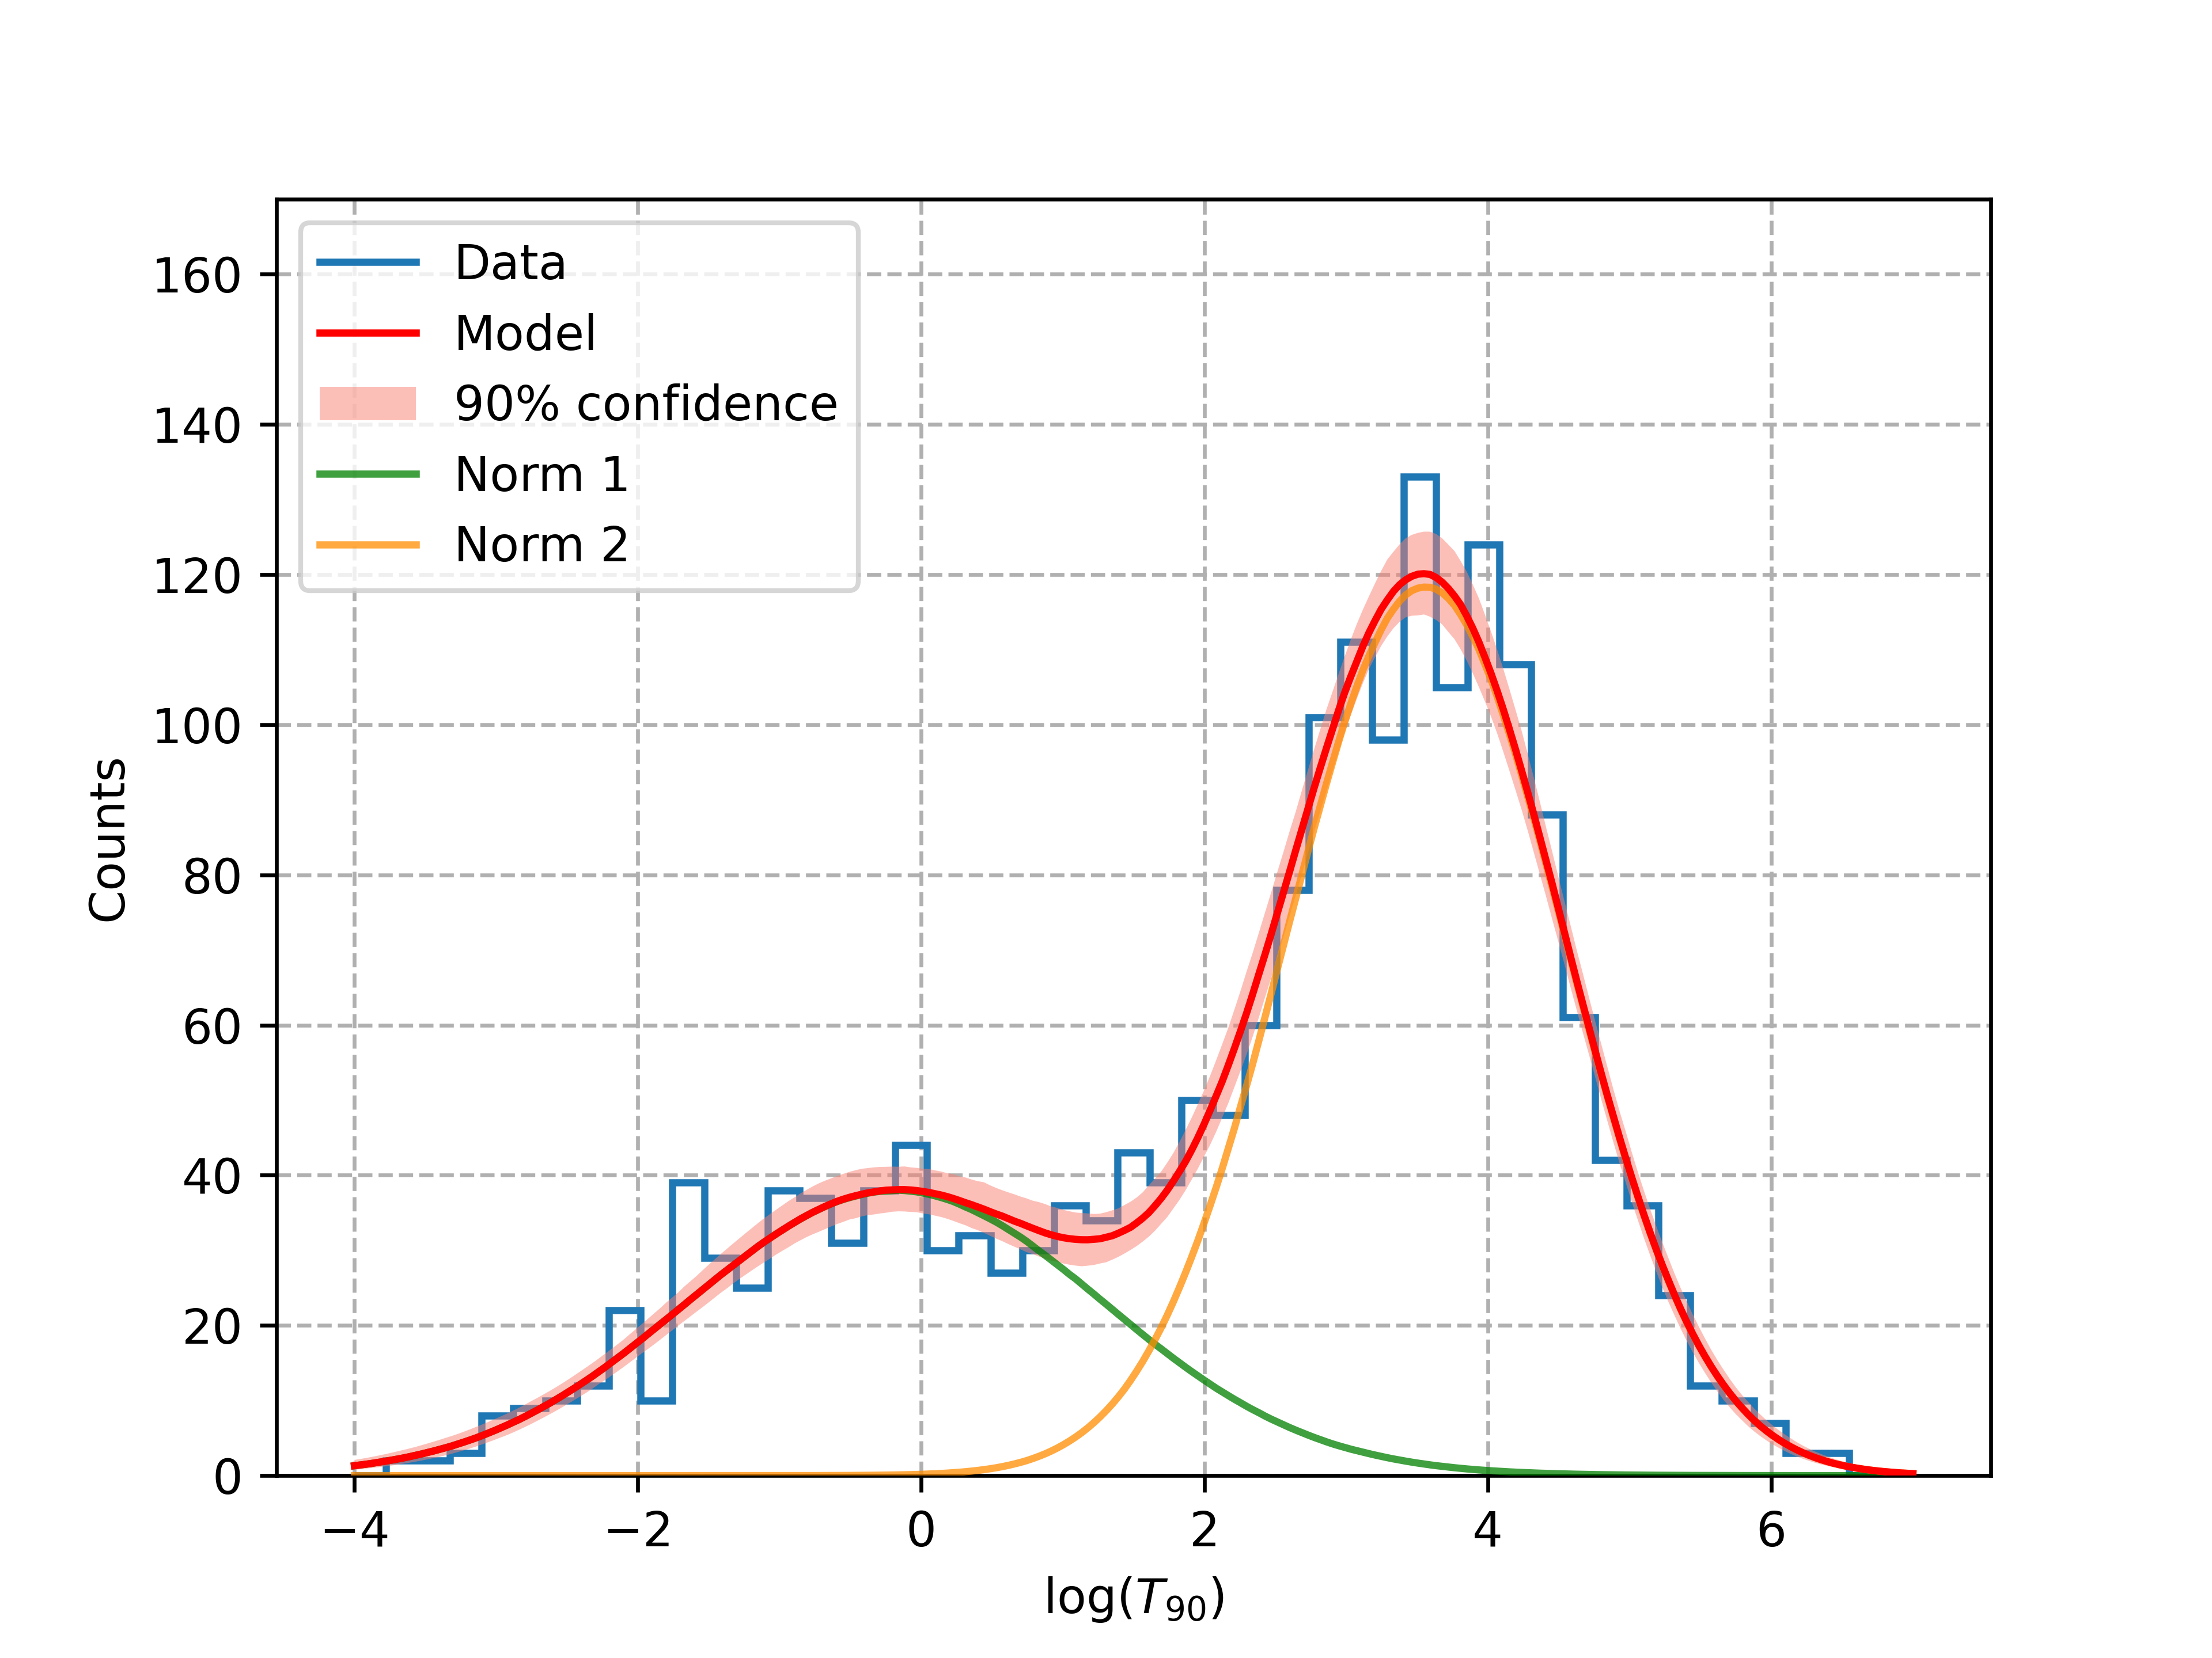

Classification on $\log\left(T_{90}\right)$: final model
The final model, so the median of the models computed on each sample

Slide 18

Classification on $\log\left(T_{90}\right)$ with errors
Now consider the errors as gaussian errors on each measure

Slide 19
Conclusions

Slide 20
Bibliografia
Questo articolo: H. Alfvén, Magneto hydrodynamic waves, and the heating of the solar corona, Monthly Notices of the Royal Astronomical Society 107, 211 (1947).
[1]: H. Alfven, On the existence of electromagnetic-hydro· dynamic waves., Ark. Mat. Astr. Fys.t 29B, (1942).
[2]: T. G. Cowling, The electrical conductivity of an ionized gas in a magnetic field, with applications to the solar atmosphere and the ionosphere, Proc. A 183, 453 (1945).

Slide 21
Grazie per l’attenzione

