Slide 1
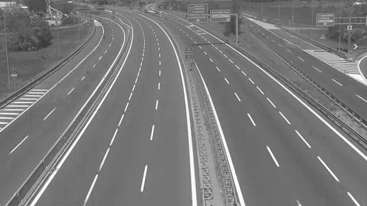
Background subtraction
Gaussian Mixture Model
Andrea Mazzeo
Daniele Moltisanti

Slide 2
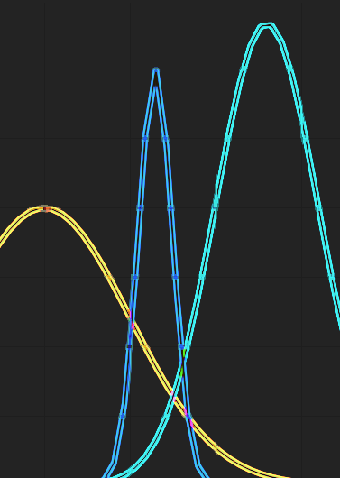
GMM overview

Slide 3
Towards our implementation
Two parameters usefull:
Threshold
Allows to manage the foreground detected.
Learning rate
Allows to manage the learning capability.

Slide 4
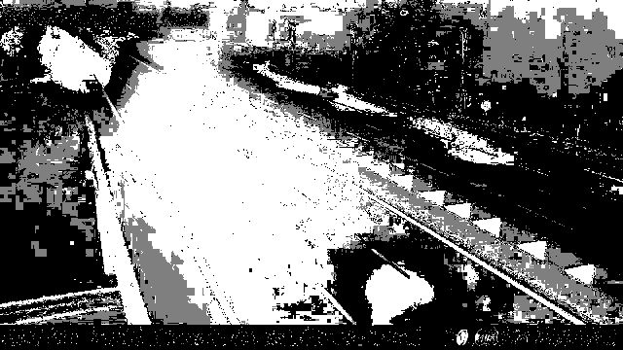
Threshold example
THRESHOLD VALUE = 20
Never used, due to its instability
Result few accurate

Slide 5
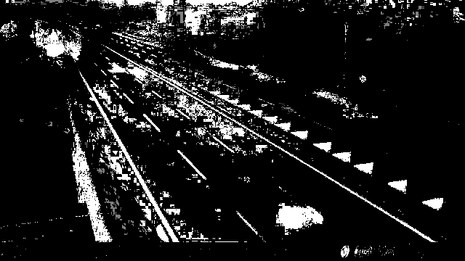
Threshold example
THRESHOLD VALUE = 70
Foreground detected highly accurated
Subject to instability
Default value of OpenCV function
Used in daily scenario

Slide 6
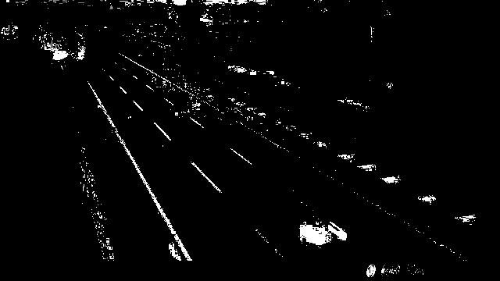
Threshold example
THRESHOLD VALUE = 140
More stability
Allows to reduce lights effects
Less realistic foreground detection
Used in night scenario

Slide 7
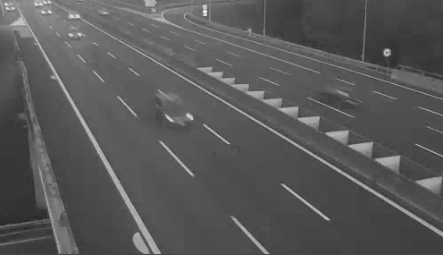
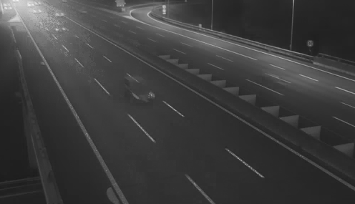
Learning rate example
LEARNING RATE VALUE = 0,001
Learning too slow
Never used

Slide 8
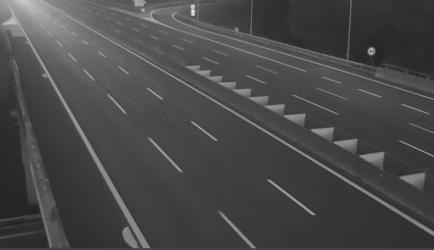
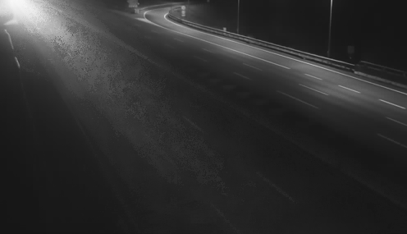
Learning rate example
LEARNING RATE VALUE = 0,01
Learning is average

Slide 9
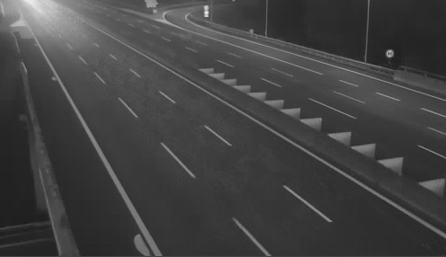
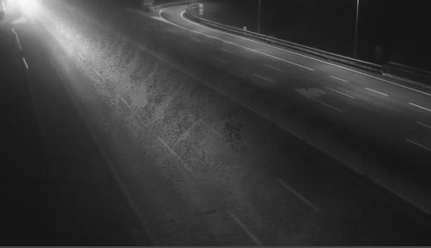
Learning rate example
LEARNING RATE VALUE = 0,1
Learning too fast
Due to its instability is never used

Slide 10
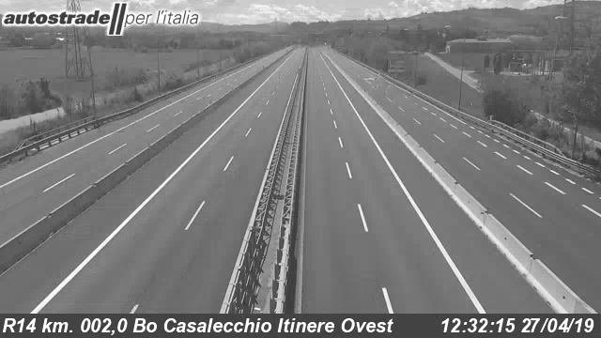
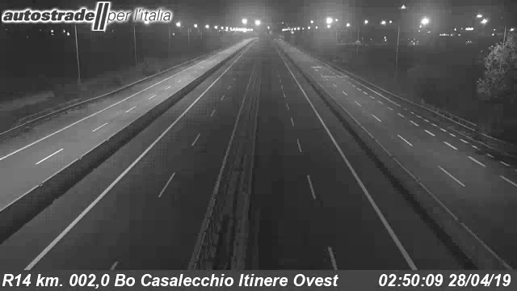
Our idea
Split the time in three scenario:
Day time
Night time
Transition: Sunrise, Sunset.
According to each scenario, GMM parameters have to be set.
Day:
Normal threshold – High background ratio
Night:
High threshold – High background ratio
Transition:
Normal threshold – Low background ratio
The main problem
Manage GMM parameters in automatic way.
Regularized as a function of time.

Slide 11



Our implementation
Training phase
Background subtraction
Results analysis

Slide 12
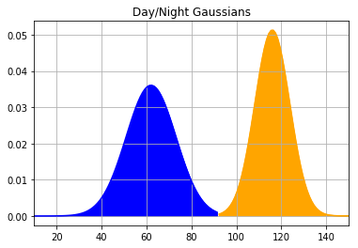
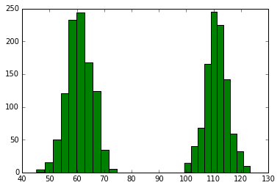
Training phase
The goal is to acquire a gaussian model able to descern night and day.
The model is build starting from the average of pixel value.
The training phase is universal. It provides a general modeI valid for each webcam.

Slide 13
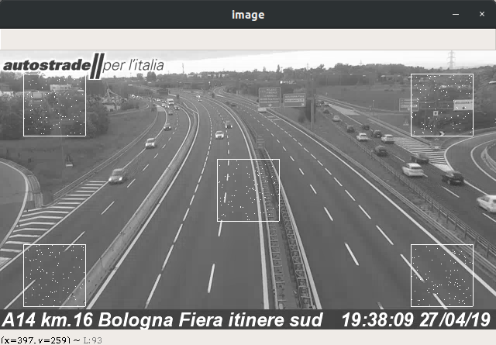
Training phase
How the average is computed?
Taking 500 points from 5 square
Random points with uniform distribution
Able to cover all image

Slide 14
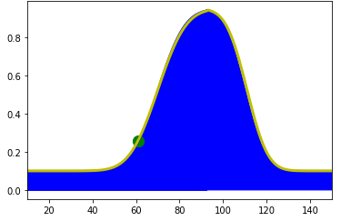
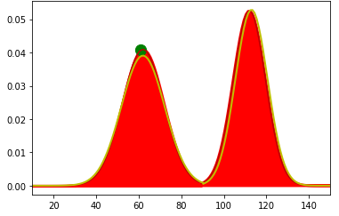
Background subtraction
Each five frames takes one frame.
Evaluate the average.
Understand the scenario (night, day, transition).
Regulate the GMM parameters.
Update the gaussians.

Slide 15
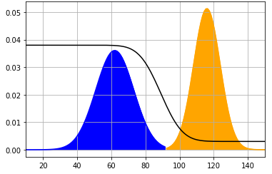
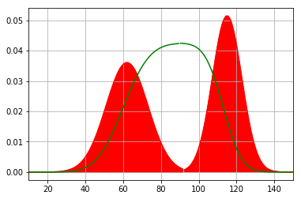
Background Subtraction
Update GMM parameters
THRESHOLD
LEARNING RATE

Slide 16
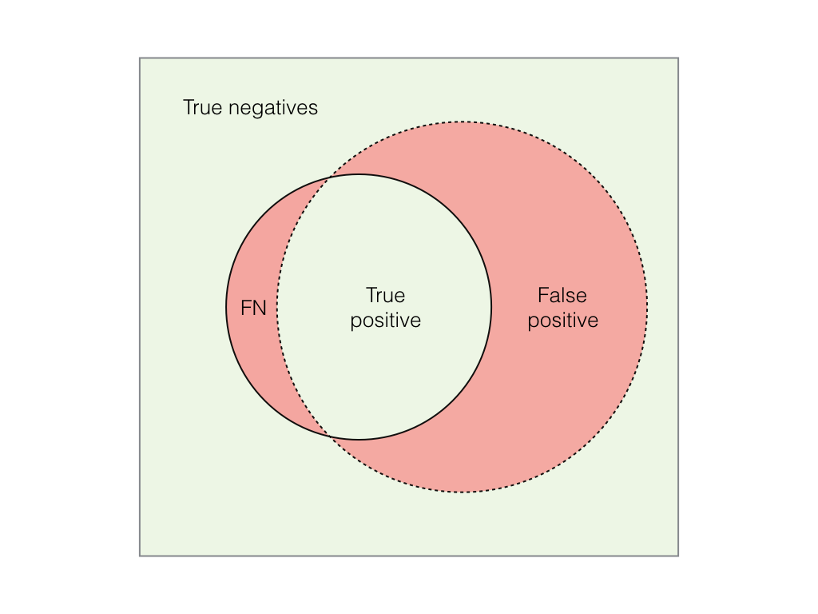
Results analysis
Compare ground truth and model identified:
If pixel is classified as foreground in both → True Positive
If pixel is classified as background in both → True Negative
If pixel is classified as foreground in ground-truth and background in model identified → False Negative
If pixel is classified as background in ground-truth and foreground in model identified → False Positive

Slide 17

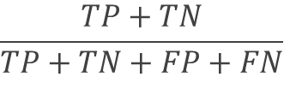
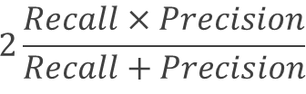

Results analysis
Evaluation metrics
$$\frac{TP+TN}{TP+TN+FP+FN}$$
$$\frac{TP}{TP+FP}$$
$$\frac{TP}{TP+FN}$$
$$2\frac{Recall×Precision}{Recall+Precision}$$
Accuracy
Precision
Recall
F1 score

Slide 18

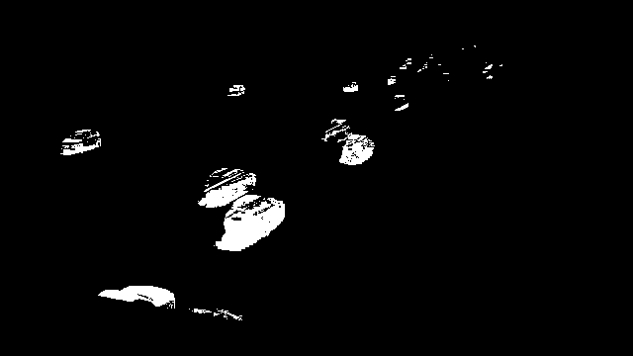
Results analysis
Average results:
Accuracy | 98,72 % | 97,82 %
Precision | 85,64 % | 41,02 %
Recall | 63,82 % | 47,78 %
F1-score | 72,42 % | 52,05 %
GROUND-TRUTH
MODEL IDENTIFIED

Slide 19
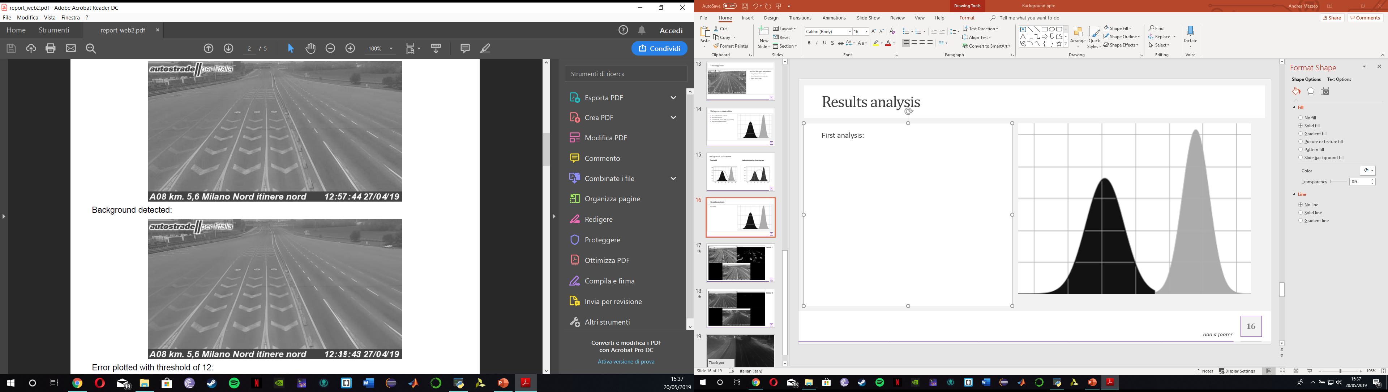
Results analysis
Check pixel per pixel differences between the two images
Use a little threshold
Results:
Day and night scenario: > 95%
Transition scenario: High unstable
BACKGROUND DETECTED
ORIGINAL FRAME

Slide 20
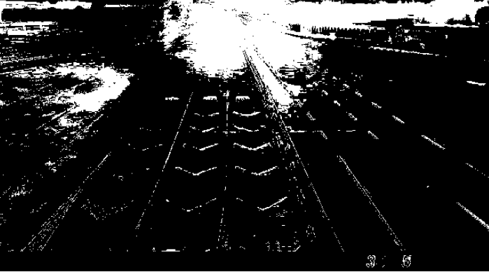
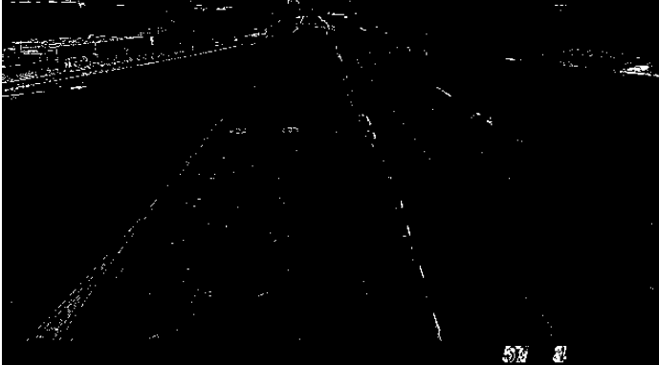
Results analysis
From detected background and original frame extract a matrix made up by differences
Create an image starting from this matrix

Slide 21
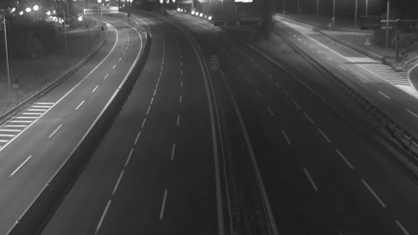
Thank you
Andrea Mazzeo
Daniele Moltisanti

