Slide 1
Relationship Categories (who the victim was in relationship to the offender)
Intimate Partner | Family | Friend | Professional | Not Related
Spouse | Parent | Friend | Employee | Stranger
Ex-Spouse | Sibling | Acquaintance | Employer | Offender
Boyfriend/girlfriend | Step-child, -parent, -sibling | Neighbor | Babysittee | Otherwise Known
Common law spouse | Child of boyfriend/girlfriend
Homosexual relationship | Grand-child, -parent
 | In-law
 | Other family member

Slide 2
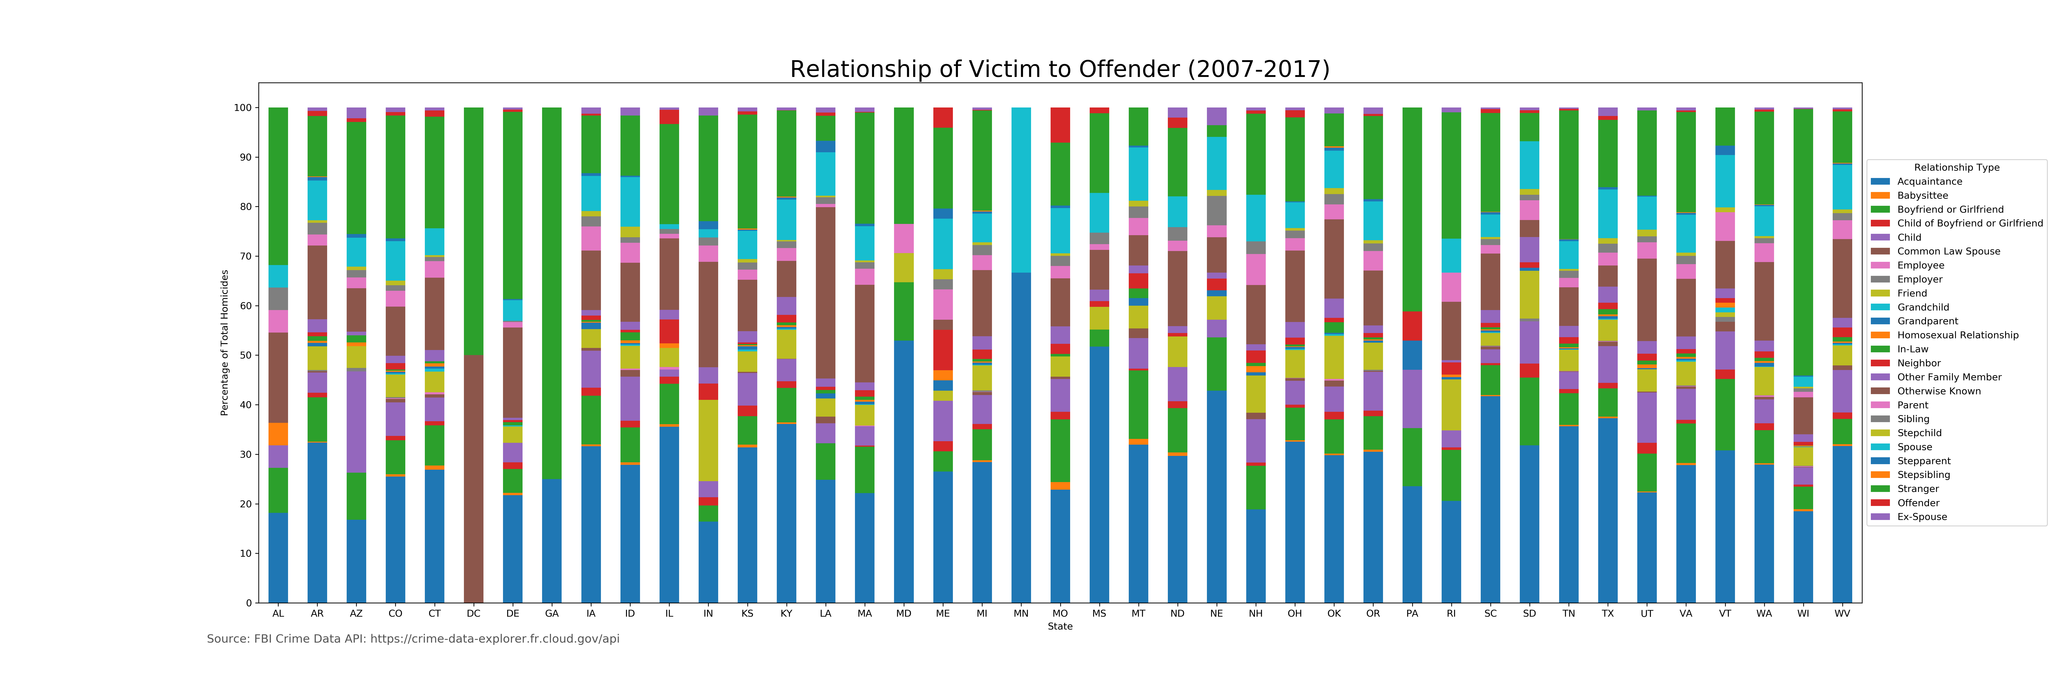
Relationship of Victim to Offender by State
This displays the percentage of people murdered in each state by each type of relationship category
Some of the largest categories appear to be acquaintance, stranger, or someone they knew outside of these categories

Slide 3
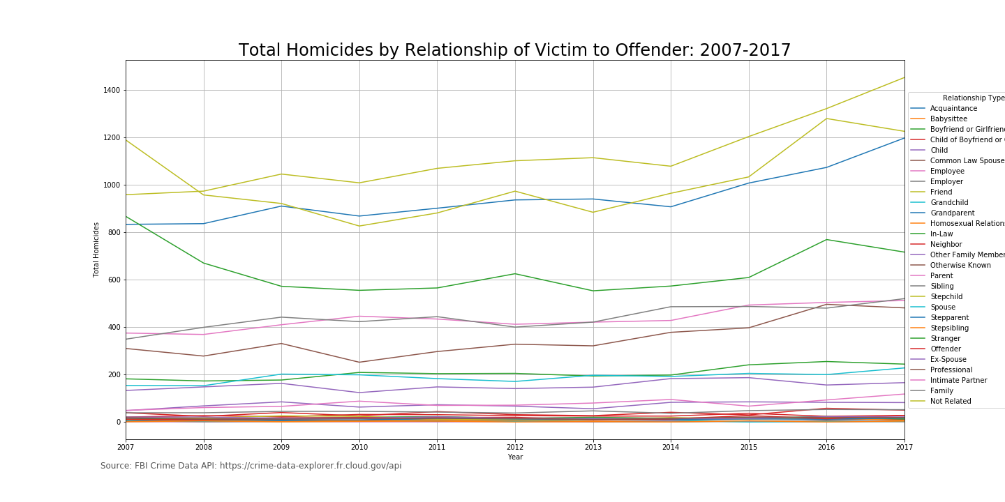
Total Homicides By Relationship (2007-2017) (All types)
Top four:
Friend
Not related
Acquaintance
Stranger
Upward trend in friends and acquaintances since 2014

Slide 4
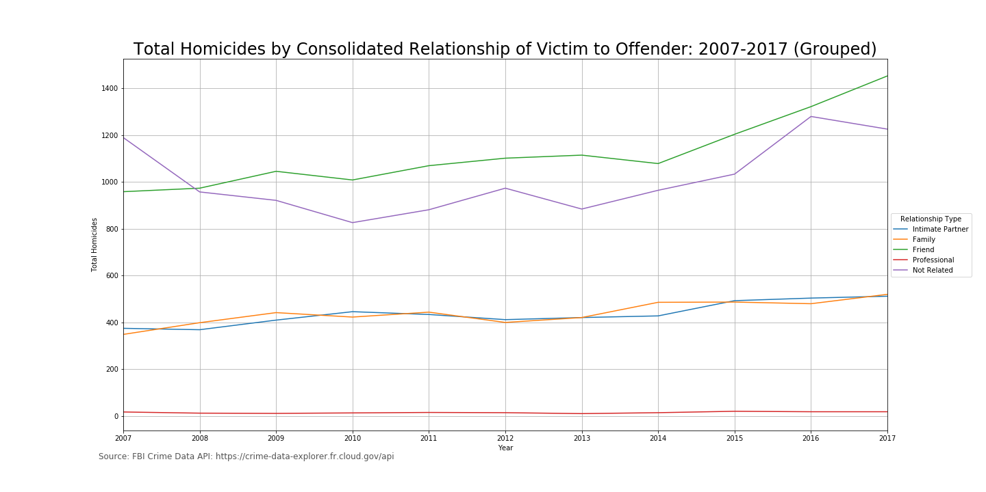
Total Homicides By Relationship (2007-2017) (Categories)
Friend and Not Related are the top two most common
Intimate Partners and Family are the next most common
Professional relationships are the least common

Slide 5
Number of Homicides by State (2007-2017)
The next five maps display the number of homicides from each of the five categories by state.
Choropleth maps are maps that show differences in values based on the shading of each state.
Some states have more agencies reporting data than others which skews some of the shading. For instance, 100% of Tennessee’s agencies report their homicide data which is why it is consistently on the darker end of the spectrum.

Slide 6
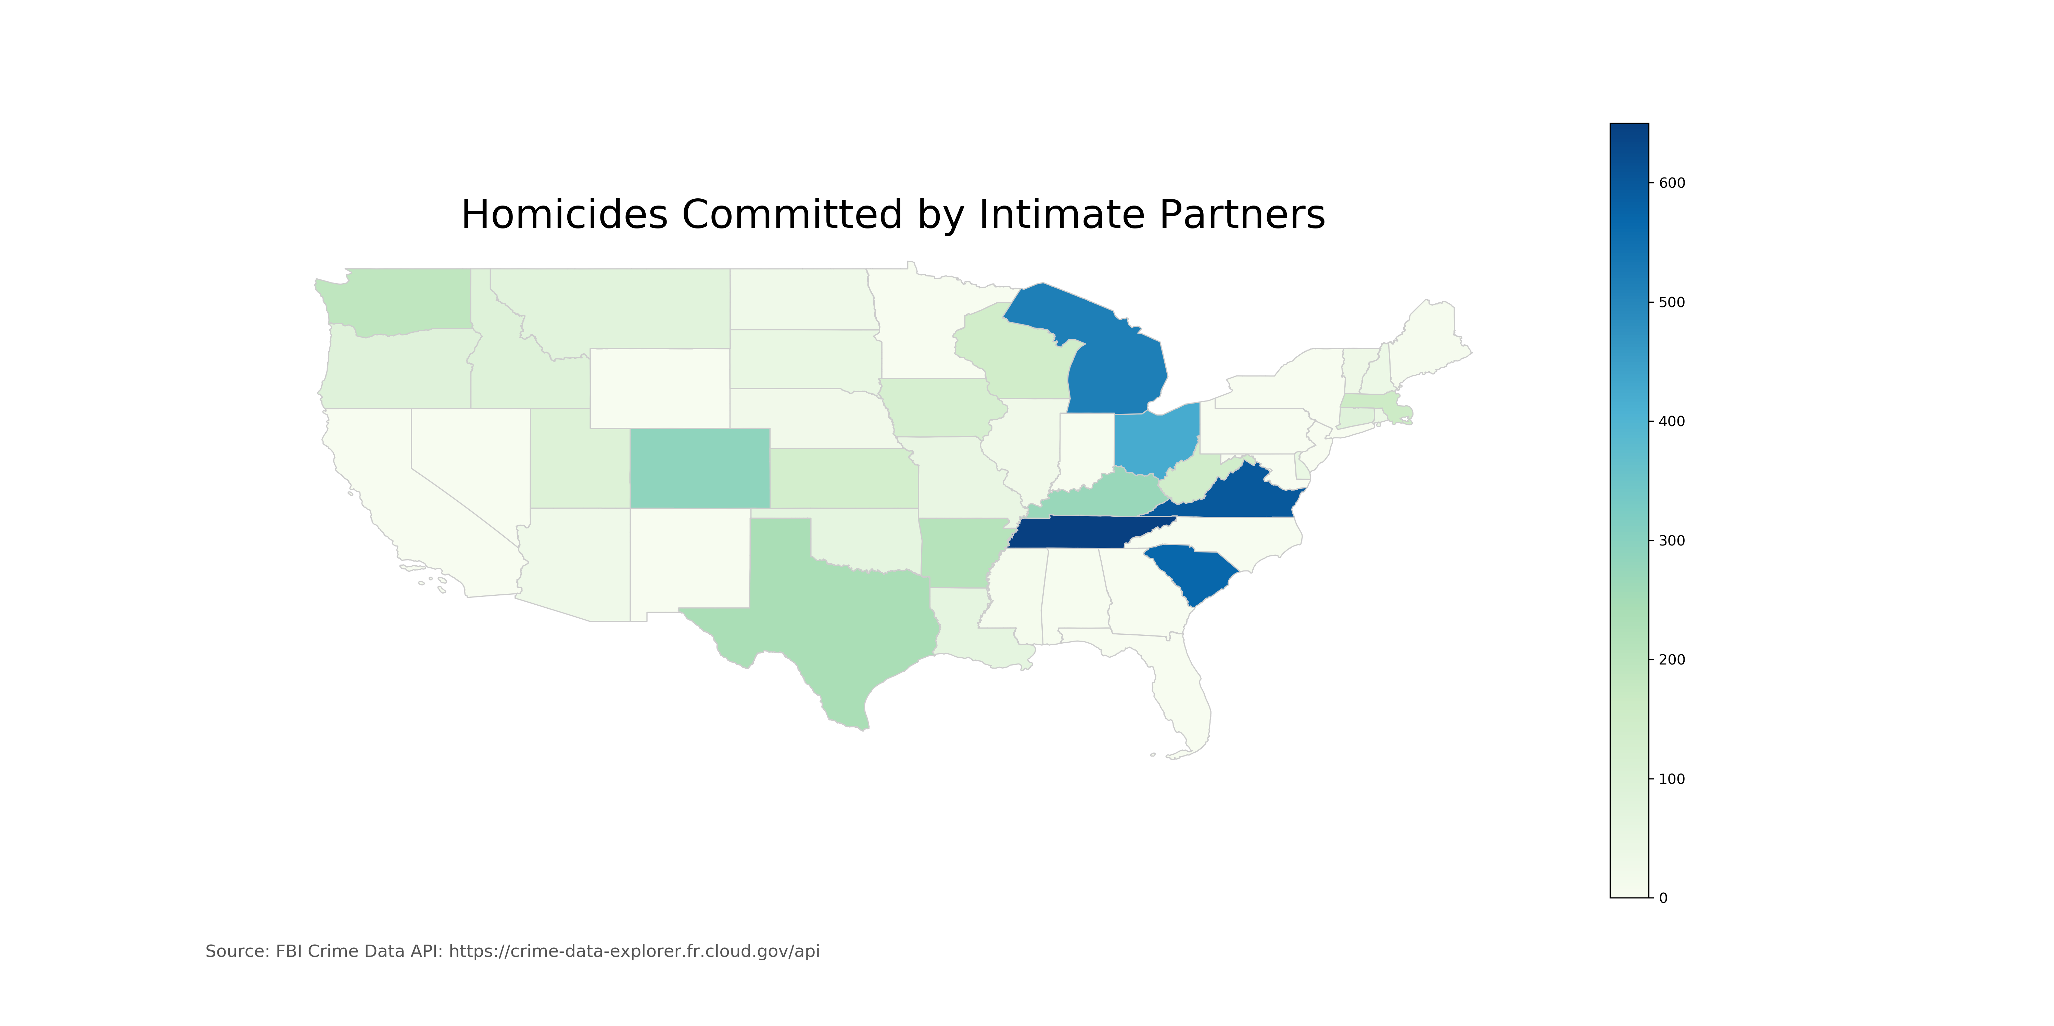

Slide 7
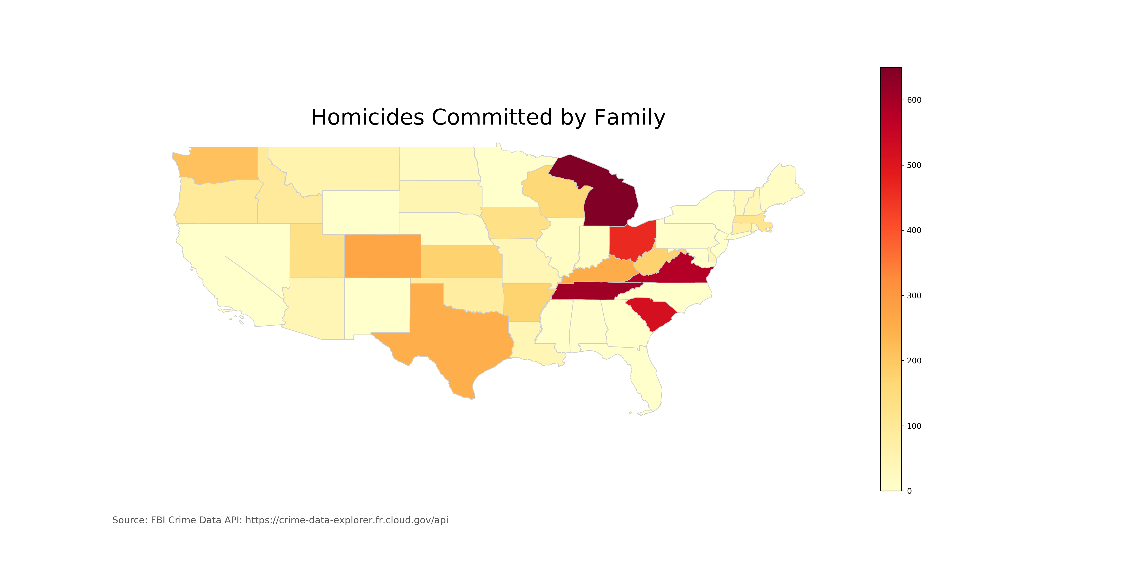

Slide 8
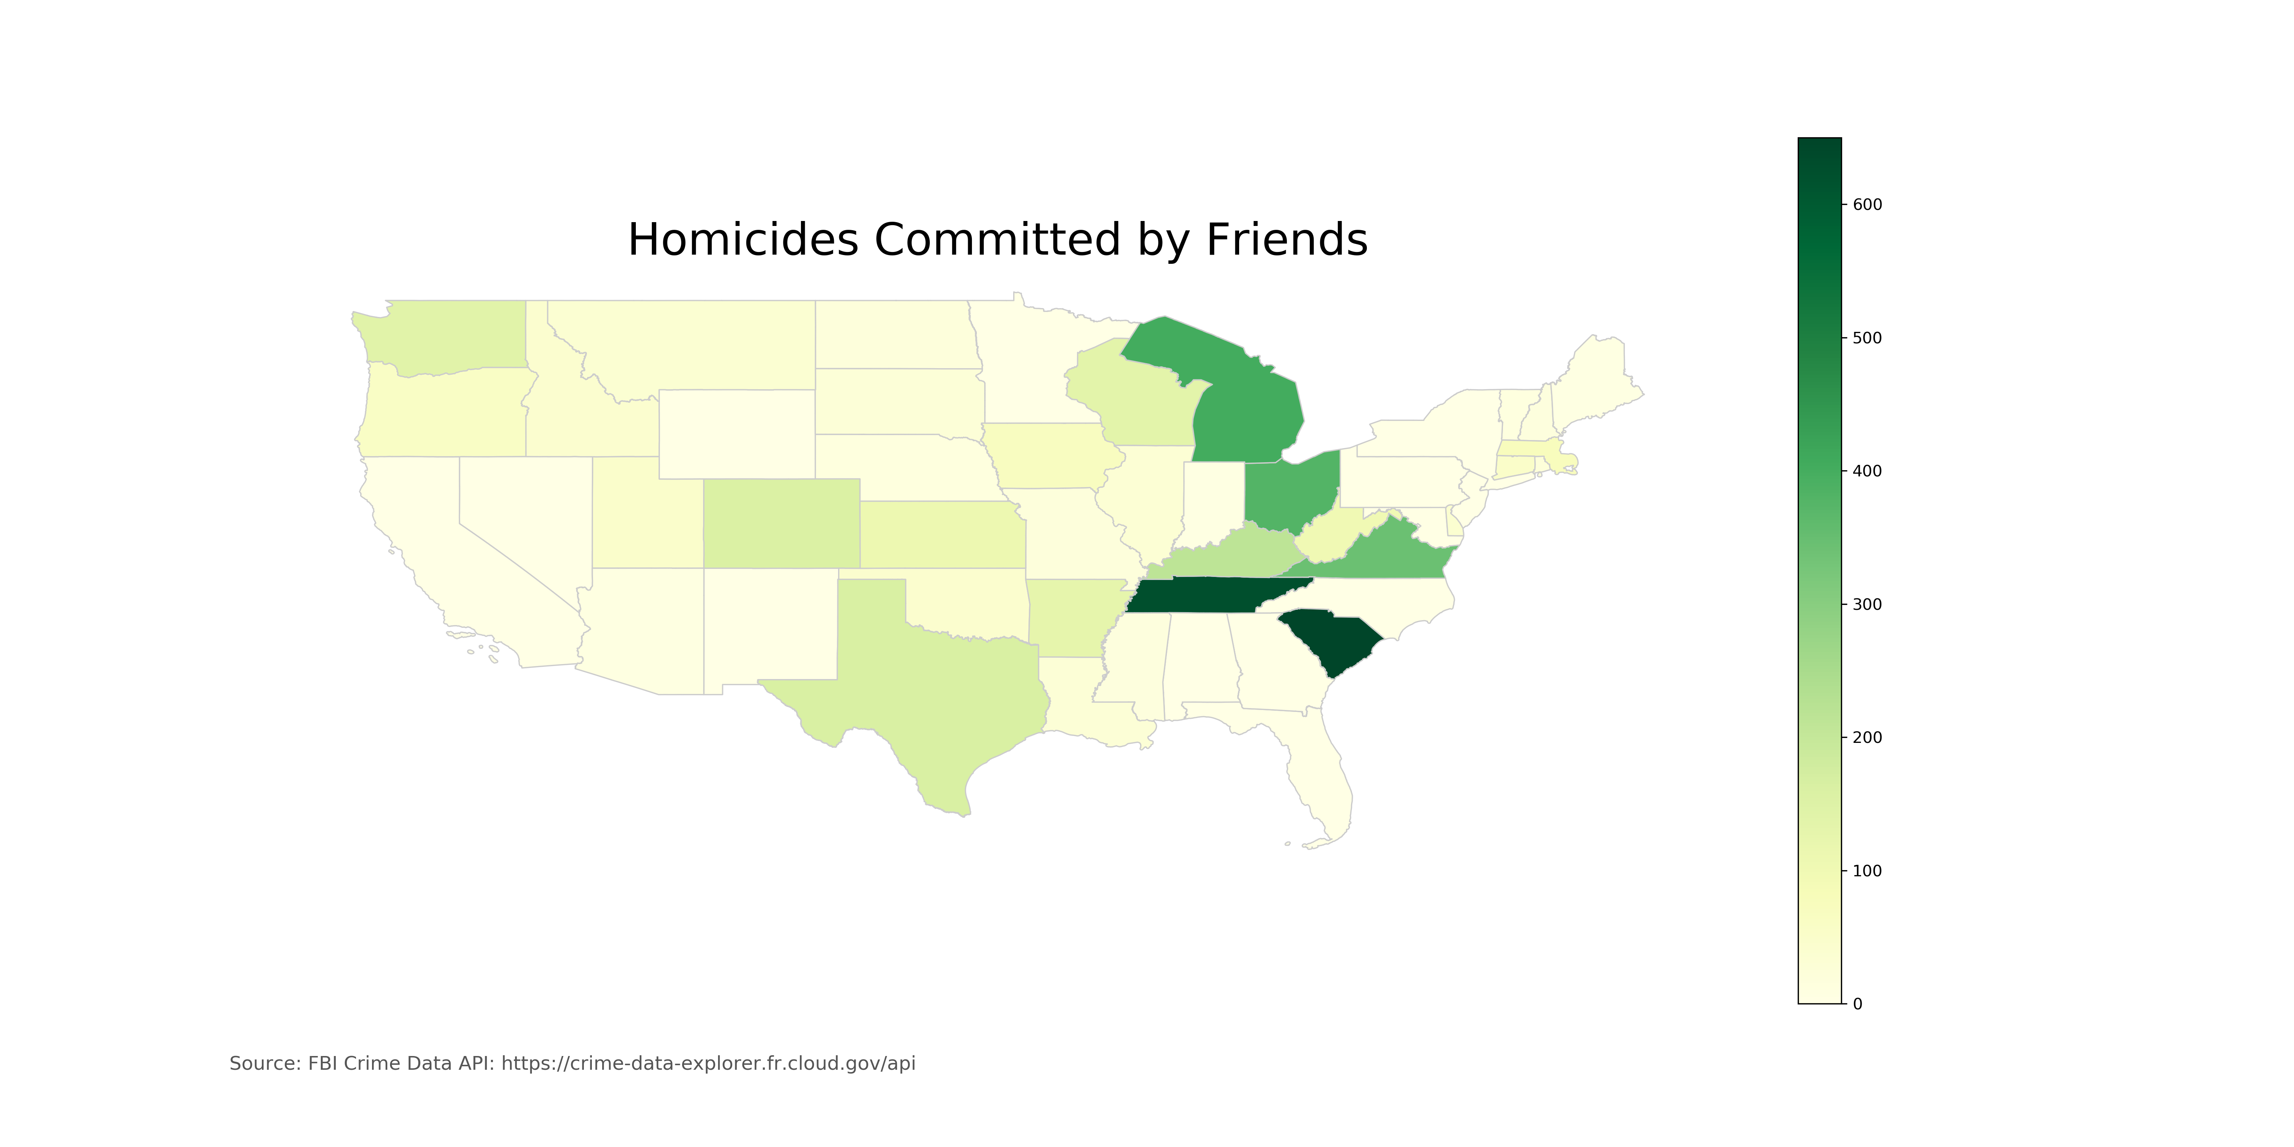

Slide 9
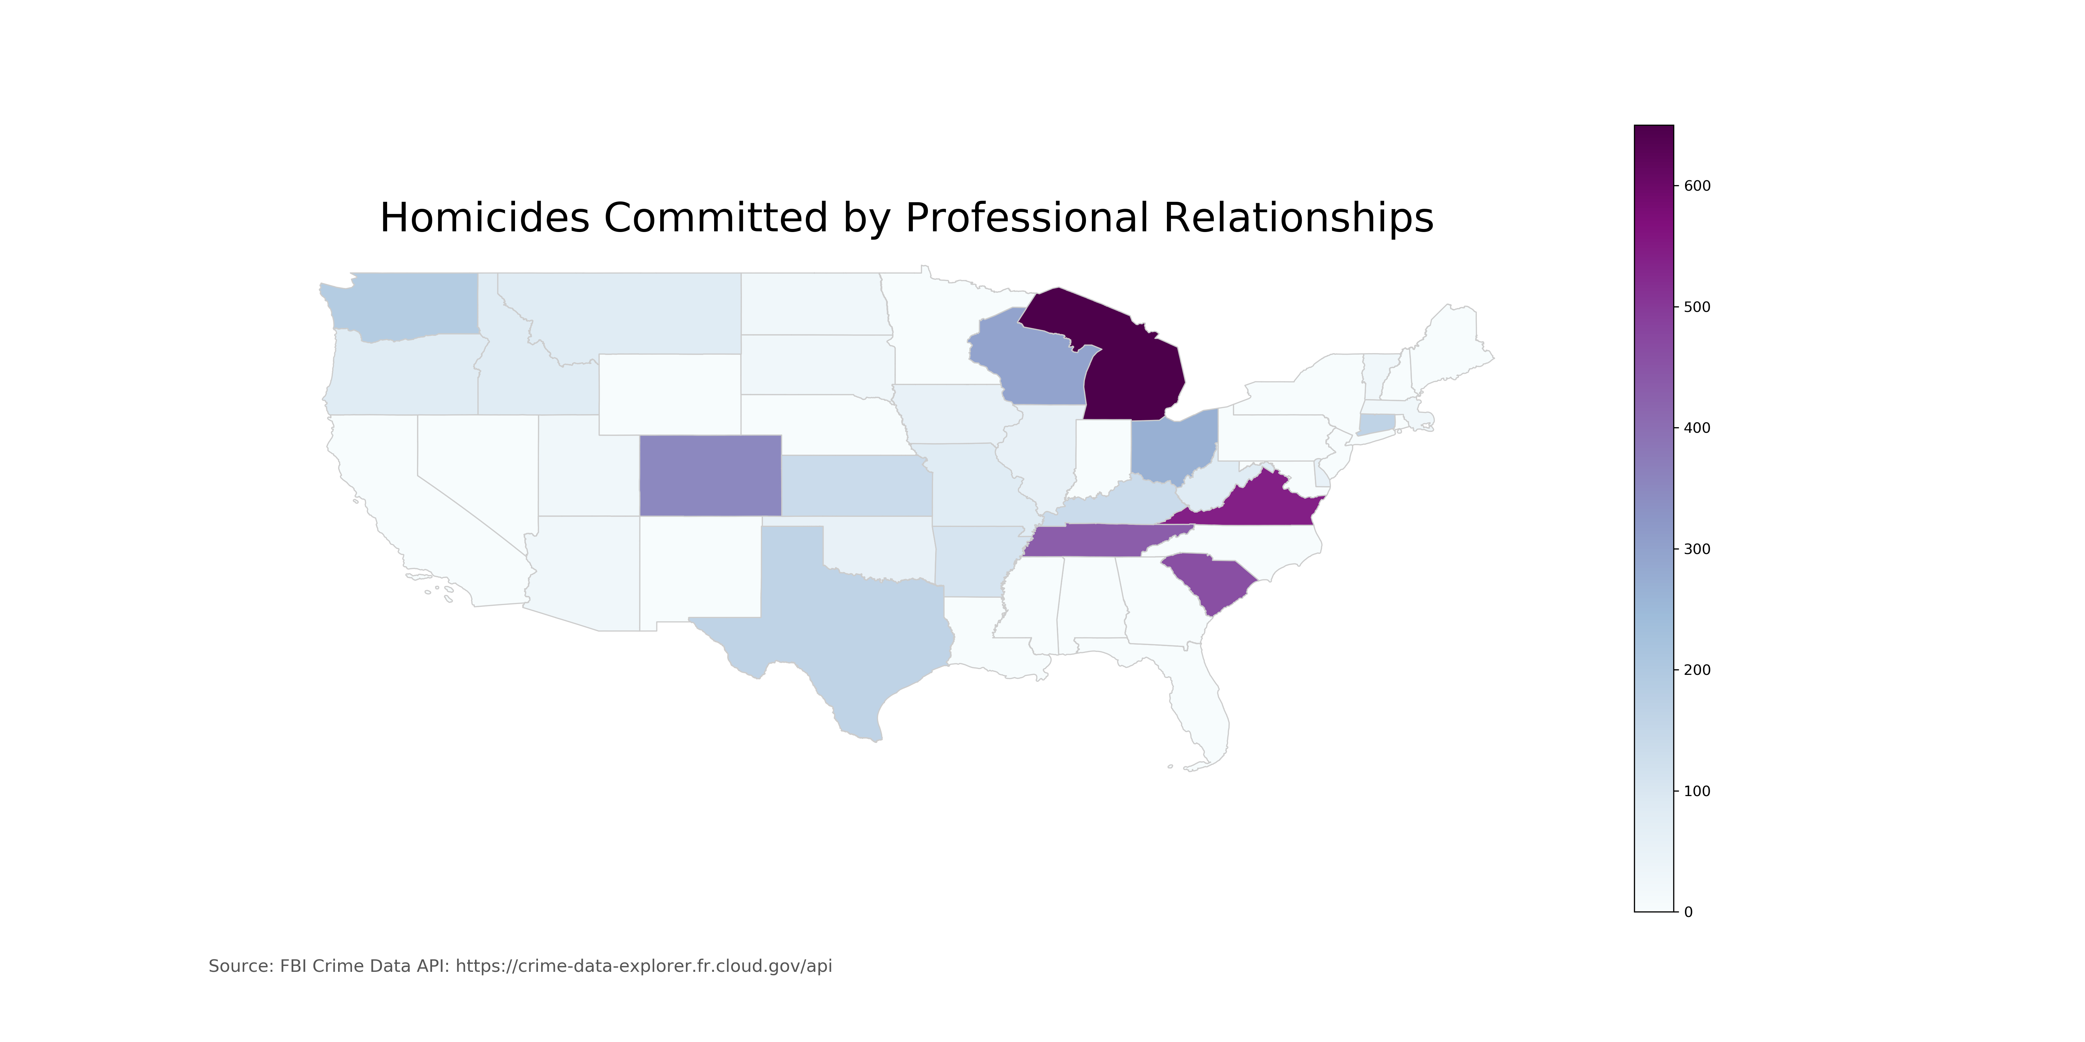

Slide 10
