Slide 1


H MICIDE: Part deux
PREDICTING CRIME TRENDS
Karen McGee | Andrea Morgan | Stacey Smith

Slide 2

WE’RE AT IT AGAIN
The FBI released expanded homicide data in the summer of 2019 that includes victim data and links victims to arrestees, along with other incident data.
This final project gives us the opportunity to revisit our prior analysis and try to predict homicide variables based on what we already know.

Slide 3
FROM LAST TIME… Our analysis was limited to what the FBI API provided, and added census and election data:
Number of homicides nationally and by state
Gender, ethnicity, race, age of offender counts by state
Gender, ethnicity, race, age of victim counts by state
Counts of relationship of victim to offender by state
No information linked between offender and victim

Slide 4
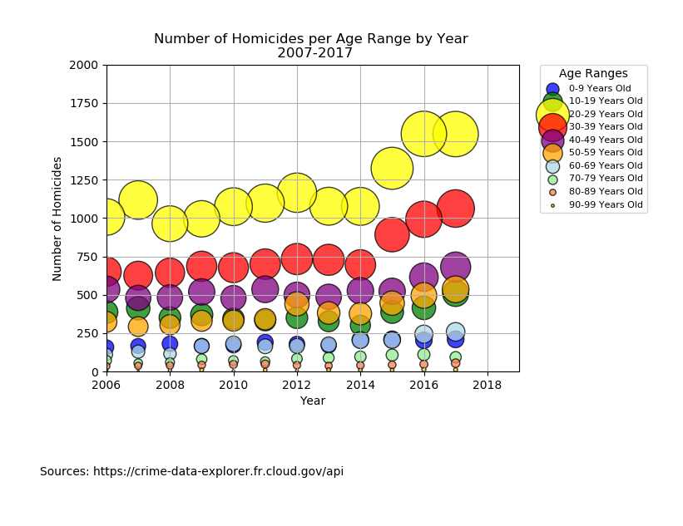
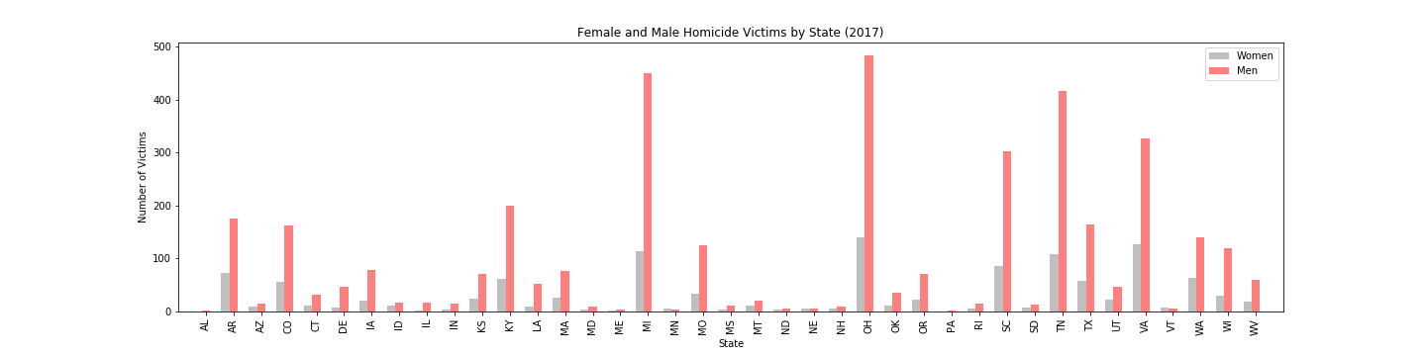
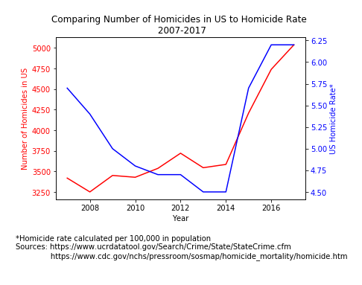
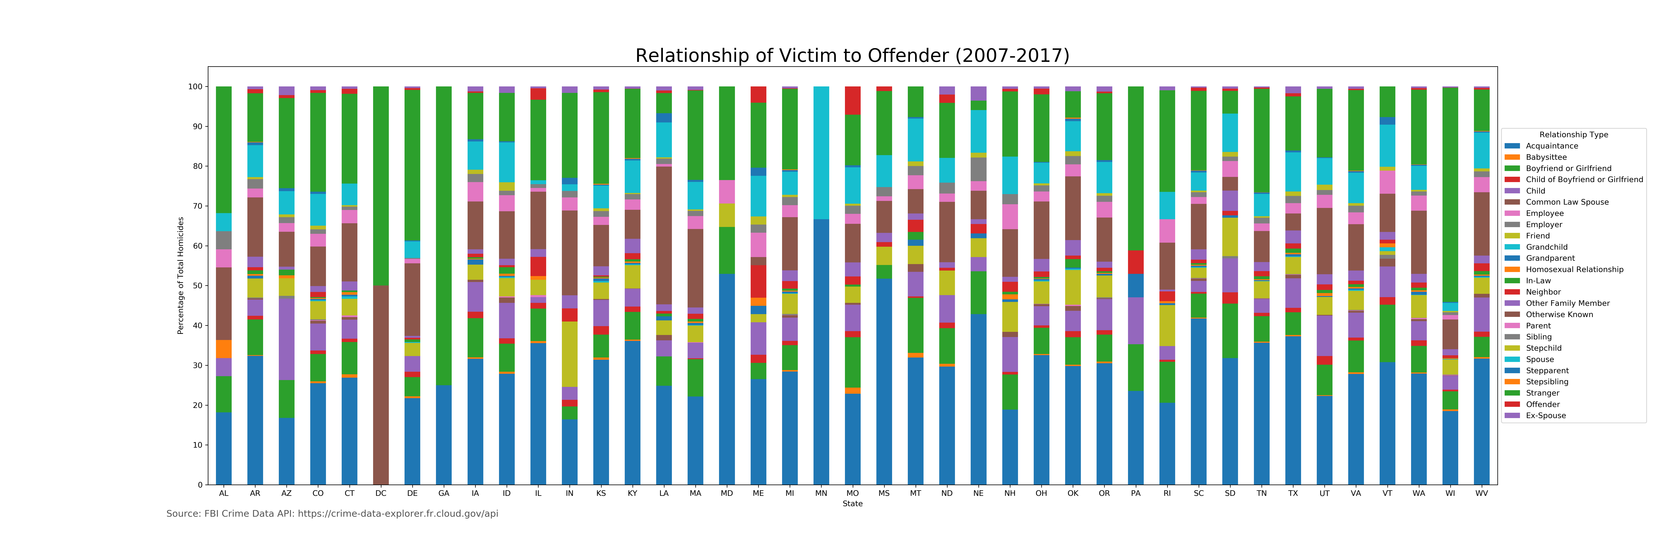
FROM LAST TIME…

Slide 5
NOW…
Expanded data allows us to get individual incident data instead of counts
Arrestees are linked to victims
Same demographic info but more granular
Scope – only Tennessee (100% of agencies report to NIBRS)
Category | Ex 1 | Ex 2 | Ex 3
arrestee_id | 27601649 | 32145814 | 28740817
arrestee_incident_id | 94289060 | 107816657 | 97592974
arrest_date | 2/25/16 0:00 | 7/8/18 0:00 | 12/24/17 0:00
arrest_type_name | Taken INTO Custody | Taken INTO Custody | On View
offense_name | Murder and Nonnegligent Manslaughter | Murder and Nonnegligent Manslaughter | Murder and Nonnegligent Manslaughter
arrestee_age_num | 30 | 19 | 32
arrestee_sex_code | M | F | M
arrestee_race_desc | Black or African American | White | White
arrestee_location_name | Highway/Road/Alley/Street/Sidewalk | Residence/Home | Other/Unknown
victim_id | 103194408 | 118680264 | 106949504
victim_type_name | Individual | Individual | Individual
victim_age_num | 24 | 23 | 20
victim_sex_code | F | M | F
victim_race_desc | Black or African American | White | White
agency_id | 18271 | 18271 | 18376
agency_name | NASHVILLE METRO PD NASHVILLE | NASHVILLE METRO PD NASHVILLE | GRUNDY CO SO ALTAMONT
weapon_name | Handgun | Handgun | Unknown

Slide 6
PROCESS… CREATING OUR DATABASE
STACEY’S INFO GOES HERE

Slide 7
PROCESS… ANALYSIS WITH TABLEAU
INFO GOES HERE

Slide 8
PROCESS… HOW AND WHY OF MACHINE LEARNING
What do we want to predict?
How can we use machine learning to make predictions?
Real time vs. future predictions

Slide 9
MACHINE LEARNING … PREDICTING HOMICIDE VARIABLES
ML INFO HERE

Slide 10

Q & A

