Slide 1


H MICIDE: Part deux
PREDICTING CRIME TRENDS
Karen McGee | Andrea Morgan | Stacey Smith

Slide 2

WE’RE AT IT AGAIN
The FBI released expanded homicide data in the summer of 2019 that includes victim data and links victims to arrestees.
This final project gives us the opportunity to revisit our prior analysis and try to predict homicide data based on what we already know.

Slide 3
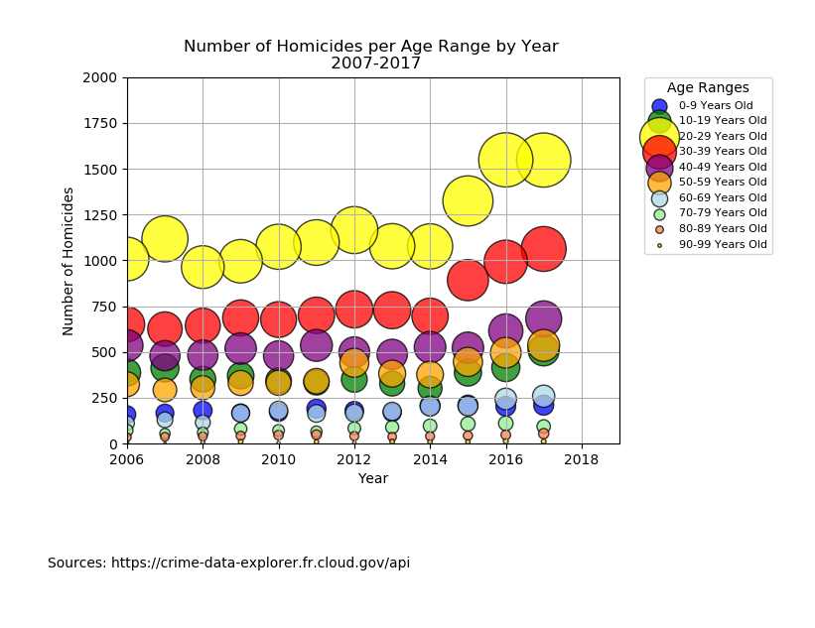
FROM LAST TIME…
What can we try to predict?
Are homicide numbers increasing?
Are more victims male or female?
What kind of relationships do victims have with their offenders?
Does state data provide more insight versus national data?

Slide 4
QUESTIONS 2.0 Our second exploration stemmed from our own curiosity, where we researched to see if we could find relationships between homicide and:
Location
Economic status
Weapon usage
Religious affiliations and cults
Mental health trends in the US
Weather
Political climate

Slide 5
FINAL QUESTIONS Based on what we found and thought we could reasonably measure, we are looking at the following topics:
Economic trends by location (Historical census data)
Political trends (Public poll/election data)
Victim relationship to offender (State breakdown of FBI API)

Slide 6
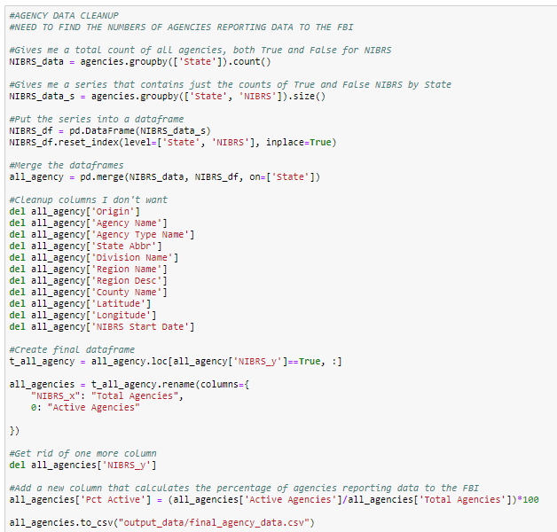
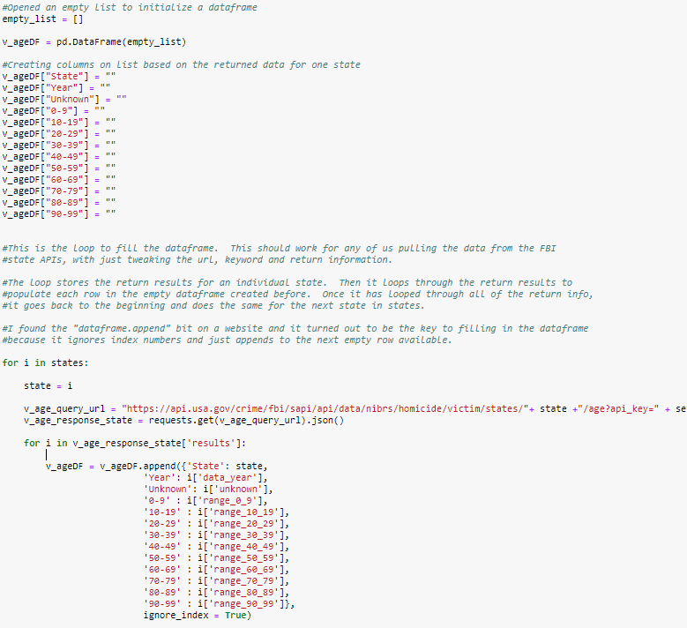
DATA CLEANUP AND EXPLORATION
Building the FBI queries by state was complicated
For the income and relationship data, had to delete and/or rename many columns
In many instances, had to use .loc to extract just one year’s worth of data for each state
Due to discrepancies in reporting, decided to only look at data post 2007

Slide 7
POST MORTEM
DIFFICULTIES:
Executive decision making on data editing and “importance”
Limitations of the FBI API – certain topics would not have been possible to explore
IF THERE WAS MORE TIME:
Getting to dig deeper into the FBI databases beyond the API, which is quick to access
Be more specific with locations – getting to look into smaller demographic areas
Getting to look into all of the “WHY?” questions that arose in our research

Slide 8

Q & A

