Slide 1


H MICIDE: Part deux
PREDICTING CRIME TRENDS
Karen McGee | Andrea Morgan | Stacey Smith

Slide 2

WE’RE AT IT AGAIN
The FBI released expanded homicide data in the summer of 2019 that includes victim data and links victims to arrestees, along with other incident data.
This final project gives us the opportunity to revisit our prior analysis and try to predict homicide variables based on what we already know.

Slide 3
FROM LAST TIME… Our analysis was limited to what the FBI API provided, and added census and election data:
Number of homicides nationally and by state
Gender, ethnicity, race, age of offender counts by state
Gender, ethnicity, race, age of victim counts by state
Counts of relationship of victim to offender by state
No information linked between offender and victim

Slide 4
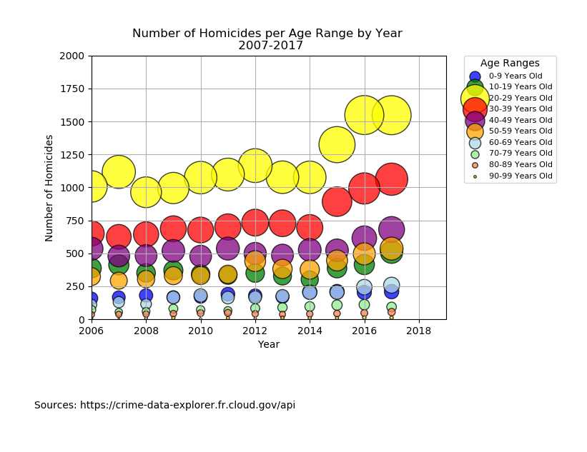
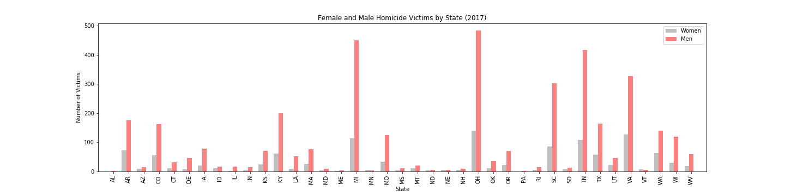
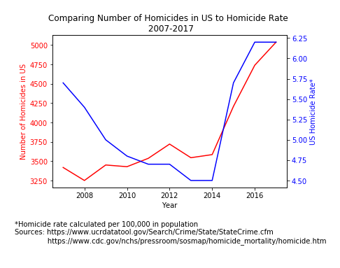
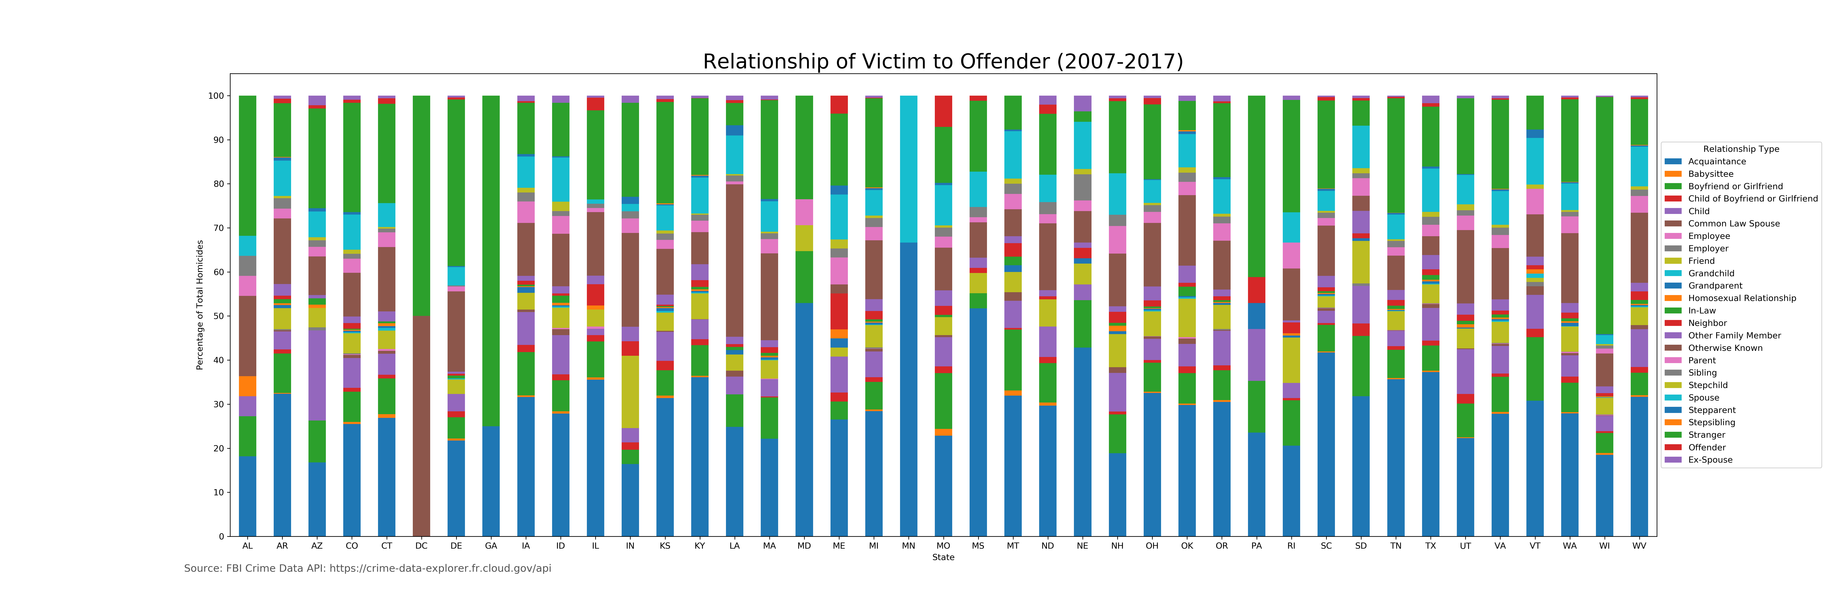
FROM LAST TIME…

Slide 5
NOW…
Expanded data allows us to get individual incident data instead of counts
Arrestees are linked to victims
Same demographic info but more granular
Scope – only Tennessee (100% of agencies report to NIBRS)
Category | Ex 1 | Ex 2 | Ex 3
arrestee_id | 27601649 | 32145814 | 28740817
arrestee_incident_id | 94289060 | 107816657 | 97592974
arrest_date | 2/25/16 0:00 | 7/8/18 0:00 | 12/24/17 0:00
arrest_type_name | Taken INTO Custody | Taken INTO Custody | On View
offense_name | Murder and Nonnegligent Manslaughter | Murder and Nonnegligent Manslaughter | Murder and Nonnegligent Manslaughter
arrestee_age_num | 30 | 19 | 32
arrestee_sex_code | M | F | M
arrestee_race_desc | Black or African American | White | White
arrestee_location_name | Highway/Road/Alley/Street/Sidewalk | Residence/Home | Other/Unknown
victim_id | 103194408 | 118680264 | 106949504
victim_type_name | Individual | Individual | Individual
victim_age_num | 24 | 23 | 20
victim_sex_code | F | M | F
victim_race_desc | Black or African American | White | White
agency_id | 18271 | 18271 | 18376
agency_name | NASHVILLE METRO PD NASHVILLE | NASHVILLE METRO PD NASHVILLE | GRUNDY CO SO ALTAMONT
weapon_name | Handgun | Handgun | Unknown

Slide 6
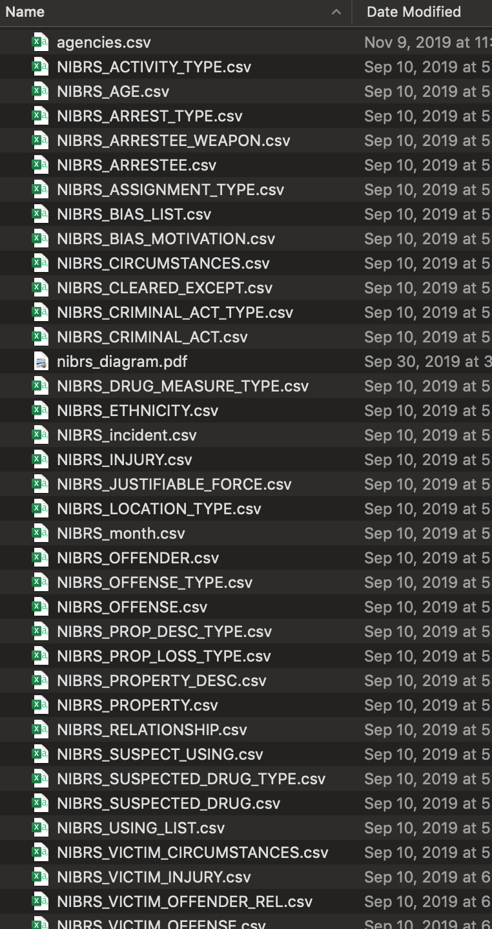
PROCESS… CREATING OUR DATABASE
The Crime Data Explorer (CDE) provides bulk data sets for download. We pulled sets for years 2007-2018. Each year contained 42 csv files, one for each table, or a total of 504 csv files to be imported into our database. Luckily, postgres setup and load scripts were included for each year, making database population a bit easier to manage. In the end, we had a dataset comprising nearly five million criminal acts.

Slide 7
PROCESS… HOW AND WHY OF MACHINE LEARNING
What do we want to predict?
How can we use machine learning to make predictions?
What data should be used to train the model?
What data should we use to compare predictions to?

Slide 8
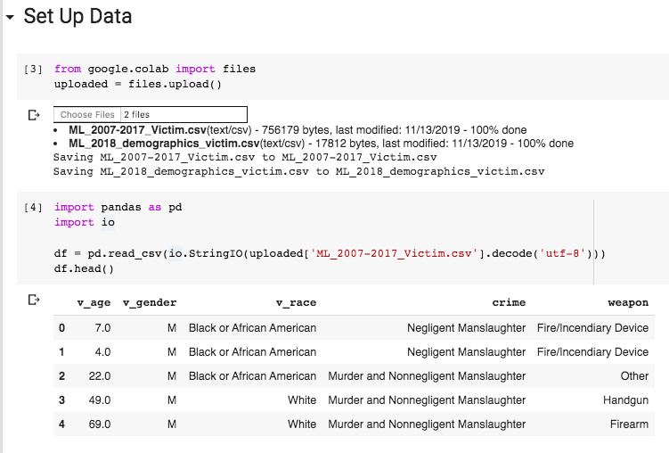
ML… SETTING UP THE DATA

Slide 9
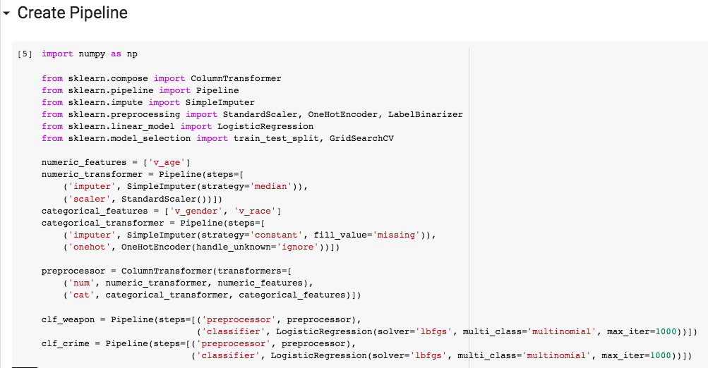
ML… PIPELINING THE DATA

Slide 10
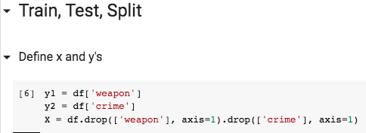
ML… SPLITTING THE DATA

Slide 11
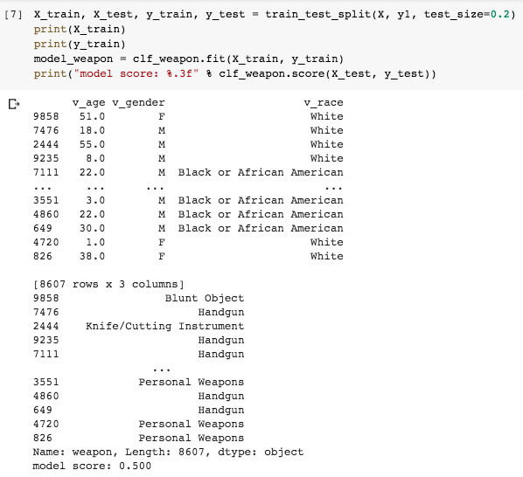
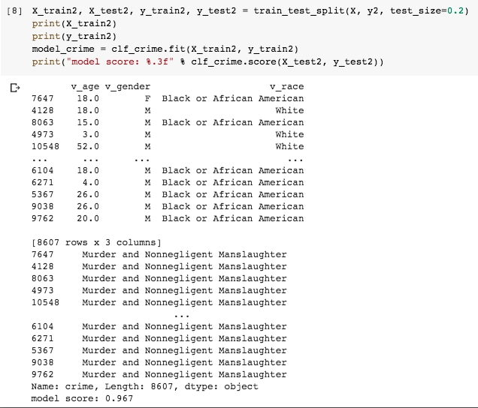
ML… TRAINING THE MODELS

Slide 12
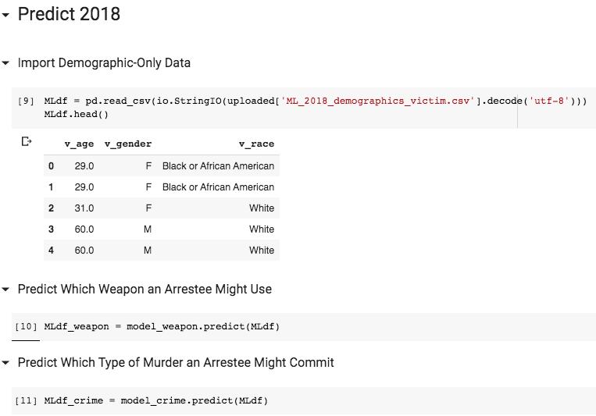
ML… PREDICTING THE 2018 DATA

Slide 13
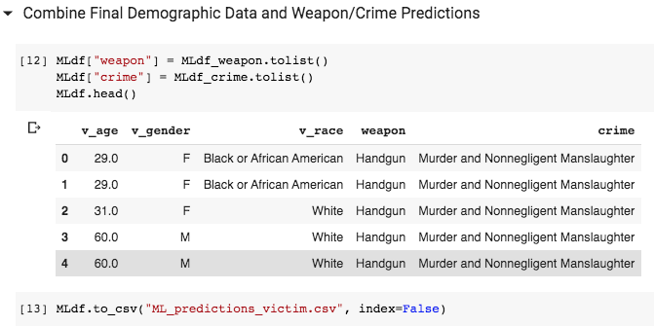
ML… RESULTS!

Slide 14
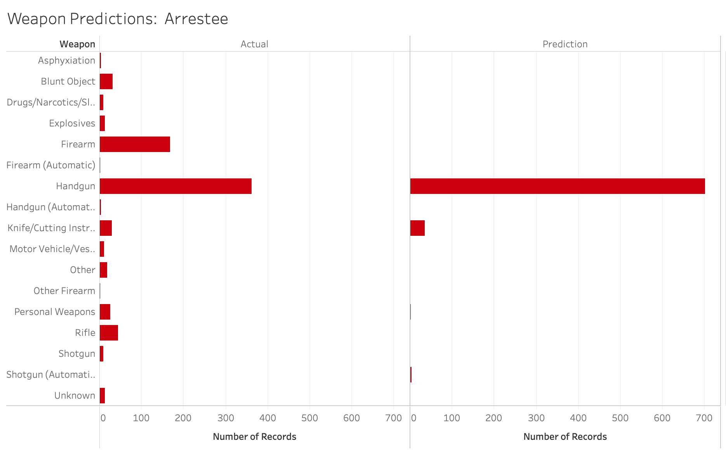
ML… RESULTS

Slide 15
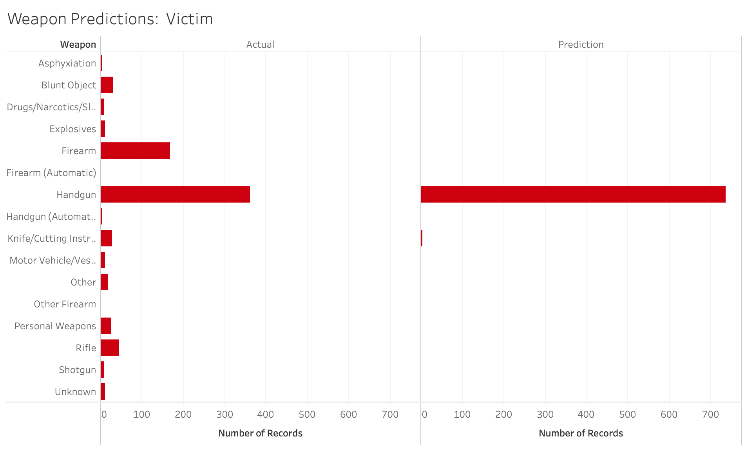
ML… RESULTS

Slide 16
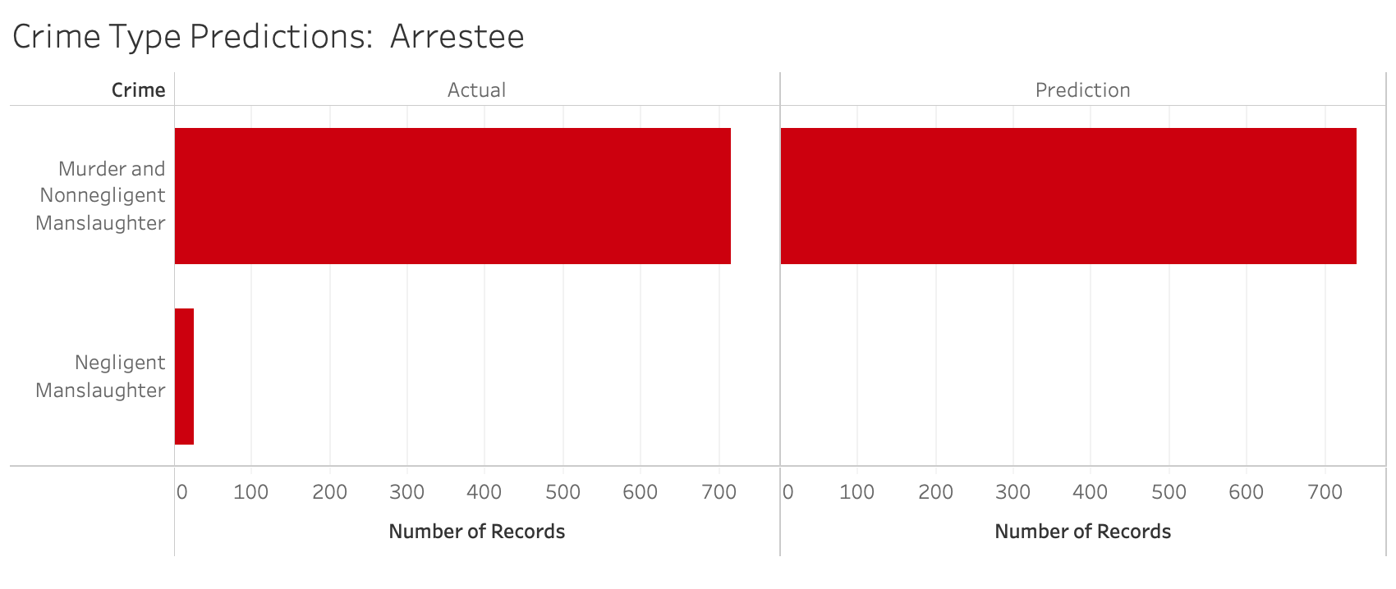
ML… RESULTS

Slide 17
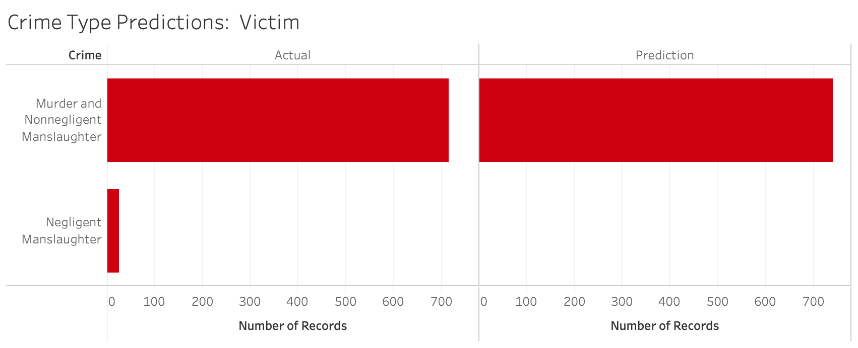
ML… RESULTS

Slide 18
Thank you
Simon
Myri
Kayla
Linh

Slide 19

Q & A

