Slide 1

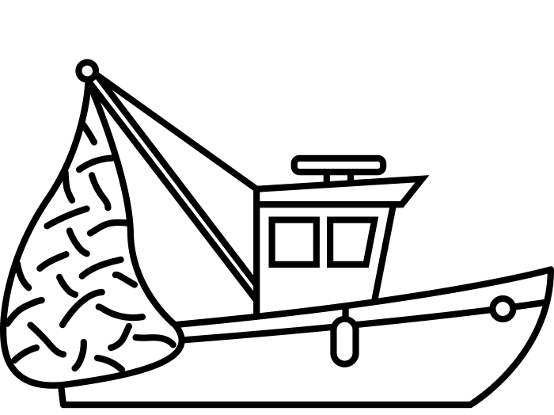

recruitment deviations
RCA established
Selective lingcod fishery established
Fishing Mortality Rate
Years
0
Years

