Slide 1
Streaming Data Analytics Preview of the part of the exam about Streaming Data Science
Emanuele Della Valle
Politecnico di Milano

Slide 2
Exam content
Questions on all lectures about Streaming Data Science to test
The breadth of your knowledge
The depth of your knowledge
(8 points)
Exercises
Given a python code snippet that addresses a streaming binary classification problem or a time series forecasting problem comment what the code tries to achieve and fill in missing parts explaining why you did so
Given a particular problem/task/situation, explain how you would solve it (methods, metrics, evaluation used) and comment why
(7 points)

Slide 3
Questions to test the breadth of your knowledge
Which are the differences between batch-oriented Machine Learning and Streaming Machine Learning?
Which are the benefits and the challenges of Streaming Machine Learning?
What is a concept drift? Which are the types of concept drift? What about the drift speed? Why is it so important to detect it?
Which are the typical Streaming Machine Learning algorithms for classification? Illustrate one of them in detail.
Which are the components of an SML Ensemble Classification model?

Slide 4
Questions to test the breadth of your knowledge
Which characteristics can a non-stationary time series have?
Why is the white noise the ”perfect” time series?
Which are the methods to test for stationarity? Explain one of them in detail
Which are the typical time series components? Illustrate your explanation with an example
Which are the methods to detrend a time series? Explain one of them in detail
Which are the methods to identify seasonality in a time series? Explain one of them in detail
Which are the methods to forecast a time series? Compare two methods of your choice (excluding the basic ones)
Which are the components of a SARIMA model?

Slide 5
Questions to test the breadth of your knowledge
Which are the main differences between Streaming Machine Learning and Continual Learning paradigms?
Which are the main Continual Learning strategies to avoid catastrophic forgetting?
Which are the primary evaluation metrics used in Continual Learning?
What’s the stability-plasticity dilemma? Illustrate your explanation with an example
What’s the catastrophic forgetting problem? Illustrate your explanation with an example

Slide 6
Questions to test the depth of your knowledge
What is a concept drift detector? Illustrate how one of them works.
How does ADWIN detect a concept drift?
Given the plot of data distribution, tell which kind of drift occurred and if it necessary to change the decision boundary.
Given the plot of the model performance, tell if there is a drift and if the model is able to adapt to it.
How does the SML version of KNN work?
Why is Hoeffding Bound used in SML to build a decision tree?
How the Poisson distribution is used in SML and what is the difference in using lambda equal to 1 and 6?
What’s the difference between an additive and a multiplicative model for time series decomposition?
Given the plot from the additive and the multiplicative decomposition, tell which decomposition suits better and why.

Slide 7
Questions to test the depth of your knowledge
Given a line chart that illustrate a time series, tell if it is stationary and why.
Why is exponential smoothing named in this way?
What’s the difference between simple, double, and triple exponential smoothing?
What’s the difference between the meaning of moving average in time series decomposition and the MA component in ARMA models?
What’s the definition of Autocorrelation? How does it differ from the definition of correlation?
Given an ACF and a PACF plot, discuss the order of the AR and MA components.
What’s the difference between the AR and the MA part of an ARMA model?
How does the Box-Jenkins Methodology for ARIMA models allow us to estimate the orders of the model?

Slide 8
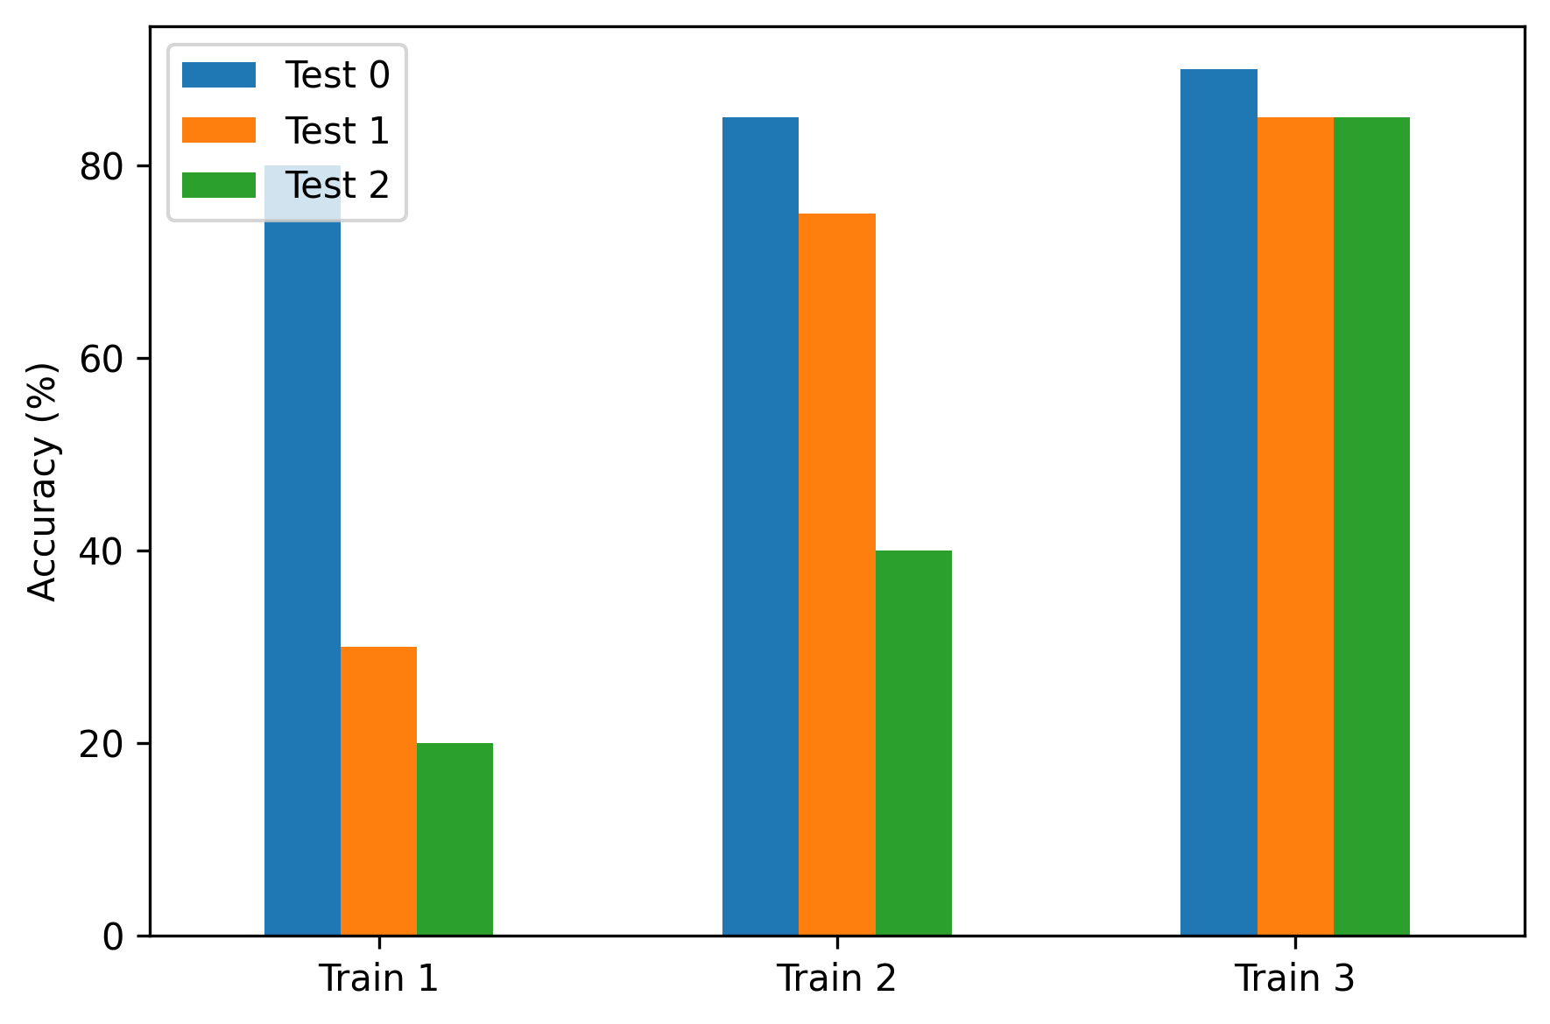
Questions to test the depth of your knowledge
Given the following plot showing the performance of a Continual Learning model, describes the learning abilities of the model.
For the solution see slides 9-11 of 10_1_CL.pdf

Slide 9
Exercises on SML
Code-snippets fill-in & comment
model = …………………………………………………………… metric = …………………………………………………………… stream = iter_pandas(X=data[features], y=data['class’]) progressive_val_score(……………………………………., ……………………………………., ……………………………………., print_every=1000)
For the solution see Stream_Classification.ipynb

Slide 10
Exercises on SML
Problem solving
Given a particular data stream, describe which method, evaluation mode, concept drift detector and metric you would use and why, listing the expected results
Given a particular data stream, describe which concept drift detector you would use and why, listing the expected results
For a facsimile solution see Stream_Classification.ipynb and Concept_Drift.ipynb

Slide 11
Exercises on TSA
Code-snippets fill-in & comment
mul_decomposition = sm.tsa.seasonal_decompose(……, ………)
………………. # plot the multiplicative decomposition
add_decomposition = sm.tsa.seasonal_decompose(……, ………)
………………. # plot the additive decomposition
For the solution see TSA_02_Decomposition.ipynb

Slide 12
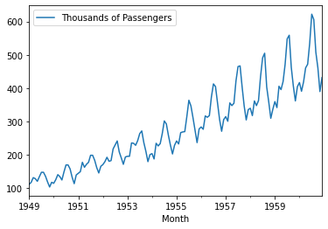
Exercises on TSA
Problem solving
Given the following time series, describe which algorithms you would use and why, listing the expected results
Given specific outputs from ACF and PACF plots, describe which order you would use for a SARIMA model, and what conclusion you would come to with the model diagnostic
For a facsimile solution see TSA_09_SARIMA.ipynb and TSA_06_Forecasting_Sol.ipynb

Slide 13
Streaming Data Analytics Preview of the part of the exam about Streaming Data Science
Emanuele Della Valle
Politecnico di Milano

